Slide 1


Slide 2



REVIEW
1
LESSON 2: SKILLS
Reading
Speaking
Listening
Writing
UNITS
1-2-3
Unit
HOBBIES

Slide 3

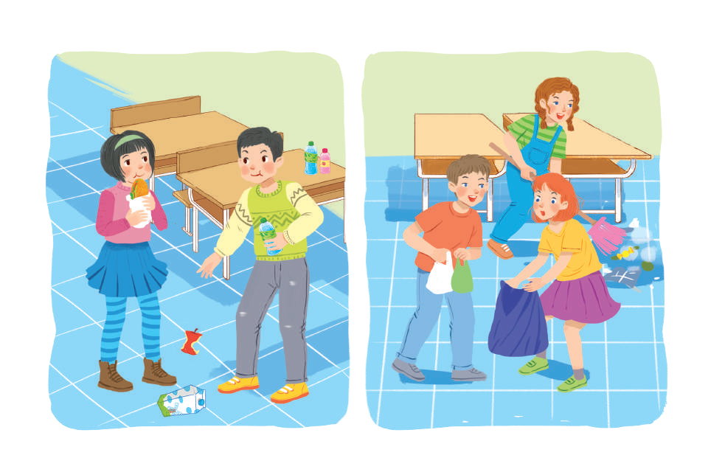
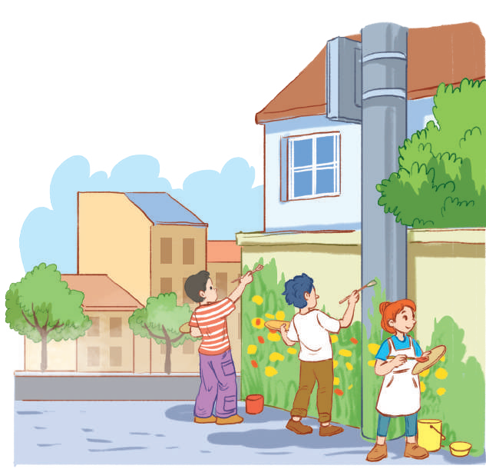
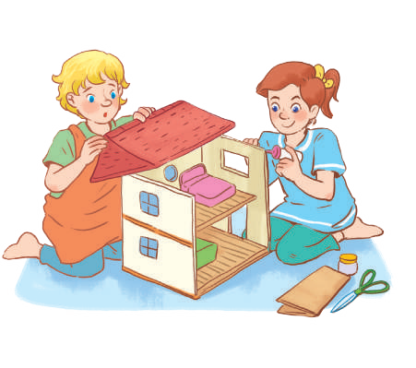
OBJECTIVES
By the end of the lesson, students will have revised the skills they have practiced in Units 1 – 3.

Slide 4
LESSON 2: SKILLS
WARM-UP
Name the pictures: How to get a healthy life?
READING
Task 1: Read the passage and choose the correct answer A, B, or C.
Task 2: Work in pairs. Interview each other, using the questions below.
SPEAKING
Task 3: Listen and complete each sentence with one word.
LISTENING
Task 4: Write complete sentences to make a passage describing community activities.
WRITING
CONSOLIDATION
Wrap-up
Homework

Slide 5

LESSON 2: SKILLS
WARM-UP
Name the pictures: How to get a healthy life?
Aims of the stage:
to lead in the lesson

Slide 6
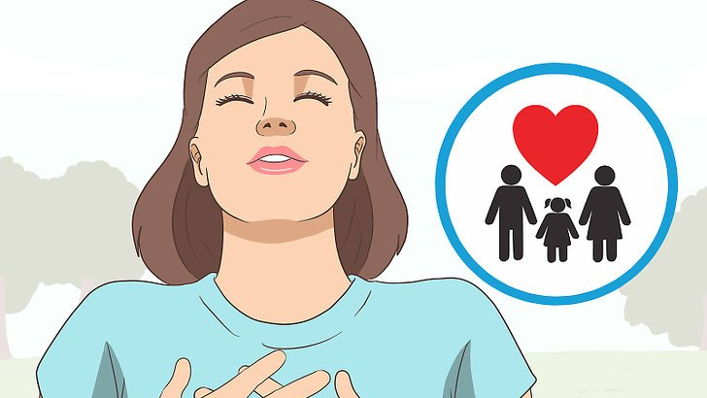
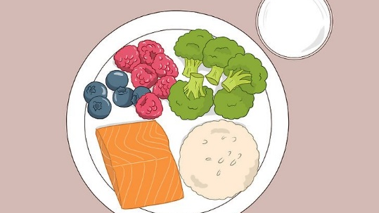
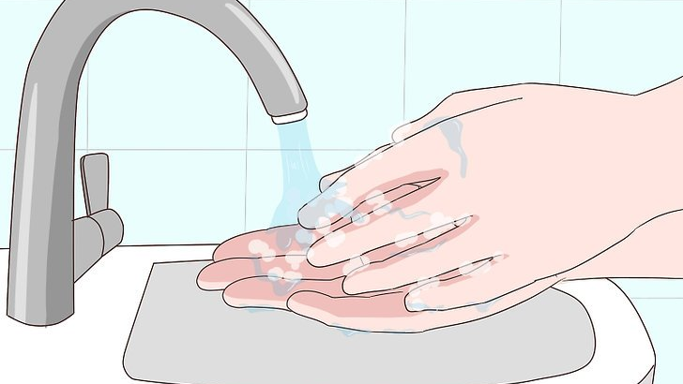
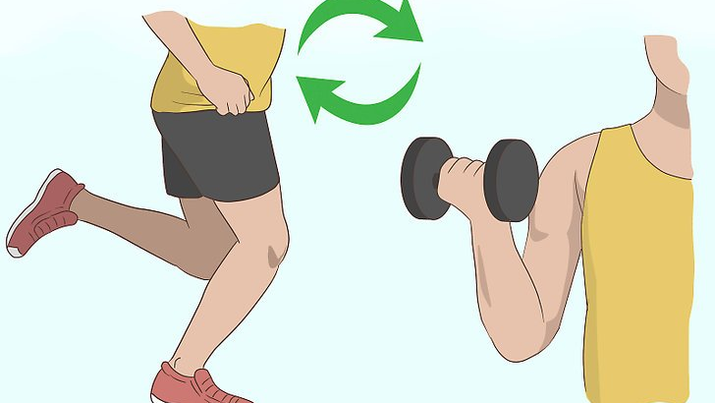
WARM-UP
Name the pictures: How to get a healthy life?
Be happy
Healthy diet
Personal hygiene
Do exercise

Slide 7
LESSON 2: SKILLS
WARM-UP
Name the pictures: How to get a healthy life?
READING
Task 1: Read the passage and choose the correct answer A, B, or C.

Slide 8
READING
1
Read the passage and choose the correct answer A, B, or C.
1. The phrase “the key” in the first line is closest in meaning to ______.
A. the first factor
B. the most important factor
C. the new factor
2. To show your love to other people, you ______.
A. give them money
B. take care of yourself
C. do things with them

Slide 9
READING
1
Read the passage and choose the correct answer A, B, or C.
3. The writer says “Laughter is like medicine” because ______.
A. it makes others laugh too
B. it helps you make friends
C. it helps people live longer
4. You can get knowledge and experience by ______.
A. visiting new places
B. loving other people
C. laughing more often

Slide 10
READING
1
Read the passage and choose the correct answer A, B, or C.
5. The best title for this passage is “______”.
A. Live to be happy
B. Laughter is the power of happiness
C. Happiness is hard to find

Slide 11
LESSON 2: SKILLS
WARM-UP
Name the pictures: How to get a healthy life?
READING
Task 1: Read the passage and choose the correct answer A, B, or C.
SPEAKING
Task 2: Work in pairs. Interview each other, using the questions below.

Slide 12

SPEAKING
2
Work in pairs. Interview each other, using the questions below. Take notes of the answers and then report the results to the class.
How much do you know about community service?
1. Who can do community service?
2. Who needs community help?
3. What can you do to help them?

Slide 13
SPEAKING
2
Work in pairs. Interview each other, using the questions below. take notes of the answers and then report the results to the class.
How much do you know about community service?
1. Who can do community service?
Anybody.

Slide 14
SPEAKING
2
Work in pairs. Interview each other, using the questions below. take notes of the answers and then report the results to the class.
How much do you know about community service?
2. Who needs community help?
Street children, old and sick people, abandoned / street animals, etc.

Slide 15
SPEAKING
2
Work in pairs. Interview each other, using the questions below. take notes of the answers and then report the results to the class.
How much do you know about community service?
3. What can you do to help them?
cooking / shopping for the old / the sick;
collecting books / clothes for street children;
opening classes to teach street children;
adopting a dog / a cat
…

Slide 16
LESSON 2: SKILLS
WARM-UP
Name the pictures: How to get a healthy life?
READING
Task 1: Read the passage and choose the correct answer A, B, or C.
SPEAKING
Task 2: Work in pairs. Interview each other, using the questions below.
LISTENING
Task 3: Listen and complete each sentence with one word.

Slide 17

LISTENING
3
Listen and complete each sentence with one word.
1. While camping, we have a lot of time for ____________.
2. When camping near the beach, we can build ____________.
3. We can have dinner by an ____________ fire.
4. At the campsite, there is no television or ____________.
5. Name one thing we should bring along when camping: __________________.
games
sandcastles
open
computer
food / water / compass/
sleeping bag/ insect cream

Slide 18
LESSON 2: SKILLS
WARM-UP
Name the pictures: How to get a healthy life?
READING
Task 1: Read the passage and choose the correct answer A, B, or C.
SPEAKING
Task 2: Work in pairs. Interview each other, using the questions below.
LISTENING
Task 3: Listen and complete each sentence with one word.
WRITING
Task 4: Write complete sentences to make a passage describing community activities.

Slide 19
WRITING
4
Write complete sentences to make a passage describing community activities
1. we / join / community activities / once a month.
_______________________________________________________
2. last month / we / plant / trees / park.
_______________________________________________________
3. we / dig / holes / put / young trees / in.
_______________________________________________________
4. then / we / water / them / two or three weeks.
_______________________________________________________
5. now / trees / grow / very well.
_______________________________________________________
6. they / make / park / greener / air / fresher.
_______________________________________________________
We join community activities once a month.
Last month we planted (some) trees in the park.
We dug some holes to put the young trees in.
Then we watered them for two or three weeks.
Now the trees are growing very well.
They will make the park greener and the air fresher.

Slide 20
LESSON 2: SKILLS
WARM-UP
Name the pictures: How to get a healthy life?
READING
Task 1: Read the passage and choose the correct answer A, B, or C.
SPEAKING
Task 2: Work in pairs. Interview each other, using the questions below.
LISTENING
Task 3: Listen and complete each sentence with one word.
WRITING
Task 4: Write complete sentences to make a passage describing community activities.
CONSOLIDATION
Wrap-up
Homework

Slide 21
CONSOLIDATION
1
WRAP-UP
Reading
Speaking
Listening
Writing
UNITS
1-2-3

Slide 22

CONSOLIDATION
2
HOMEWORK
Prepare for Unit 4 – Getting started

Slide 23

Website: hoclieu.vn
Fanpage: facebook.com/www.tienganhglobalsuccess.vn/

