Slide 1

UNIT 10: NEW WAYS TO LEARN
Lesson 1.3 – Pronunciation & Speaking
Page 84

Slide 2




LESSSON OUTLINE
Consolidation

Slide 3

By the end of this lesson,
students will be able to:
- Practice word stress for words with suffix –ion.
- Talk about the future of education.
- Improve speaking skill.

Slide 4



Slide 5

Choose the word whose main stress is placed
differently from the others.
Work in pairs.
A. actual B. global C. fluent D. extreme
2. necessary B. fashionable C. reasonable D. reusable
3. A. virtual B. public C. afraid D. lazy
/ˈæktʃuəl/
/ˈɡloʊbəl/
/ˈflu:ənt/
/ɪkˈstri:m/
/ˈnesəseri/
/ˈfæʃənəbəl/
/ˈri:zənəbəl/
/ˌri:ˈju:zəbəl/
/ˈvɜ:tʃuəl/
/ˈpʌblɪk/
/əˈfreɪd/
/ˈleɪzi/

Slide 6
Work in pairs.
Choose the word whose underlined part is
pronounced differently from that of the other words.
A. whiteboard B. testing C. thinking D. children
2. A. virtual B. skillful C. inner D. silky
3. A. food B. door C. room D. mood
/ˈwaɪtbɔ:rd/
/ˈtestɪŋ/
/ˈθɪŋkɪŋ/
/ˈtʃɪldrən/
/ˈvɜ:tʃuəl/
/ˈskɪlfəl/
/ˈɪnə/
/ˈsɪlki/
/fu:d/
/dɔ:r/
/ru:m/
/mu:d/

Slide 7

Work in pairs.
Pick out one redundant letter in each word
to make correct words
INTERAACTION
PRESENATATION
CONVERSATTION
EDUCATIION
PRODDUCTION

Slide 8

Work in pairs.
INTERACTION
PRESENTATION
CONVERSATION
EDUCATION
PRODUCTION
INTERAACTION
PRESENATATION
CONVERSATTION
EDUCATIION
PRODDUCTION
KEY ANSWERS

Slide 9
What do those words have in common?
They end in “-ion”.

Slide 10



Slide 11
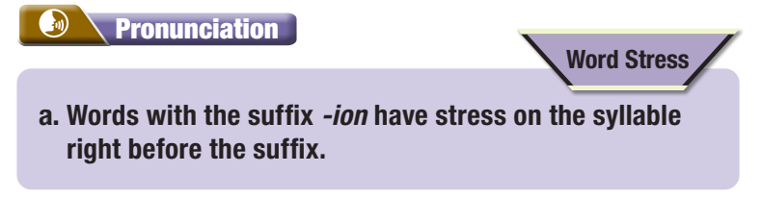

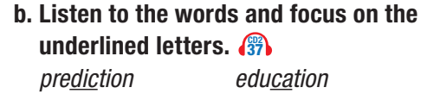

Slide 12


Slide 13
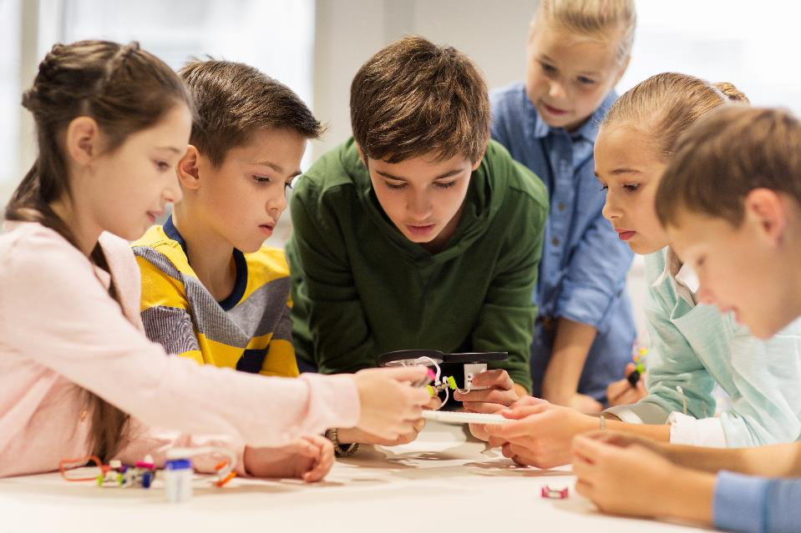


Slide 14
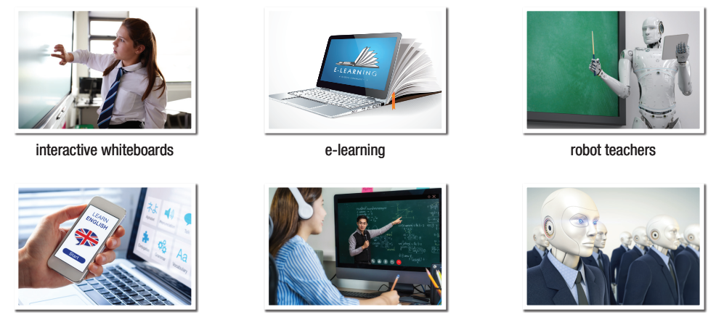
Look and name the pictures
1
2
3
interactive whiteboard
e-learning
robot teacher
4
5
6
educational app
virtual classroom
robot students

Slide 15
Unit 1
Model conversation
A: What do you think education is going to be like in the future?
B: _______we're going to have more_____________________.
I think
interactive whiteboards

Slide 16


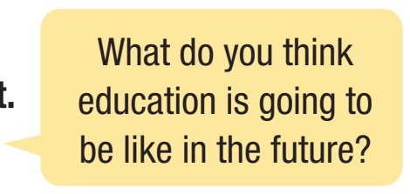
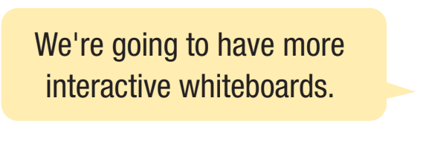

Slide 17
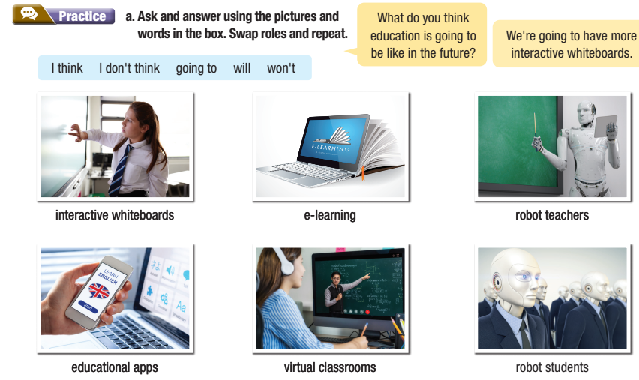

Slide 18

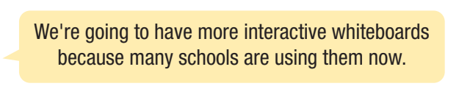
Work in pairs.
Think of reasons for these predictions and practice again.

Slide 19



Slide 20
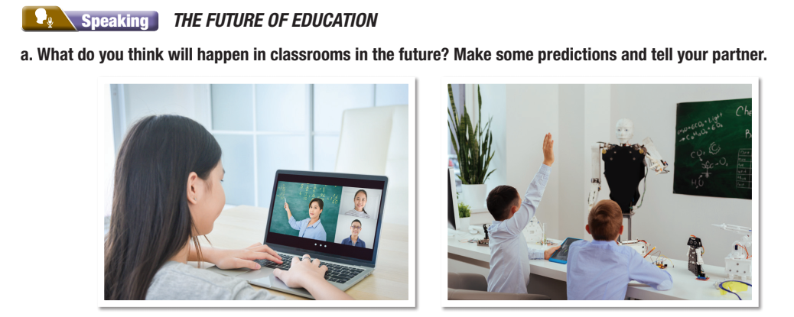
What do you think will happen in classrooms in the future? Make some predictions and tell your partner.

Slide 21
STUDENT A
STUDENT B
What do think will happen in the future?
I think there will be more interactive whiteboards.
What else?
I don’t think robot teachers will take care of children.
How will students connect to the Internet?
I think students will connect to theinternet using artificial intelligence.

Slide 22

Work in pairs.
Which predictions do you think are most likely to come true? Why?
Notes:
Please, click on each phrase to hear the sound

Slide 23
STUDENT A
STUDENT B
Which predictions do you think are most likely to come true?
I think we are going to have more interactive whiteboards.
Why?
Because it will help teaching and learning a lot.

Slide 24

Consolidation

Slide 25
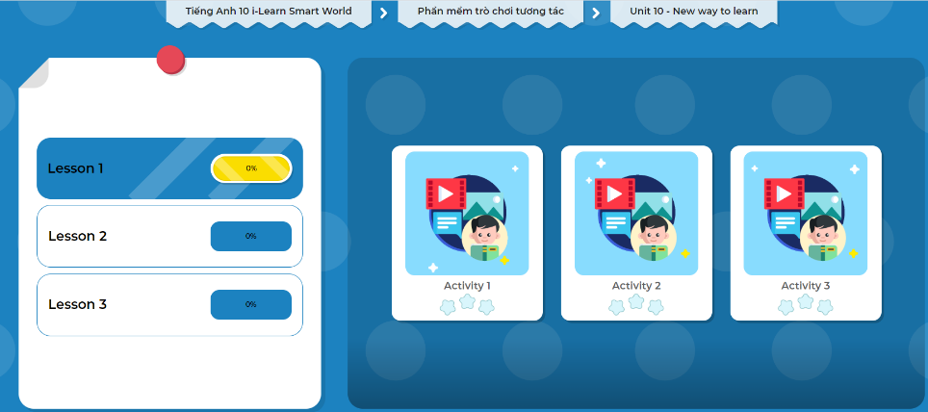
LET’S PLAY!
Click here to play the games.

Slide 26
Write a paragraph about your prediction of the future learning. You can begin with.
I think in the future, there will be more…..

Slide 27

WRAP-UP

Slide 28
Today’s lesson
Pronunciation:
- Practice word stress for words with suffix –ion.
Speaking:
- Talk about the future of education.

Slide 29
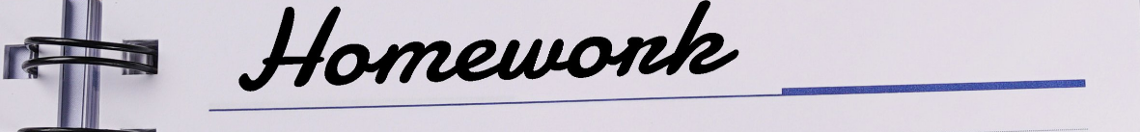
- Write a short paragraph about how to be a successful learner in the future.
- Prepare the next lesson: Lesson 2.1 – Vocab & Listening, (page 85).
Review the vocabulary and grammar notes in Tiếng Anh 10
i-Learn Smart World Notebook (pages 56 & 57).
- Play games in Tiếng Anh 10 i-Learn Smart World DHA App on www.eduhome.com.vn

Slide 30
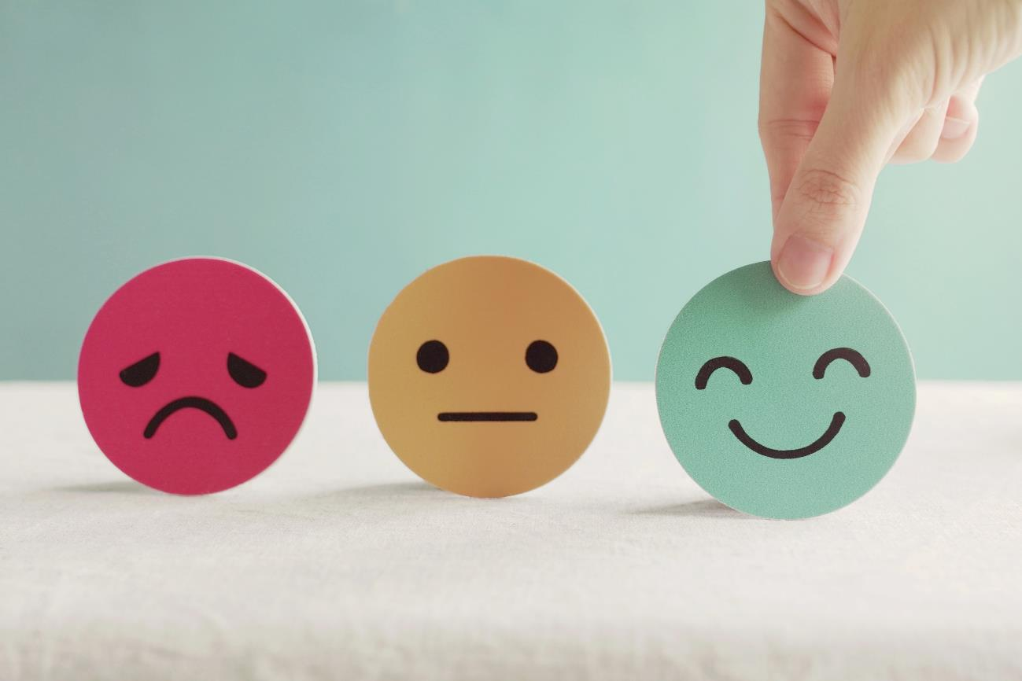
Stay positive and have a happy day!

