Slide 2
REVIEW 3
LESSON I
LANGUAGE

Slide 3
LESSON I
LANGUAGE
WARM-UP
Hidden words
Task 1: Choose the correct answer.
Task 2: Choose the correct answer.
Task 3: Listen and complete sentences
Task 4: Mark the linking /r/ sound
Task 5: Assimilation
PRONUNCIATION
Task 1: Complete the sentences.
Task 2: Choose the synonym.
Task 3: Choose the antonym.
Task 4: Choose the best answer.
VOCABULARY
GRAMMAR
Task 1,2: Choose the best answer.
Task 3: Mistake correction
CONSOLIDATION
Wrap-up
Homework

Slide 4
WARM-UP
HIDDEN WORDS
- Play in 2 teams.
- A student from each team pick 1 word from the box and use body language or speech to express the meaning of the word (without mentioning the word).
- The rest of the class guess what the word is.
- The team with more words is the winner.

Slide 5
PRONUNCIATION
1
Mark the letter A, B, C, or D to indicate the word whose underlined part differs from the other three in pronunciation.
1.
A. update B. reliable
C. activate D. application
2.
A. monitor B. recognition
C. artificial D. survive

Slide 6
PRONUNCIATION
2
Mark the letter A, B, C, or D to indicate the word which differs from the other three in the position of the main stress.
1.
A. rescue B. release
C. survive D. conserve
2.
A. robotic B. suspicious
C. digital D. endangered

Slide 7

PRONUNCIATION
3
Listen and complete the sentences with the correct words. Then practice saying them in pairs.
1. We often _________ some _________ turtles on the beach.
2. This is not the _________ way to _________ an email.
see
sea
right
write

Slide 8
PRONUNCIATION
4
Mark the places where the linking /r/ can appear. Listen and check. Then practise saying the sentences in pairs..
1. A number of nature reserves have been created to protect rare animals.
2. There is a new national park that I want to visit, but it is too far away from my city.

Slide 9
PRONUNCIATION
5
Read the sentences and underline the parts where assimilation can occur.
1. My brother was in Paris to see an exhibition
on modern media.
2. They wrote many reports on how
to protect pandas in China.

Slide 10

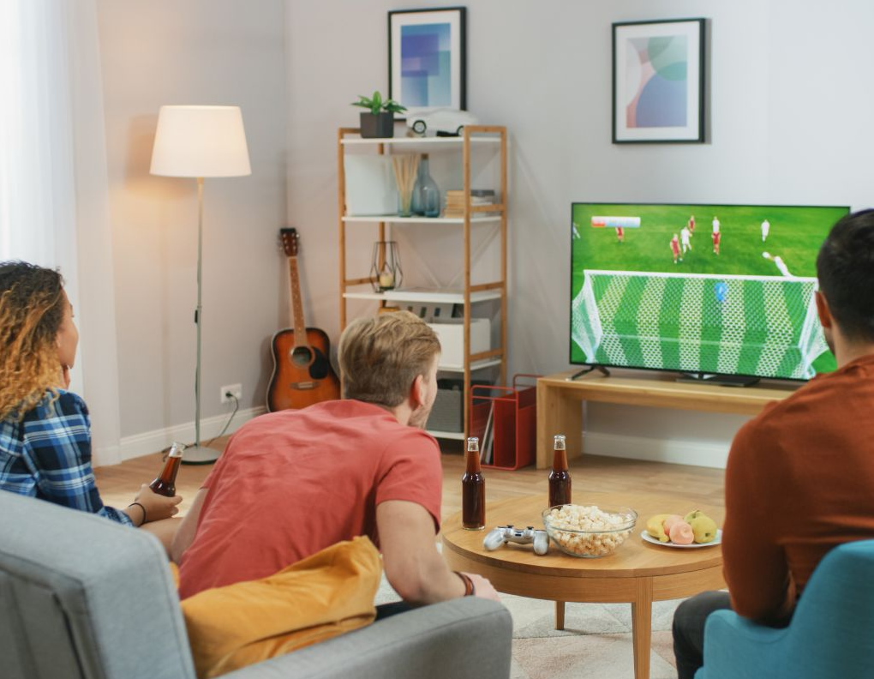
VOCABULARY
1
What are the missing letters? Complete the sentences using the pictures to help you.
hatbot
1. Interacting with a c________ can be annoying as often it doesn't understand your questions.
2. The football match attracted a large number of TV vi________.
ewers

Slide 11
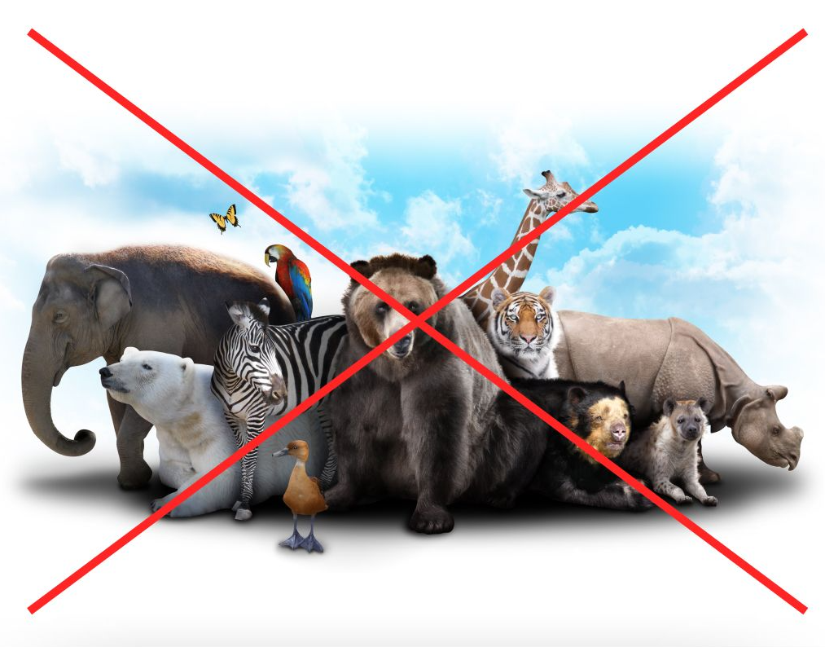
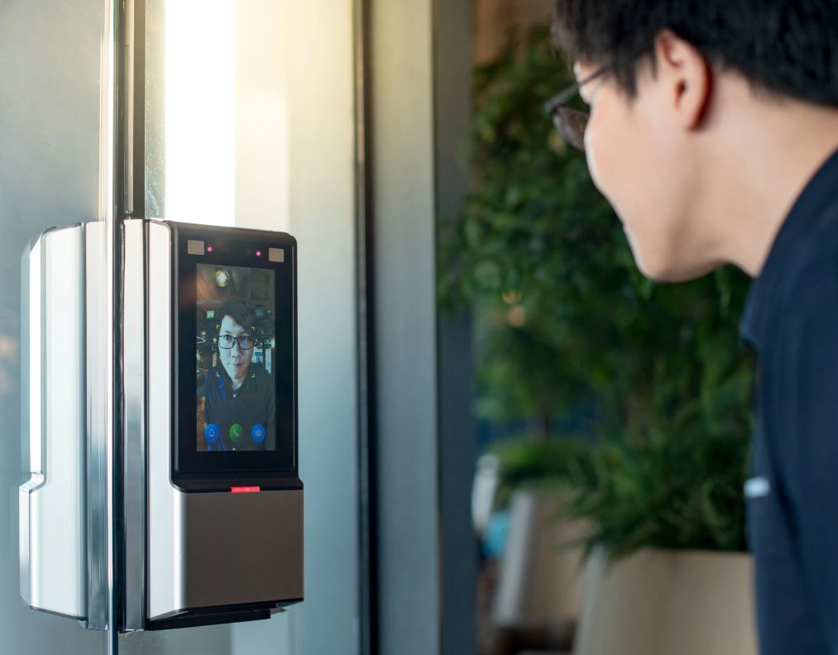
VOCABULARY
1
What are the missing letters? Complete the sentences using the pictures to help you.
3. In the last 50 years, the number of plant and animal species has decreased by more than a half, and more will become ex________.
4. Fa_____ re__________ technology can quickly identify customers and improve banking security.
tinct
cial
cognition

Slide 12
VOCABULARY
2
Mark the letter A, B, C, or D to indicate the word CLOSEST in meaning to the underlined word.
1. With only around 70 individuals, the Javan rhino is one of the largest endangered mammals.
A. dangerous B. threatened
C. risky D. capable
2. The music festival has been widely reported in the local press.
A. social media B. television sets
C. radio D. newspapers

Slide 13
VOCABULARY
3
Mark the letter A, B, C, or D to indicate the word OPPOSITE in meaning to the underlined word.
1. Online articles published on government websites are reliable sources of information.
A. untrue B. believable
C. useful D. unlimited
2. Many people are unable to recognise fake news and share untrue information on social media.
A. dangerous stories B. facts and figures
C. true stories D. online reports

Slide 14
VOCABULARY
4
Mark the letter A, B, C, or D to indicate the correct answer.
1. ______ sources are free from bias and based on strong evidence.
A. Credible B. Popular
C. Accessible D. Powerful
2. The saola, whose population is fewer than 250 mature individuals, is one of the world’s _________ mammals and is only found in Viet Nam.
A. scariest B. most natural
C. rarest D. most threatening

Slide 15
VOCABULARY
3. The website is _______ with new information every day.
A. updated B. protected
C. spread D. interacted
4. AI-based _______ in education may pose a risk to students' privacy.
A. poaching B. applications
C. chatbots D. recognition
5. The new website for students will be good _______ for our school.
A. source B. platform C. function D. publicity

Slide 16
VOCABULARY
6. Although some animal species are living in extreme weather conditions, they can still ______.
A. protect B. survive C. update D. exploit
7. Robots are _________ to perform specific tasks such as cleaning rooms or moving heavy boxes.
A. conserved B. threatened
C. rescued D. programmed
8. Scientists _________ the data collected from their field trip to China.
A. carried out B. analysed C. preserved D. protected

Slide 17
GRAMMAR
1
Mark the letter A, B, C, or D to indicate the correct answer.
1. AI-based robots can do household chores _____ they were humans.
A. as if B. although
C. because D. than
2. What would you do _________ you suddenly became famous and received a lot of publicity?
A. if B. like
C. so that D. such that

Slide 18
GRAMMAR
1
Mark the letter A, B, C, or D to indicate the correct answer.
3. To prepare for the graduation party, we had a technician _______ big screens on the walls.
A. installed B. install
C. installing D. installs
4. I’m writing a report on wildlife conservation and need to get all facts _________.
A. check B. checking C. to check D. checked

Slide 19
GRAMMAR
2
Mark the letter A, B, C, or D to indicate the sentence that best combines each pair of sentences.
1. The computer technology has changed the world. No science has changed the world like that.
A. The computer technology has changed the world as if no science has done that.
B. No science has changed the world because the computer technology has done that.
C. The computer technology has changed the world so that no science has done that.
D. No science has changed the world like the computer technology has.

Slide 20
GRAMMAR
2. Poachers have killed so many tigers in the area. Therefore, the authorities are considering harsher punishments for illegal hunting.
A. Poachers have killed so many tigers in the area as the authorities are considering harsher punishments for illegal hunting.
B. Poachers have killed so many tigers in the area that the authorities are considering harsher punishments for illegal hunting.
C. Poachers have killed so many tigers, but the authorities are not considering harsher punishments for illegal hunting.
D. Although poachers have killed so many tigers, the authorities are not considering harsher punishments for illegal hunting.

Slide 21
GRAMMAR
3. The newspaper should have an online version. Otherwise, it won’t attract many readers.
A. Unless the newspaper has an online version, it won’t attract many readers.
B. If the newspaper should have an online version, it won’t attract many readers.
C. The newspaper has an online version as if it won’t attract many readers.
D. If the newspaper doesn't have an online version, it attracts many readers.

Slide 22
GRAMMAR
4. Alba is an advanced robot. She can talk and express emotions like humans.
A. Alba is an advanced robot, but she cannot talk and express emotions like humans.
B. Although Alba can talk and express emotions like humans, she is not an advanced robot.
C. Alba is such an advanced robot that she can talk and express emotions like humans.
D. Alba is so an advanced robot that she can talk and express emotions like humans.

Slide 23
GRAMMAR
3
Mark the letter A, B, C, or D to indicate the underlined part that needs correction in each of the following sentences.
1. There are enough many endangered species in the region that the
A B C
local authority has decided to create more protected areas.
D
2. The cost of advertising on the Internet is equally low
A B C
as that of using printed brochures.
D
→ so
→ as

Slide 24
GRAMMAR
3
Mark the letter A, B, C, or D to indicate the underlined part that needs correction in each of the following sentences.
3. Visitors can safely take photos of wild animals in the
A B
park unless they quietly move around the area.
C D
4. My manager has decided to have the company’s
A B
computer software update at least once a month.
C D
→ if
→ updated

Slide 25
CONSOLIDATION
1
Wrap-up
What have you learnt today?
Revise the vocabulary and grammar learnt in Units 6-8.

Slide 26
CONSOLIDATION
2
Homework
Do exercises in the workbook.
Prepare Review 2: Skills

Slide 27
Website: hoclieu.vn
Fanpage: facebook.com/www.tienganhglobalsuccess.vn

