Slide 2
19
The animal world
LESSON 2 PERIOD 3

Slide 3
Table of Contents
02
New words
01
Warm up
03
Activity 1
04
Activity 2
Look, listen and repeat
Listen, point and say
05
Activity 3
06
Fun corner
Let’s talk

Slide 4
1
Warm up

Slide 6
Review
1
Look and guess

Slide 7
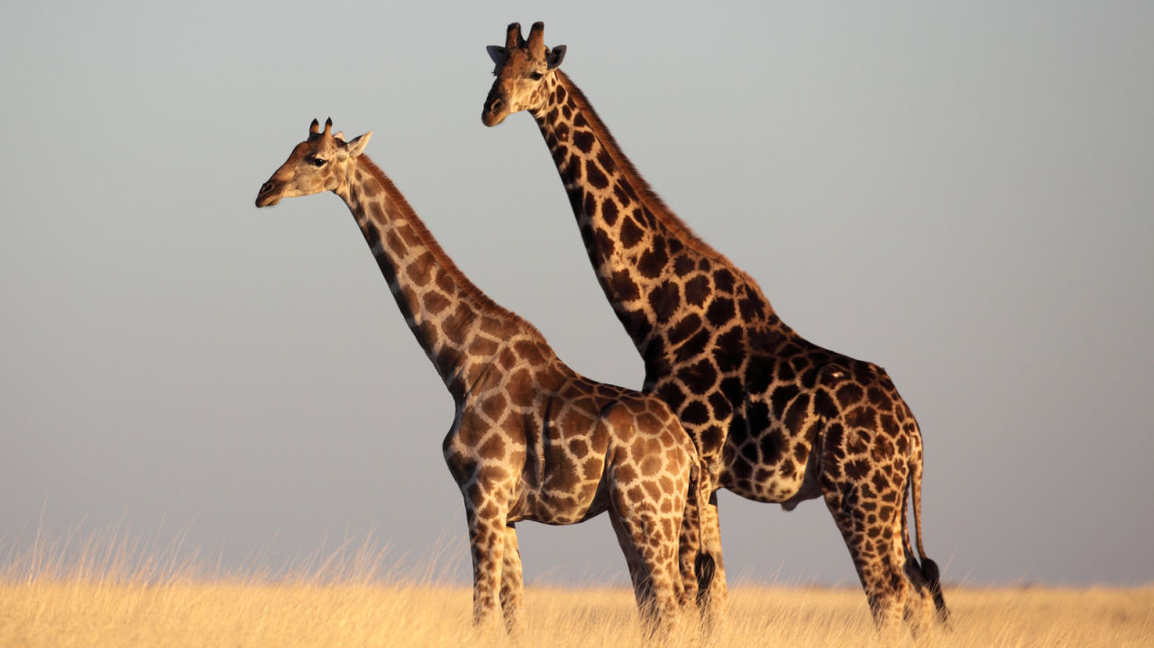
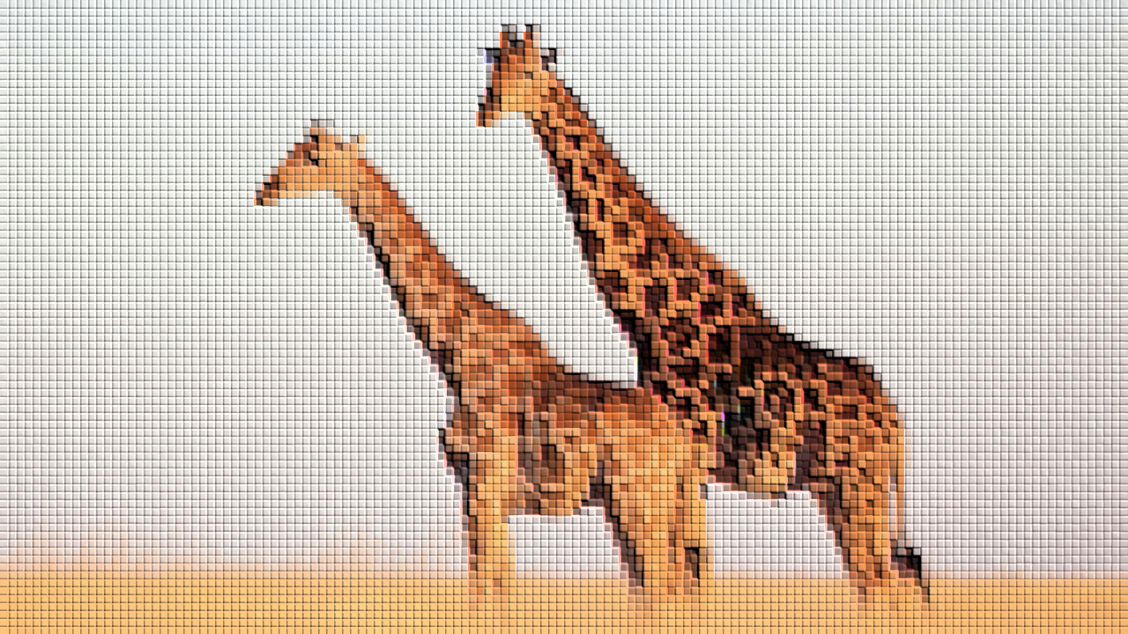
giraffes

Slide 8
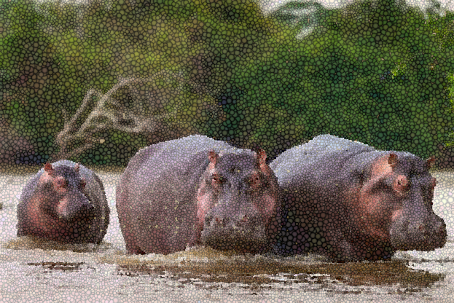
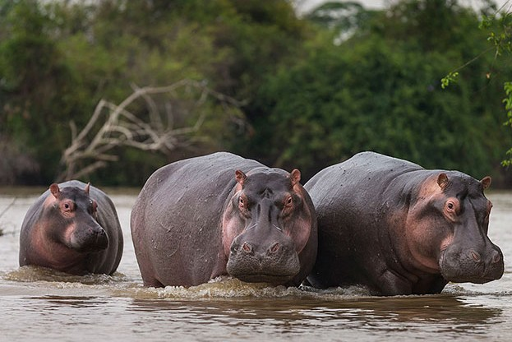
hippos

Slide 9
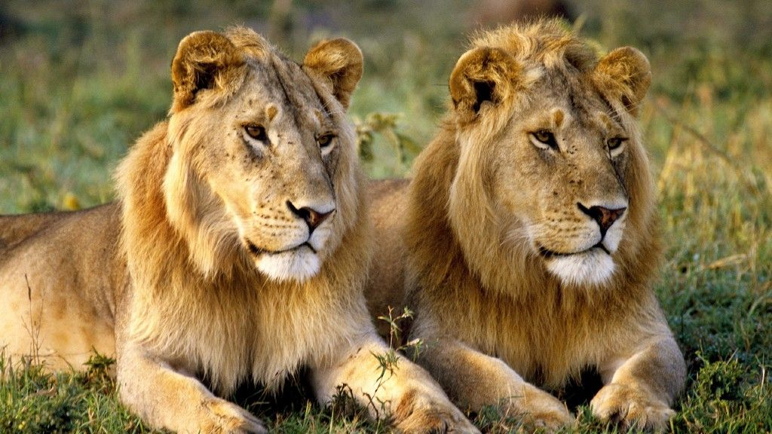
lions

Slide 10
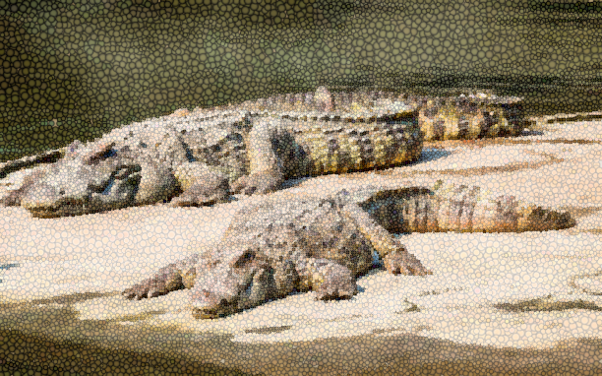
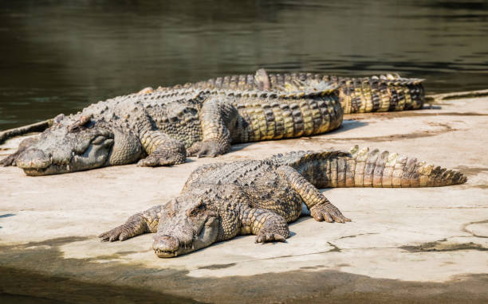
crocodiles

Slide 11
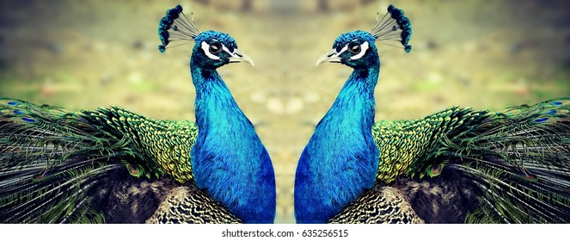
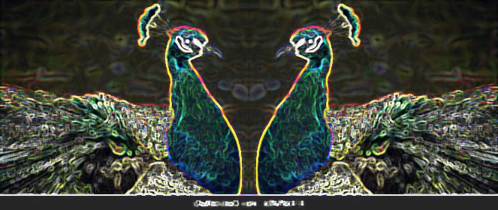
peacocks

Slide 12
2
New words

Slide 13
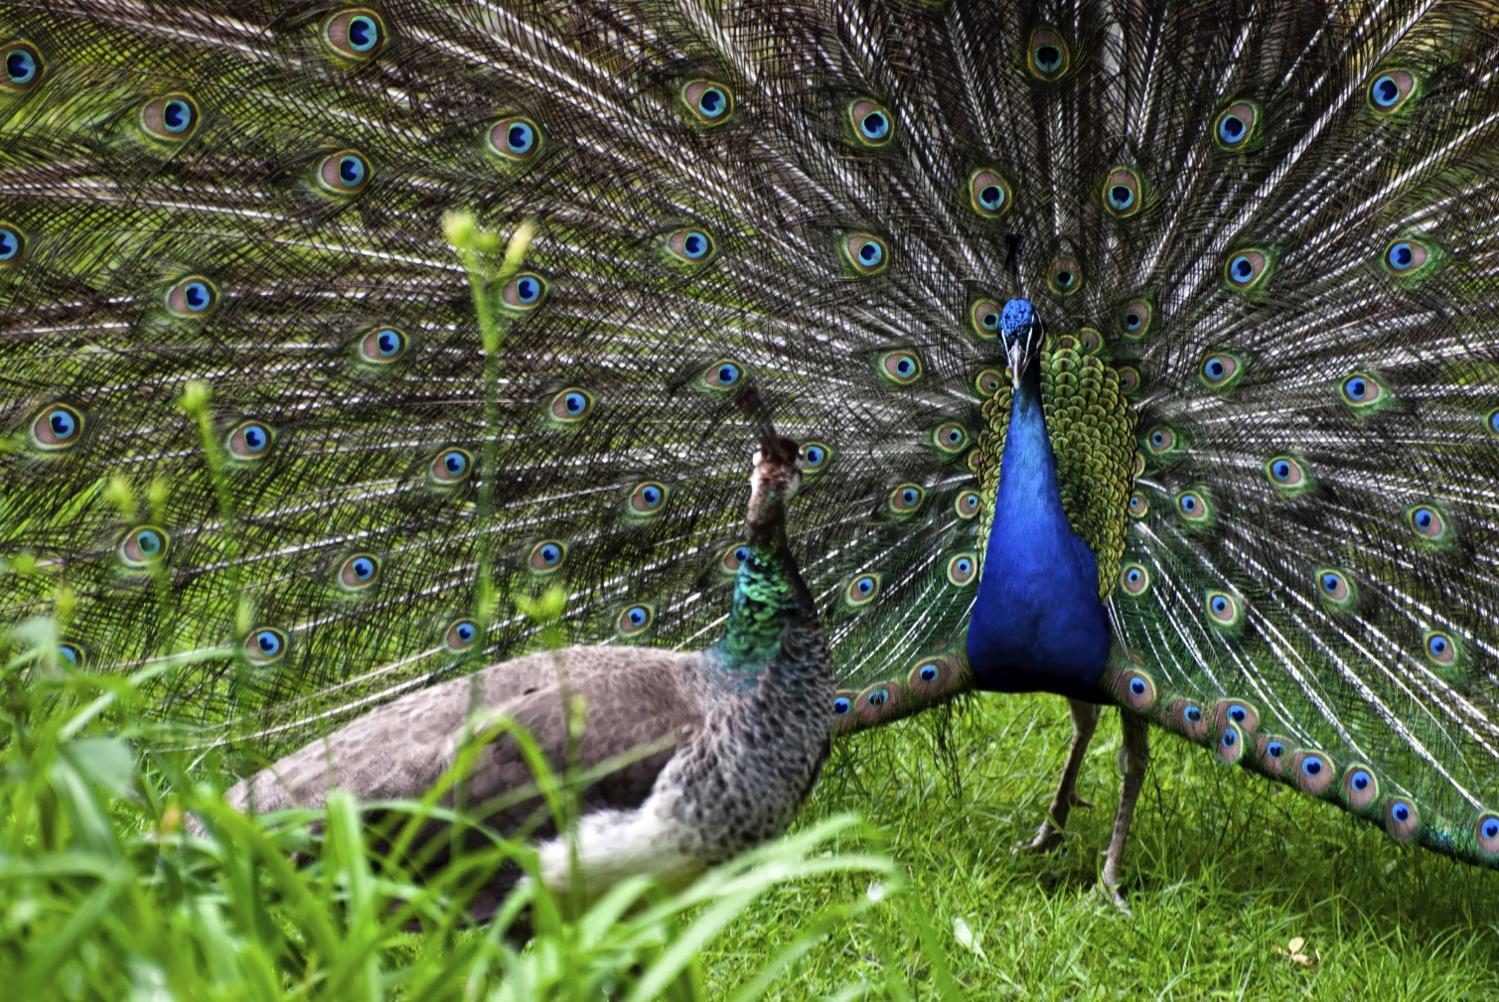
dance beautifully

Slide 14
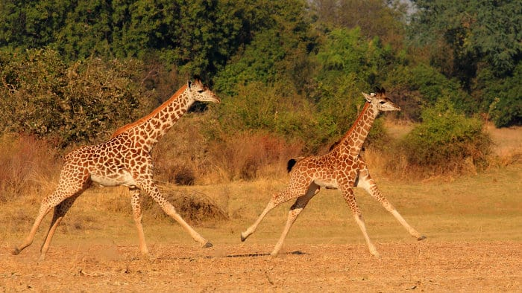
run quickly

Slide 15
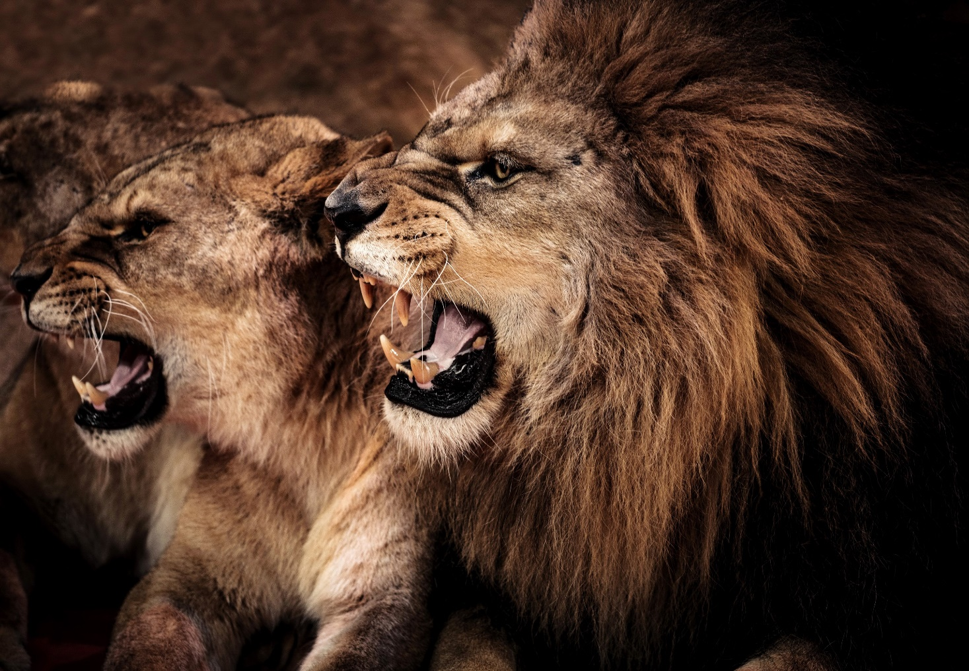
roar loudly

Slide 16
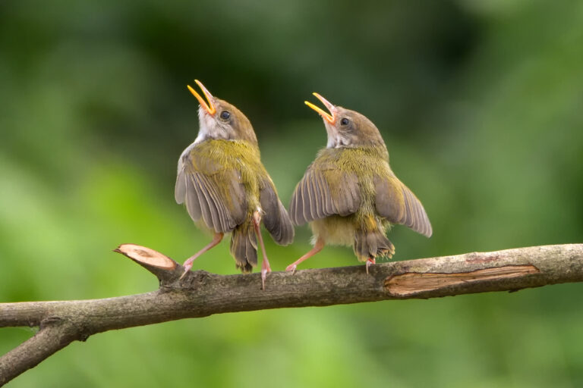
sing merrily

Slide 17
1
Practice

Slide 18
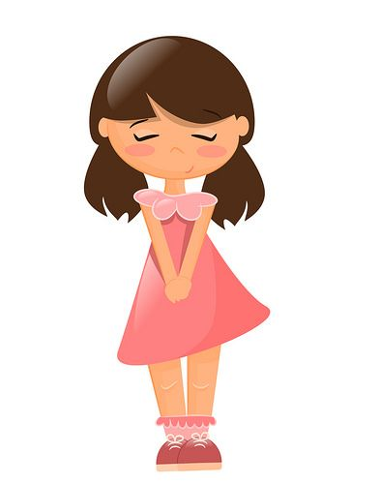
What are these animals?
They’re peacocks.

Slide 19
Why do you like peacocks?
Because they dance beautifully.

Slide 20
3
Activity 1
Look, listen and repeat

Slide 21
Look, listen and repeat

Slide 22
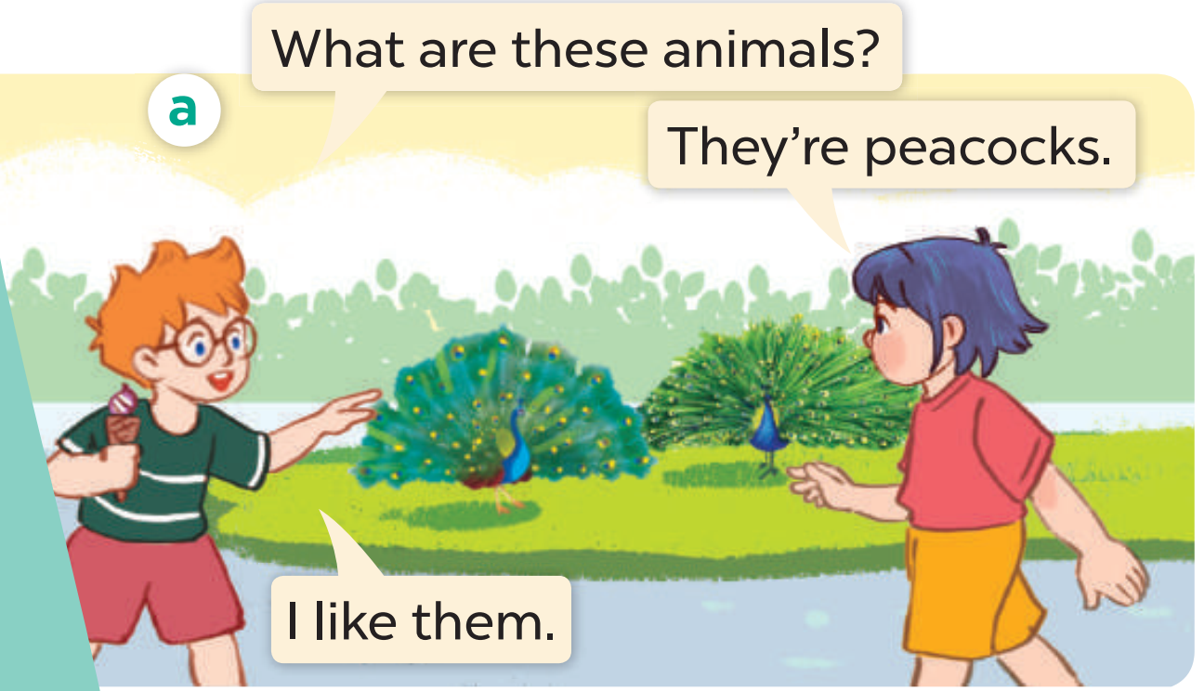
Look, listen and repeat

Slide 23
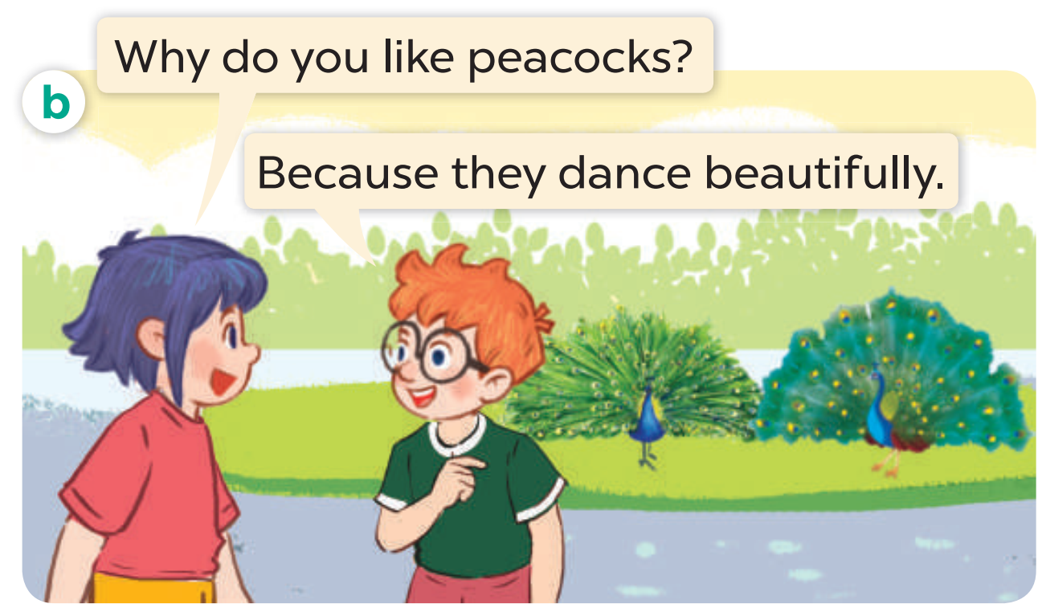
Look, listen and repeat

Slide 24
4
Activity 2
Listen, point and say

Slide 25
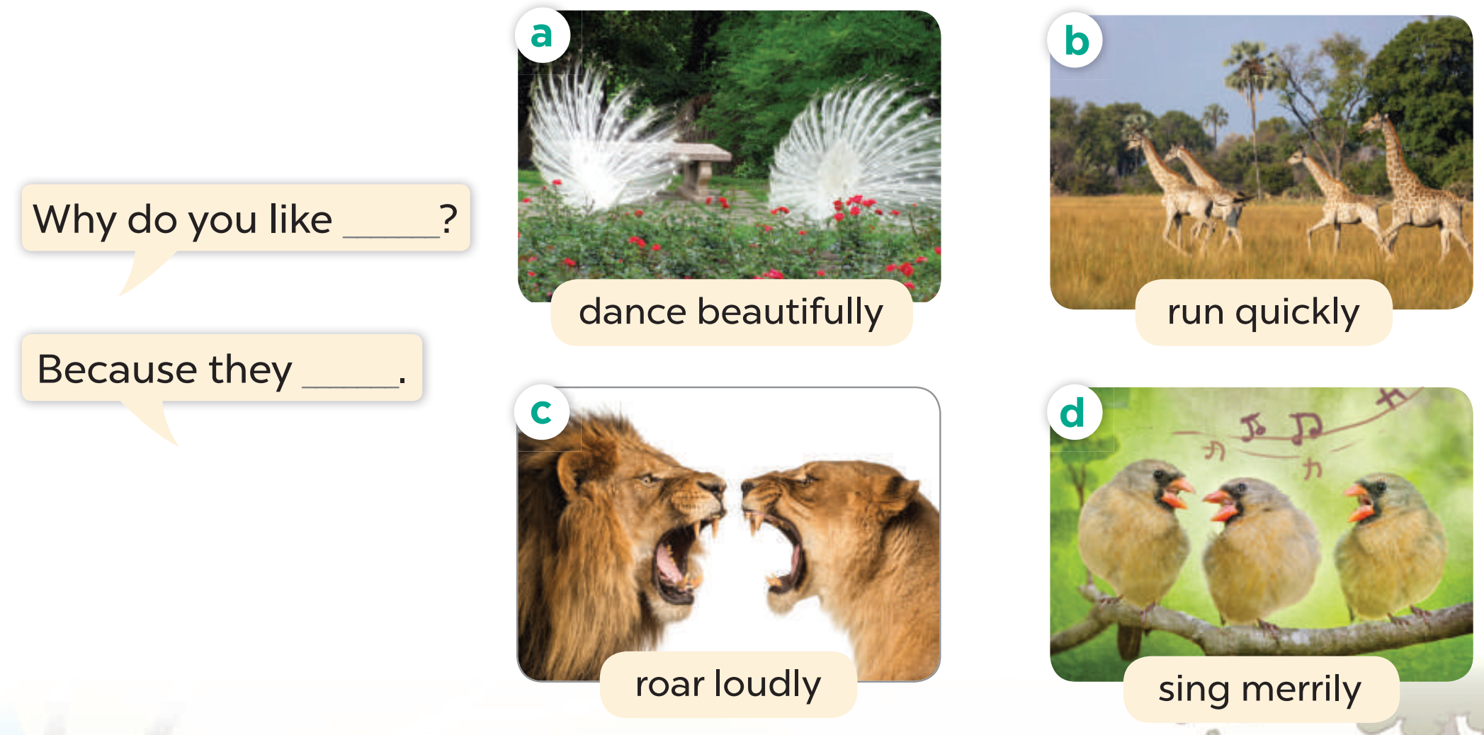
Listen, point and say.

Slide 26
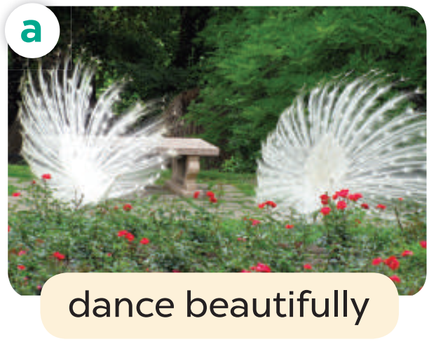
Why do you like ______?
Because they________.

Slide 27
Where do you like ______?
Because they________.

Slide 28
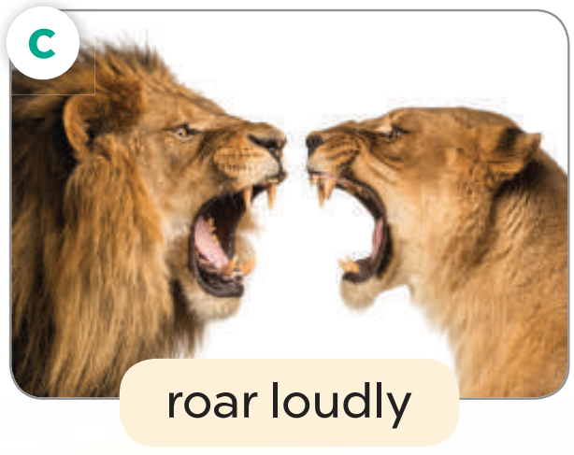
Where do you like ______?
Because they________.

Slide 29
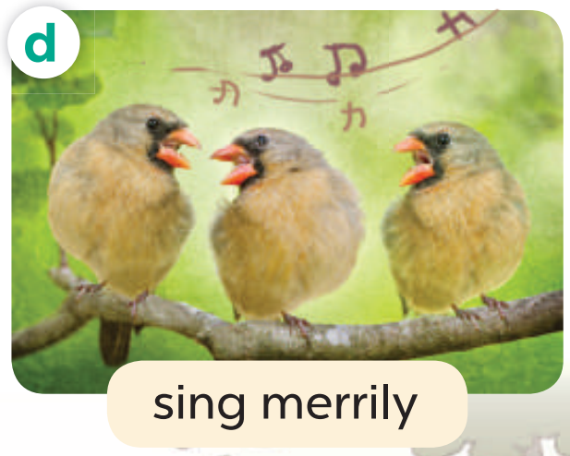
Where do you like ______?
Because they________.

Slide 30
4
Activity 3
Let’s talk

Slide 31
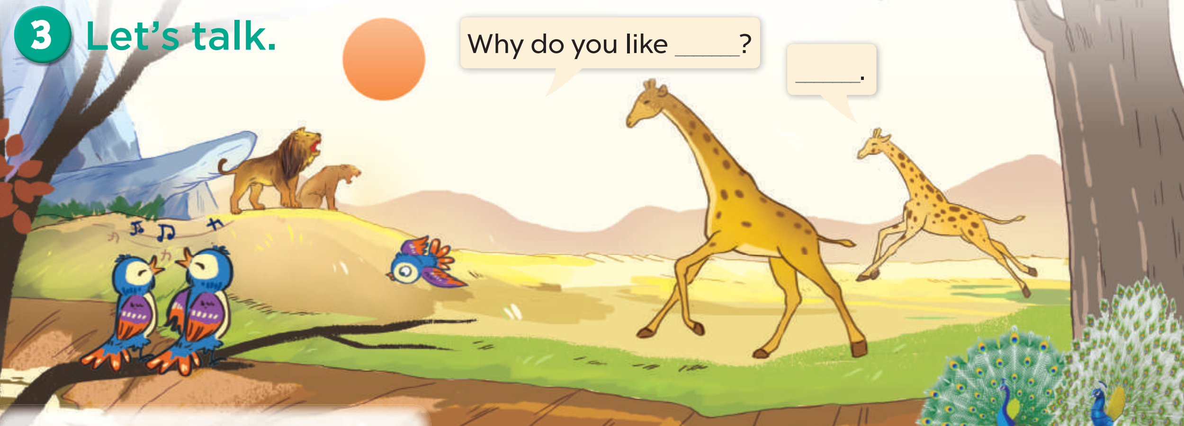

Slide 32
6
Fun corner

Slide 33
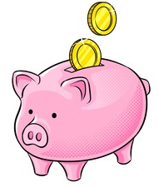
Piggy Bank

Slide 34
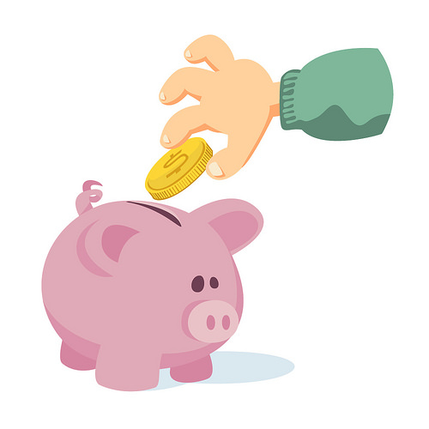
TEAM 1
TEAM 2
TEAM 3

Slide 35
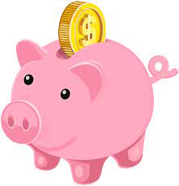
Choose the pig!
1
2
3
4
5
6
7
8

Slide 36
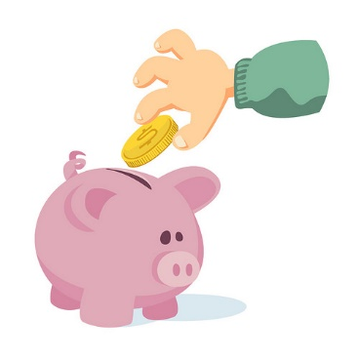
What are these animals?
They’re peacocks.

Slide 37
Why do you like peacocks?
Because they dance beautifully.

Slide 38
What are these animals?
They’re giraffes.

Slide 39
Why do you like giraffes?
Because they run quickly.

Slide 40
What are these animals?
They’re lions.

Slide 41
Why do you like lions?
Because they roar loudly.

Slide 42
What are these animals?
They’re birds.

Slide 43
Why do you like birds?
Because they sing merrily.

Slide 44
THANK YOU

