Slide 1

Unit 10: Energy Sources
Lesson 1.1: Vocabulary & Listening
Page 76

Slide 2



LESSON OUTLINE
Consolidation

Slide 3

By the end of this lesson, students will be able to…
talk about types and sources of energy.
ask for clarification.
practice listening for main ideas and specific information.

Slide 4

New words
• renewable
• non-renewable
• solar power
• wind power
• oil
• coal
• natural gas
• hydropower

Slide 5

WARM UP

Slide 6

Work in pairs
1 What do you use in your home to …
cook food?
run your TV, smart phone, laptop, etc.?
2 Where are they from?

Slide 7



Slide 8

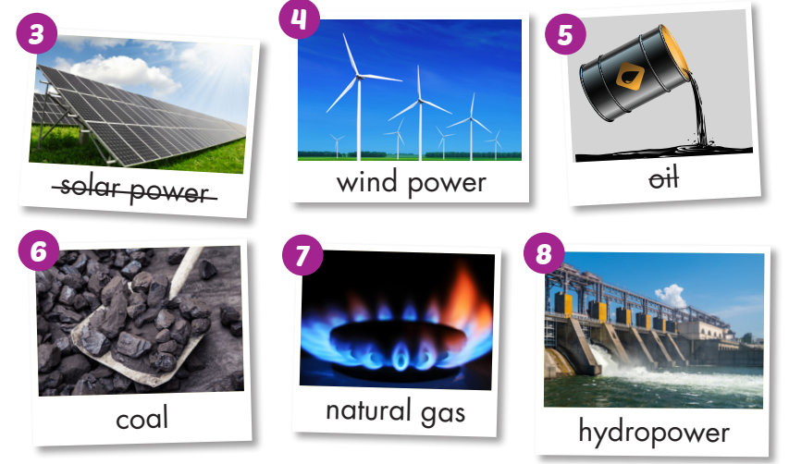
Work in pairs. What are these used for?
They are used to make electricity.

Slide 9
Work in pairs.
Which can be used again and again (Renewable energy)?
Which cannot be used again and again (Non-renewable energy)?

Slide 10
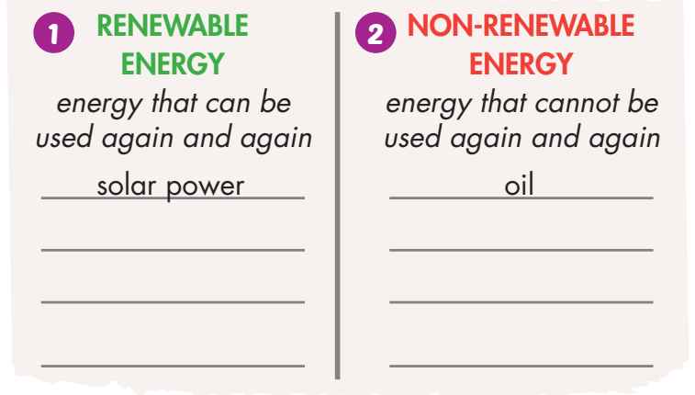
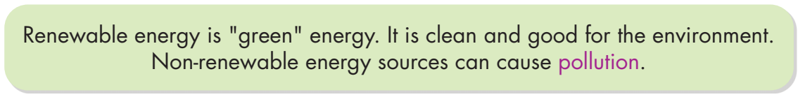
wind power
coal
hydropower
natural gas

Slide 11

Listen and repeat. Click each phrase to hear the sound.
renewable (adj) /rɪˈnuːəbl/ có thể tái tạo
non-renewable (adj) /ˌnɒn rɪˈnuːəbl/ không thể tái tạo
solar power (n) /ˌsoʊlər ˈpaʊər/ năng lượng mặt trời
wind power (n) /ˌwɪnd ˈpaʊər/ năng lượng gió
oil (n) /ɔɪl/ dầu
coal (n) /koʊl/ than đá
natural gas (n) /ˌnætʃrəl ˈɡæs/ khí tự nhiên
hydropower (n) /ˈhaɪdroʊpaʊər/ thủy điện
Notes:
GV click vào từng cụm nghe âm thanh

Slide 12
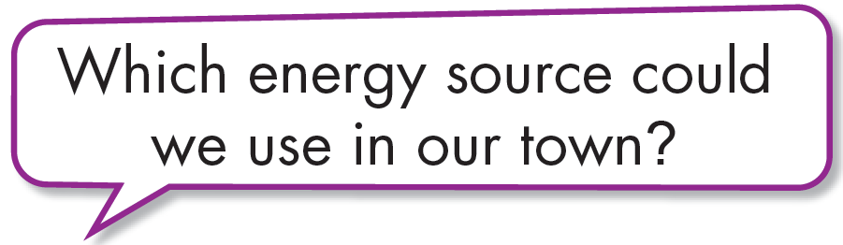
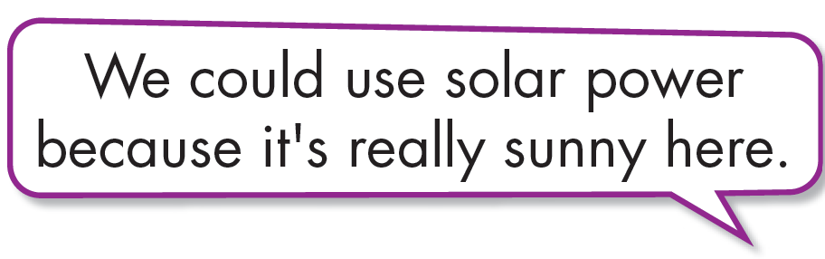

Work in pairs.
b. Discuss which renewable energy source could be useful where you live.

Slide 13
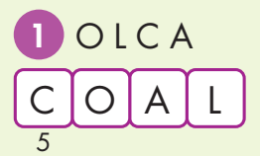
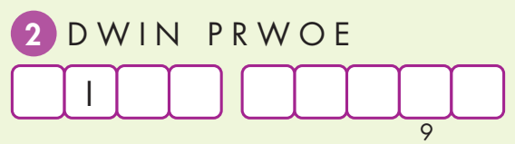
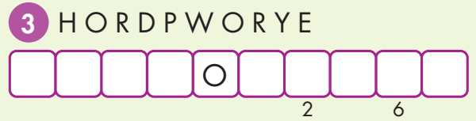
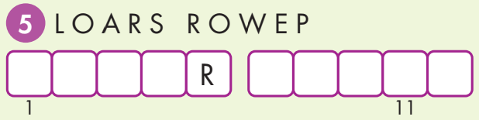
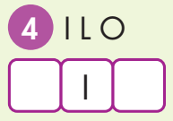
Extra Practice
WB, page 56
Unscramble the words. Copy the letters in the numbered boxes to find the final message.
W N D P O W E R
H Y D R P O W E R
S O L A P O W E R
O L

Slide 14
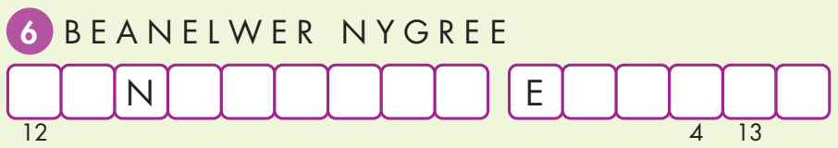
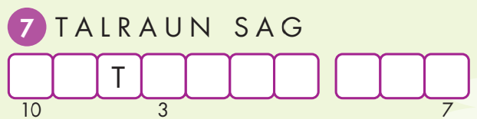
Extra Practice
WB, page 56
Unscramble the words. Copy the letters in the numbered boxes to find the final message.
R E E W A B L E N E R G Y
N A U R A L G A S

Slide 15
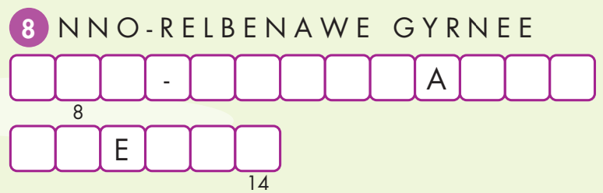
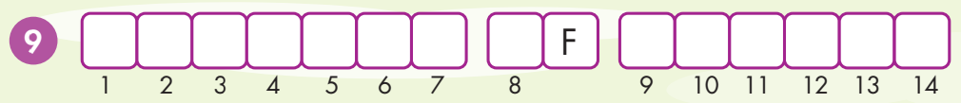
Extra Practice
WB, page 56
Unscramble the words. Copy the letters in the numbered boxes to find the final message.
N O N R E N E W B L E
E N R G Y
S O U R C E S O E N E R G Y

Slide 16


It’s listening time….

Slide 17
Pre - listening
Read the instruction quickly. Underline the key words. What are we going to do?
Listen and choose the correct answer.
a. Listen to Emma and James talking to experts at an energy convention.
What do they want to learn about?

Slide 18
While - listening
Now listen and choose the correct answer.  FIRST TIME
a. Listen to Emma and James talking to experts at an energy convention.
What do they want to learn about?
☞ YOUR ANSWER?
1. different energy sources
☞ WHY?

Slide 19
While - listening
Now listen again and check.  SECOND TIME
While you are listening, focus on what Emma and James asks.
Emma: How much energy does Greenwood get from coal?
Emma: How much energy does it get from renewable sources?
James: How much energy does Maple Falls get from coal?
James: How much energy does it get from wind power?
☞ YOUR ANSWER?
☞ THE ANSWER IS …
1. different energy sources
2. renewable energy sources only

Slide 20
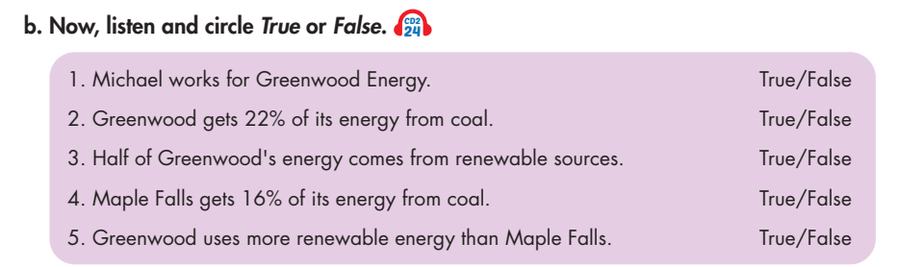
Pre - listening
Read the instruction and questions quickly. Underline the key words. What are we going to do?
Listen and circle True or False.

Slide 21
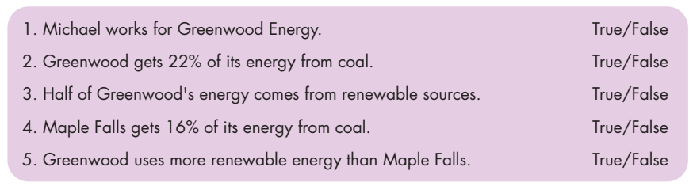
While - listening
Now listen and circle True or False.  FIRST TIME
☞ WHAT ARE YOUR ANWERS?

Slide 22
While - listening
Now listen again and check.  SECOND TIME
☞ WHY ARE THESE ANWERS?

Slide 23
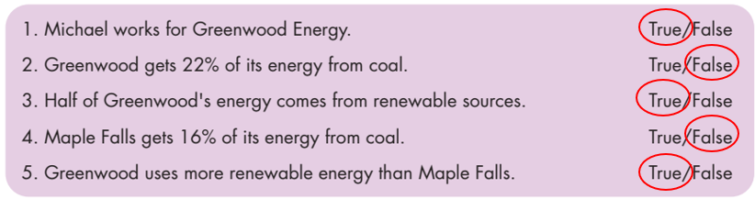
While - listening
Now listen again and check.  THIRD TIME
Emma: Hi, are you from Greenwood Energy?
Michael: Yes. My name's Michael.
Emma: How much energy does Greenwood get from coal?
Michael: It gets sixteen percent from coal.
1. Michael works for Greenwood Energy. True
2. Greenwood gets 22% of its energy
from coal. False
Emma: How much energy does it get from renewable sources?
Michael: Fifty percent.
3. Half of Greenwood's energy comes from renewable sources. True

Slide 24
James: How much energy does Maple Falls get from coal?
Ann: Sixty percent.
4. Maple Falls gets 16% of its energy from coal. False
Emma: Greenwood gets fifty percent. It uses more renewable energy sources than Maple Falls.
5. Greenwood uses more renewable energy than Maple Falls. True

Slide 25
Audio - Scripts
Practice the conversation with a partner.
Michael: Yes. My name's Michael. How can I help you?
Emma: How much energy does Greenwood get from coal?
Michael: It gets sixteen percent from coal.
Emma: Did you say sixty or sixteen?
Michael: Sixteen percent.
Emma: How much energy does it get from renewable sources?
Michael: Fifty percent. We use lots of wind power.
Emma: OK. Thank you.
Michael: You're welcome.

Slide 26
Audio - Scripts
Practice the conversation with a partner.
James: Hi, are you Ann from Maple Falls Energy?
Ann: Yes.
James: Can I ask you some questions?
Ann: OK.
James: How much energy does Maple Falls get from coal?
Ann: Sixty percent.
James: How much energy does it get from wind power?
Ann: Just under three percent.
James: Thank you.
James: Hey Emma, Maple Falls gets less than three percent of its energy from renewable sources.
Emma: Greenwood gets fifty percent. It uses more renewable energy sources than Maple Falls.
James: So, Greenwood is greener than Maple Falls.

Slide 27

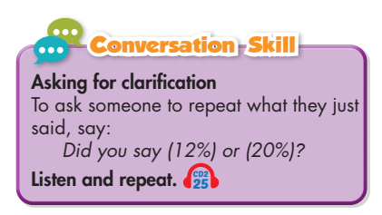
Work in pairs
Post - listening
What sources of energy does your country use?
Do you think it uses more non-renewable or
renewable energy?

Slide 28

CONSOLIDATION

Slide 29
Write 5 sentences about what sources of energy your country use. Use the information from Listening Task c.
Use the structures:
  My country / Vietnam gets … of its energy from … .
  Half of my country’s energy comes from … .
  It uses more/less … than …

Slide 30

WRAP-UP

Slide 31
Today’s lesson
Vocabularies
• renewable
• non-renewable
• solar power
• wind power
• oil
• coal
• natural gas
• hydropower

Slide 32
Today’s lesson
Listening:
Listening for main ideas and specific information
Speaking:
Talking about types and sources of energy
Asking for clarification

Slide 33
Homework
Learn by heart vocabularies and make sentences using them.
Do the Listening exercise on page 56 WB.
Do exercises in Tiếng Anh 7 i-Learn Smart World Notebook on page 58.
Prepare the next lesson (page 77 SB)
Play the consolidation games in Tiếng Anh 7 i-Learn Smart World App on www.eduhome.com.vn

Slide 34

Lesson 3
Stay positive and have a nice day!

