Slide 1

UNIT 7: INVENTIONS
Lesson 1.2 – Grammar
Page 57

Slide 2


Lesson 1.2
LESSON OUTLINE
Consolidation

Slide 3
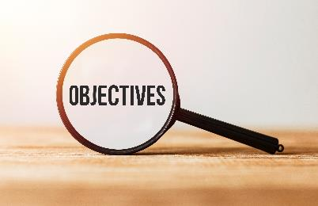
By the end of this lesson,
students will be able to …
practice and use Non-defining relative clause correctly.
ask and answer about inventors.

Slide 4



Slide 5

Work in pairs.
Who is Daniel Fahrenheit?
He is a Dutch scientist.
What did he invent in 1714?
He invented the mercury thermometer in 1714.

Slide 6
Work in pairs.
Who is Robert Goddard?
He is an American physicist.
What did he invent in 1926?
He invented the liquid-fueled rocket in 1926.

Slide 7

Presentation
Non-defining relative clause

Slide 8
Lead in:
How to combine 2 single sentences
Daniel Fahrenheit is a Dutch scientist.
refer to
an extra information
He invented the mercury thermometer in 1714.
Daniel Fahrenheit, who is a Dutch scientist, invented the mercury thermometer in 1714.

Slide 9
Do the same
Robert Goddard is an American physicist.
refer to
an extra information
He invented the liquid-fueled rocket in 1926.
Robert Goddard, who is an American physicist, invented the liquid-fueled rocket in 1926.
Lead in:
Non-defining relative clause

Slide 10


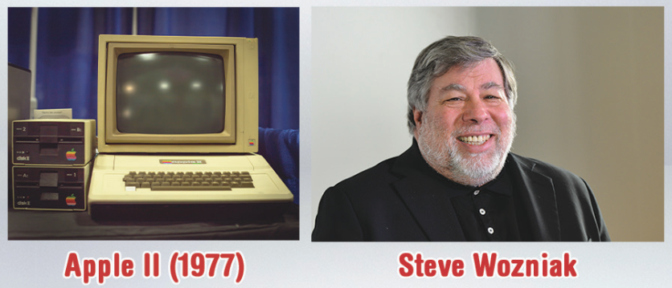
The Apple II computer, which was created in 1977, was designed by Steve Wozniak.

Slide 11

Non-defining relative clause
We use non-defining relative clauses to give extra information about someone or something.
Alexander Graham Bell, who was a Canadian inventor, invented the telephone.

Slide 12

Non-defining relative clause
We start the relative clause with a relative pronoun: who (for people) or which (for things). We can't use that with non-defining clauses.
We use commas to separate the non-defining clause from the rest of the sentence.

Slide 13
Non-defining relative clause
Examples
Guglielmo Marconi, who was an Italian inventor, invented the radio in 1896.
The ice cream maker, which was invented in 1843,
was first made by Nancy Johnson

Slide 14

Practice

Slide 15
b. Combine the sentences using non-defining relative clauses.
1. George Beauchamp was an American inventor. He invented the electric guitar in 1932.
George Beauchamp, who was an American inventor, invented the electric guitar in 1932.
2. Philo T. Farnsworth was the first television's inventor. He invented it in 1927.
Philo T. Farnsworth, who was the first television's inventor, invented it in 1927.

Slide 16
b. Combine the sentences using non-defining relative clauses.
3. Tom Kilburn developed the first software in 1948. He worked for the University of Manchester.
Tom Kilburn, who worked for the University of Manchester, developed the first software in 1948.
4. Edward Jenner created the first vaccine in 1796. He was a country doctor in England.
Edward Jenner, who was a country doctor in England, created the first vaccine in 1796

Slide 17
c. Use the information in the table to write sentences with non-defining relative clauses.
1. (who/job/what/when)
Hans Lipperhey, who was a glasses maker, invented the telescope in 1608.
2. (what/when/who)
The mercury thermometer, which was first made in 1714, was invented by Daniel Fahrenheit.

Slide 18
c. Use the information in the table to write sentences with non-defining relative clauses.
3. (what/when/who)
The modern-day dishwasher, which was first made in 1886, was invented by Josephine Cochran.
4. (who/job/what)
Karl Benz, who was a designer, invented the car.

Slide 19
Extra Practice
WB, page 39
a. Combine the sentences using non-defining relative clauses.
1. The fridge was invented by Jacob Perkins. It was created in 1835.
The fridge, which was created in 1835, was invented by
Jacob Perkins.
2. Peter Henlein invented the watch in 1505. He was a German clockmaker
Peter Henlein, who was a German clockmaker, invented the watch in 1505.

Slide 20
3. The video game console was invented by Ralph Baer. It was created in 1972.
The video game console, which was created in 1972, was invented by Ralph Baer.
4. The television was invented by Philo Farnsworth. It was created in 1927.
The television, which was created in 1927, was invented by Philo Farnsworth.

Slide 21
5. Edward Jenner invented the first vaccine. He was an English doctor.
Edward Jenner, who was an English doctor, invented the first vaccine.

Slide 22
b. Underline the relative clauses and add commas if it is a non-defining relative clause.
1. The first watches that Peter Henlein made were often given as gifts to important people.
The first watches that Peter Henlein made were often given as gifts to important people
2. Daniel Gabriel Fahrenheit who was born in 1686 invented the mercury thermometer.
Daniel Gabriel Fahrenheit, who was born in 1686, invented the mercury thermometer.

Slide 23
3. Earle Dickson invented the Band-Aid which were first made by hand because his wife often sliced her fingers when she cooked.
Earl Dickson invented the Band-Aid, which were first made by hand, because his wife often sliced her fingers when she cooked.

Slide 24
4. Although John Loud who was an American inventor designed the first ballpoint pen, his ballpoint pen didn't really work.
Although John Loud, who was an American inventor, designed the first ballpoint pen, his ballpoint pen didn't really work.
5. It is believed that the first umbrella was created by a man who lived in China about 3,500 years ago.
It is believed that the first umbrella was created by a man who lived in China about 3,500 years ago.

Slide 25

Production

Slide 26

Production
Write sentences using the prompts.
1. Karl Benz – German engineer – modern car in 1886
Karl Benz, who was a German engineer, invented the modern car in 1886.
2. Airplane – 1903 – the Wright brothers
The airplane, which was created in 1903, was invented
by the Wright brothers.
Extra Practice
WB, page 39
Notes:
Taken from TA 10 i-Learn Smart World WB, page 2

Slide 27
3. George Eastman – American inventor – modern camera in 1888
George Eastman, who was an American inventor, invented the modern camera in 1888.
4. Alexander Graham Bell – American inventor – telephone in 1876
Alexander Graham Bell, who was an American inventor, invented the telephone in 1876.
5. Ballpoint pen – 1938 – Laszlo Biro
The ballpoint pen, which was created in 1938, was invented by Laszlo Biro.
Notes:
Taken from TA 10 i-Learn Smart World WB, page 2

Slide 28

Consolidation

Slide 29

Extra Practice
DHA on Eduhome
Let’s Play!
Click here to play the games.

Slide 30

Work in pairs.
d. Ask each other about the inventors in Task c.
Use the grammar point: Non-defining relative clause
Can you tell me about the inventor of the telescope?
Yes. Hans Lipperhey, who was a glasses maker, invented the telescope in 1608.

Slide 31

WRAP-UP

Slide 32
Today’s lesson
Grammar: Non-defining relative clause
Speaking: asking and answering about
inventors

Slide 33
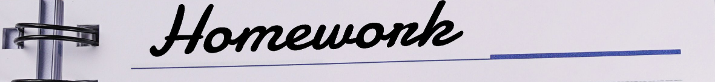
Practice making sentences using Non-defining relative clause
Do the exercises in WB on page 39 (Grammar).
Complete the grammar notes in Tiếng Anh 10 i-Learn Smart World Notebook on page 39.
Prepare the next lesson - Grammar on page 58 in SB.
Play the consolidation games in Tiếng Anh 10 i-Learn Smart World DHA App on www.eduhome.com.vn

