Slide 1


Slide 2

Unit
9
1
Unit
FAMILY LIFE
Protecting the environment
LESSON 8
LOOKING BACK AND PROJECT

Slide 3

OBJECTIVES
To help students further revise sentence stress and practise speaking with a natural rhythm.
To help students revise the vocabulary items they have learnt in the unit.
To help students revise the use of reported speech.
To guide students to do research on a local or an international organisation and give a group presentation about it.

Slide 4
LESSON 8
LOOKING BACK AND PROJECT
WARM-UP
Video watching
Pronunciation: Listen and mark the stressed syllables in the words in bold.
Vocabulary: Complete the sentences.
Grammar: Rewrite the sentences.
LOOKING BACK
PROJECT
An environmental organisation
CONSOLIDATION
Wrap-up
Home work

Slide 5
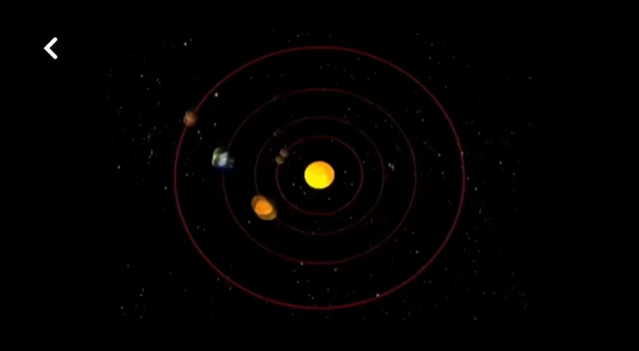

Slide 6
LESSON 8
LOOKING BACK AND PROJECT
WARM-UP
Video watching
Pronunciation: Listen and mark the stressed syllables in the words in bold.
Vocabulary: Complete the sentences.
Grammar: Rewrite the sentences.
LOOKING BACK

Slide 7

PRONUNCIATION
1
Listen and mark the stressed syllables in the words in bold. Then practise saying the sentences with a natural rhythm.
1. Don’t buy products that are made from wild animal parts.
2. What can we do to help the animals in the wild?
3. Large tigers tend to live in colder areas while smaller tigers live in warmer countries.
4. Elephants are endangered because of illegal hunting and body part trade.
5. Do you know why so many endangered animals are disappearing?
1. ‘Don’t ‘buy ‘products that are ‘made from ‘wild ‘animal ‘parts.
2. ‘What can we ‘do to ‘help the ‘animals in the ‘wild?
3. ‘Large ‘tigers tend to ‘live in ‘colder ‘areas while ‘smaller ‘tigers ‘live in ‘warmer ‘countries.
4. ‘Elephants are en‘dangered because of il‘legal ‘hunting and ‘body ‘part ‘trade.
5. Do you ‘know why so many en‘dangered ‘animals are disap‘pearing?

Slide 8
VOCABULARY
2
Choose the correct word to complete each sentence.
1. Many wildlife habits / habitats will be destroyed if people keep cutting down the forests.
2. Researchers are looking for ways to reduce the environmental
impact / affect of air pollution on the local community.
3. It’s illegal to kill pandas, tigers or any other dangerous / endangered animals.
4. Global warming / climate is mainly caused by pollution and clearing of forests.

Slide 9
GRAMMAR
3
Change the following sentences into reported speech.
1. ‘The rising sea level is a result of global warming,’ the teacher explained.
→ The teacher explained that the rising sea level was / is a result of global warming.
2. ‘I will take part in the competition next month,’ my friend told me.
→ My friend told me that she would take part in the competition the following month.
3. ‘The clearing and burning of forests lead to air pollution,’ the speaker said.
→ The speaker said the clearing and burning of forests led / lead to air pollution.
4. ‘Are you interested in joining the event this weekend, Minh?’ asked Tuan.
→ Tuan asked Minh if/ whether he was interested in joining the event that weekend.
5. ‘When are you going to deliver your presentation on the environment, Mai?’ asked Nam.
→ Nam asked Mai when she was going to deliver the presentation on the environment.

Slide 10
LESSON 8
LOOKING BACK AND PROJECT
WARM-UP
Video watching
Pronunciation: Listen and mark the stressed syllables in the words in bold.
Vocabulary: Complete the sentences.
Grammar: Rewrite the sentences.
LOOKING BACK
PROJECT
An environmental organisation

Slide 11
PROJECT
PRACTICE
AN ENVIRONMENTAL ORGANISATION
Work in groups and get ready for your presentations on a local or an international environmental organisation and assigned at the first lesson of unit 9.
Two or three groups give their presentations to the whole class.

Slide 12

PRACTICE

Slide 13
LESSON 8
LOOKING BACK AND PROJECT
WARM-UP
Video watching
Pronunciation: Listen and mark the stressed syllables in the words in bold.
Vocabulary: Complete the sentences.
Grammar: Rewrite the sentences.
LOOKING BACK
PROJECT
An environmental organisation
CONSOLIDATION
Wrap-up
Home work

Slide 14
CONSOLIDATION
1
Wrap-up
Further revise sentence stress and practise speaking with a natural rhythm.
Revise the vocabulary items learnt in the unit.
Revise the use of reported speech.
Do research on an environment organization and give a group presentation about it.

Slide 15
CONSOLIDATION
2
Homework
Do exercises in the Workbook

Slide 16

Website: hoclieu.vn
Fanpage: facebook.com/tienganhglobalsuccess.vn/

