Slide 1

UNIT 3: SHOPPING
Lesson 3.2 – Writing
Page 27

Slide 2




Unit 3 Lesson 3.2
Lesson 3.2
LESSON OUTLINE
Consolidation

Slide 3

Unit 3 Lesson 3.2
By the end of this lesson,
students will be able to:
- write a complaint email.
- talk about the problems and what the customer should do.

Slide 4


Unit 3 Lesson 3.2

Slide 5

Unit 3 Lesson 3.2
Work in pairs.
Have you ever complained to the manager of a store about your items?
Yes, I have. Last year, I…

Slide 6



Slide 7

Unit 3 Lesson 3.2
a. Read about writing complaint emails, then read June's email again and underline the examples of parts 1-4 from the Writing Skill in the email.
Writing complaint emails
To make complaints effectively in an email, you should use formal language and:
1. explain why you're writing:
I bought a B300 laptop on December 5th, and it has a problem.
2. describe the problem:
It crashes when I play games.
3. (optional) explain how you tried to fix the problem:
I tried restarting it, but it still does not work.
4. say what you want the store to do:
I would like you to replace it

Slide 8

Unit 3 Lesson 3.2
a. Read about writing complaint emails, then read June's email again and underline the examples of parts 1-4 from the Writing Skill in the email.
Dear Sir or Madam,
On Friday, November 27th, I bought a Link76 laptop from your website and it is not working.
The laptop has two main problems. It overheats when I play games and it keeps crashing when I do my homework. It also sometimes slows down when I watch movies.
I called RocketTech's customer hotline and waited 30 minutes to speak to someone. Finally, I spoke to your colleague, Andy. He said he would speak to his manager and call back in ten minutes. That was three hours ago.
I would like RocketTech to repair my laptop or provide a new one as soon as possible.
I look forward to your reply.
Yours faithfully,
June Evans

Slide 9

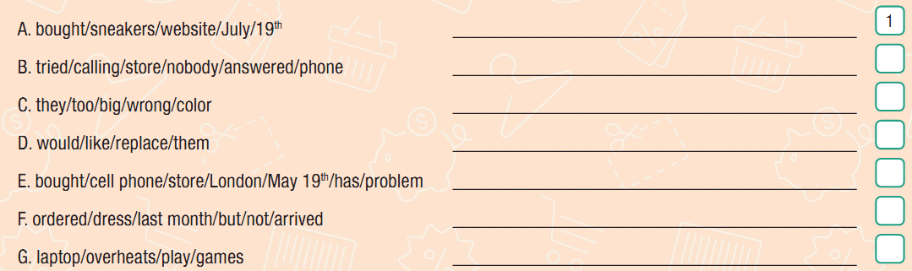
Unit 3 Lesson 3.2
b. Write full sentences using the prompts. Use the skill box to help you. Then, number the sentences (1–4) to match them with the parts of a complaint email.

Slide 10

Unit 3 Lesson 3.2
b. Write full sentences using the prompts. Use the skill box to help you. Then, number the sentences (1–4) to match them with the parts of a complaint email.
A. bought/sneakers/website/July/19th
____________________________________________
B. tried/calling/store/nobody/answered/phone ____________________________________________
C. they/too/big/wrong/color ____________________________________________
D. would/like/replace/them ____________________________________________
A. I bought a pair of sneakers from your website on July 19th.
B. I tried calling the store, but nobody answered the phone.
C. They are too big and of the wrong color.
D. I would like you to replace them.

Slide 11

Unit 3 Lesson 3.2
b. Write full sentences using the prompts. Use the skill box to help you. Then, number the sentences (1–4) to match them with the parts of a complaint email.
E. bought/cell phone/store/London/May 19th/has/problem ____________________________________________
F. ordered/dress/last month/but/not/arrived ____________________________________________
G. laptop/overheats/play/games ____________________________________________
E. I bought a cell phone from your store in London May 19th, and it has a problem.
F. I ordered a dress last month, but it has not arrived.
G. The laptop overheats when I play games.

Slide 12

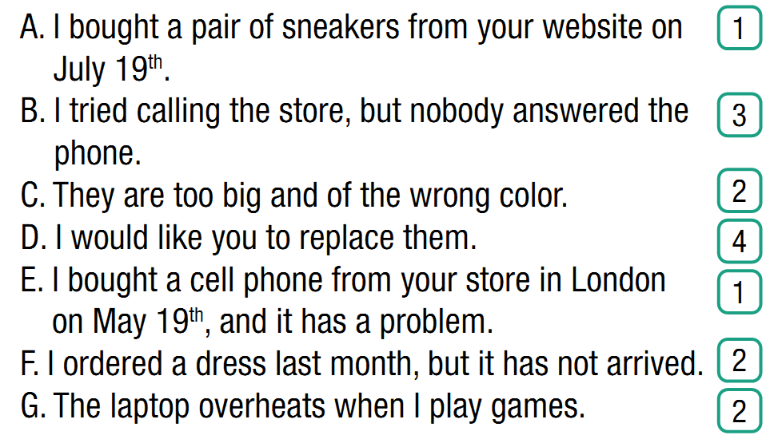
Unit 3 Lesson 3.2
b. Write full sentences using the prompts. Use the skill box to help you. Then, number the sentences (1–4) to match them with the parts of a complaint email.

Slide 13



Slide 14


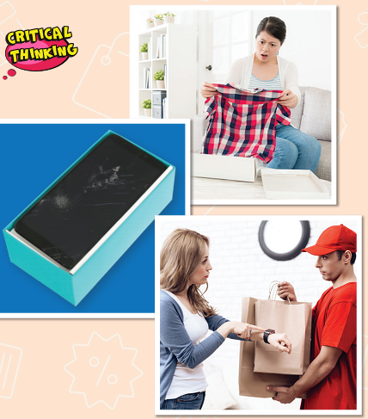
Unit 3 Lesson 3.2
a. In pairs:
Look at the pictures in the lesson.
Discuss what the problems are
and what the customers should do.

Slide 15
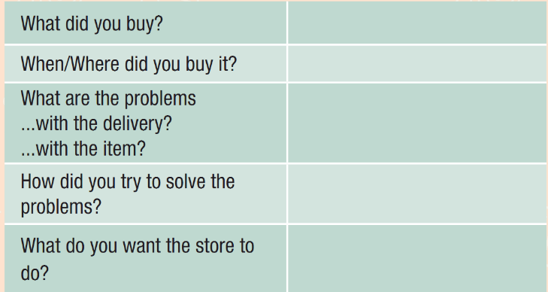
Unit 3 Lesson 3.2
b. Choose an item from the pictures or use your own idea and make notes in the table.

Slide 16



Slide 17

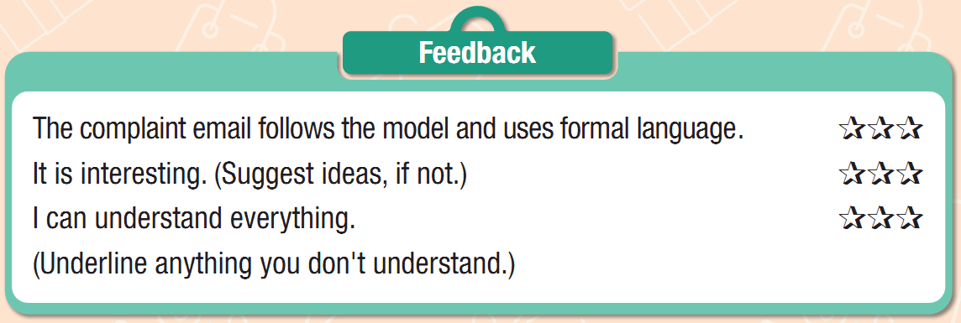
Unit 3 Lesson 3.2
Now, write a complaint email to the company. Remember to
follow the model and use formal language. Use the Feedback form to help you. Write 120 to 150 words.

Slide 18

Unit 3 Lesson 3.2
Suggested answer:
Dear Sir or Madam,
I bought an LX3 laptop from your website on October 4th, and it is not working. The laptop restarts when I play games, and it overheats when I do my homework. I called your store three times, but nobody answered the phone. I want you to fix my laptop or give me my money back as soon as possible.
I look forward to hearing from you very soon.
Best regards,
Susan Parker

Slide 19
Unit 3 Lesson 3.2
Extra Practice
WB, page 19
Write full sentences using the prompts.
Use the Writing Skill box to help you.
Writing complaint emails
To make complaints effectively in an email, you should use formal language and:
1. explain why you're writing:
I bought a B300 laptop on December 5th, and it has a problem.
2. describe the problem:
It crashes when I play games.
3. (optional) explain how you tried to fix the problem:
I tried restarting it, but it still does not work.
4. say what you want the store to do:
I would like you to replace it

Slide 20
Unit 3 Lesson 3.2
Extra Practice
WB, page 19
Write full sentences using the prompts. Use the Writing Skill box to help you.
1. order/backpack/website/October/23rd
____________________________________________________
2. wait/two/weeks/for/the/delivery ___________________________________________________
3. tried/calling/customer/service/nobody/answer/ phone
____________________________________________________
4. would/like/have/a refund/for/order ___________________________________________________
I ordered a backpack from your website on October 23rd.
I waited two weeks for the delivery.
I tried calling the customer service, but nobody answered the phone
I would like you to have a refund for the order.

Slide 21
Unit 3 Lesson 3.2
Extra Practice
WB, page 19
Write full sentences using the prompts. Use the Writing Skill box to help you.
5. bought/camera/your/store/last month/but/not/arrived
________________________________________________
6. the/battery/the tablet/run out/too fast/surf the internet
________________________________________________
7. the/shoes/wrong/size ________________________________________________
I bought a camera from your store last month, but it didn’t arrived.
The battery of the tablet runs out too fast when I surf the internet
The shoes have a wrong size.

Slide 22
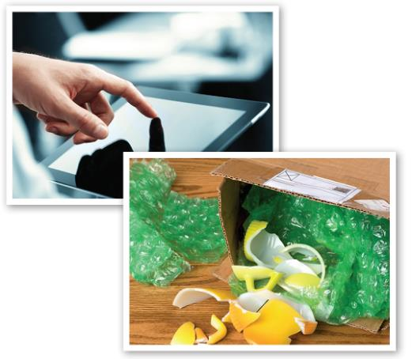
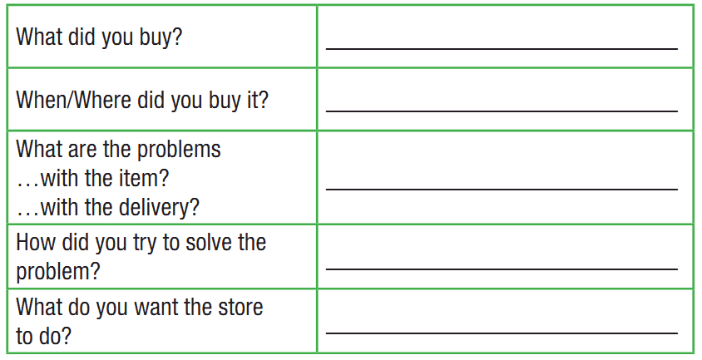
Unit 3 Lesson 3.2
Extra Practice
WB, page 19
Choose an item from the pictures or your own idea, then make notes in the table.

Slide 23

Unit 3 Lesson 3.2
Extra Practice
WB, page 19
Now, use your notes to write a complaint email to the store. Remember to follow the model and use formal language. Write 100 to 140 words.

Slide 24

Consolidation

Slide 25
Unit 3 Lesson 3.2
Write a complaint letter about the watch you have just bought. It doesn’t work after 5 days.

Slide 26

WRAP-UP

Slide 27
Unit 3 Lesson 3.2
WRAP-UP
Today’s lesson
Writing: A complaint email
Speaking: starting a formal conversation asking and answering about the problems and what the customers should do

Slide 28
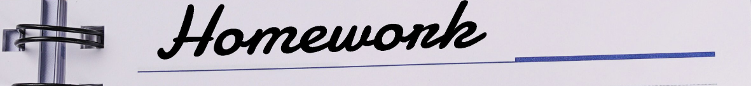
Unit 3 Lesson 3.2
Write a complaint email.
Do the exercises in WB on page 19.
Complete the writing notes in Tiếng Anh 10 i-Learn Smart World Notebook on page 19.
Prepare the next lesson – Review 1 on page 28 in SB.
Play the consolidation games in Tiếng Anh 10 i-Learn Smart World DHA App on www.eduhome.com.vn

Slide 29

Have a nice day!

