Slide 2
LANGUAGE
Review 4
REVIEW
FAMILY LIFE
Unit
PART I

Slide 3


PART I
LANGUAGE
PRONUNCIATION
Choose the correct answers. Then listen and check. Practise saying the sentences in pairs.
VOCABULARY
What are the missing letters?
Read the passage and fill in the blanks.
GRAMMAR
Choose the correct answers.

Slide 4

Catch a word

Slide 5
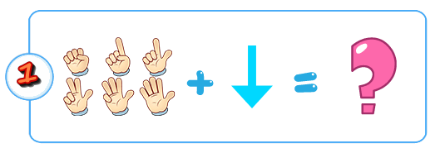
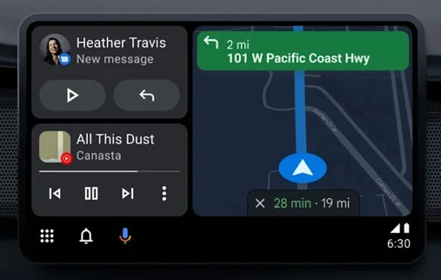

+
Automate

Slide 6
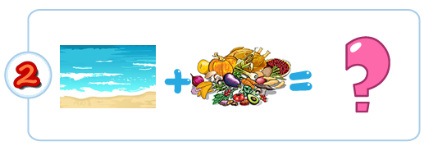

A
+
Adapt

Slide 7
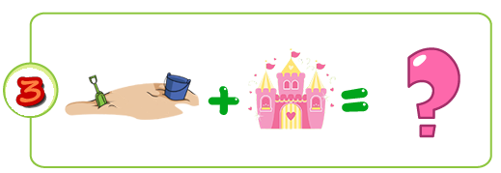



+
+
Go in for

Slide 8
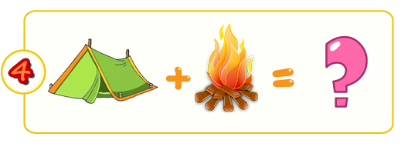


+
Bullying

Slide 9
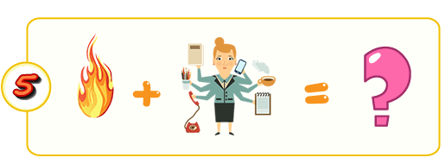


+ 2
+
Live up to

Slide 10



+
Brush up

Slide 11
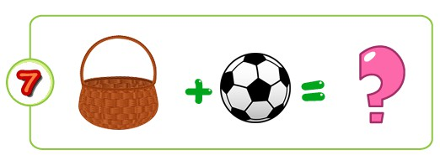


+
Adult education

Slide 12



+ P
+
/
Complex

Slide 13

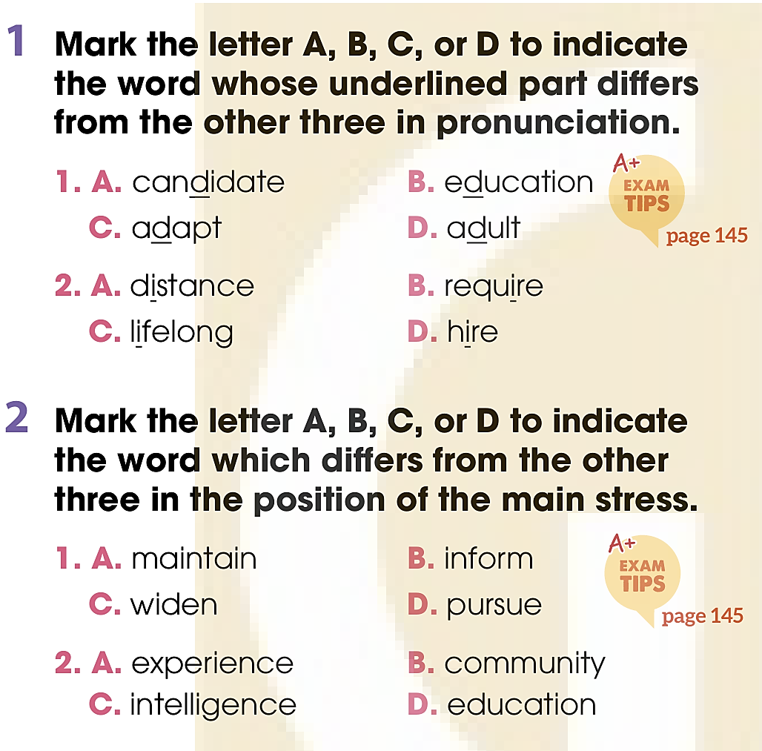
PRONUNCIATION

Slide 14
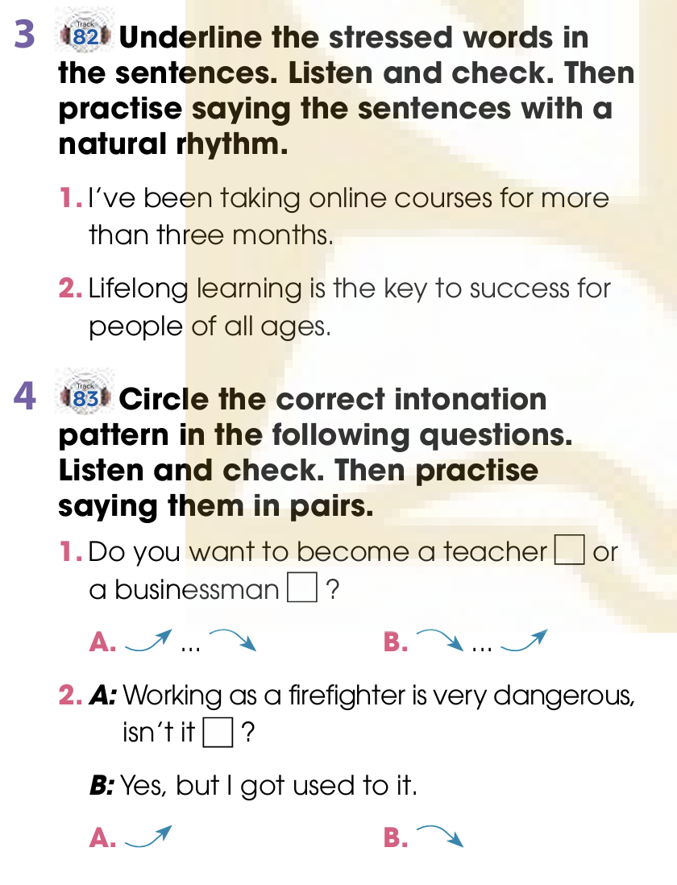

PRONUNCIATION

Slide 15
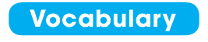
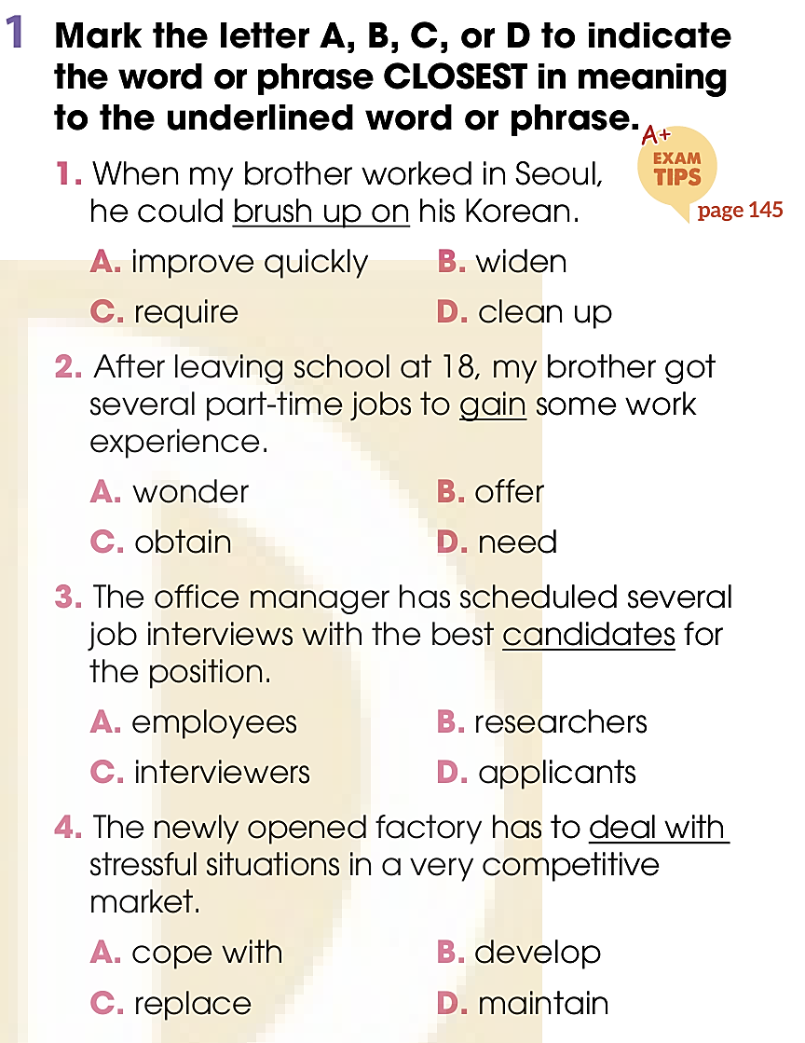
VOCABULARY

Slide 16
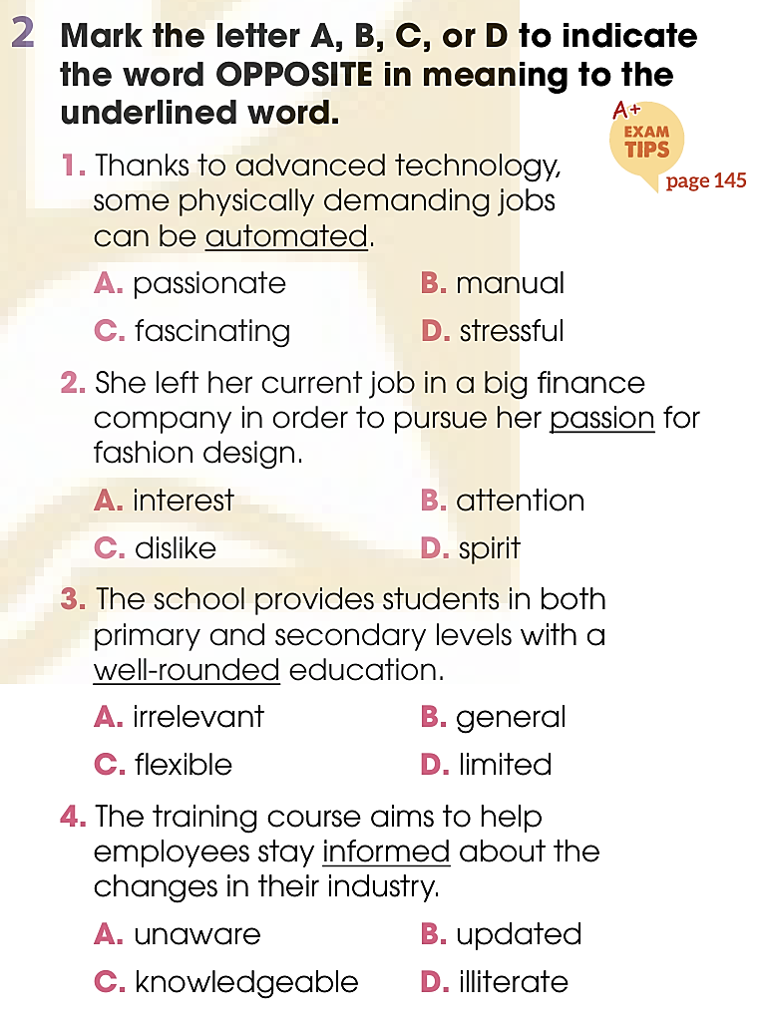
VOCABULARY

Slide 17
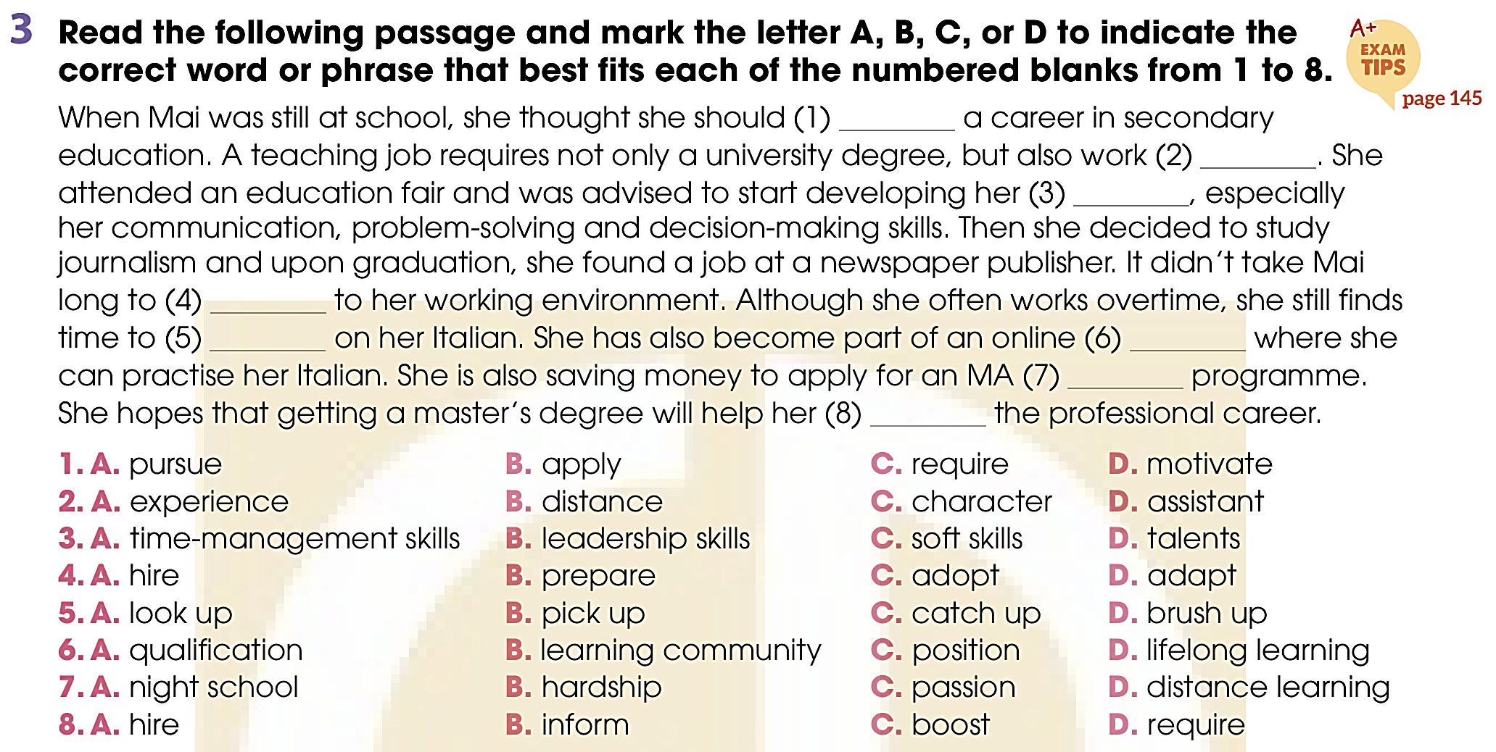
VOCABULARY
pursue
experience
soft skills
adapt
look up
learning
community
distance
learning
boost

Slide 18
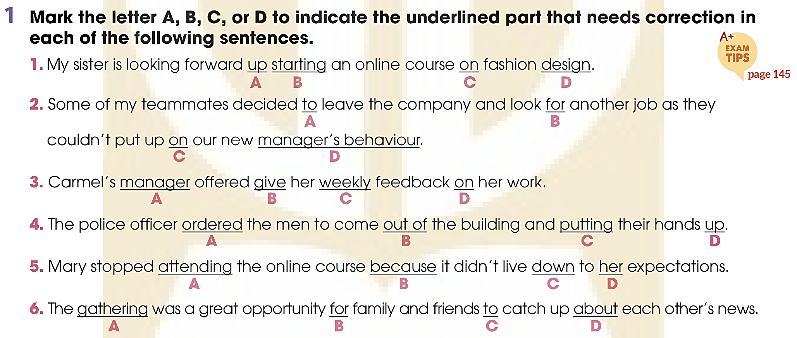
GRAMMAR
1
→ to
→ with
→ to give
→ put
→ up
→ on

Slide 19
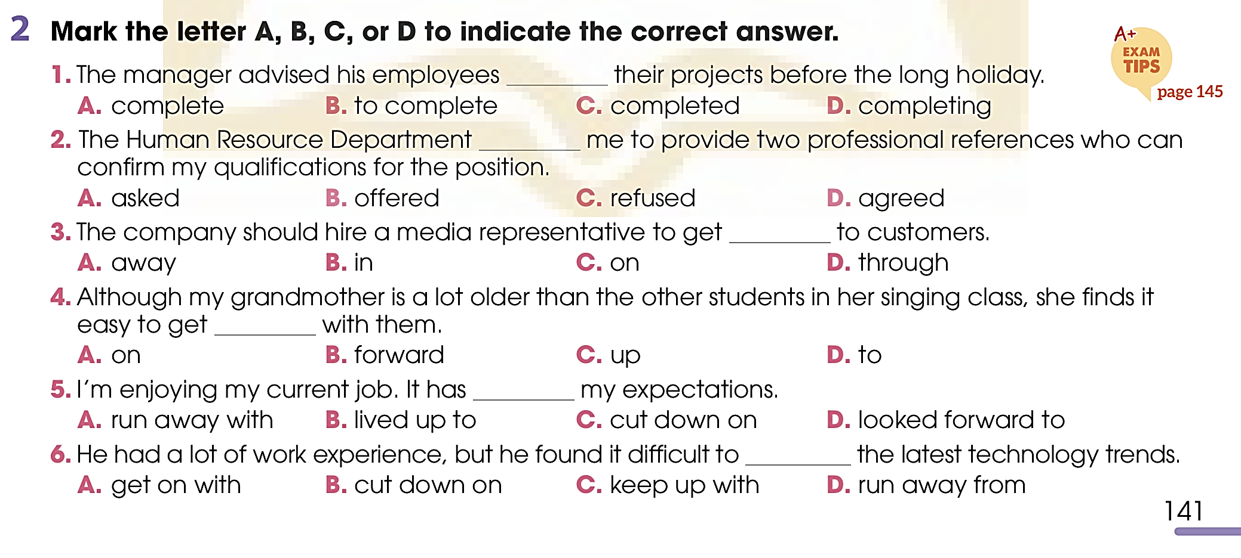
GRAMMAR

Slide 20
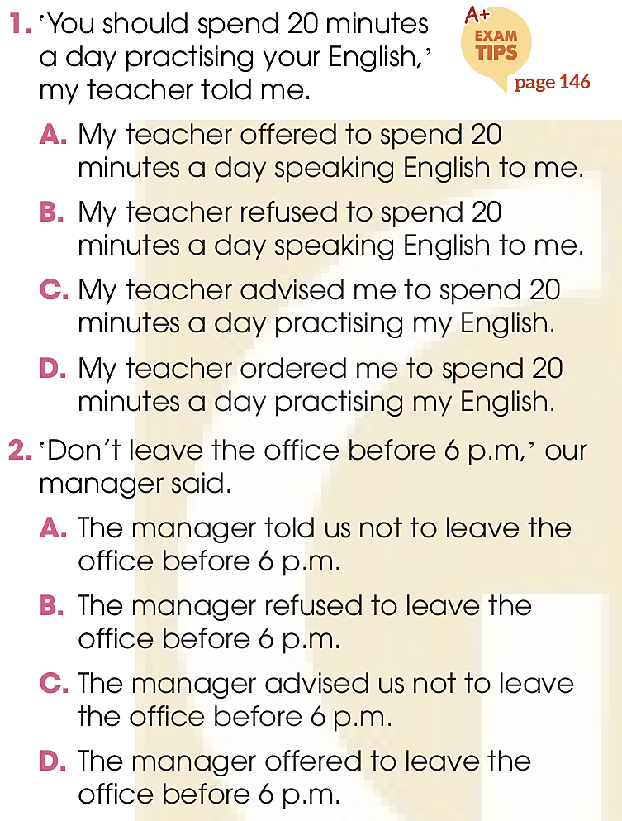
GRAMMAR
3
Mark the letter a, B, C, or d to indicate the reported sentence that is closest in meaning to each of the following direct speech sentences..

Slide 21
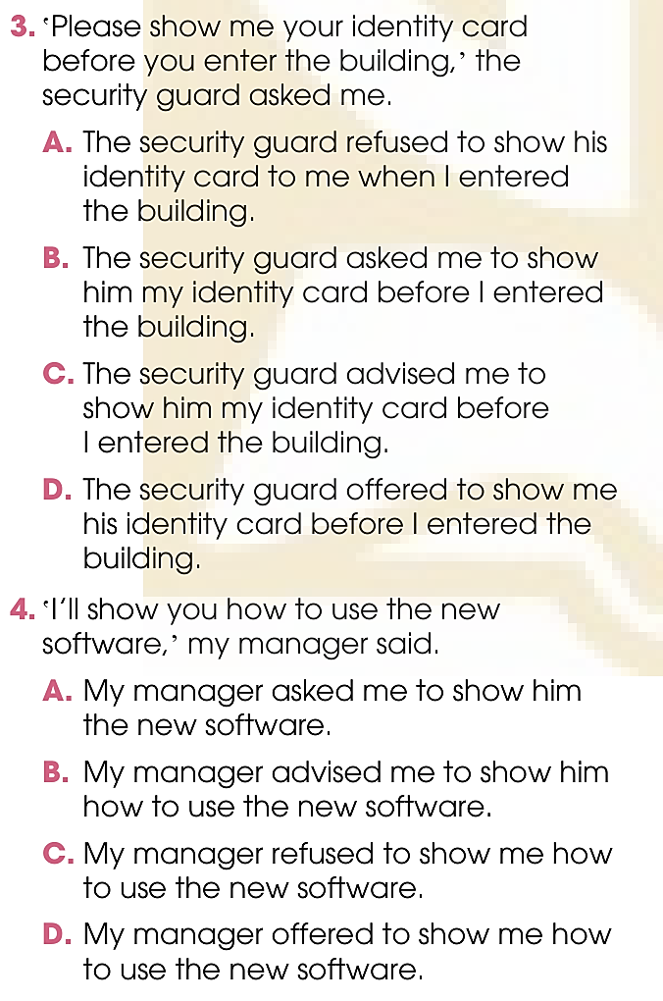
GRAMMAR

Slide 22
CONSOLIDATION
1
Wrap-up
What have you learnt today?
Review the vocabulary and grammar of Unit 9 & 10.
H
0

Slide 23
Website: hoclieu.vn
Fanpage: facebook.com/www.tienganhglobalsuccess.vn

