Slide 1
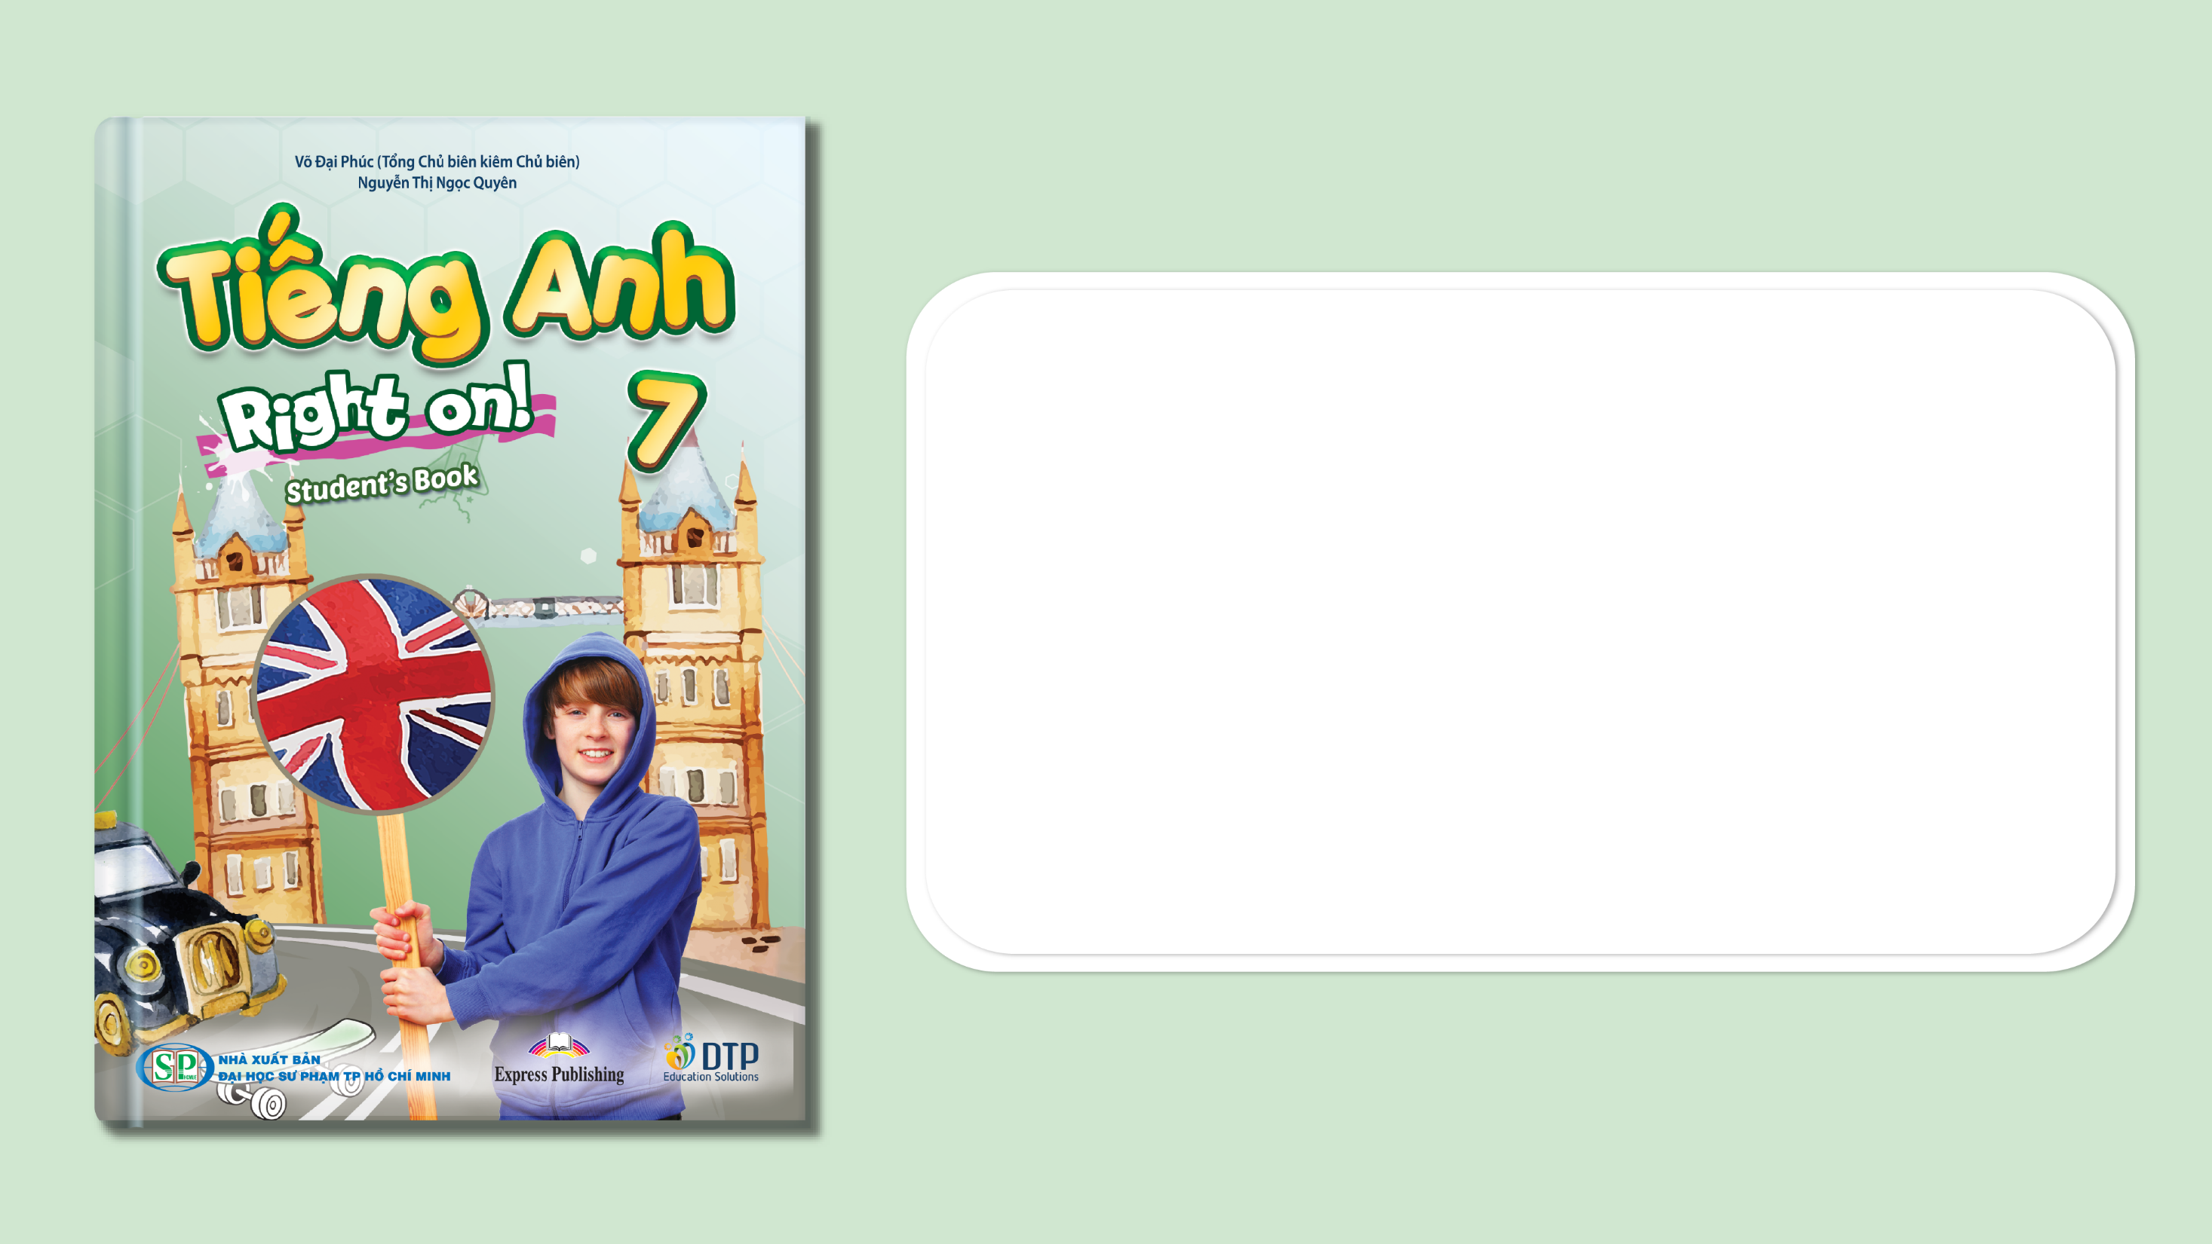
Unit 4: All things high-tech
Lesson: Overview
Pages 62 & 63

Slide 2
Lesson Outline
Warm-up
Vocabulary
Listening
Consolidation
Wrap-up

Slide 3
Objectives
By the end of this lesson, students will be able to…
- get an overview of Unit 4.
- practise and learn vocabularies for things in high-tech: tablet, games console, smartphone, drone, virtual reality headset, MP3 player.
- practise listening specific information.

Slide 4

WARM-UP

Slide 5

Work in pairs.
Chatting
1. Can you name some things in high-tech?
Drones, smart phones, MP3 players.
2. What can you do with them?
I can take photos with a drone.
I can send messages with a smart phone.
I can listen to music with an MP3 player.

Slide 6

It’s time to learn …

Slide 7

New words
drone
smartphone
MP3 player
tablet
virtual reality headset
games console

Slide 8
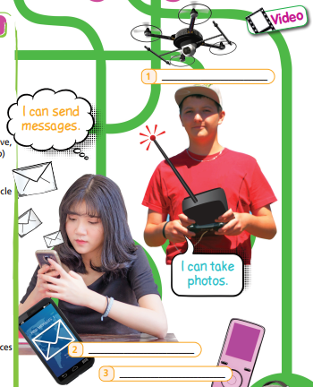
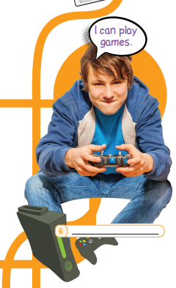

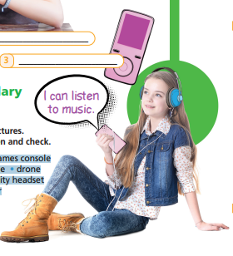
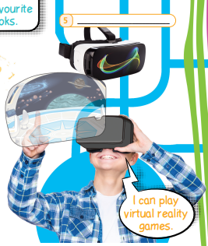

Label the pictures. Listen and check.
1. drone
4. tablet
2. smartphone
5. virtual reality headset
6. games console
3. MP3 player

Slide 9
Listen and repeat. Click each phrase to hear the sound.
drone /drəʊn/ (n) máy bay không người lái (quay phim)
games console /ˈɡeɪmz kɒnsəʊl/ (n) máy chơi trò chơi điện tử
MP3 player /ˌem piː ˈθriː pleɪə(r)/ (n) máy nghe nhạc MP3
tablet /ˈtæblət/ (n) máy tính bảng
virtual reality headset /ˈvɜːtʃuəl riˈælətiˈhedset / (n) kính thực tế ảo
smartphone /ˈsmɑːtfəʊn/ (n) điện thoại thông minh
Notes:
GV click vào từng cụm nghe âm thanh

Slide 10


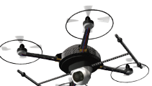

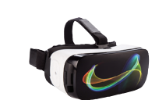

Extra Practice
WB, page 32
Label the pictures with the words you have learnt.
drone
smartphone
tablet
virtual reality headset
MP3 player
games console

Slide 11

Work in pairs.
Which of the devices in the pictures have you got? How do
you use them? Choose from the ideas below.
• play games
• call friends
• send text messages
• read books
• listen to music
• watch films
• video chat with friends/relatives
• take photos from the air
• interact with 3D objects & play virtual reality games

Slide 12
Example
• play games
• call friends
• send text messages
• read books
• listen to music
• watch films
• video chat with friends/relatives
• take photos from the air
• interact with 3D objects & play virtual reality games
I’ve got a games console. I play games with my friends.

Slide 13
Suggested Answer Key
I use my drone to take photos from the air.
I use my smartphone to play games, call friends, send text messages, listen to music and video chat with friends/relatives.
I use my MP3 player to listen to music.
I use my tablet to play games, read books, listen to music, watch films and video chat with friends/relatives.
I use my virtual reality headset to interact with 3D objects and play virtual reality games.

Slide 14

Listening

Slide 15
Which of the devices in Exercise 1 has Danny
got? Listen and write in your notebook.
Pre - listening
Who is the speaker?
Danny.
What are you going to do?
Listen and write in notebook which of the devices in Exercise 1 Danny has got.

Slide 16
While - listening
Now listen and answer.  FIRST TIME
Which of the devices in Exercise 1 has Danny got? Listen.
☞ YOUR ANSWER?
He has got a smart phone and a tablet.
☞ WHY?

Slide 17
While - listening
Now listen again and check.  SECOND TIME
While you are listening, focus on what Danny says.
I love my smartphone – it’s my favourite device.
I use my tablet to read ebooks, though.
☞ THE ANSWER IS …
He has a smartphone and a tablet.

Slide 18
Post- listening
Listen again and fill in the blanks.
Extra Practice
I love my smartphone – it’s my favourite device. I use it every day. I listen to music on it, so I don’t need an (1) ____________. I use my tablet to read ebooks, though, because my smartphone’s screen is really small. Some of my friends have got (2) ________, but I don’t want one. I’d prefer a (3) __________________ with a virtual reality headset! Maybe my parents will buy me one for my (4) ___________ next year.
MP3 player
drones
games console
birthday

Slide 19
Audio - Scripts
I love my smartphone – it’s my favourite device. I use it every day. I listen to music on it, so I don’t need an MP3 player. I use my tablet to read ebooks, though, because my smartphone’s screen is really small. Some of my friends have got drones, but I don’t want one. I’d prefer a games console with a virtual reality headset! Maybe my parents will buy me one for my birthday next year.

Slide 20

Speaking

Slide 21

Pre - Speaking
Work in pairs.
Making predictions
Which devices do you think will/won’t be around in 20 years? Give reasons.
What are you going to do?
→ Make predictions and give reasons.
What predictions?
→ Which devices will/won’t be around in 20 years?

Slide 22
STUDENT A
STUDENT B
Which devices do you think will be around in 20 years?
I think that smartphones and tablets will.
Why?
Because they are very useful.
Which devices do you think won’t be around in 20 years?
I think that MP3 players won’t be around in 20 years.
Why?
Because we will listen to music on our smartphones instead.

Slide 23

While - Speaking
Work in pairs.
Make similar conversations with:
drone
tablet
virtual reality headset
games console

Slide 24
Post - Speaking
In groups, discuss your favourite high-tech device. You can begin with:
My favourite high-tech device is … I like it because …

Slide 25

CONSOLIDATION

Slide 26
Write about your favourite high-tech device.
Write about 60-80 words.

Slide 27
Suggested answer
My favourite high-tech device is MP3 player. I like it because it is small and I can carry it everywhere. I listen to music on it. I use my smartphone to search for information and play games. It is really helpful. I really want to have a virtual reality headset because it is so modern and wonderful! I hope my parents will buy me one on my next birthday.

Slide 28

WRAP-UP

Slide 29
Today’s lesson
Vocabularies
• tablet
• games console
• smartphone
• drone
• virtual reality headset
• MP3 player
Listening: practice listening specifc information.
Speaking: talk about your favorite high-tech device.

Slide 30
Lesson 3
Homework
Practise the vocabularies and make sentences using them.
Do the exercises in TA 7 Right on WB (page 32).
Prepare the next lesson (page 64 SB).
Do the exercises in TA 7 Right on Notebook (pages 26 & 27).

Slide 31
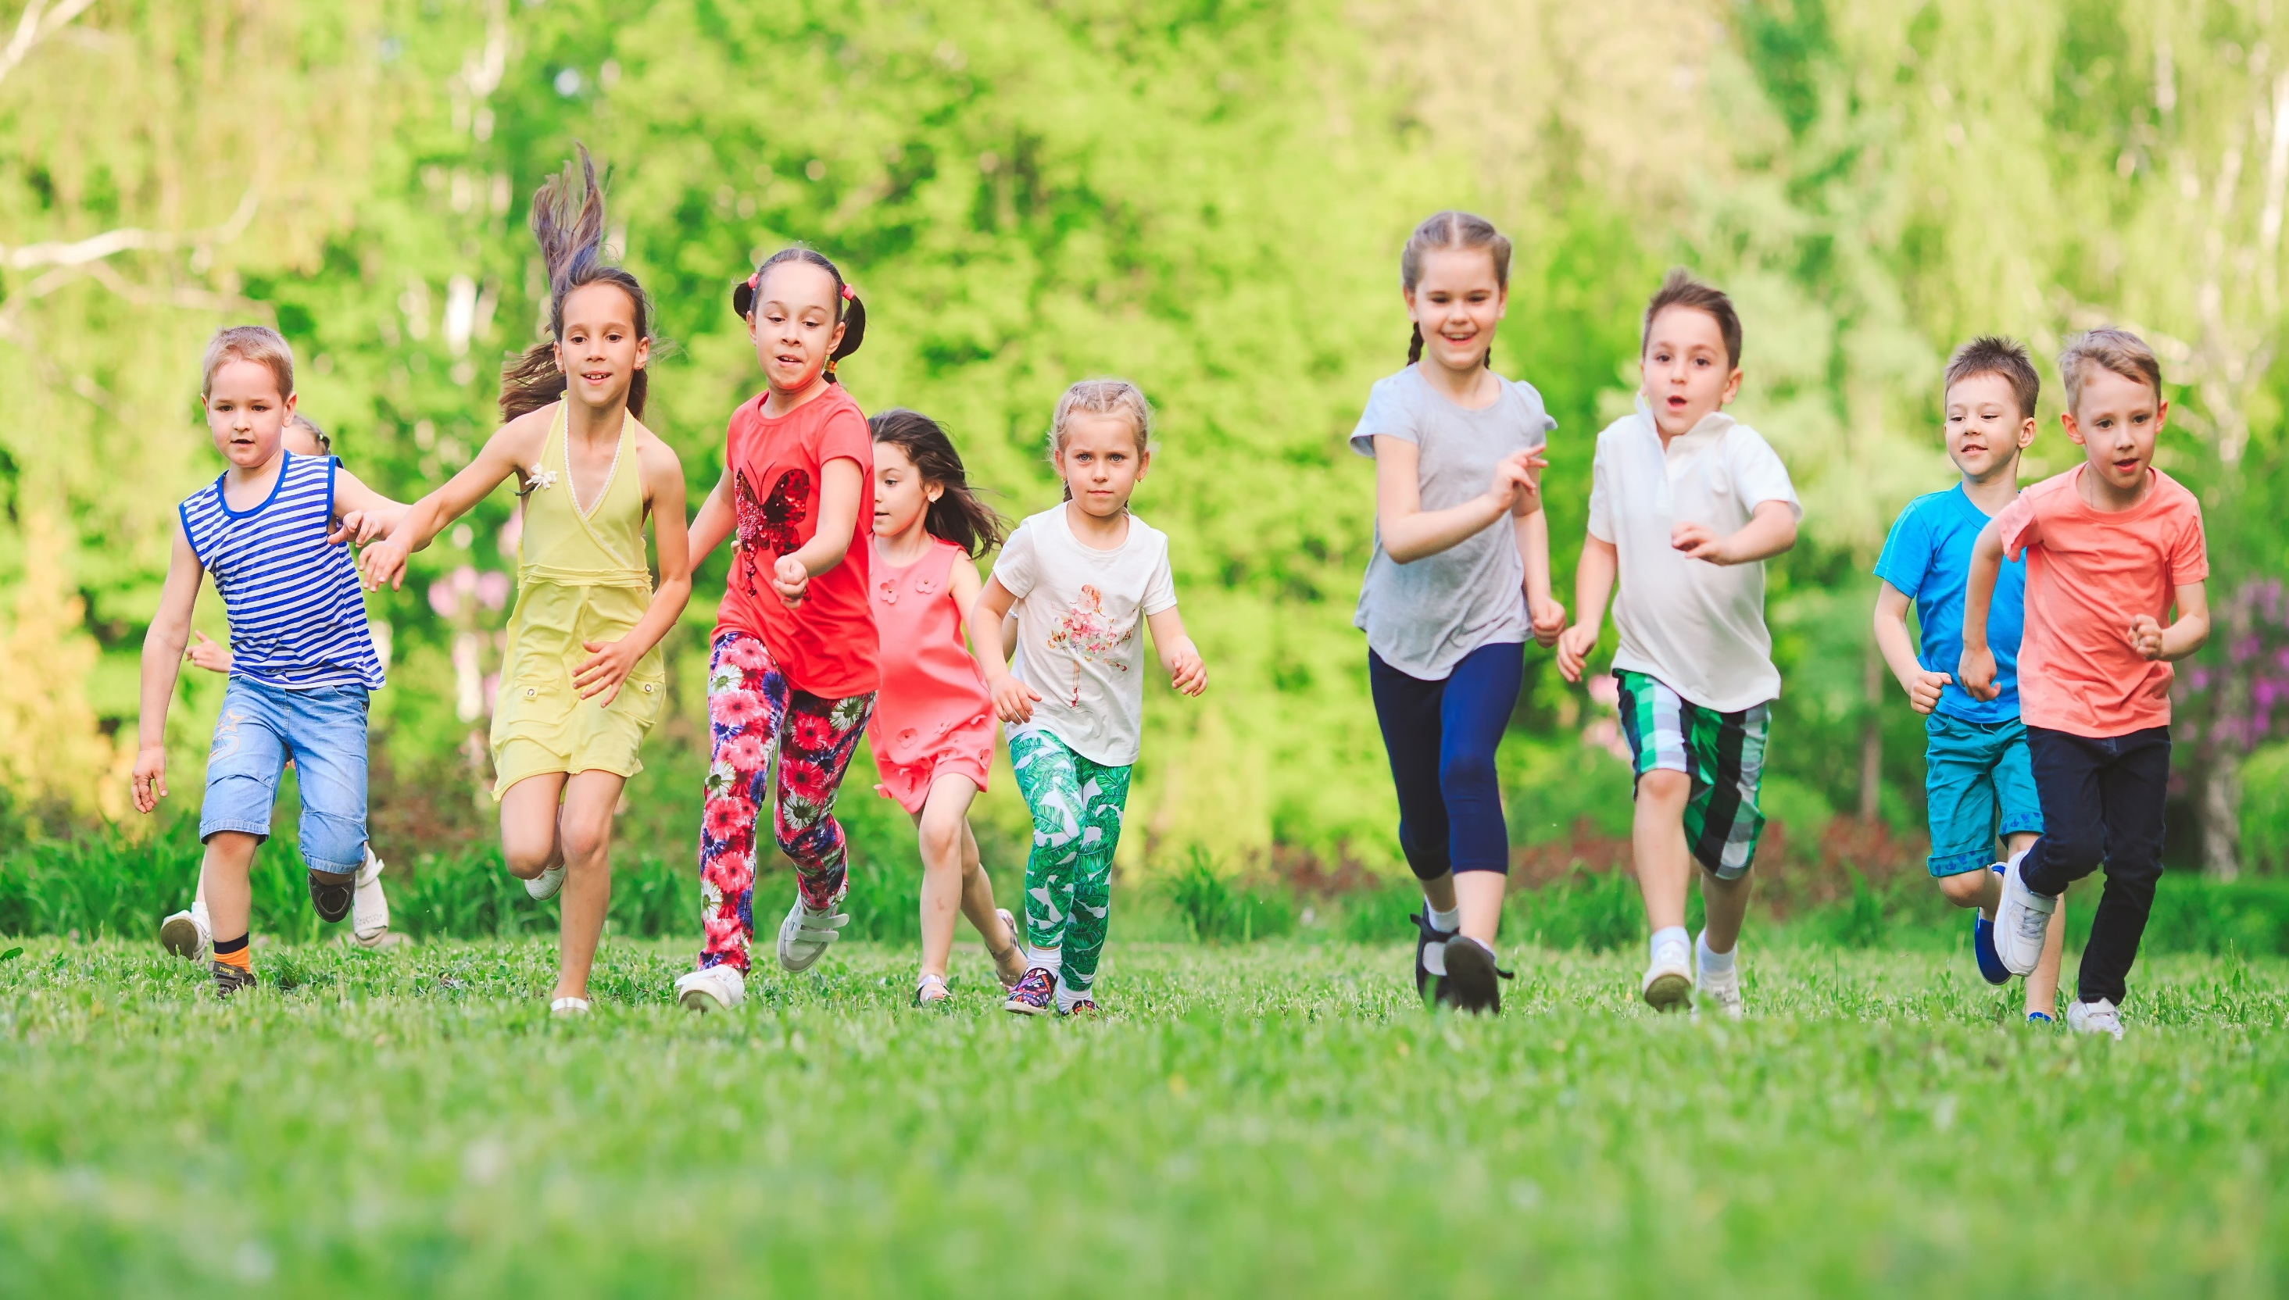
Have a nice day!

