Slide 1
UNIT 4: DISASTERS
Lesson 1.1 – Vocab & Reading
Pages 34 & 35

Slide 2
Lesson Outline
Warm-up
Vocabulary
Reading
Consolidation
Wrap-up

Slide 3
By the end of this lesson, students will be able to…
learn and use vocabulary related to disasters
practice reading for gist, reading to recognize correct/incorrect/not given information

Slide 4
NEW WORDS
typhoon
blizzard
drought
wildfire
flood
avalanche
landslide
tsunami
earthquake
heat wave

Slide 5
WARM UP

Slide 6
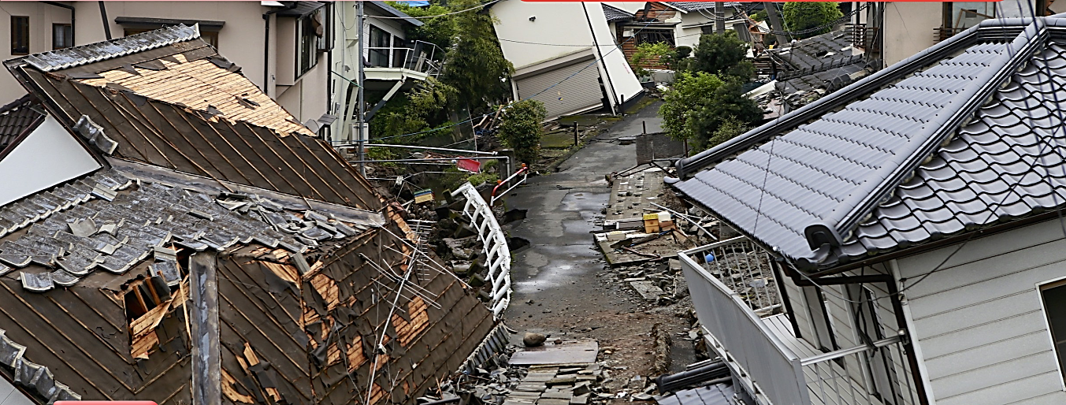

Slide 7
New Words

Slide 8
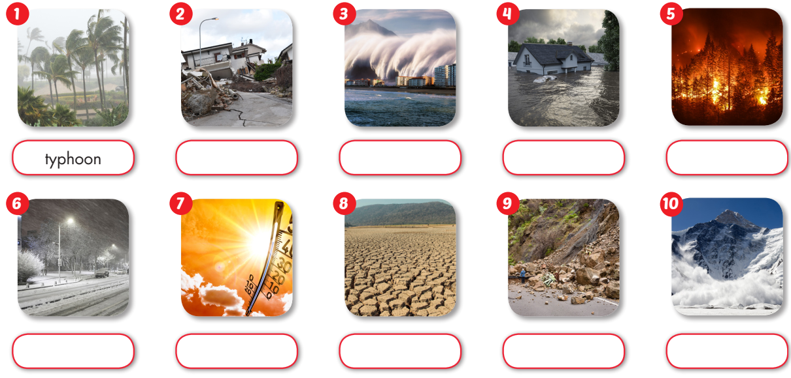

earthquake
tsunami
flood
wildfire
blizzard
heat wave
drought
landslide
avalanche

Slide 9
Listen and repeat. Practice saying these words.
typhoon (n) /taɪˈfuːn/ bão nhiệt đới
blizzard (n) /ˈblɪzərd/ trận bão tuyết
drought (n) /draʊt/ hạn hán
wildfire (n) /ˈwaɪldfaɪər/ cháy rừng
flood (n) /flʌd/ lũ lụt
avalanche (n) /ˈævəlæntʃ/ tuyết lở
landslide (n) /ˈlændslaɪd/ sạt lở đất
tsunami (n) /tsuːˈnɑːmi/ sóng thần
earthquake (n) /ˈɜːrθkweɪk/ động đất
heat wave (n) /ˈhiːt weɪv/ đợt nắng nóng

Slide 10
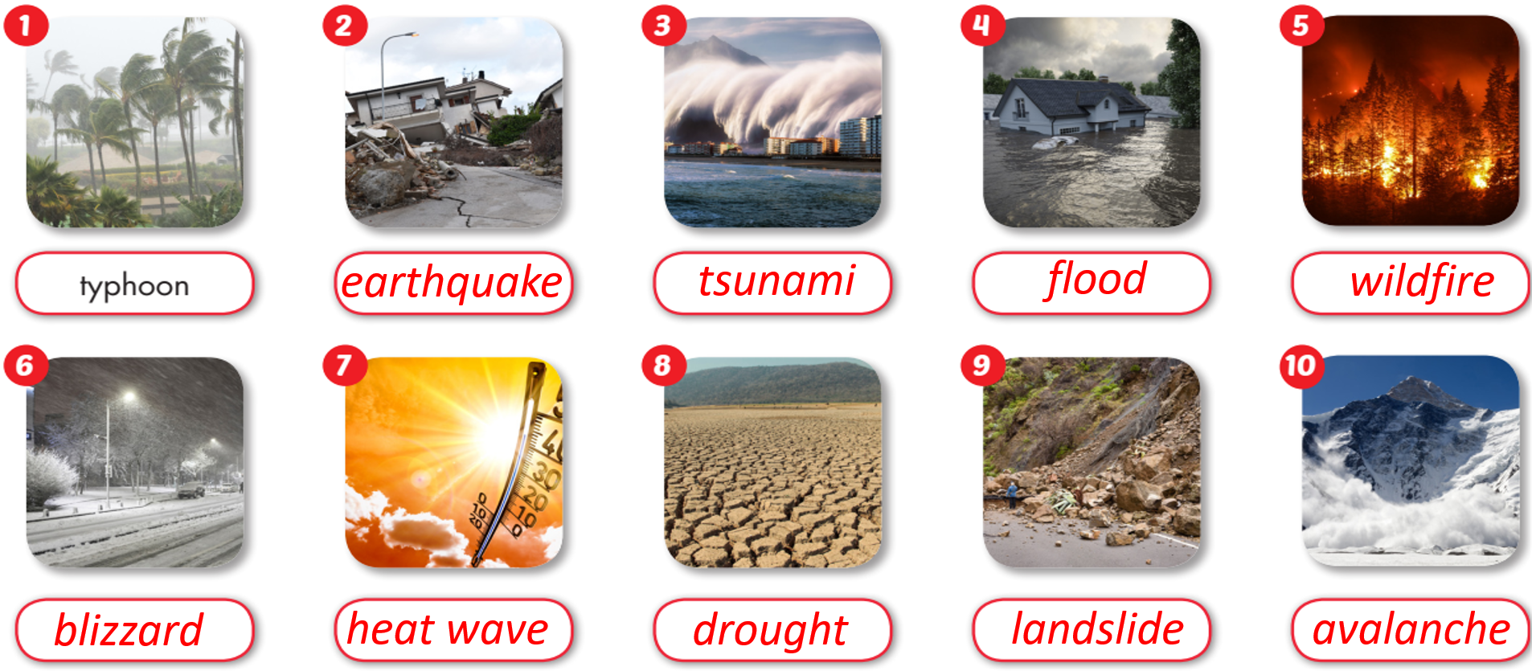

Slide 11
WILDFIRE_
EARTHQUAKE
Extra Practice
WB, page 20
TSUNAMI
FLOOD
TYPHOON
LANDSLIDE
AVALANCHE
BLIZZARD
HEAT WAVE
DROUGHT

Slide 12
Reading

Slide 13
Pre - reading
Read the instruction quickly. Underline the key words.
What are we going to do?
Read and choose the topic that is NOT mentioned.

Slide 14
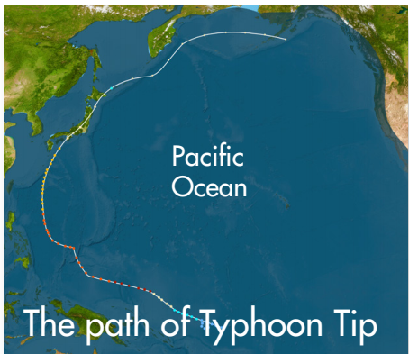
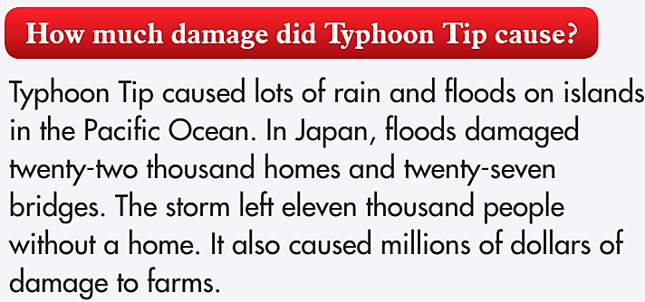


Slide 15
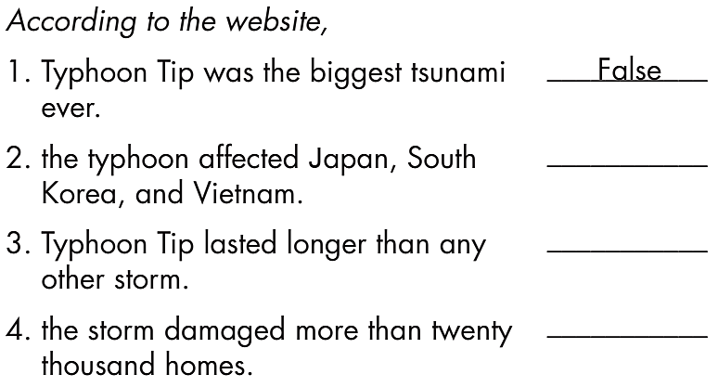
While - reading
It was the biggest typhoon, not the biggest tsunami.

Slide 16
While - reading
False

Slide 17
While - reading
False
Doesn’t say

Slide 18
While - reading
False
Doesn’t say
True

Slide 19
Post - reading

Slide 20
Extra Practice
How much can you remember about Typhoon Tip?
Close your book.
Work in pairs. Test your partner about Typhoon Tip.
Where was Typhoon Tip?
When was Typhoon Tip?
How much damage did Typhoon Tip cause?
How many people died in Typhoon Tip?

Slide 21
CONSOLIDATION

Slide 22
Complete the sentences with words about disasters in today’s lesson:
In the summer, temperatures can rise very high, causing a __________.
When a powerful tropical storm hits land, it is called a __________.
A sudden and violent shaking of the ground is known as an __________.
Heavy snowfall and strong winds can cause a __________.
A long period of dry weather can lead to a __________.
A massive ocean wave caused by an earthquake or volcanic eruption is called a _____.
A large amount of water overflowing onto normally dry land is known as a _______.
A large mass of snow, ice, and rock sliding down a mountain is called an _______.
A fire that spreads quickly through a forest or grassland is known as a _______.
When the ground becomes unstable and suddenly moves downhill, it is called a _____.
heat wave
typhoon
Extra Practice
earthquake
blizzard
drought
tsunami
flood
avalanche
wildfire
landslide

Slide 23
WRAP-UP

Slide 24
typhoon
blizzard
drought
wildfire
flood
avalanche
landslide tsunami
earthquake heat wave
Today’s lesson
Vocabularies

Slide 25
Today’s lesson
Vocabulary: - to learn and use vocabulary related to disasters
Reading: - to practice reading for gist, reading to recognize correct/incorrect/not given information

Slide 26
Homework
Learn by hearts vocabularies and make sentences using them.
Do the exercises on page 20 WB.
Do the exercises in Tiếng Anh 8 i-Learn Smart World Notebook on pages 28 & 29.
Prepare the next lesson (pages 35 & 36, SB)
Play the consolidation games on www.eduhome.com.vn

Slide 27
Lesson 3
Stay positive and have a nice day!

