Slide 1
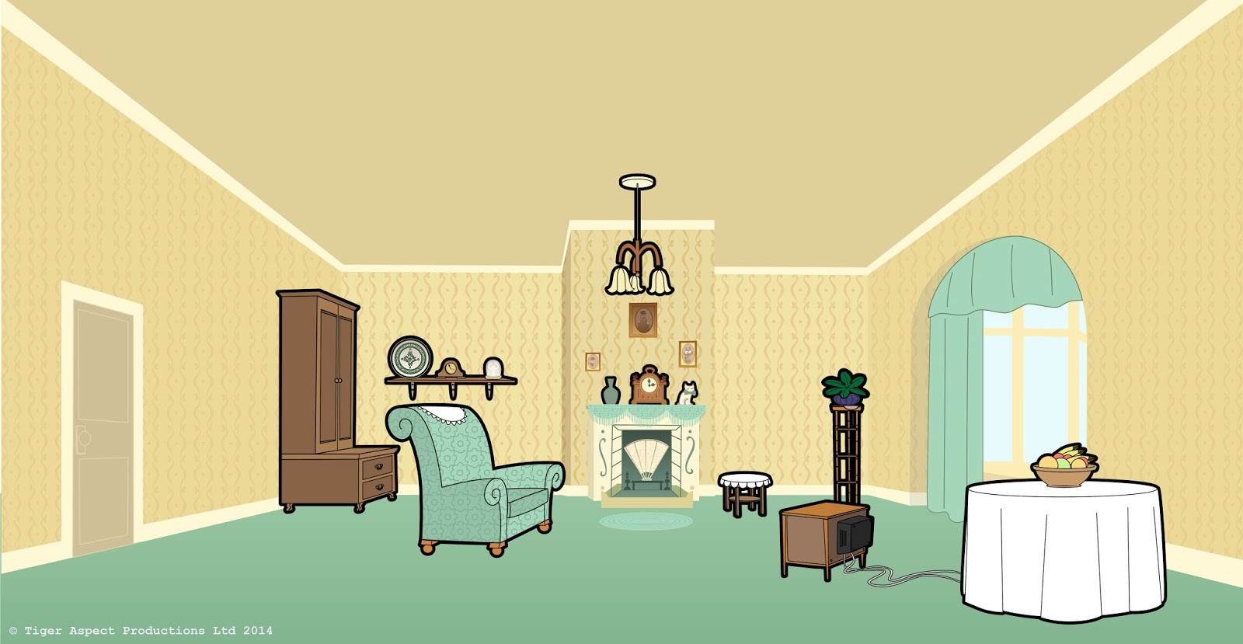
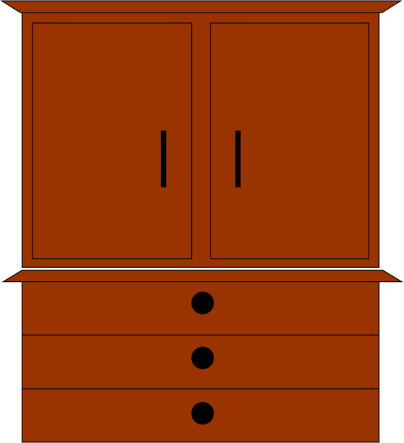
In the living room
FURNITURE & PREPOSITIONS OF PLACE

Slide 2
In the living room
a) Next to the bookcase
Listen, repeat and match the word with the right picture.
Where is the ARMCHAIR?
b) Near the window
c) Beside the fireplace

Slide 3
In the living room
a) On the wall
Listen, repeat and match the word with the right picture.
Where is the
FAMILY PHOTO?
b) On the table
c) On the shelf

Slide 4
In the living room
a) On the floor, under the wall clock
Listen, repeat and match the word with the right picture.
Where is the
POT PLANT?
b) On the floor, next to the sofa
c) On the floor, in front of the table

Slide 5
In the living room
a) On the right of the room
Listen, repeat and match the word with the right picture.
Where is the
RUG?
b) In the middle of the room
c) On the left of the room

Slide 6
In the living room
a) Behind the sofa
Listen, repeat and match the word with the right picture.
Where is the
BOOKCASE?
b) Next to the door
c) Near the chair

Slide 7
In the living room
a) In the coffee table
Listen, repeat and match the word with the right picture.
Where is the
READING LAMP?
b) Over the coffee table
c) On the coffee table

Slide 8
In the living room
a) Between the chair and the cupboard
Listen, repeat and match the word with the right picture.
Where is the
FIREPLACE?
b) Between the bookcase and the shelf
c) Between the sofa and the window

Slide 9
In the living room
a) Under the pot plant
Listen, repeat and match the word with the right picture.
Where is the
WALL CLOCK?
b) Over the pot plant
c) On the pot plant

Slide 10
In the living room
a) On the armchair
Listen, repeat and match the word with the right picture.
Where is the
CUSHION?
b) On the chair
c) On the sofa

Slide 11
In the living room
a) Next to the fireplace
Listen, repeat and match the word with the right picture.
Where is the
PAINTING?
b) Near the chair
c) Over the TV set

Slide 12
In the living room
a) Beside the sofa
Listen, repeat and match the word with the right picture.
Where is the
COFFEE TABLE?
b) Under the rug
c) In front of the armchair

Slide 13
In the living room
a) Over the chair
Listen, repeat and match the word with the right picture.
Where is the
SHELF?
b) Next to the cupboard
c) Near the TV set

Slide 14
In the living room
a) Behind the window
Listen, repeat and match the word with the right picture.
Where is the
SOFA?
b) Opposite the TV set
c) On the right side

Slide 15
In the living room
a) Opposite the TV set
Listen, repeat and match the word with the right picture.
Where is the
CHAIR?
b) In front of the TV set
c) Next to the TV set

Slide 16
In the living room
a) On the right of the room
Listen, repeat and match the word with the right picture.
Where is the
CUPBOARD?
b) Near the door
c) In front of the armchair

Slide 17
In the living room
a) On the left of the sofa
Listen, repeat and match the word with the right picture.
Where is the
TV SET?
b) On the right of the sofa
c) In front of the sofa

Slide 18
SƯU TẦM: ĐOÀN VĂN DOANH, NAM TRỰC, NAM ĐỊNH
LINK NHÓM DÀNH CHO GV BỘ MÔN VẬT LÝ TRAO ĐỔI TÀI LIỆU VÀ CHUYÊN MÔN CT 2018
https://www.facebook.com/groups/299257004355186

