Slide 1

Unit 4: HOME
Lesson 4.2
Page 62

Slide 2
Lesson Outline
Warm-up
Reading
Listening
Consolidation
Wrap-up

Slide 3
Objectives
By the end of this lesson, students will be able to talk about their homes and ask and answer about what in their house is.
Vocabulary: houseboat, canal.
Structure: Who do you live with? - I live with my mother.
What’s your home like? - It’s great.
What’s it like? - It’s orange.

Slide 4

WARM UP

Slide 5

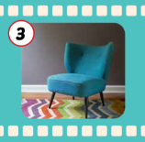
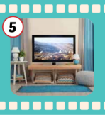
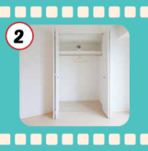
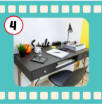
Matching.
1. bed
Cái ghế
2. closet
Cái bàn
3. chair
Cái ti-vi
4. desk
Cái tủ quần áo
Cái giường
5. TV
Notes:
Hoặc cháu cho thành bài làm mờ để học sinh đoán từ (giống bài của cái đứa mà anh Riêu gửi cho mình tham khảo đầu tiên ấy)

Slide 6


Make up sentences.
My bedroom has ______.

Slide 7
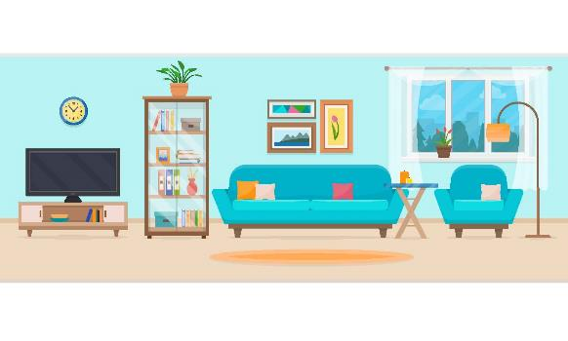
Make up sentences.
My living room has ______.

Slide 8

It’s time to learn …

Slide 9

Reading

Slide 10

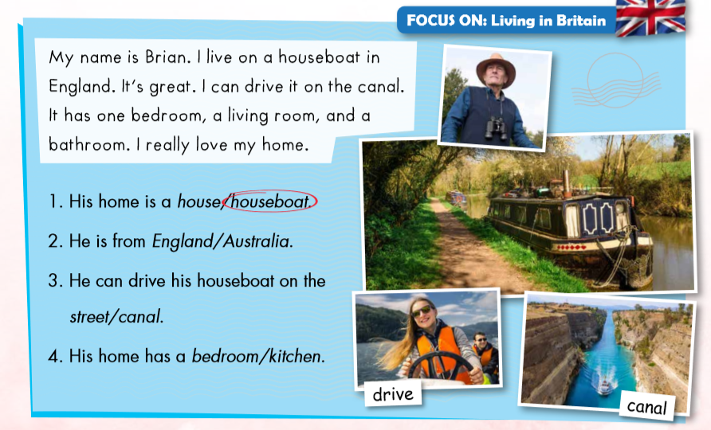

Slide 15

Listening

Slide 16

Alex: Where do you live, Mia?
Mia: I live on (1)_Red_ Street in London.
Alex: Cool. Who do you live with?
Mia: I live with my mother, father, and two (2)______ .
brothers
Notes:
Brothers cho chữ hiện ra

Slide 17

Listening
Writing

Slide 18

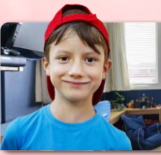

Where do you live, Mia?
I live on street in London.
Red
Cool.
Who do you live with?
I live with my mother, father, and two
brothers.
Notes:
brothers

Slide 19
What’s your home like, Alex?
It’s great. I love my bedroom.
What’s it like?
orange.
It’s
It has a closet, a and a TV.
desk
Wow.
That sounds nice.
Notes:
Orange desk

Slide 20

Alex: Where do you live, Mia?
Mia: I live on Red Street in London.
Alex: Cool. Who do you live with?
Mia: I live with my mother, father, and two brothers.

Slide 21
Alex: Where do you live, Mia?
Mia: I live on Red Street in London.
Alex: Cool. Who do you live with?
Mia: I live with my mother, father, and two brothers.

Slide 22
Mia: What’s your home like, Alex?
Alex: It’s great. I hope my bedroom.
Mia: What’s it like?
Alex: It’s orange. It has a closet, a desk, and a TV in it.
Mia: Wow. That sounds nice.
Notes:
Orange desk

Slide 23
Mia: What’s your home like, Alex?
Alex: It’s great. I hope my bedroom.
Mia: What’s it like?
Alex: It’s orange. It has a closet, a desk, and a TV in it.
Mia: Wow. That sounds nice.
Notes:
Orange desk

Slide 24

Workbook
p. 45

Slide 25

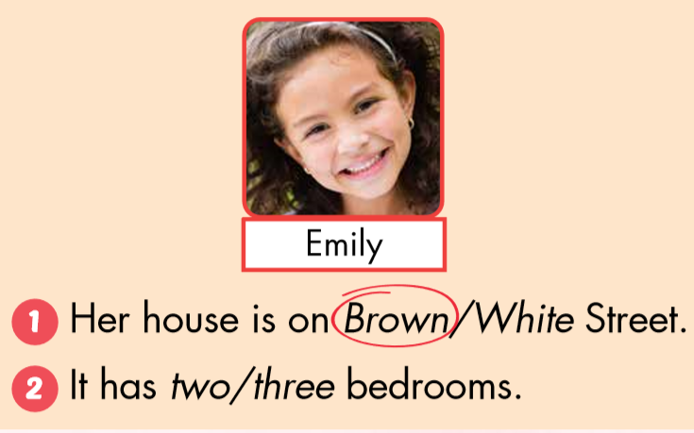

Slide 26
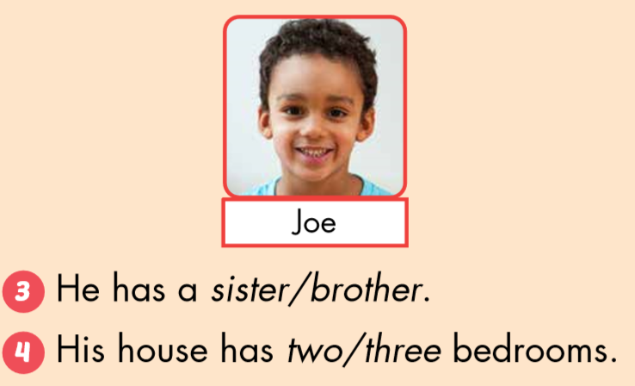

Slide 27

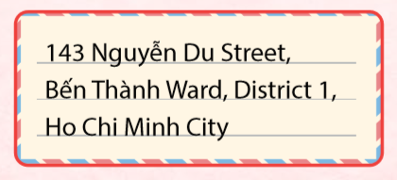


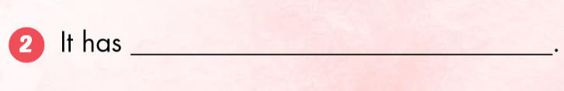
Nguyễn Du Street.
a sofa, a TV.

Slide 28
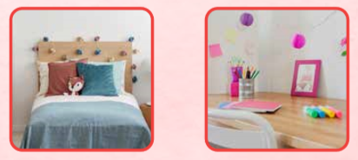
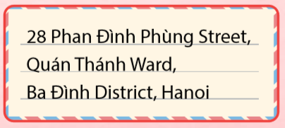
has a bedroom.
Ba Đình District, Hanoi.

Slide 29

CONSOLIDATION

Slide 30
56 Minh Cầu Street, Hoàng Văn Thụ Ward, Thái Nguyên City
I live on Minh Cầu Street
in Thái Nguyên.

Slide 31
125 Lương Ngọc Quyến Street, Bắc Ninh
I live on Lương Ngọc Quyến Street
in Bắc Ninh.

Slide 32
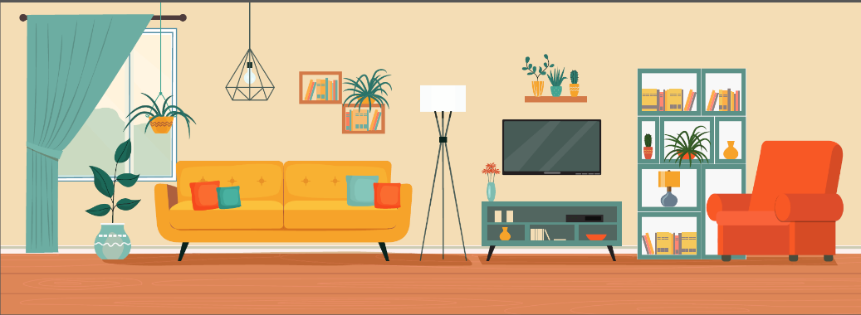
My house has a living room.
It has a sofa and a TV.
It has a picture and a TV.

Slide 33

WRAP-UP

Slide 34
Lesson 3
Today’s lesson
Structures/ Sentence patterns
Where do you live, Mia?
I live on Red Street in London.
His home has a bedroom.

Slide 35
Homework
Review the vocabularies and sentence patterns. Make sentences using them.
Do the exercises on page 45 (WB)
Prepare the next lesson (page 63 SB)
Play the consolidation games in Tiếng Anh 3 i-Learn Smart Start DHA App on www.eduhome.com.vn
Do the exercise the Tiếng Anh 3 i-Learn Smart Start Notebook (page 31)

Slide 36
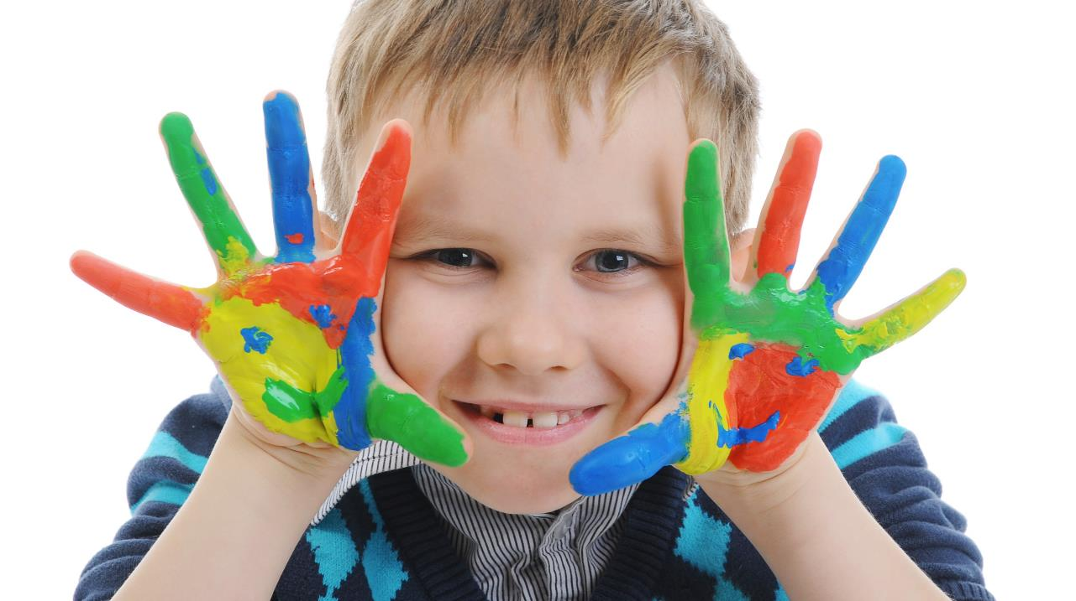
Enjoy your day!

Slide 37

Have a nice day!

