Slide 1
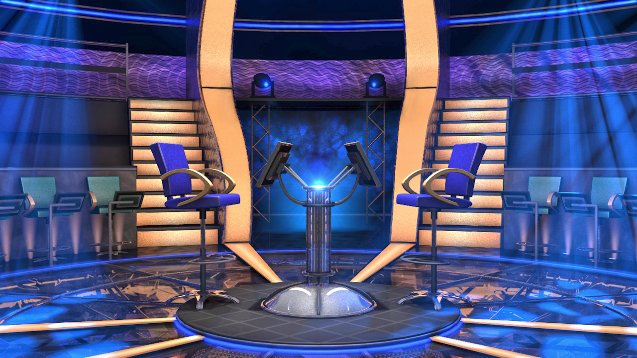
Question BGM
Em trai của bố ta gọi bằng gì?
Q Select
$1,000,000
Q Right
$500,000
$250,000
CLOSE
Q Wrong
$100,000
$50,000
00
$25,000
START
TIMER
$16,000
$8,000
IS THAT YOUR FINAL ANSWER?
END
$200
$2,000
YES
NO
$1,000
Cậu
Dượng
$500
A
B
$300
1
2
$200
Bác
chú
$100
C
D
50/50
CORRECT ANSWER
END
CONTINUE
Bắt đầu

