Slide 1

Unit 8: Food
Lesson 4.1
Page 119

Slide 2
Lesson Outline
Warm-up
Vocabulary
Structure
Consolidation
Wrap-up

Slide 3
Objectives
By the end of this lesson, students will be able to…
Vocabulary: learn and practice knife, spoon, chopsticks, fork, noodles
Structure: learn and practice
We eat ____with a ____.
We often eat ____.
My favorite food is ____.

Slide 4

WARM UP

Slide 5
Vocabulary
How to play?
- T will call out the words
- Cross off ONE square that has the word
- If you get the pattern, say BINGGO, you win!
BINGGO

Slide 6
Word list to choose
apple banana carrot some
cupcake donut onion any
tomato potato lime like
egg fries pizza please
cake chicken ice cream fish

Slide 7

Fill in this BINGO card with vocabulary from the list in slide 6

Slide 8
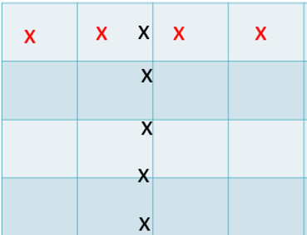
Any Straight Line Pattern like this

Slide 9

It’s time to learn …

Slide 10
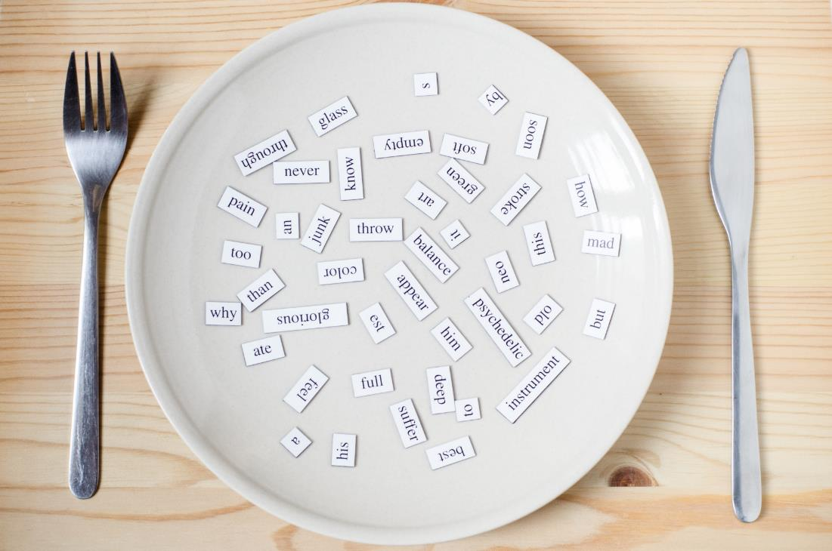
New words
knife
fork
spoon
chopsticks
noodles

Slide 11

Presentation

Slide 12



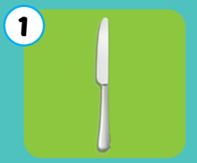
Giấu các icon audio
Click each picture to hear the sound.
knife
/naɪf/
Con dao

Slide 13
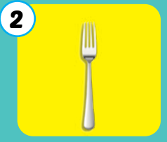
Giấu các icon audio
Click each picture to hear the sound.
fork
/fɔːrk/
Cái nĩa

Slide 14
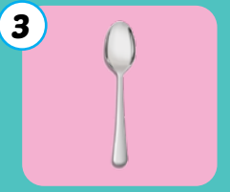
Giấu các icon audio
Click each picture to hear the sound.
spoon
/spuːn/
Cái thìa

Slide 15
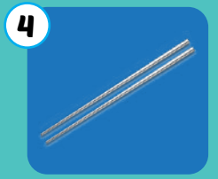
Giấu các icon audio
Click each picture to hear the sound.
chopsticks
/ˈtʃɑːpstɪks/
Đôi đũa

Slide 16
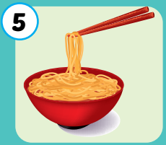
Giấu các icon audio
Click each picture to hear the sound.
noodles
/ˈnuːdlz/
mì, bún, phở

Slide 17
Giấu các icon audio
Click each picture to hear the sound.
knife
fork
spoon
chopsticks
noodles
/naɪf/
Con dao
/fɔːrk/
Cái nĩa
/spuːn/
Cái thìa
/ˈtʃɑːpstɪks/
Đôi đũa
/ˈnuːdlz/
Mì,bún, phở

Slide 18

Practice

Slide 19
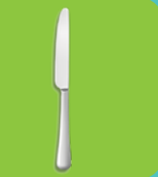

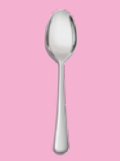
Sound here
Listen and choose the correct picture
Notes:
Click vào hình headphone để nghe âm thanh. click vào câu trả lời đúng để thấy hiệu ứng

Slide 20
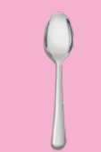
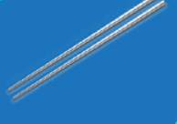
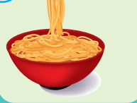
Listen and choose the correct picture

Slide 21


Listen and choose the correct picture

Slide 22



Listen and choose the correct picture

Slide 23
Listen and choose the correct picture

Slide 24
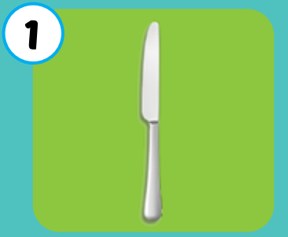
What is it?
folk
noodles
knife
chopsticks
spoon
Click the picture to see the answer

Slide 25
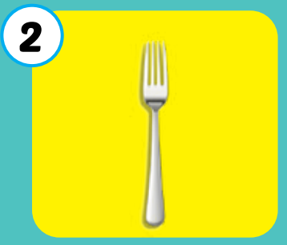
What is it?
folk
noodles
knife
chopsticks
spoon
Click the picture to see the answer

Slide 26
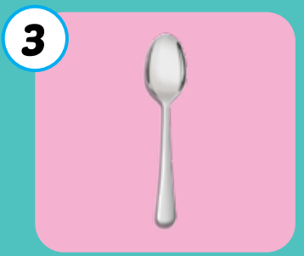
What is it?
folk
noodles
knife
chopsticks
spoon
Click the picture to see the answer

Slide 27
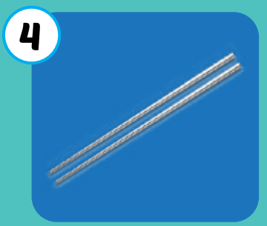
What is it?
folk
noodles
knife
chopsticks
spoon
Click the picture to see the answer

Slide 28
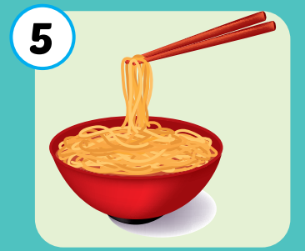
What is it?
folk
noodles
knife
chopsticks
spoon
Click the picture to see the answer

Slide 29
Listen and choose the correct answer
A. spoon
B. chopsticks
C. fork
D. noodles
Notes:
Click vào câu trả lời sai> sẽ bay đi mất
Câu trả lời đúng: có tiếng vỗ tay

Slide 30
Listen and choose the correct answer
A. spoon
C. chopsticks
B. fork
D. noodles

Slide 31
Listen and choose the correct answer
A. spoon
B. knife
C. fork
D. noodles

Slide 32
Listen and choose the correct answer
A. spoon
B. knife
C. fork
D. noodles
Notes:
Click on the picture to hear the sound
Click on incorrect answer-> disappear
Click on correct answer->applause sound

Slide 33
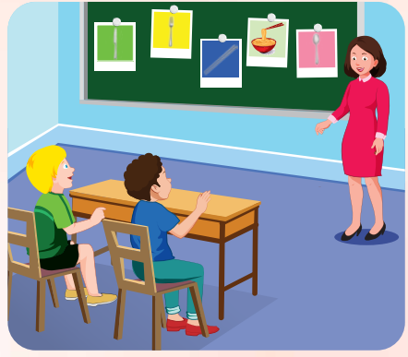

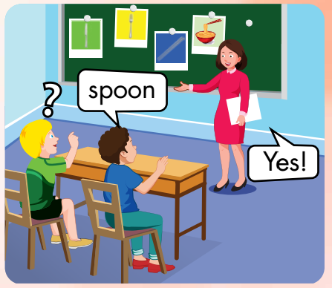

Slide 34
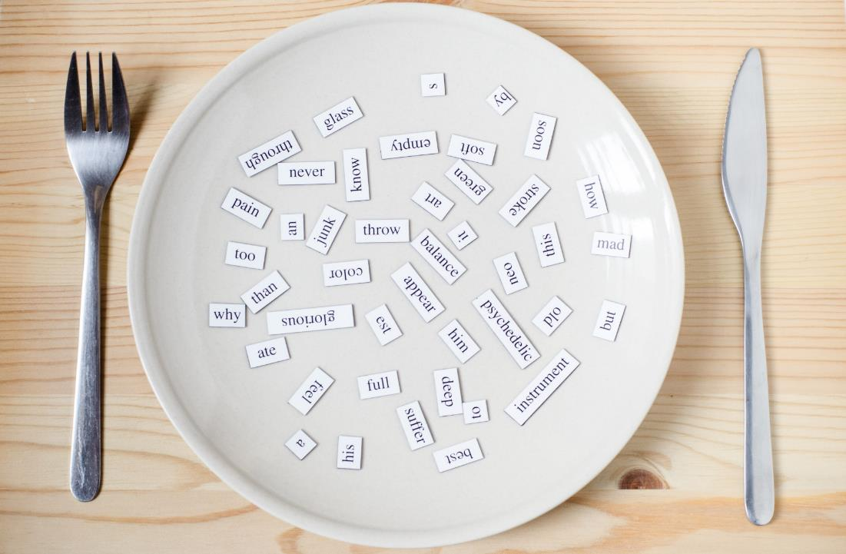
Structures
We eat __with a ____.
We often eat ____.
My favorite food is___.

Slide 35
Presentation

Slide 36
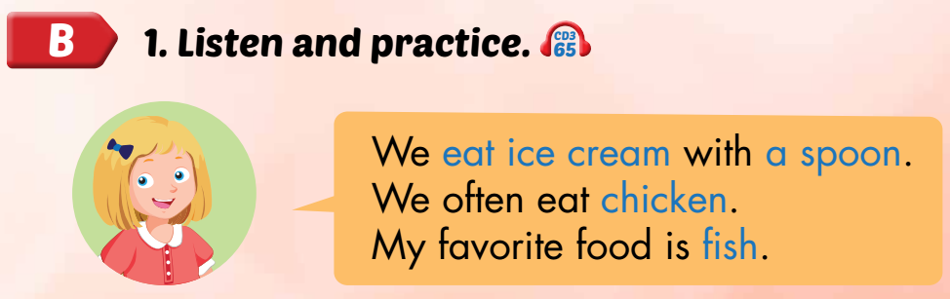
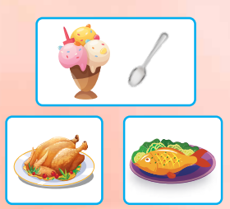

Slide 37
Practice

Slide 38

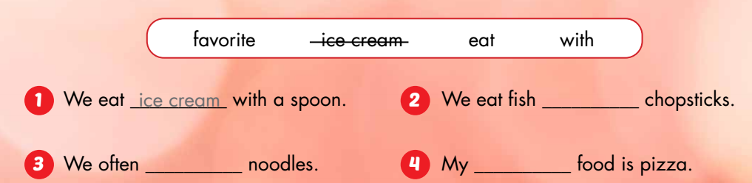
with
eat
favorite

Slide 39
Let’s talk about yourself
My favorite food is…….
I often eat…….
I eat…..with a spoon.
I eat……with chopsticks.
I eat ice cream with……
I eat noodles with……
What is your favorite food?
What do you often eat?
What do you eat with a spoon?
What do you eat with chopsticks?
What do you eat ice cream with?
What do you eat noodles with?

Slide 40

CONSOLIDATION

Slide 41

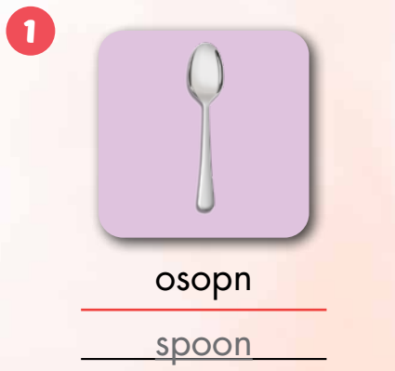
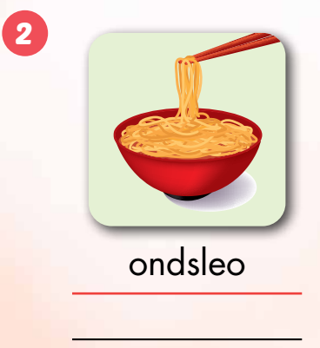
Extra Practice
WB, P. 88
noodles

Slide 42
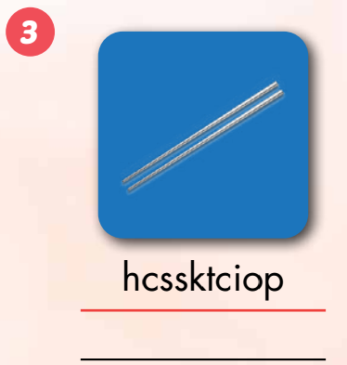
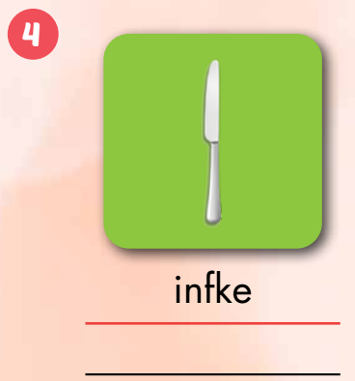
chopsticks
knife

Slide 43
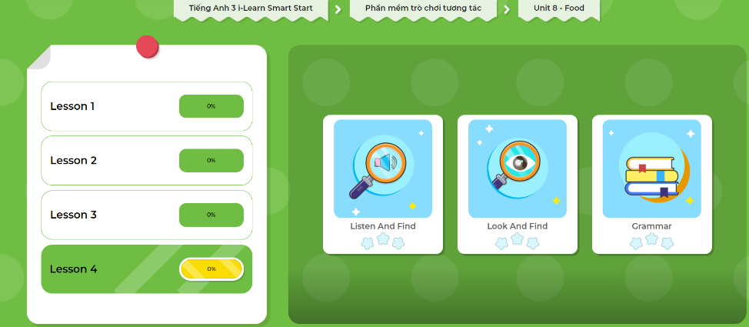
Extra Practice
DHA App
LET’S PLAY!
Click here to play the games

Slide 44

WRAP-UP

Slide 45
Lesson 3
Today’s lesson
Vocabularies
Spoon
Knife
Fork
Chopsticks
Noodles
Structures/ Sentence patterns
We eat __with a ____.
We often eat ____.
My favorite food is___.

Slide 46
Lesson 3
Homework
Practice the vocabularies and structure; and make sentences using them.
Do the exercises in Tiếng Anh 3 i-Learn Smart Start WB (page 84)
Prepare the next lesson (page 120 SB)
Play the consolidation games in Tiếng Anh 3 i-Learn Smart Start DHA App on www.eduhome.com.vn

Slide 47

Enjoy your day!

