Slide 2
REVIEW 3
LESSON II
SKILLS

Slide 3
LESSON II
SKILLS
WARM-UP
Video watching
Task 1: Listen and choose the factors.
Task 2: Listen and choose the correct answer.
LISTENING
Task 1: Match the threats with the solutions.
Task 2: Discussion
SPEAKING
Wrap-up
Homework
CONSOLIDATION

Slide 4
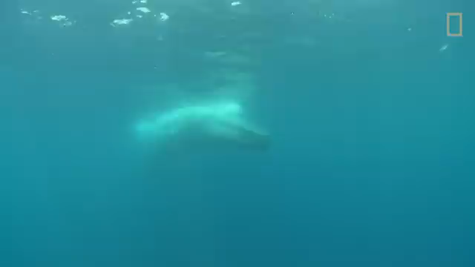
WARM-UP
Notes:
https://www.youtube.com/watch?v=bgiPTUy2RqI

Slide 5

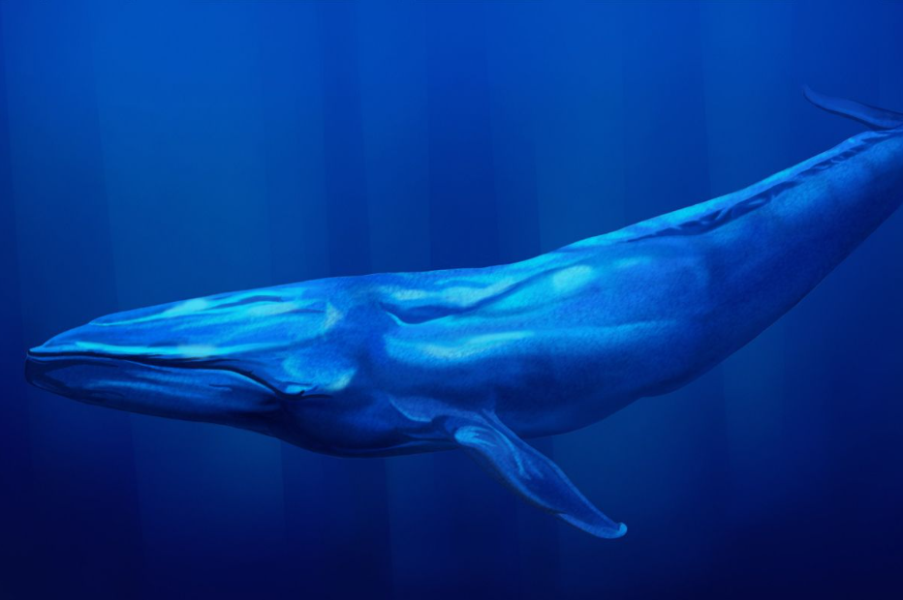
LISTENING
Listen and choose the factors that have affected the blue whale
population.
1
A. They were hunted for commercial purposes.
B. They are hit by large ships.
C. They are dangerous to humans.
D. They eat pieces of plastic.
E. They find it hard to find food in warming oceans.

Slide 6
LISTENING
2
Listen again and choose the correct answer A, B, or C.
1. How does Nam feel about the size of whales?
A. Impressed. B. Concerned. C. Annoyed.
2. Which of the following is NOT mentioned as the reason for the widespread whaling in the 1920s?
A. Advances in technology made whale hunting easier.
B. It became a profitable business.
C. It was impossible to build suitable habitats for blue whales.

Slide 7
LISTENING
2
Listen again and choose the correct answer A, B, or C.
3. According to the speaker, what is the current number of blue whales?
A. About 10,000.
B. No more than 25,000.
C. About 340,000.
4. Why are blue whales more likely to be hit by ships at night?
A. They can’t see or hear well at night.
B. There is more plastic pollution at night.
C. They are looking for food near the water surface at night

Slide 8
SPEAKING
1
Match the threats facing blue whales with the solutions.
Threats |  | Solutions
1. Hunting whales for commercial purposes |  | a. Changing shipping routes away from their habitats
2. Being hit by large ships |  | b. Imposing a total ban in all countries
3. Plastic pollution |  | c. Slowing global warming down
4. Climate change |  | d. Reducing plastic use

Slide 9
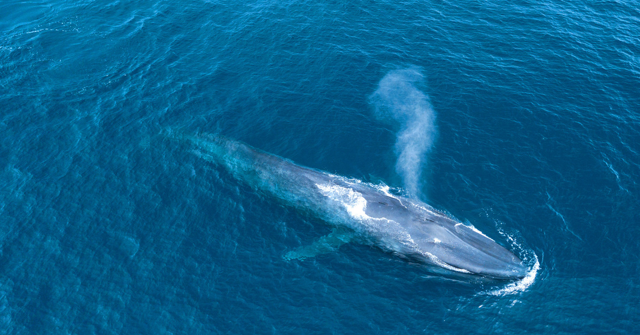
SPEAKING
2
Discussion.
Discuss each solution above and think about what each individual can do to help save the blue whales.

Slide 10
CONSOLIDATION
1
Wrap-up
What have you learnt today?
Revise skills: listening and speaking

Slide 11
CONSOLIDATION
2
Homework
Do exercises in the workbook.
Prepare for the next lesson.

Slide 12
Website: hoclieu.vn
Fanpage: facebook.com/www.tienganhglobalsuccess.vn

