Slide 1
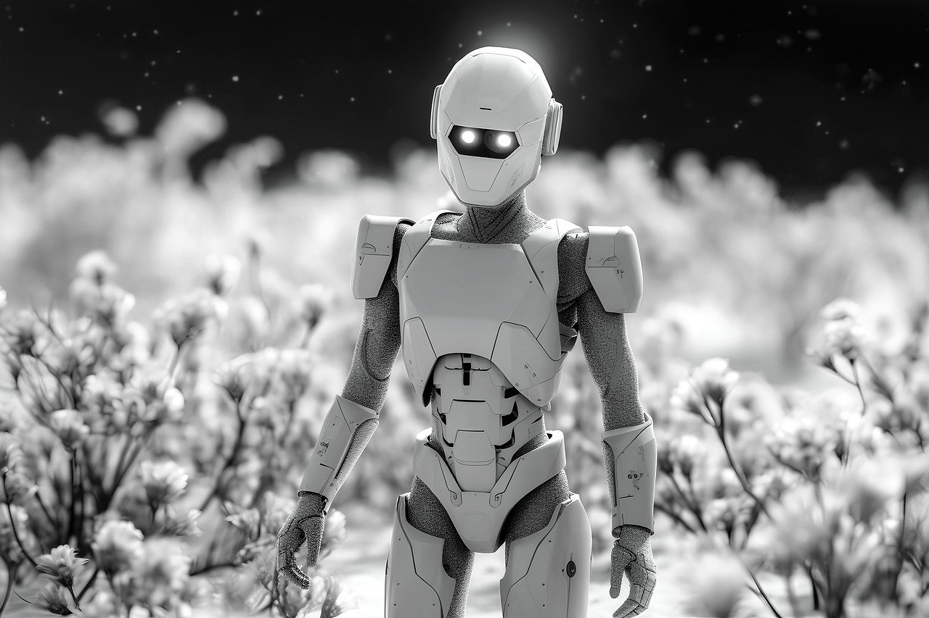


Slide 2
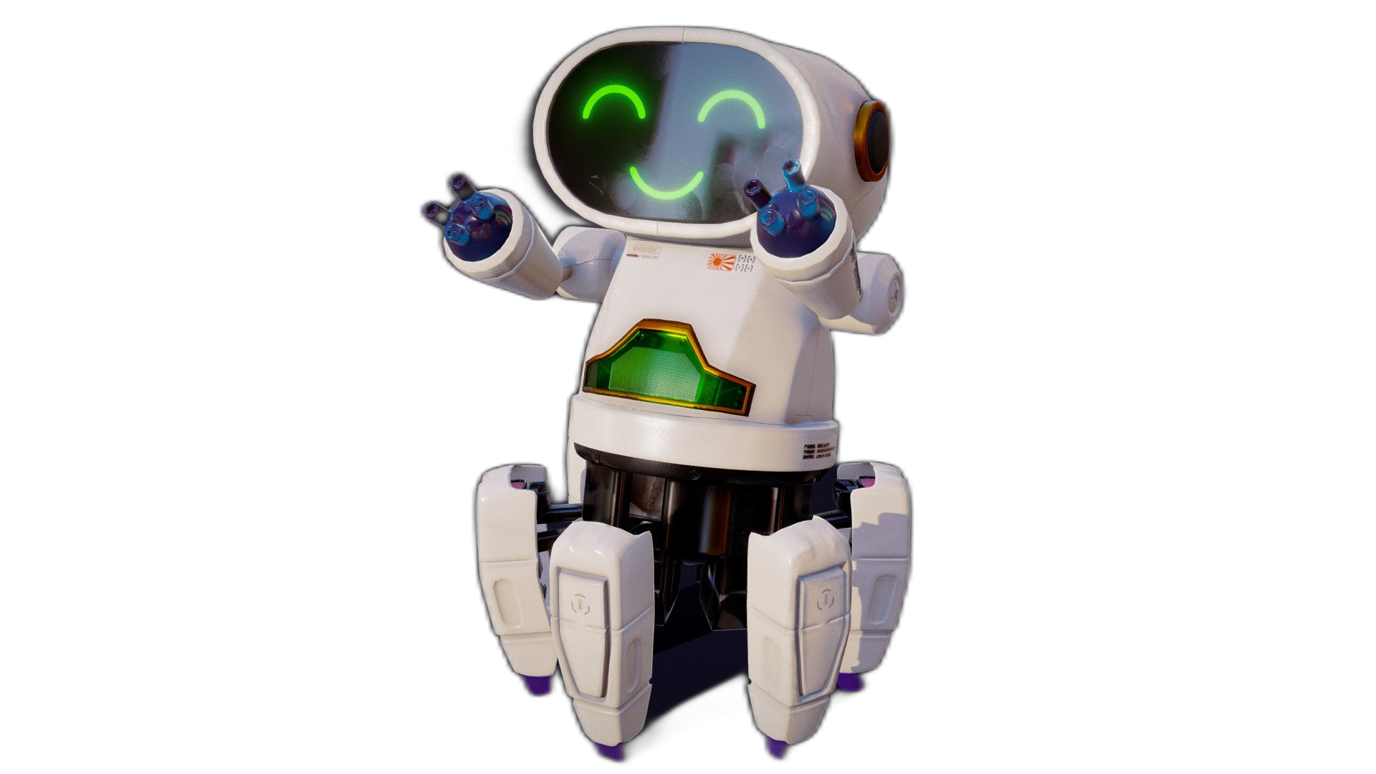


Unit
12
ROBOTS
LESSON 6: SKILLS 2

Slide 3


LESSON 5: SKILLS 1
LESSON 1: GETTING STARTED
Brainstorming
WARM-UP
Task 1: Listen to the conversation and tick the phrases you hear.
Task 2: Listen and tick True (T) or False (F).
LISTENING
Task 3: Imagine a robot you would like to have and make notes about it.
Task 4: Write a paragraph of 50-60 words about the robot you would like to have
WRITING
CONSOLIDATION
Wrap-up
Homework

Slide 4

WARM-UP
BRAINSTORMING

Slide 5
WARM-UP
Work in groups
Brainstorm all abilities that the robot can have.
The group having the most suitable answers is the winner.

Slide 6
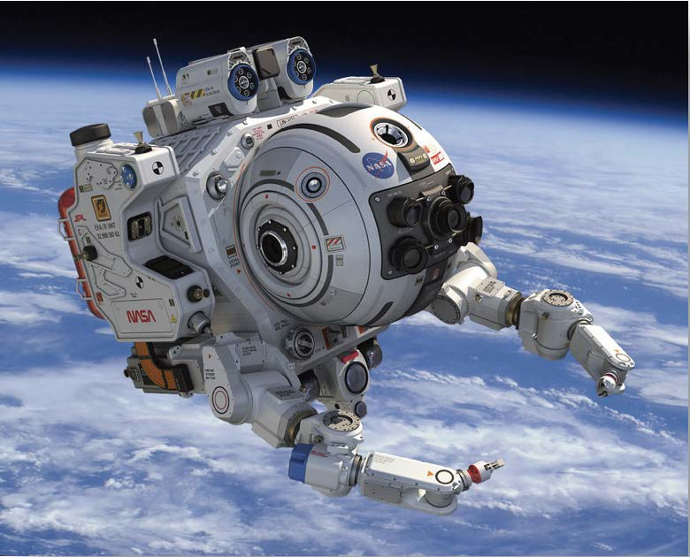
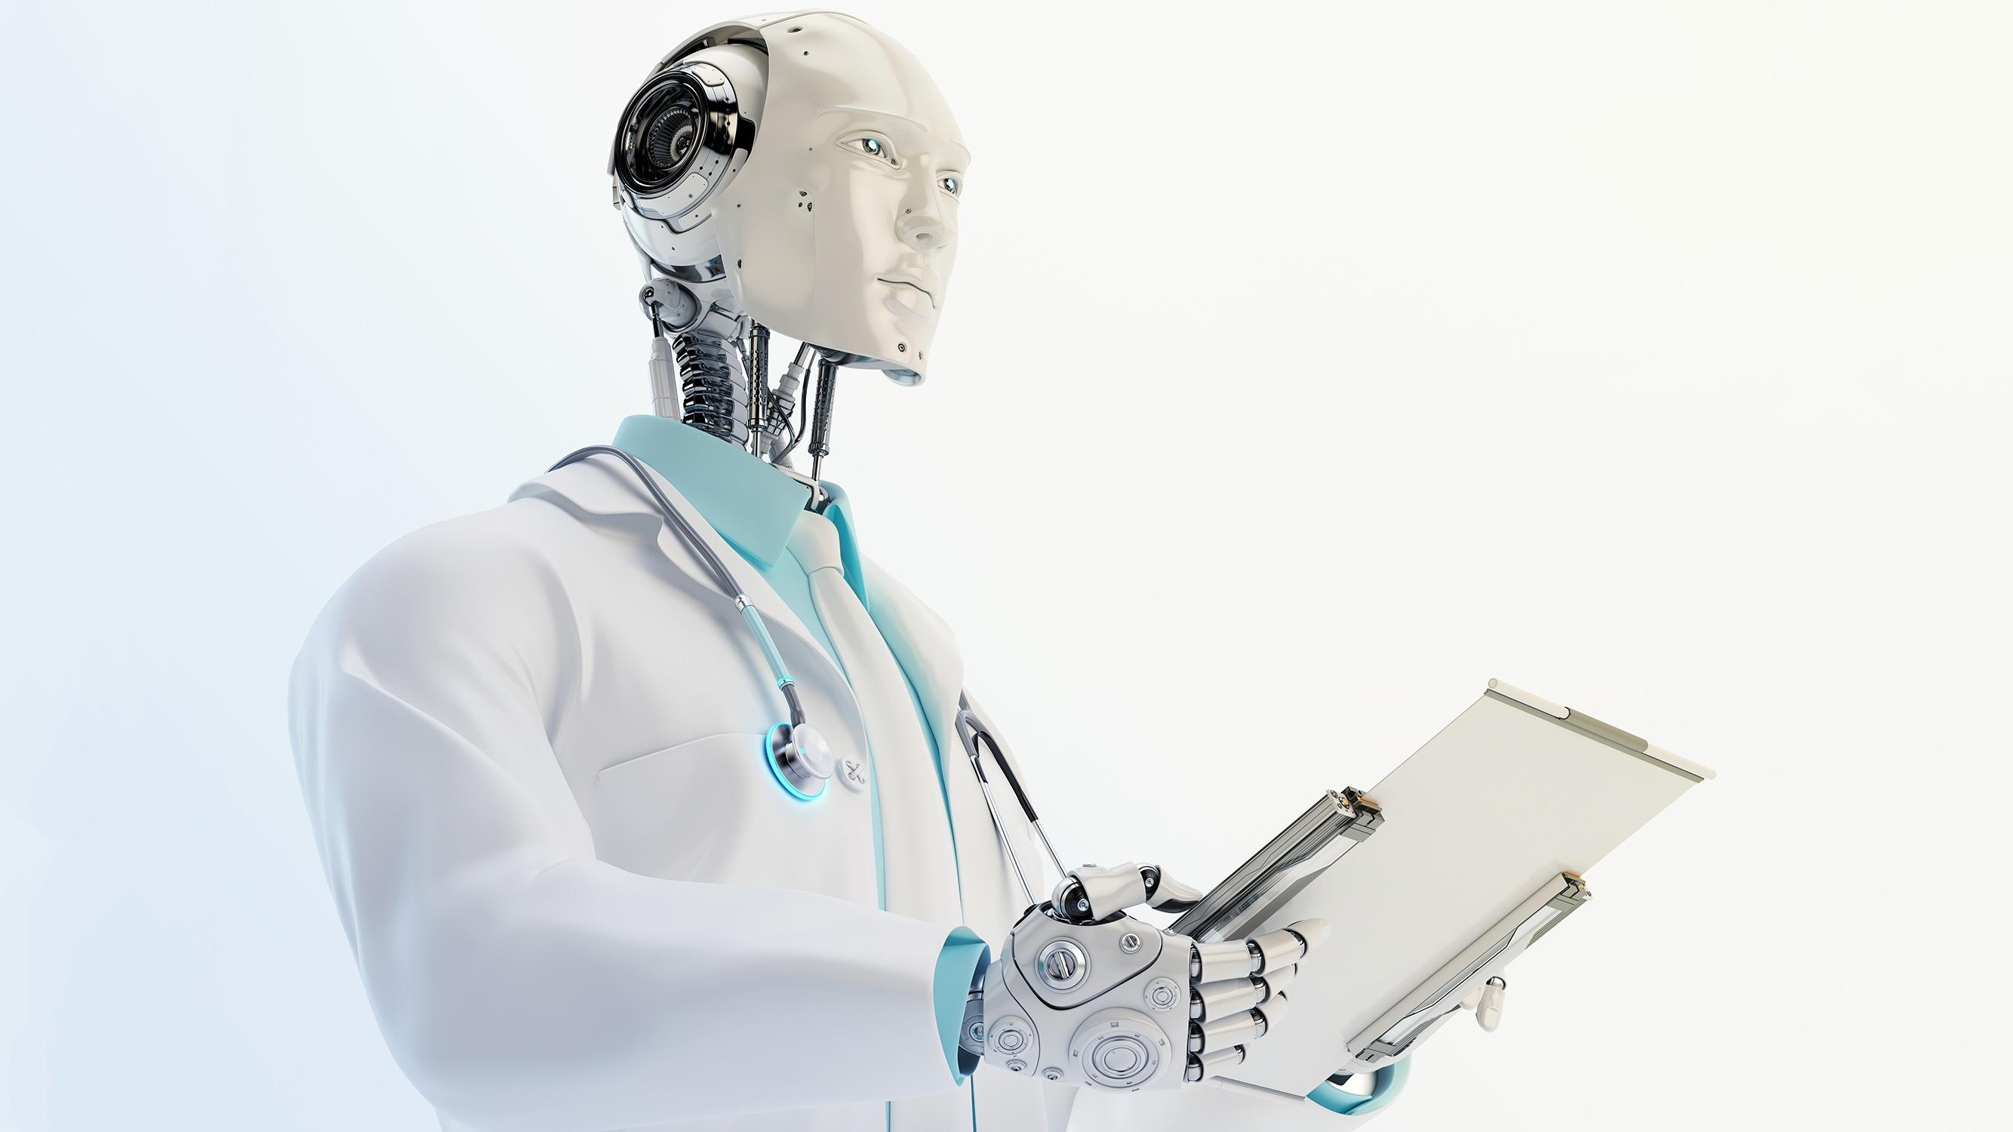
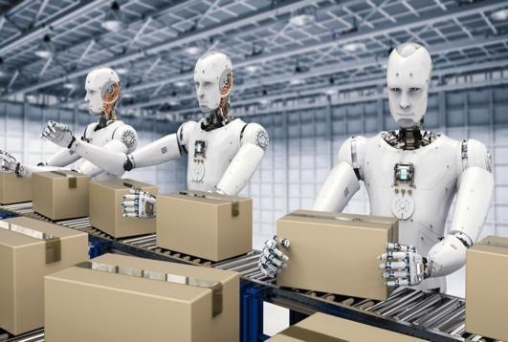
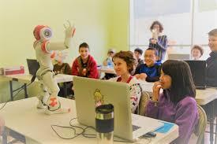
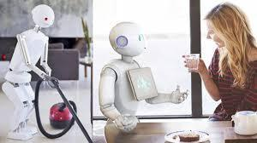
WARM-UP

Slide 7
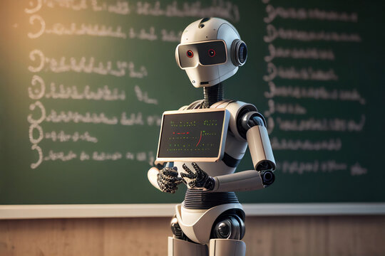
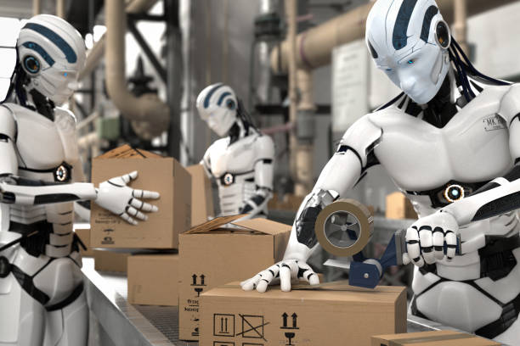
WARM-UP

Slide 8
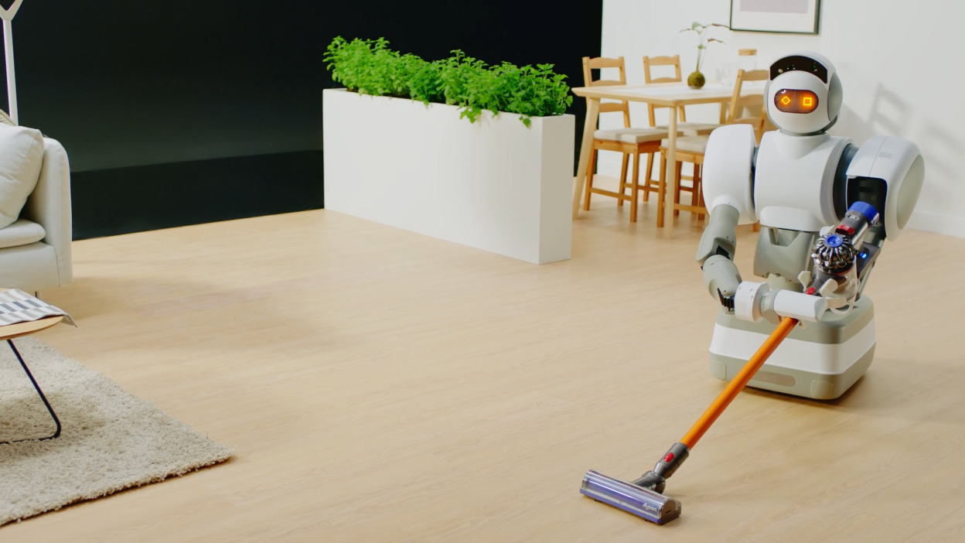
WARM-UP

Slide 9
LESSON 5: SKILLS 1
LESSON 1: GETTING STARTED
Brainstorming
WARM-UP
Task 1: Listen to the conversation and tick the phrases you hear.
Task 2: Listen and tick True (T) or False (F).
LISTENING

Slide 10



LISTENING
Listen to the conversation between Khang and Dr Adams and tick () the phrases you hear.
- look after sick people

- understand what we say

- build the very high buildings

- teach many subjects

- move heavy things
Audio script

Slide 11

AUDIO SCRIPT
Khang: Dr Adams, please tell me something about robots.
Dr Adams: Sure. Robots can do quite a lot today. Home robots can do housework. Doctor robots can look after sick people. And...
Khang: Can robots build houses?
Dr Adams: Yes. Worker robots can even build the very high buildings.
Khang: Can they teach?
Dr Adams: Yes. Teacher robots can teach many subjects in a classroom or online.
Khang: Can they understand what we say?
Dr Adams: Yes, they do. They can even speak to us.
Khang: Robots can do everything like humans?
Dr Adams: No, not everything. They can't understand our feelings or play football.

Slide 12

LISTENING
Listen and tick True or False
 | T | F
1. Robots can’t do many things today.
2. Worker robots can build the very high buildings.
3. Teacher robots can teach on the internet.




Slide 13
LISTENING
Listen and tick True or False
 | T | F
4. Robots can talk to humans.
5. Robots can do everything like humans.



Slide 14
LESSON 5: SKILLS 1
LESSON 1: GETTING STARTED
Brainstorming
WARM-UP
Task 1: Listen to the conversation and tick the phrases you hear.
Task 2: Listen and tick True (T) or False (F).
LISTENING
Task 3: Imagine a robot you would like to have and make notes about it.
Task 4: Write a paragraph of 50-60 words about the robot you would like to have
WRITING

Slide 15

WRITING
Imagine a robot you would like to have. Make notes about it.
-Make notes on a robot you want to design
1. Name of your robot | _______________________
2. Type of robot | _______________________
3. Where it can work | _______________________
4. What it can do for you | _______________________
- Don’t have to write full sentences

Slide 16

WRITING
Now write a paragraph of 50-60 words about the robot you would like to have. Use the information in 3 to help you.
- You will write a short paragraph about your robot.
- There are some structures you can use.

Slide 17
LISTENING
*Name:
My robot’s name is…
I would like to have a robot named…
I would name my robot …
*Type:
It is a …
*Where it can work:
It can work at…
… is an ideal place for it.
*What it can do:
My robot can…
My robot is able to…

Slide 18

WRITING
Now write a paragraph of 50-60 words about the robot you would like to have. Use the information in 3 to help you.
My robot’s name is ____________________.
It is a ________________________________. _____________________________________ _____________________________________ _____________________________________ _____________________________________

Slide 19
LESSON 5: SKILLS 1
LESSON 1: GETTING STARTED
Brainstorming
WARM-UP
Task 1: Listen to the conversation and tick the phrases you hear.
Task 2: Listen and tick True (T) or False (F).
LISTENING
Task 3: Imagine a robot you would like to have and make notes about it.
Task 4: Write a paragraph of 50-60 words about the robot you would like to have
WRITING
CONSOLIDATION
Wrap-up
Homework

Slide 20

CONSOLIDATION
1
Wrap-up
What have we learnt in this lesson?
Listen for specific information about what a robot can do
Write a paragraph about the robot they want to have

Slide 21

CONSOLIDATION
2
Homework
Rewrite the final version of students’ writing on your notebook.

Slide 22






Website: hoclieu.vn
Fanpage: facebook.com/www.tienganhglobalsuccess.vn/

