Slide 1

UNIT 4: DISASTERS
Lesson 1.2 – Grammar
Pages 35 & 36

Slide 2
Lesson Outline
Warm-up
Grammar
Practice
Consolidation
Wrap-up

Slide 3

By the end of this lesson, students will be able to…
- Practice and use Wh-questions.

Slide 4



Slide 5

WARM UP

Slide 6

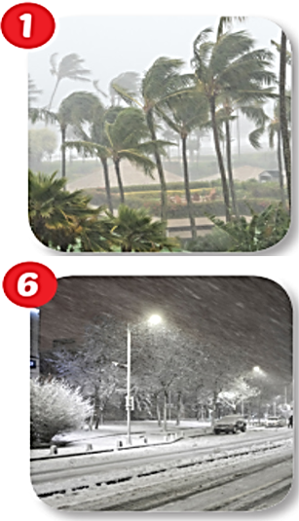
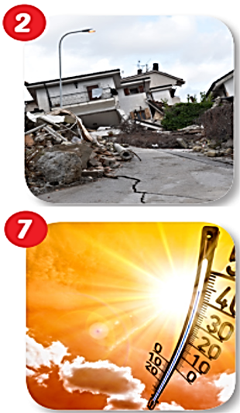
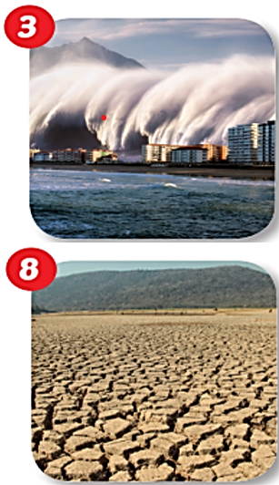
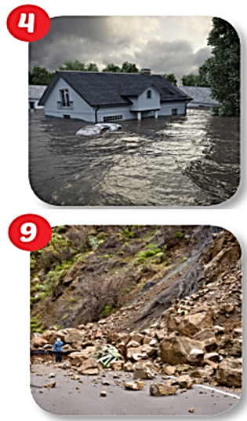
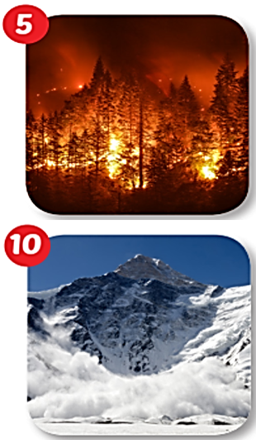
Listen.
Say the correct picture.
Look at the pictures.
Work in pairs. Test your partner the Vocabulary about Disasters.
WILDFIRE
EARTHQUAKE
TSUNAMI
FLOOD
TYPHOON
LANDSLIDE
AVALANCHE
BLIZZARD
HEAT WAVE
DROUGHT

Slide 7

Listen and repeat.
typhoon (n) /taɪˈfuːn/ bão nhiệt đới
blizzard (n) /ˈblɪzərd/ trận bão tuyết
drought (n) /draʊt/ hạn hán
wildfire (n) /ˈwaɪldfaɪər/ cháy rừng
flood (n) /flʌd/ lũ lụt
avalanche (n) /ˈævəlæntʃ/ tuyết lở
landslide (n) /ˈlændslaɪd/ sạt lở đất
tsunami (n) /tsuːˈnɑːmi/ sóng thần
earthquake (n) /ˈɜːrθkweɪk/ động đất
heat wave (n) /ˈhiːt weɪv/ đợt nắng nóng

Slide 8

Grammar

Slide 9



Read.

Slide 10
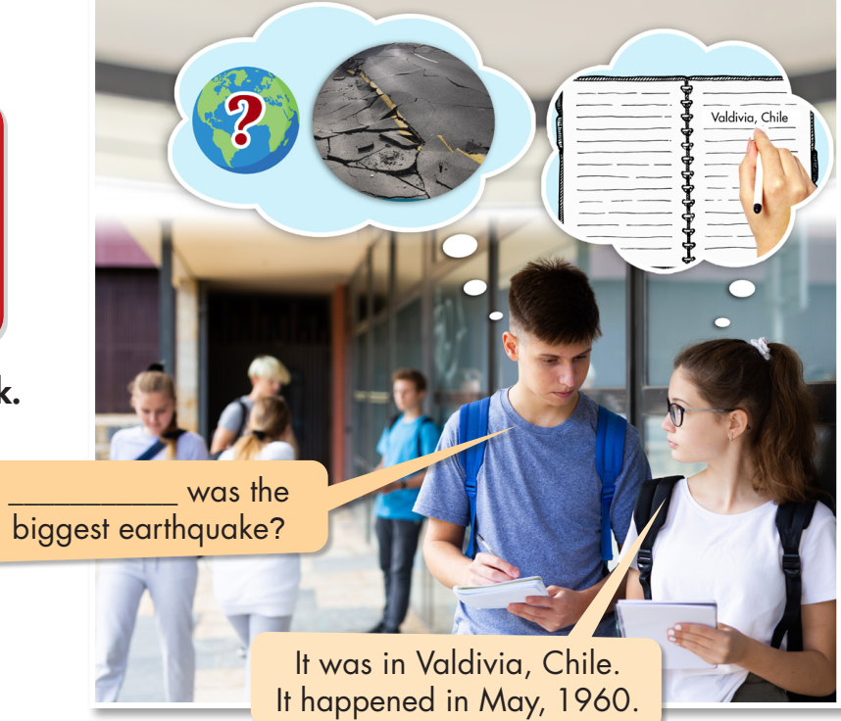

Slide 11





Where


Slide 12

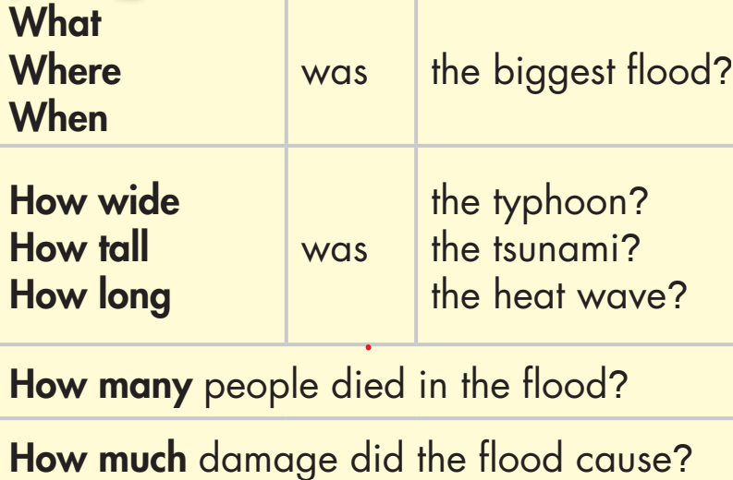
What was the biggest flood?
Where was the biggest flood?
When was the biggest flood?
How wide was the typhoon?
How tall was the tsunami?
How long was the heat wave?
How many people died in the flood?
How much damage did the flood cause?
Read the Wh-questions.

Slide 13

Practice

Slide 14

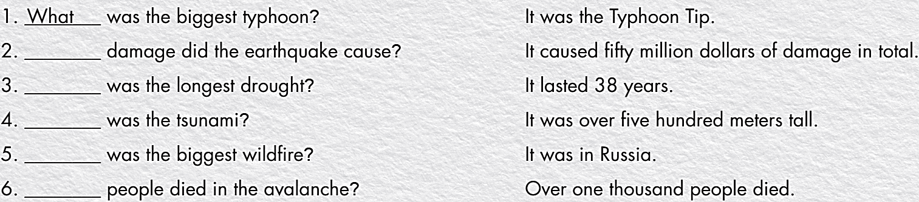
Work in pairs.
Ask and answer the Wh-questions.
How much
How long
How tall
Where
How many

Slide 15
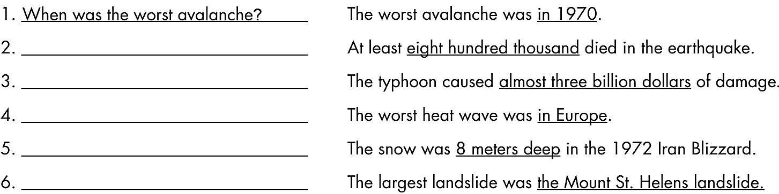
How many people died in the
earthquake?
How much damage did the
typhoon cause?
Where was the worst heat wave?
How deep was the snow in the
1972 Iran Blizzard?
What was the largest landslide?

Slide 16

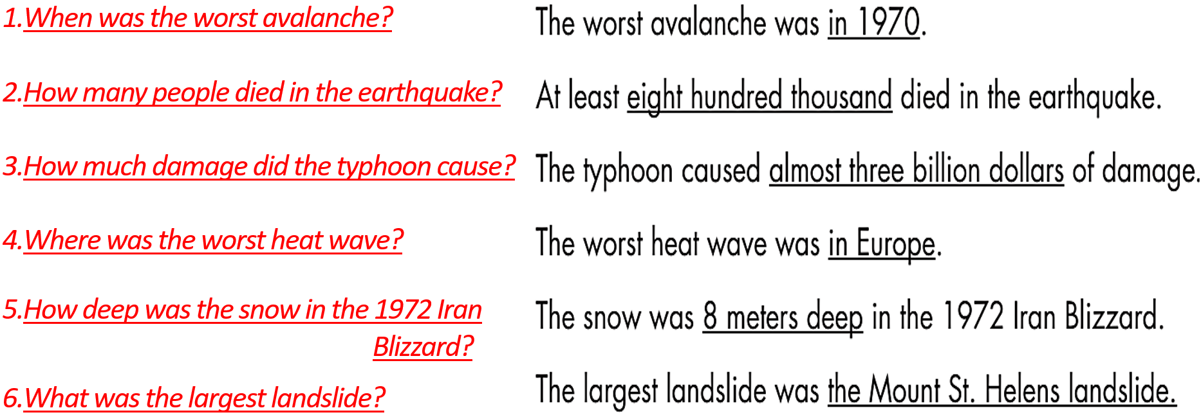
c. In pairs: Study the questions and answers in b. for one minute.
Cover the answers and take turns asking and answering the questions.
When was the worst avalanche?
How many people died in the earthquake?
How much damage did the typhoon cause?
Where was the worst heat wave?
How deep was the snow in the 1972 Iran Blizzard?
What was the largest landslide?

Slide 17
When was the worst avalanche?
How many people died in the earthquake?
How much damage did the typhoon cause?
Where was the worst heat wave?
How deep was the snow in the 1972 Iran Blizzard?
What was the largest landslide?

Slide 18
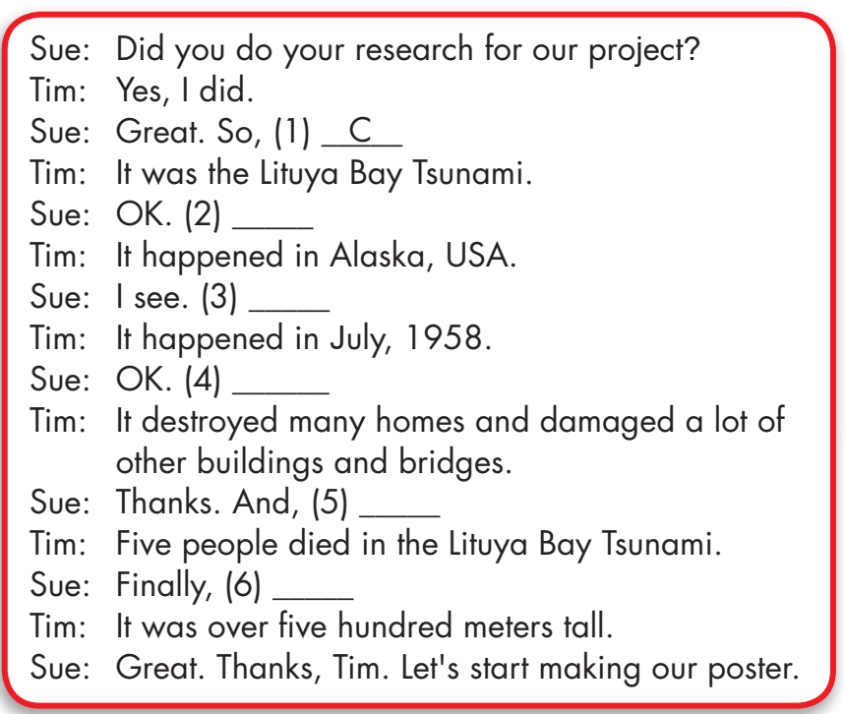
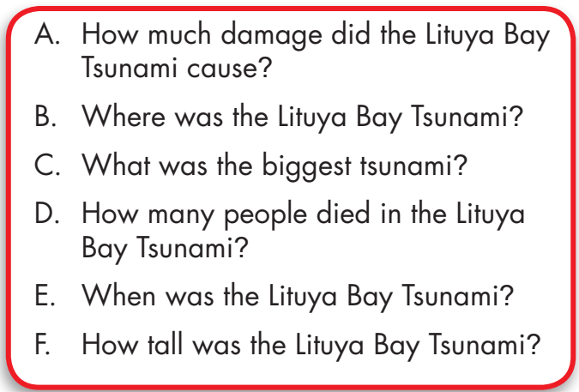
Practice the conversation with a partner.
Extra Practice
WB, page 21
B
E
A
D
F

Slide 19

CONSOLIDATION

Slide 20
Work with a new partner.
Make 5 Wh-questions to ask about his/her last vacation.
Question words
Who
What
When
Where
Why
How
Which

Slide 21

WRAP-UP

Slide 22
Today’s lesson
Grammar:
- To practice and use Wh-questions.
Speaking:
- To practice asking and answering Wh-questions.

Slide 23
Homework
Review how to make Wh-questions.
Do the exercises on page 21 WB.
Do the exercises in Tiếng Anh 8 i-Learn Smart World Notebook on pages 29&30.
Prepare the next lesson (pages 36 & 37, SB)
Play the consolidation games on www.eduhome.com.vn

Slide 24

Lesson 3
Stay positive and have a nice day!

