Slide 2

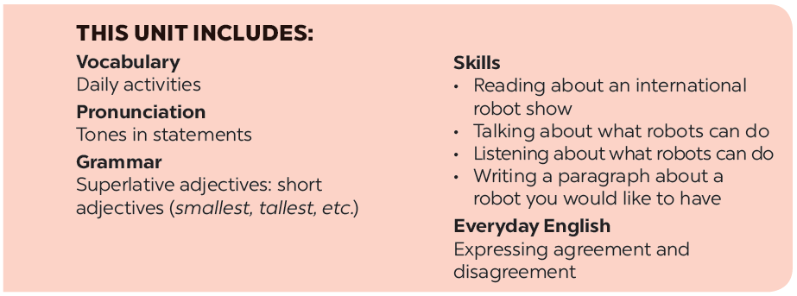

Slide 3







Vocabulary
Grammar
Write the correct words to complete the phrases.
Use the correct form of the adjectives in brackets to complete the paragraph.
Complete the following sentences with superlative form of the adjectives in brackets.
Fill the blanks with the verbs from the box.

Slide 4
Vocabulary

Slide 5



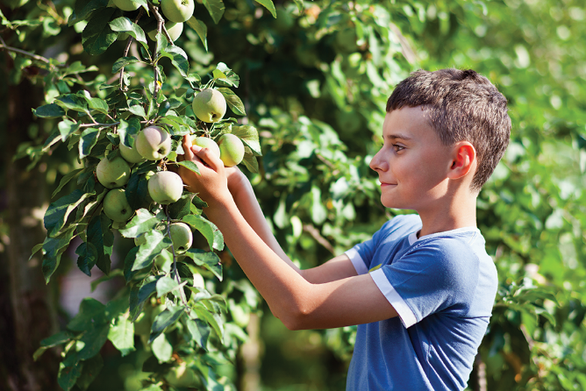
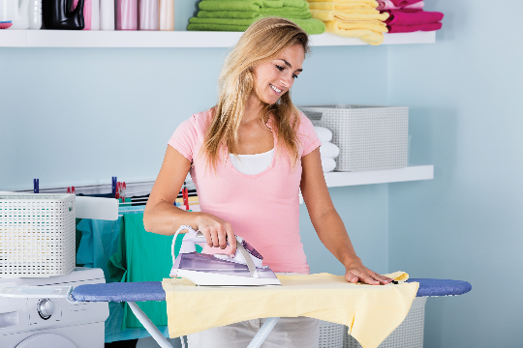
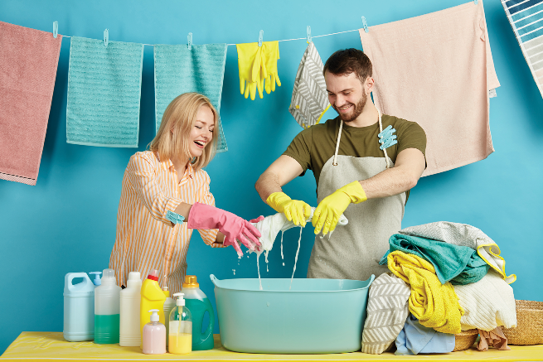
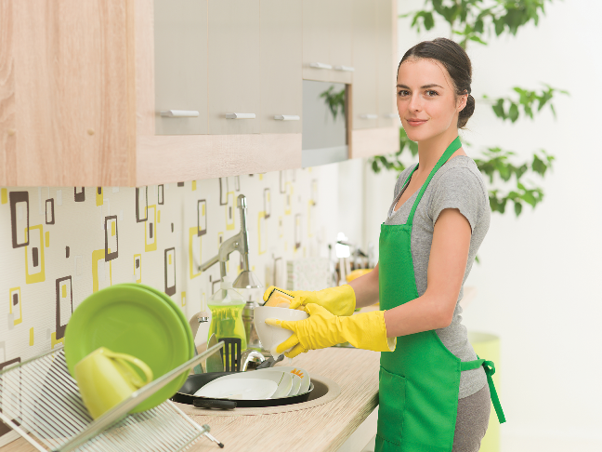
Write the correct words to complete the phrases.
_______ the clothes
2.
_______ heavy things
_______ fruit
1.
1.
2.
move heavy things
3.
iron the clothes
3.
pick fruit
4.
4.
do the washing
5.
do the _______
5.
_______ the dishes
do the dishes

Slide 6

Fill the blanks with the verbs from the box.
water
make
repair
work
understand
Robots can
work as guards when we’re away.
1.
_______ as guards when we’re away.
2.
We rarely go to restaurants because my father can
make delicious meals at home.
_______ delicious meals at home.
3.
Can you
_______ my broken clock?
repair my broken clock?
4.
Can robots
understand our feelings?
_______ our feelings?
5.
_______ the plants in our garden
My father and I
every morning.
water the plants in our garden

Slide 7
Grammar

Slide 8

Use the correct form of the adjectives in brackets to complete the paragraph.
Welcome to our company. We’ve made the (1. smart) robot in the world. It’s the (2. small) and the (3. light)
we’ve made but it can do many things in your house. It can even ﬂy to clean the ceilings. It can teach children all school subjects. It’s also the (4. strong) in our lab because it can move more than 200 kg. It’s not difficult to own a robot like this because it’s one of the (5. cheap) robots in the world.
smartest
smallest
lightest
strongest
cheapest

Slide 9

Complete the following sentences with superlative form of the adjectives in brackets.
What is the (high)
highest mountain in the world?
1.
_______ mountain in the world?
2.
What is the (large)
_______ lake in Viet Nam?
largest lake in Viet Nam?
3.
What is the (long)
_______ beach in Viet Nam?
longest beach in Viet Nam?
widest river in the world?
4.
What is the (wide)
_______ river in the world?
5.
What is the (hot)
_______ desert in the world?
hottest desert in the world?
Do you know the answers?

Slide 10



You are taking part in a robot design competition. Work in groups, decide what your robot is like and complete this table.
Robot name
Appearance (weight, height, etc.)
Where it can work
What it can do

Slide 11

Draw your robot here
Present your designs to other groups. Vote on the best robot.

Slide 12
Now I can … |  |  | 
use the words for daily activities.
say statements with correct tones.
compare people and things using superlative adjectives.
express agreement and disagreement about something.
read about a robot show.
talk about what robots can do.
listen about what robots can do.
write a paragraph about a robot.
✓
✓
✓
✓
✓
✓
✓
✓
✓
✓
✓
✓
✓
✓
✓
✓
✓
✓
✓
✓
✓
✓
✓
✓

Slide 13






Website: hoclieu.vn
Fanpage: facebook.com/www.tienganhglobalsuccess.vn/

