Slide 1



Unit 4: Our planet
Lesson 4E: Word Skills

Slide 2

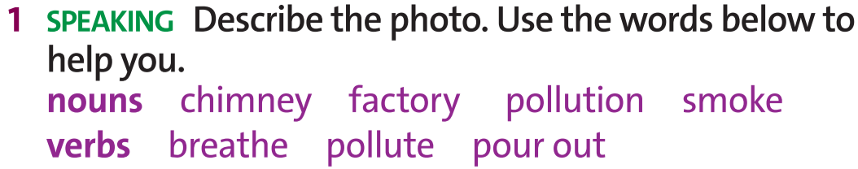
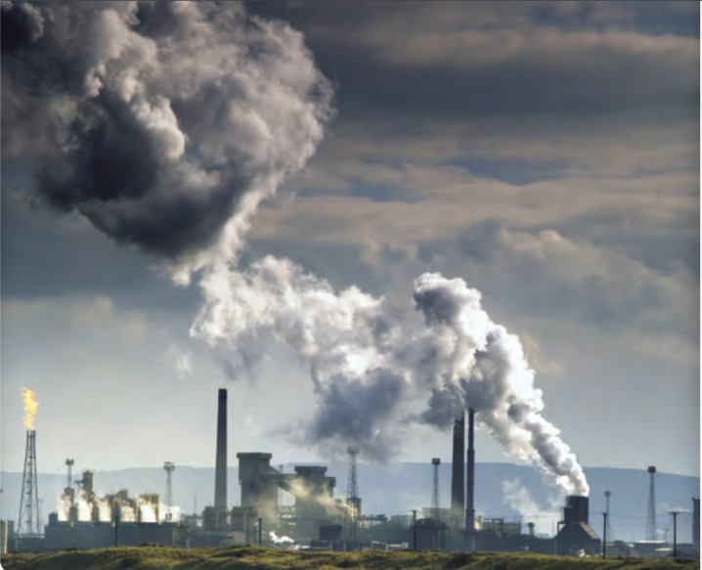

www.phuongnam.edu.vn

Slide 3
Possible answers:
The smoke from the chimneys is polluting the air.
The chimneys from the factory are pouring out smoke and polluting the air.
The factory is causing air pollution.
Air pollution makes it difficult to breathe.
www.phuongnam.edu.vn

Slide 4



www.phuongnam.edu.vn

Slide 5

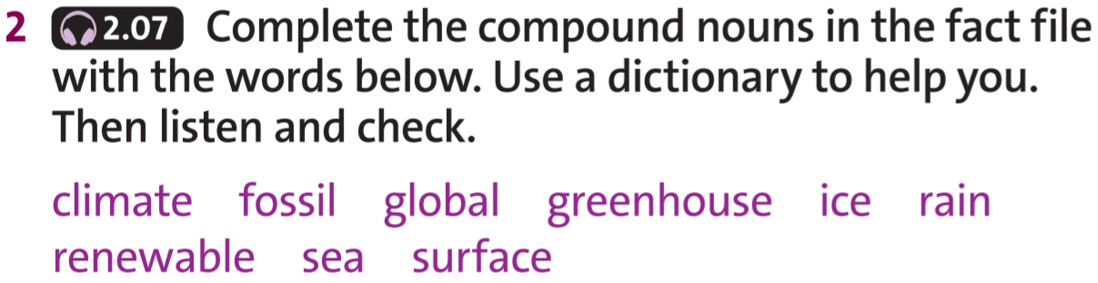
www.phuongnam.edu.vn

Slide 6
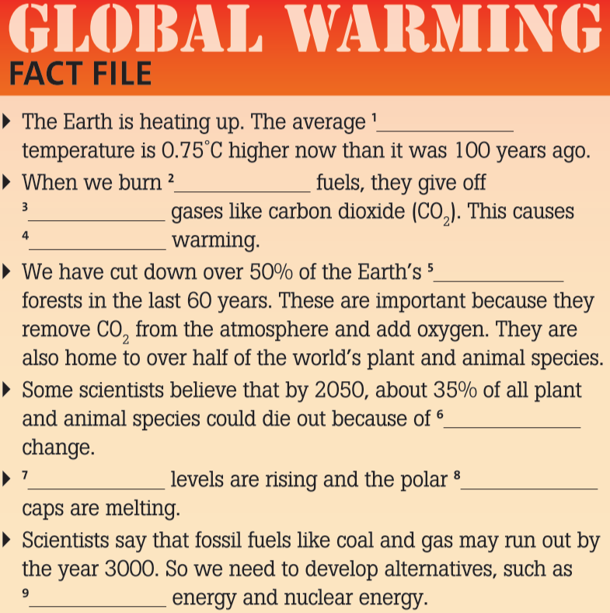

climate
ice
rain
fossil
renewable
global
sea
greenhouse
surface
Check all
www.phuongnam.edu.vn

Slide 7
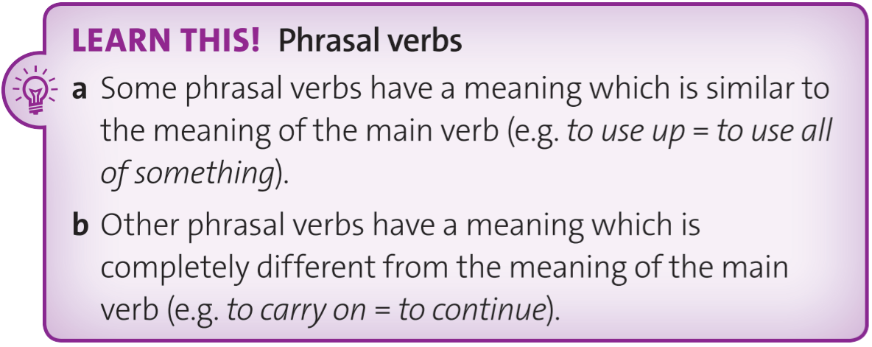
www.phuongnam.edu.vn

Slide 8
Ex3. Read the Learn this! box. Find five phrasal verbs in the fact file.
www.phuongnam.edu.vn

Slide 9
Ex3. Which phrasal verbs have a similar meaning to the main verb and which have a completely different meaning?
similar meaning to the main verb | different meaning to the main verb
heat up
die out
Check all
run out
give off
cut down
www.phuongnam.edu.vn

Slide 10
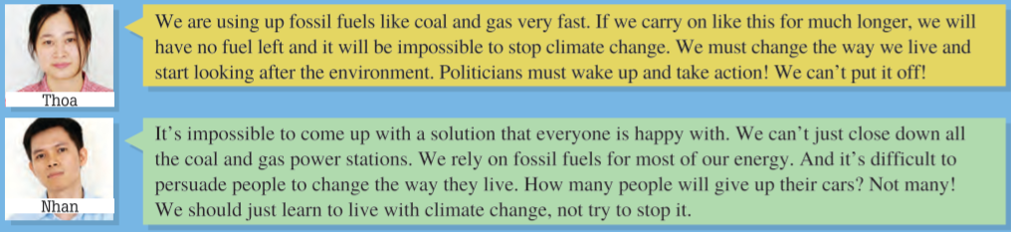
Ex4. Read what two students say about global warming and climate change. Who is more worried about the situation?
Thoa is more worried about global warming and climate change
www.phuongnam.edu.vn

Slide 11
Ex5. Find nine phrasal verbs in the texts in exercise 4.
www.phuongnam.edu.vn

Slide 12
Ex5. Match five of them with the definitions below. Check the meaning of the others in the dictionary.
carry on
look after
put off
come up with
give up
www.phuongnam.edu.vn

Slide 13
Ex5. Are the meanings similar to the main verbs or different?
similar meaning to the main verb | different meaning to the main verb
carry on
put off
give up
look after
rely on
Check all
use up
wake up
close down
come up with
www.phuongnam.edu.vn

Slide 14

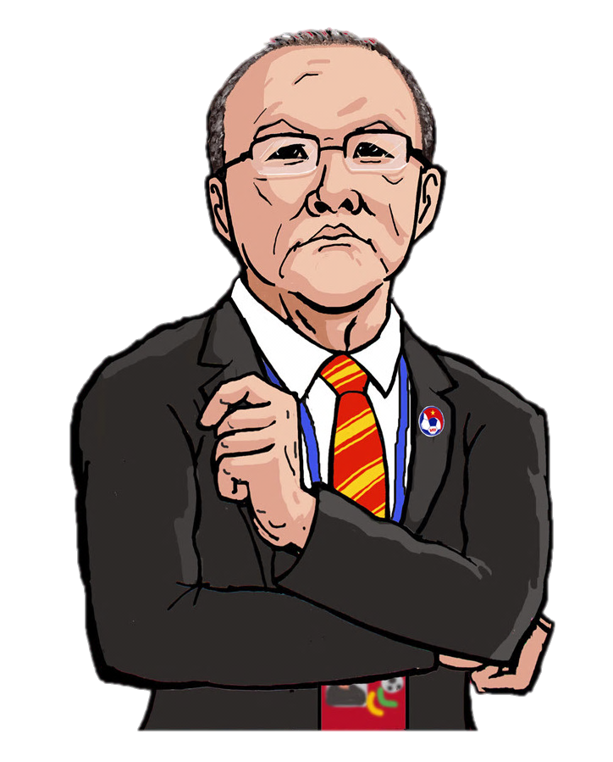
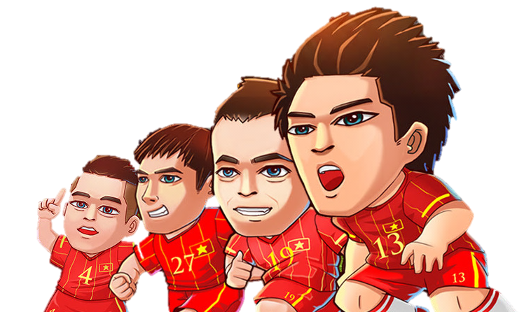
Ex6. PHRASAL VERBS
THE BEST GOALKEEPER
Park Hang Seo’s edition

Slide 15
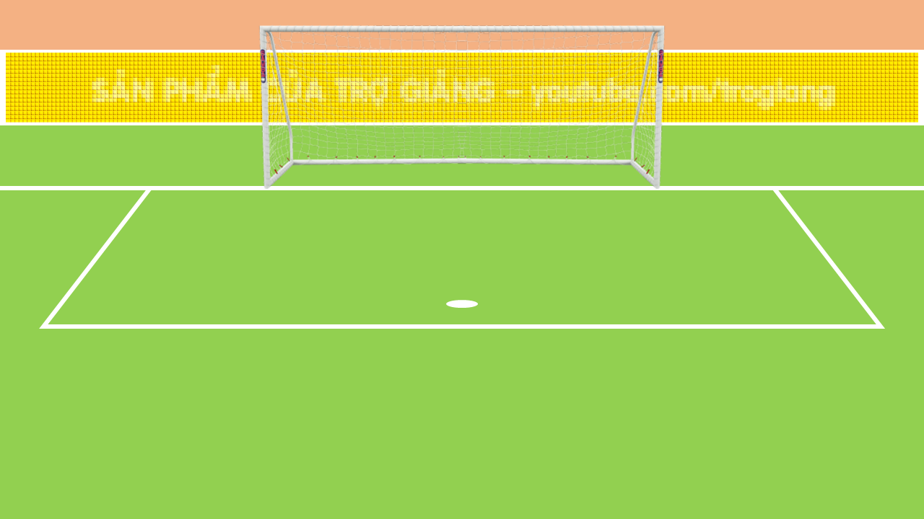

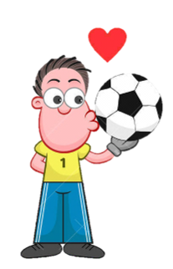
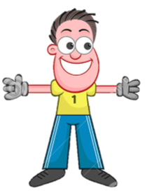


Internet cafés are dying _________ because people use smartphones instead.
A. out
B. up
C. down
D. off

Slide 16
My dad __________ down the tree in the front garden.
A. looked
B. cut
C. used
D. died

Slide 17
Jo gave _________ sugar because she wants to be heathier.
A. down
B. out
C. up
D. on

Slide 18
Supermarkets are causing small shops to close __________.
A. up
B. down
C. out
D. in

Slide 19
We’ve _______ up all the bread. Can you buy some more?
A. looked
B. played
C. cut
D. used

Slide 20
I _______ after my little brother while Mum was out.
A. looked
B. used
C. cut
D. took

Slide 21
01
Homework
02
03
1. Finish all the tasks
2. Prepare U4-F (P.52-53)
04
?
05
06

Slide 22

www.phuongnam.edu.vn

Slide 23



Thank you!
CTCP ĐẦU TƯ VÀ PHÁT TRIỂN GIÁO DỤC PHƯƠNG NAM

