Slide 1

Unit 8: Festivals around the World
Lesson 2.3: Pronunciation
Page 65

Slide 2

LESSSON OUTLINE
Pronunciation
Practice
Speaking
Consolidation
Wrap-up

Slide 3

By the end of this lesson, students will be able to…
- practice the / ɪ / sound.
- talk about traditions in different countries.

Slide 4

WARM-UP

Slide 5

Work in pairs.
Choose the word whose main stress is placed
differently from the others.
1. A. greeting B. midnight C. temple D. Japan
2. A. exchange B. perform C. visit D. attract
3. A. history B. tradition C. attraction D. container
/ˈɡri:tɪŋ/
/ˈmɪdnaɪt/
/ˈtempl/
/dʒəˈpæn/
/ɪksˈtʃeɪndʒ/
/pərˈfɔːrm/
/ˈvɪzɪt/
/əˈtrækt/
/ˈhɪstri/
/trəˈdɪʃn/
/əˈtrækʃn/
/kənˈteɪnər/

Slide 6
Work in pairs.
Choose the word whose underlined part is
pronounced differently from that of the other words.
1. A. son B. ton C. month D. town
2. A. sugar B. soccer C. singer D. sticker
3. A. station B. nation C. question D. motion
/sʌn/
/tʌn/
/mʌnθ/
/taʊn/
/ˈʃʊɡər/
/ˈsɑ:kər/
/ˈsɪŋər/
/ ˈstɪkər/
/ˈsteɪʃn/
/ˈneɪʃn/
/ˈkwestʃn/
/ˈmoʊʃn/

Slide 7
Work in pairs.
Talk about a festival you went to.
FESTIVAL
1. What was the festival? Where was it?
2. When did you go there?
3. What did you do at the festival?
4. Do you like it? Why/ Why not?

Slide 8

PRONUNCIATION

Slide 9
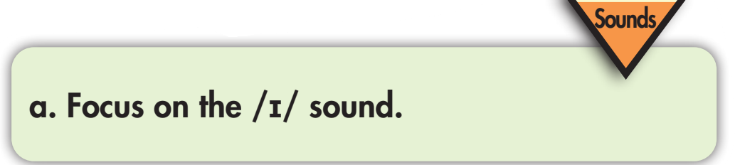
Click on the icon in each square to hear the sound
/ ɪ /

electronic
ticket

public
tourist



Slide 10
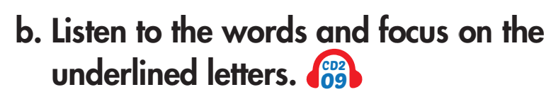

Click on the icon in each square to hear the sound
/ɪ/
midnight

Christmas

wish

festival


Slide 11
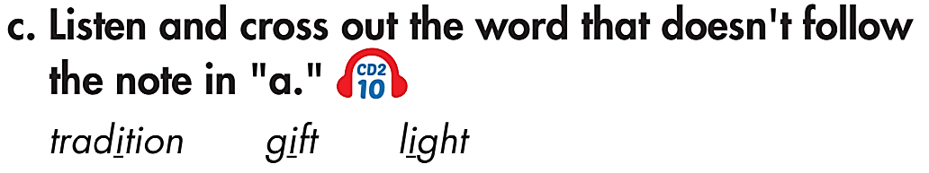
Click on the icon to hear the sound




Slide 12
Click on each word to hear the sound
Listen and repeat. Notice the sounds /ɪ/ and /aɪ/. Practice saying them.
/ɪ/ | /aɪ/
children
child


mine
minute



market
file


Slide 13
Click on each word to hear the sound
Which sound is it, /ɪ/ or /aɪ/?
Say the words as they appear, then listen and check.
 alive
 live
 bright
 bridge
 driver
 river
 kitten
 sky
/ ɪ / | / aɪ /
live
bridge
alive
bright
river
kitten
driver
sky

Slide 14

PRACTICE

Slide 15
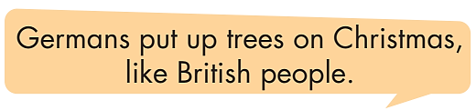
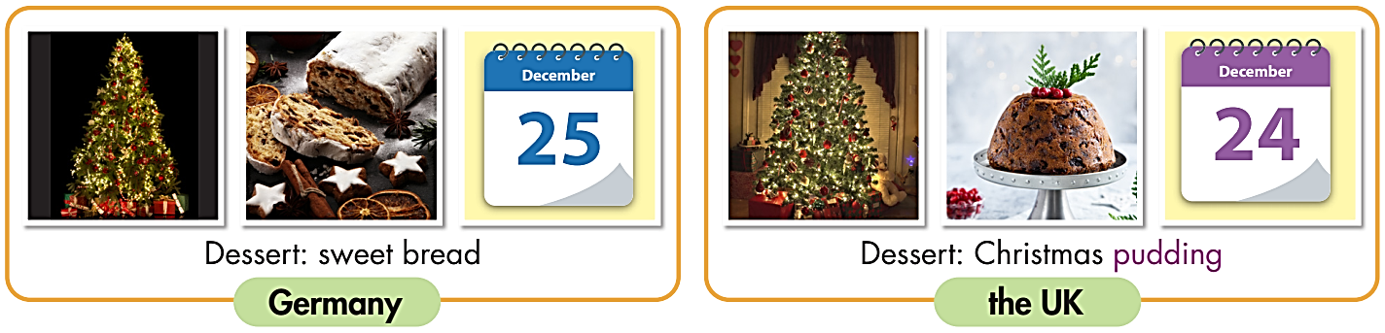
Notice the similar thing.
Look at the pictures about Christmas traditions in Germany and the UK.
Now look and read the sentence:
Christmas

Slide 16
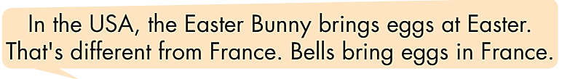
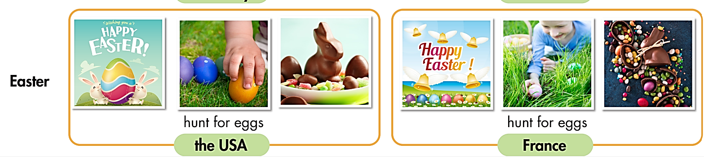
Notice the difference.
Look at the pictures about Easter traditions in the USA and France.
Now look and read the sentence:
Easter

Slide 17
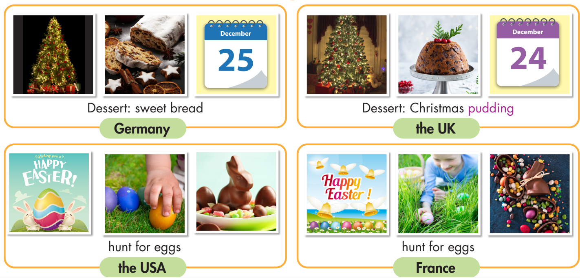
Christmas
Easter

Slide 18
What’s the difference?
Tell it to your class.
Christmas

Slide 19
What do people in the USA and France have in common?
Tell your class.
What else can you say about the pictures?
Easter

Slide 20
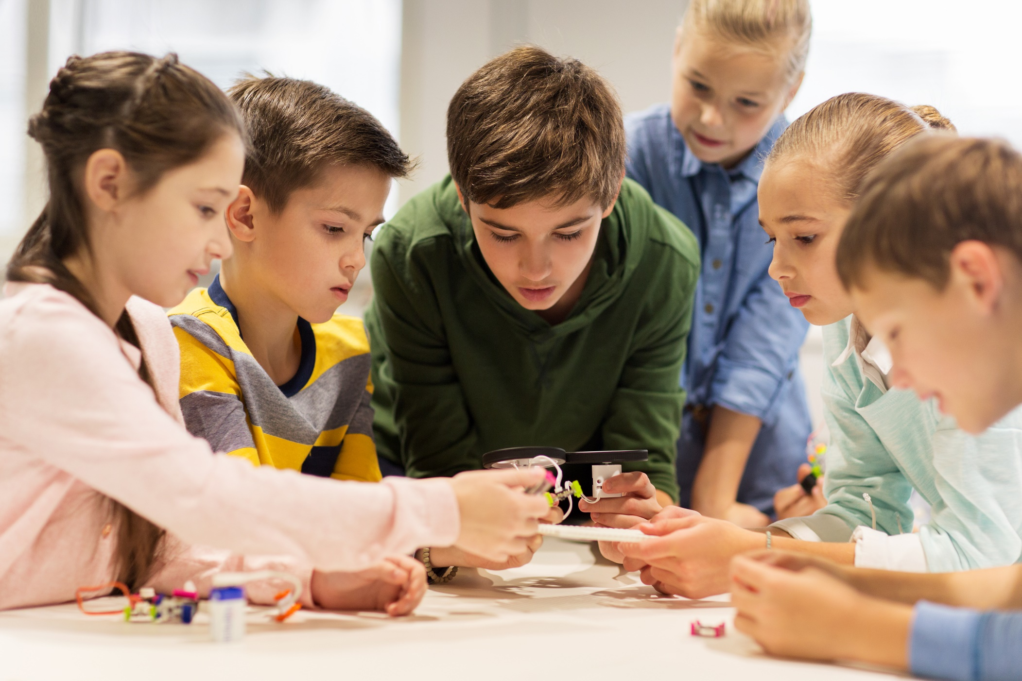
SPEAKING

Slide 21

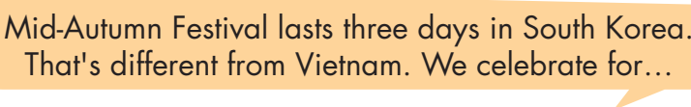
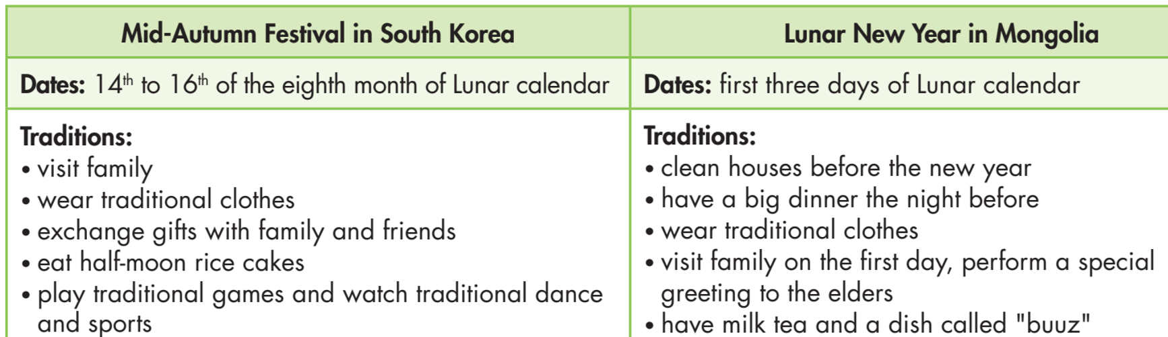

Slide 22
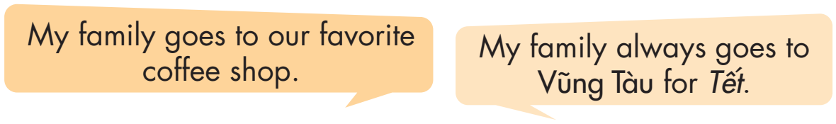

Slide 23

CONSOLIDATION

Slide 24
Write 2 sentences to compare Easter traditions in the USA and France using like + noun and be + different from:
Easter
____________________________________________
____________________________________________

Slide 25
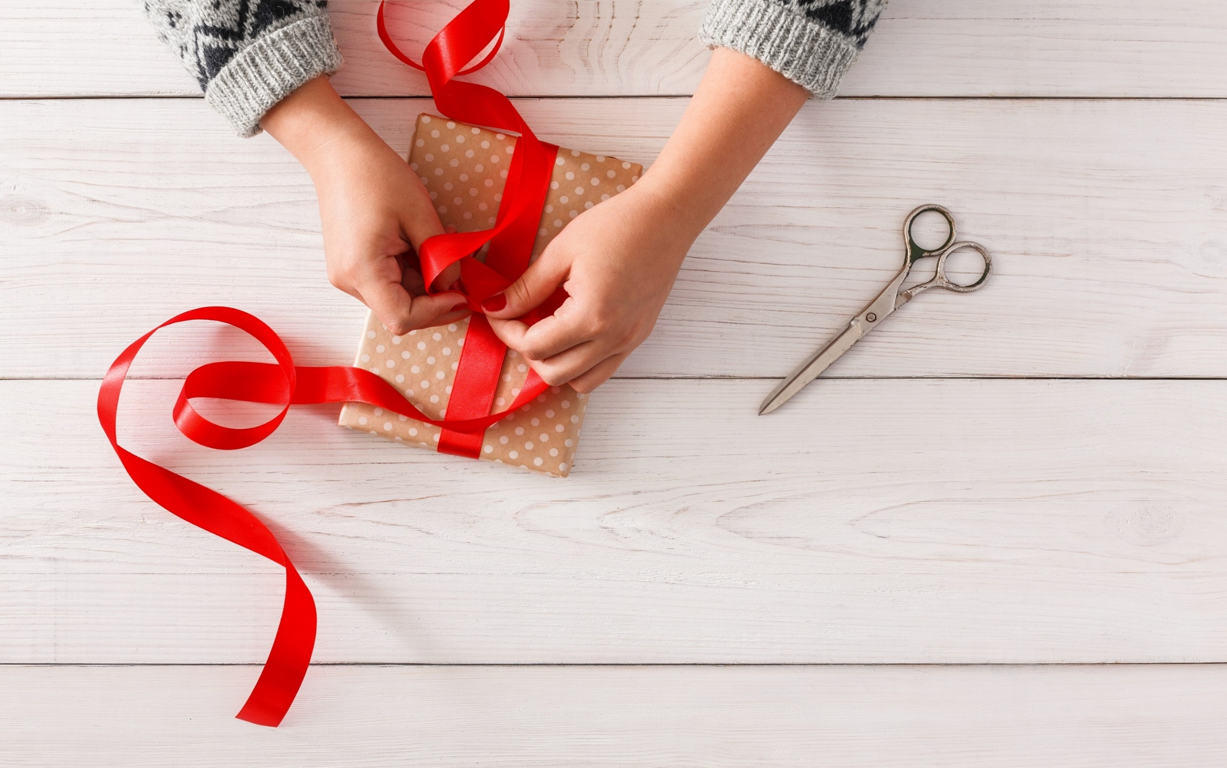
WRAP-UP

Slide 26
Today’s lesson
Focusing on the sound /ɪ/.
Talking about traditions in different countries.

Slide 27
Homework
Learn vocabularies in lesson 2.1.
Review the grammar points in lesson 1.2.
Practice the sound /ɪ/.
Play the consolidation games in Tiếng Anh 7 i-Learn Smart World DHA App on www.eduhome.com.vn
Prepare the next lesson (page 66 SB).

Slide 28
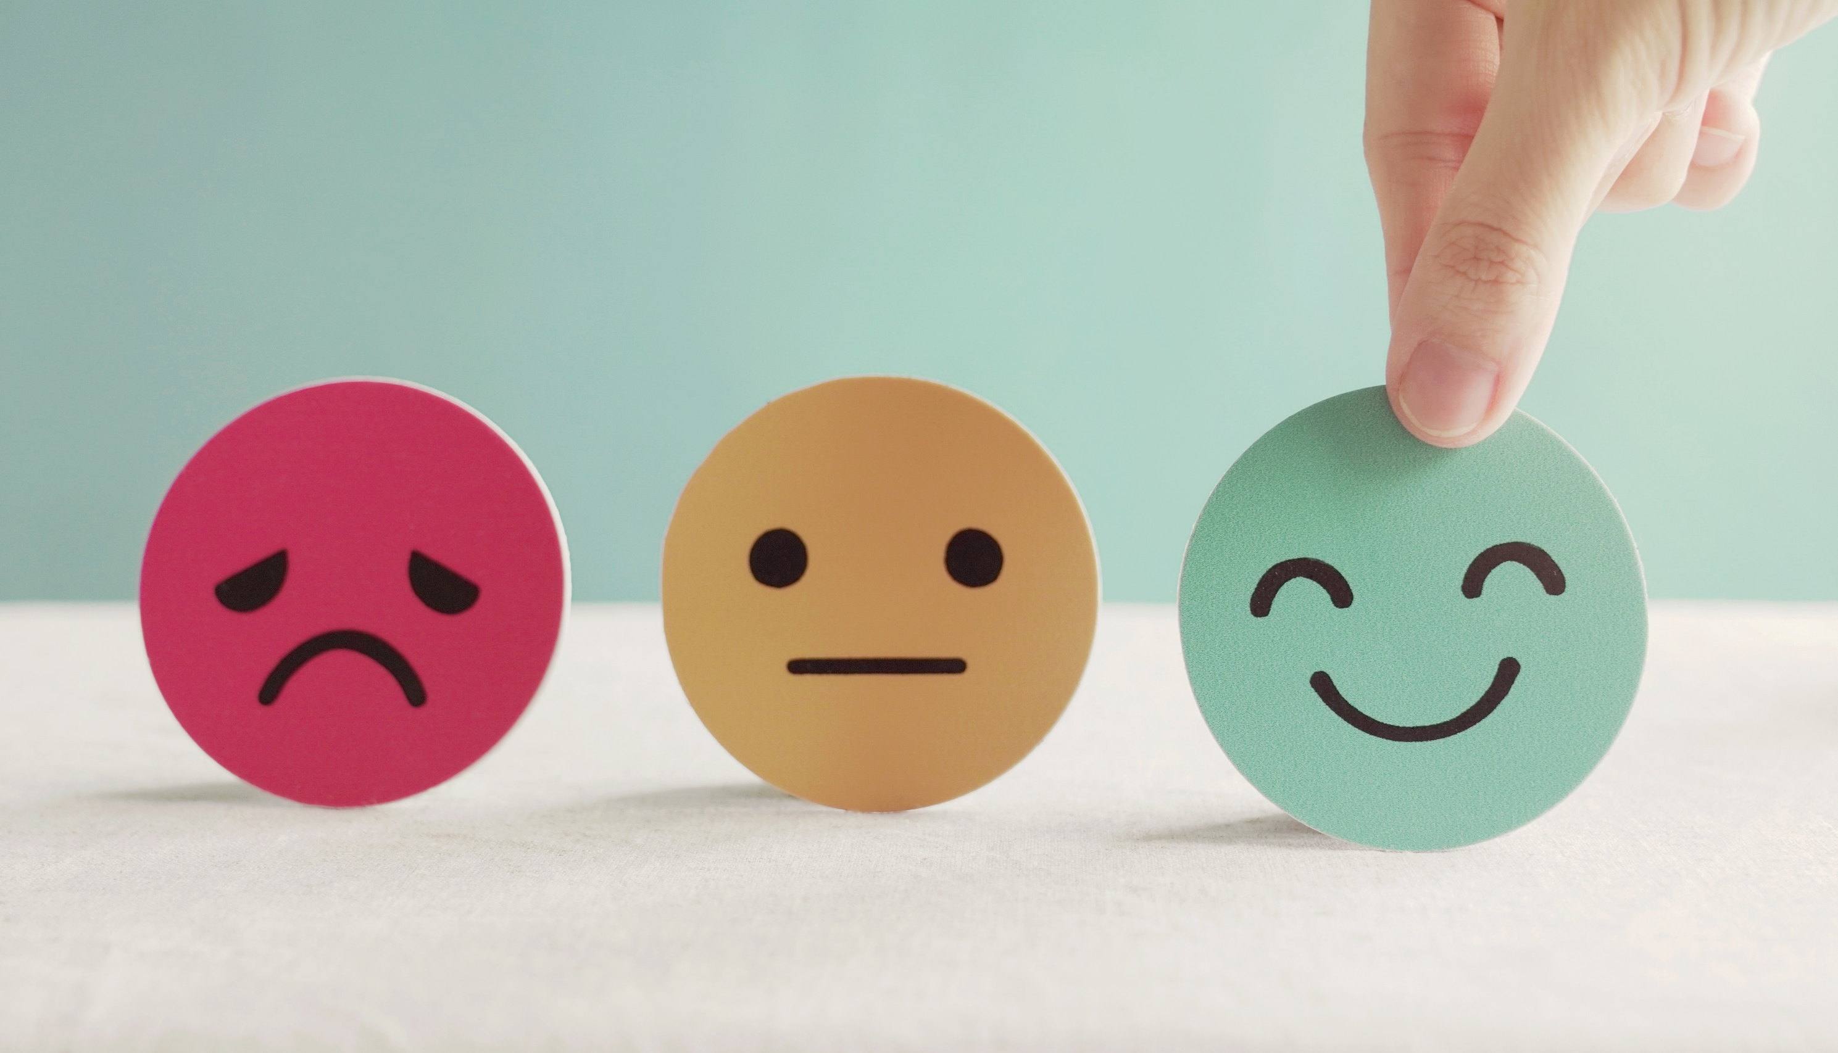
Lesson 3
Stay positive and have a nice day!

