Slide 1

Unit 1: Home
Lesson 3.1: Vocabulary & Listening
Student’s Book - Page 12

Slide 2
Lesson Outline
Warm-up
Vocabulary
Listening
Useful language
Consolidation
Wrap-up

Slide 3
Objectives
By the end of this lesson, students will be able to…
- learn vocabulary for directions and places;
- enhance listening skills (for key information and details).

Slide 4

WARM-UP

Slide 5

Ask and answer
1. Where do you live?
2. Where is it?
3. Is your house/ apartment/ village big or small?

Slide 6

New words
Center
North
South
East
West
Village
Town
City

Slide 7



Slide 8

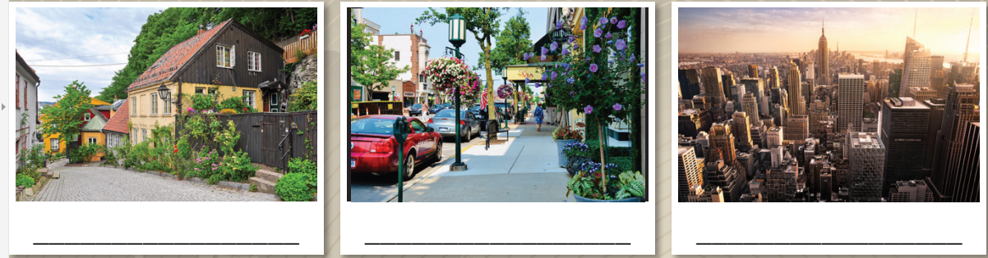


Center (n) /ˈsentər/ trung tâm
North (n) /nɔːrθ / phía Bắc
South (n) /saʊθ/ phía Nam
East (n) /iːst/ phía Đông
West (n) /west/ phía Tây
Village (n) /ˈvɪlɪdʒ/ ngôi làng
Town (n) /taʊn/ thị trấn, thị xã
City (n) /ˈsɪti/ thành phố

Slide 9
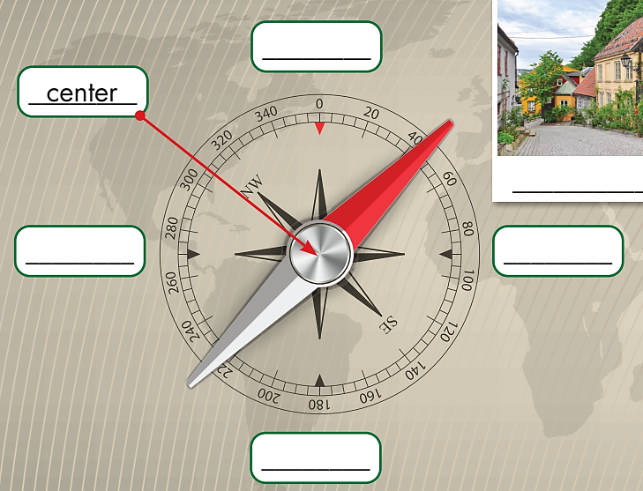
1
north
Write the words
west
east
4
2
3
south

Slide 10
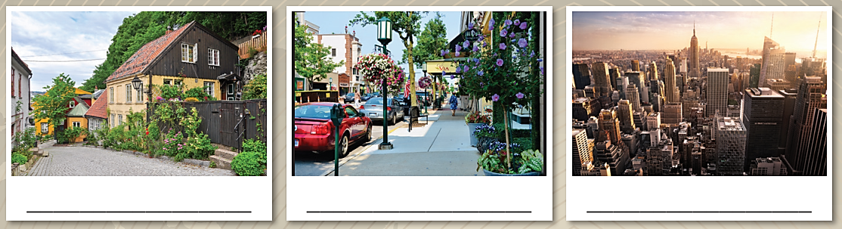
Giúp mình add thêm vài trò chơi để HS nhận dạng, nhớ từ và phát âm đúng
village
town
city
Now, read the descriptions and write the underlined
words under each picture. Listen and repeat.
1. A city has many big buildings, schools, and hospitals.
2. A village is in the countryside and usually has a few houses.
3. A town has houses, parks, schools, and stores.

Slide 11
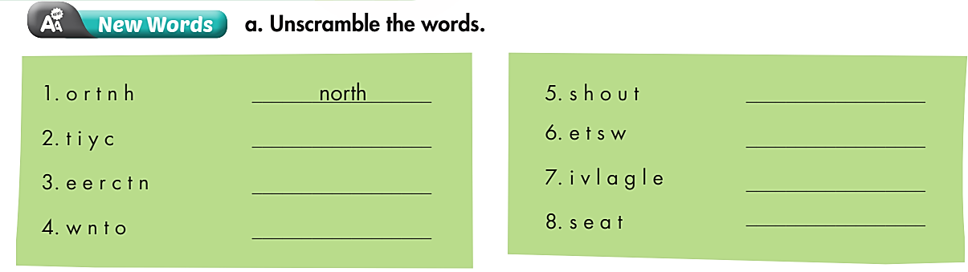
Extra Practice
WB page 6
south
city
west
center
village
east
town

Slide 12

Listening

Slide 13
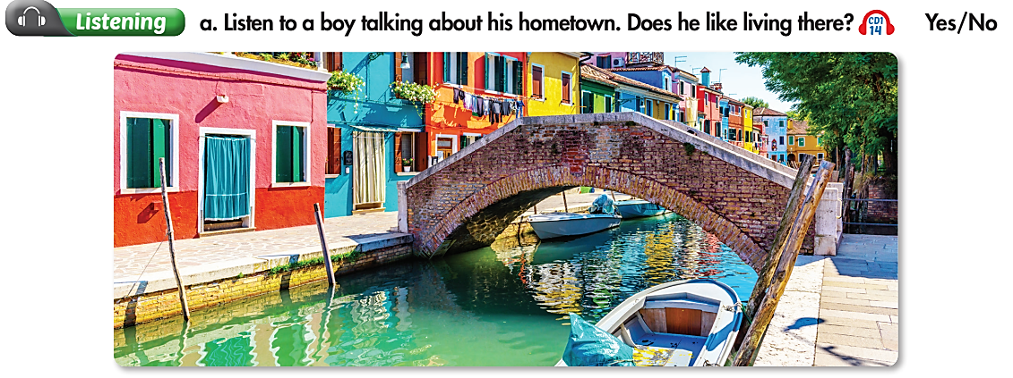
Pre-Listening

Slide 14
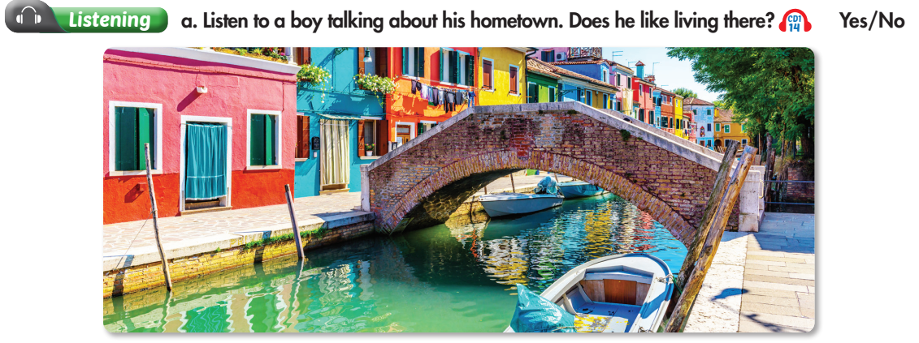
While-Listening

Slide 15
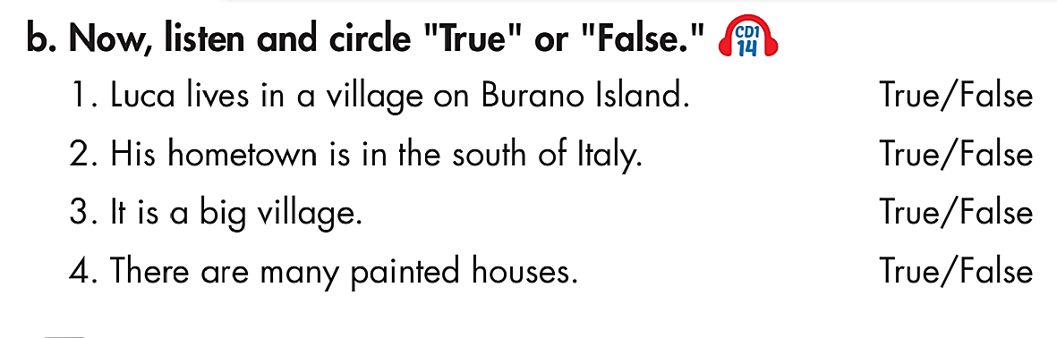
Pre-Listening

Slide 16
While-Listening
north
isn’t

Slide 17
Post-Listening
B: Hi, everyone. My name is Luca. I live in a small village
on Burano Island. It's in the north of Italy, about nine
kilometers from Venice. You have to take a ferry to get
here. It isn't a big village, fewer than three thousand
people live here. Burano is famous for its brightly
painted houses. My house is bright yellow. A lot of
tourists come here to take photos and buy souvenirs.
Here we have warm summers and very cold winters.
I love my village. It's the best place in the world.
→ Fewer than 3000 people.
→ About nine kilometers.
How far is the village from Venice?
→ Bright yellow.
How many people live there?
What color is his house?

Slide 18
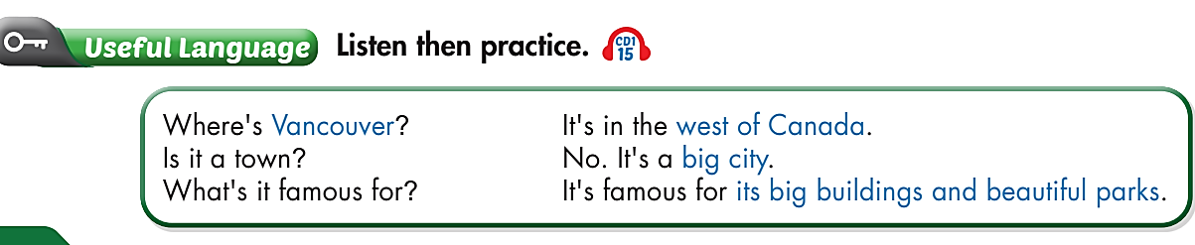

Practice with a partner.

Slide 19
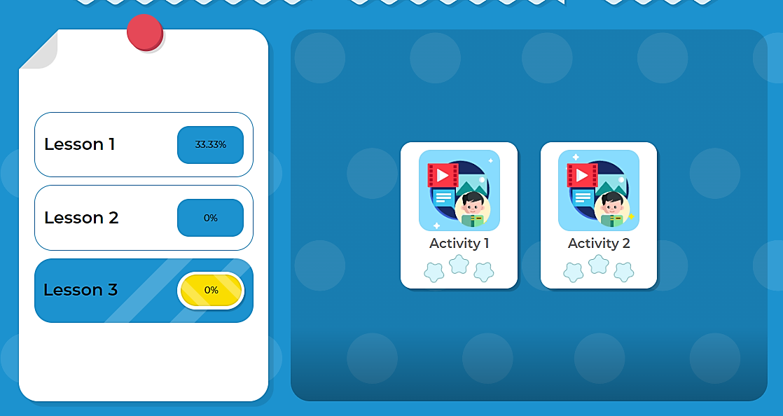
Click here to play the game

Slide 20

CONSOLIDATION

Slide 21
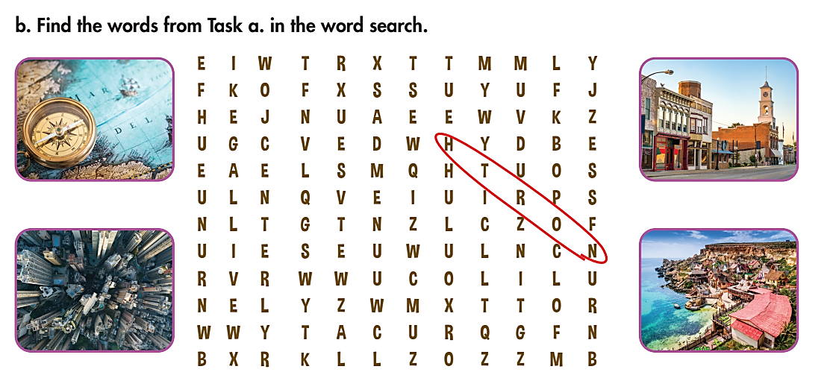
Find the words you have learned in this lesson.
Then make sentences with them.

Slide 22

WRAP-UP

Slide 23
Today’s lesson
Vocabularies
Center
North
South
East
West
Village
Town
City
Structures/ Sentence patterns
Where’s …? - It’s in the …….
Is it a …….? - No, it’s …….
What’s it famous for? – It’s famous for …………….

Slide 24
Homework
Review the vocabularies and practice using them.
Do the exercise(s) in Tiếng Anh 6 i-Learn Smart World Workbook (page 6).
Do the vocabulary exercise in Tiếng Anh 6 i-Learn Smart World Notebook (page 6) .
Play the consolation games in Tiếng Anh 6 i-Learn Smart World DHA App on www.eduhome.com.vn.
Prepare the next lesson (page 13 - SB).

Slide 25

Enjoy your day!

