Slide 2
Unit 3
GREEN LIVING
LESSON 4
SPEAKING
Paper: Reduce, Reuse, and Recycle!

Slide 3
LESSON 4
SPEAKING
WARM-UP
Brainstorming
Task 1: Sort activities into Reduce, Reuse, or Recycle.
Task 2: Talk about how to reduce, reuse, and recycle paper.
CONTROLLED PRACTICE
Task 3: think of some possible responses to promote a greener lifestyle.
Task 4: Report your group's answers.
LESS-CONTROLLED PRACTICE
CONSOLIDATION
Wrap-up
Homework

Slide 4


WARM-UP
What can you do with this piece of cloth?

Slide 5
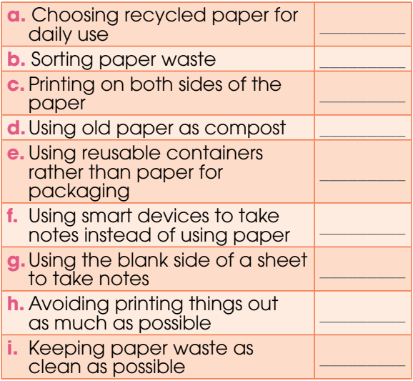
CONTROLLED PRACTICE
1
Sort these activities into Reduce, Reuse, and Recycle activities.
reduce
recycle
reduce
reuse
reduce
reduce
reuse
reduce
recycle

Slide 6
CONTROLLED PRACTICE
2
Talk about how to reduce, reuse, and recycle paper.
1. Which of the activities (a–i) above are you doing?
2. Can you suggest more ideas? How will they help save the environment?

Slide 7
LESS CONTROLLED PRACTICE
3
Read the situations below and think of some possible responses to promote a greener lifestyle.
1. After a club meeting, you notice that there are a lot of leaflets left, and they are only printed on one side. Your friend is asking you to help throw them away.
2. Your group is preparing for a presentation, and everyone has found a lot of useful online material. A group member is asking you to print out about 50 pages of information for the group to read.
3. Your club is organising a meeting, including a game in which people should write down something about themselves to share with others. The club president is asking you to buy a lot of Post-it notes for the game.

Slide 8
FREE PRACTICE
Report your group's answers to the whole class. Vote for the most interesting responses.
4
Example: ‘Do not throw them away. We should reuse these leaflets by using the blank pages to take notes, which will save natural resources such as trees and water.’

Slide 9
CONSOLIDATION
1
Wrap-up
What have you learnt today?
Some lexical items about green living
Talk about how to reduce, reuse and recycle

Slide 10
CONSOLIDATION
2
Homework
Do exercises in the workbook.
Write a paragraph about what you have done to save the environment.

Slide 11
Website: hoclieu.vn
Fanpage: facebook.com/www.tienganhglobalsuccess.vn

