Slide 1

UNIT 2
ENTERTAINMENT & LEISURE
Lesson 2.3 – Pronunciation & Speaking
Page 17

Slide 2




Lesson .
LESSSON OUTLINE
Consolidation

Slide 3

By the end of this lesson,
students will be able to:
pronounce verb-ed endings.
make arrangements and find a time to meet someone.
make sentences with the verbs given.

Slide 4



Slide 5

Work in pairs.
Choose the word whose main stress is placed
differently from the others.
A. agree B. arrange C. decide D. promise
2. A. refuse B. offer C. provide D. detect
3. A. temple B. suburb C. kindness D. mistake
/əˈɡri:/
/əˈreɪndʒ/
/dɪˈsaɪd/
/ˈprɑ:mɪs/
/rɪˈfju:z/
/ˈɑ:fə/
/prəˈvaɪd/
/dɪˈtekt/
/ˈtempl/
/ˈsʌbɜ:b/
/ˈkaɪndnəs/
/mɪˈsteɪk/

Slide 6
Work in pairs.
Choose the word whose underlined part is
pronounced differently from that of the other words.
A. light B. pill C. night D. knife
2. A. school B. check C. chore D. child
3. A. remind B. decide C. provide D. finish
/laɪt/
/pɪl/
/naɪt/
/naɪf/
/sku:l/
/tʃek/
/tʃɔ:r/
/tʃaɪld/
/rɪˈmaɪnd/
/dɪˈsaɪd/
/prəˈvaɪd/
/ˈfɪnɪʃ/

Slide 7
In pairs: ask and answer the questions.
1. What did you decide to do this weekend?
2. Do you often offer to help your family? What kinds of things do you help them with?
3. What did you plan to do this month?
4. Did anyone promise to do something for you? What did they promise to do?
5. Would you agree to do an extreme sport such as skiing?
Why? Why not?

Slide 8



Slide 9

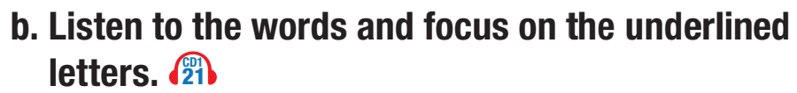

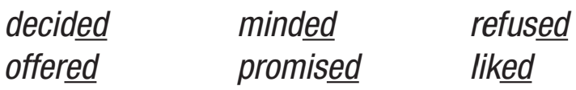
Verb-ed endings are pronounced / d /, / t /, or / ɪd /.


/ɪd/

/ɪd/

/d/

/d/


/t/
/t/

Slide 10
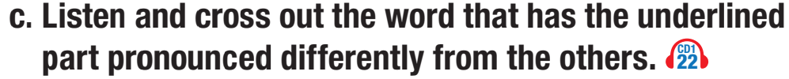


/t/

/d/

/d/

Slide 11
/d/ | /t/ | /ɪd/
enjoyed | watched | decided
agreed | promised | minded
offered | liked
refused










Slide 12

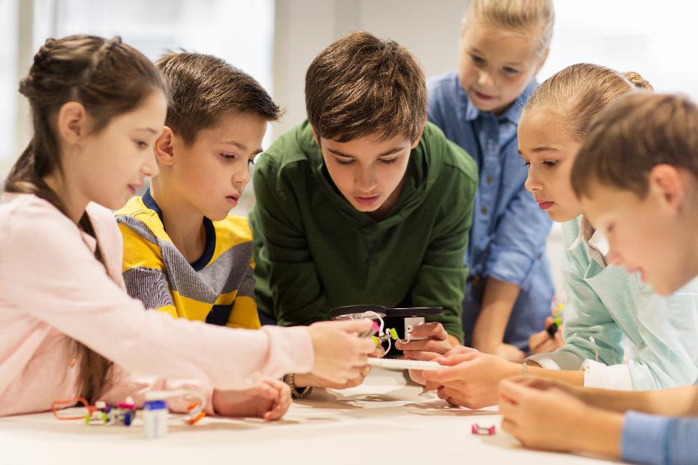

Slide 13
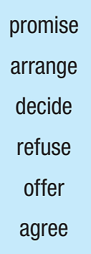
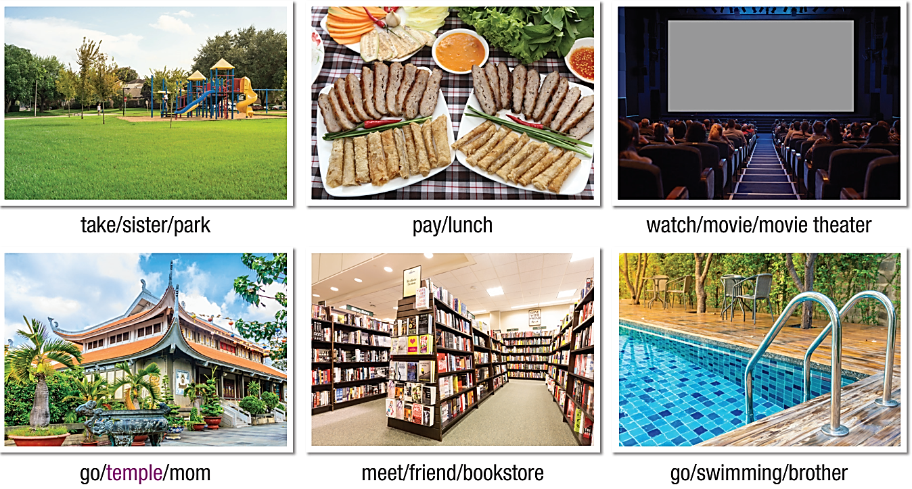
a. Take turns making sentences using the verbs and the pictures. Use the Past Simple.

Slide 14


Slide 15



Slide 16

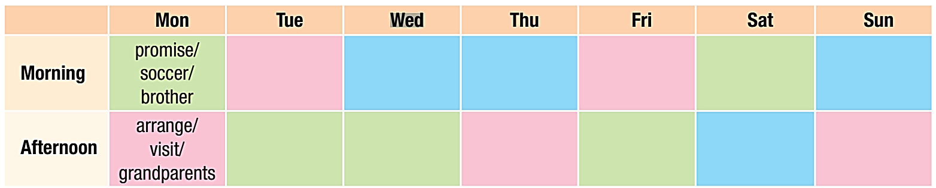
You're arranging to meet your friend. In pairs:
Student A: Fill in the green areas.
Student B: Fill in the pink areas.

Slide 17
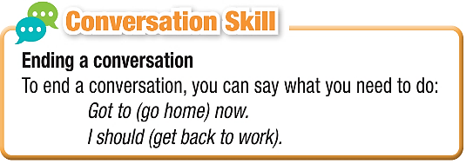
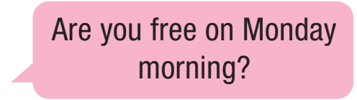
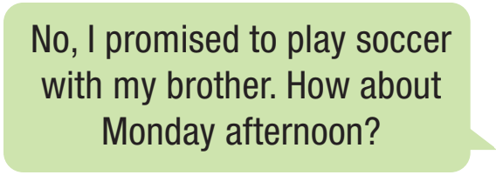
In pairs: Take turns inviting each other and find a time to meet.

Slide 18
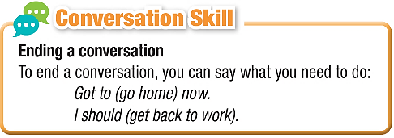

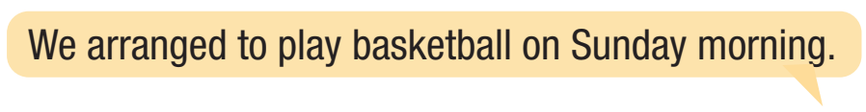

Slide 19

Consolidation

Slide 20

Write a sentence for each verb using the Past Simple.
__________________________________________
__________________________________________
__________________________________________
__________________________________________
__________________________________________
__________________________________________

Slide 21
Today’s lesson
Wrap-up
Pronunciation: verb-ed endings.
Speaking: arranging to meet a friend.
Writing: making sentences with the verbs given.

Slide 22
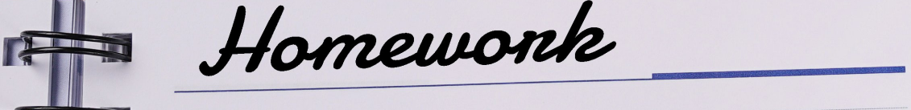
Review the vocabulary and grammar notes Tiếng Anh 10 i-Learn Smart World Notebook on pages 10 & 11.
Prepare the next lesson on page 18, SB.
Play the consolidation games in Tiếng Anh 10 i-Learn Smart World DHA App on www.eduhome.com.vn

Slide 23

Have a nice day!

