Slide 1
Unit 8: Traditions of
Ethnic Group in Vietnam
Lesson 1.3: Pronun. & Speaking
Pages 76 & 77

Slide 2
Lesson Outline
Warm-up
Pronunciation
Speaking
Consolidation
Wrap-up

Slide 3
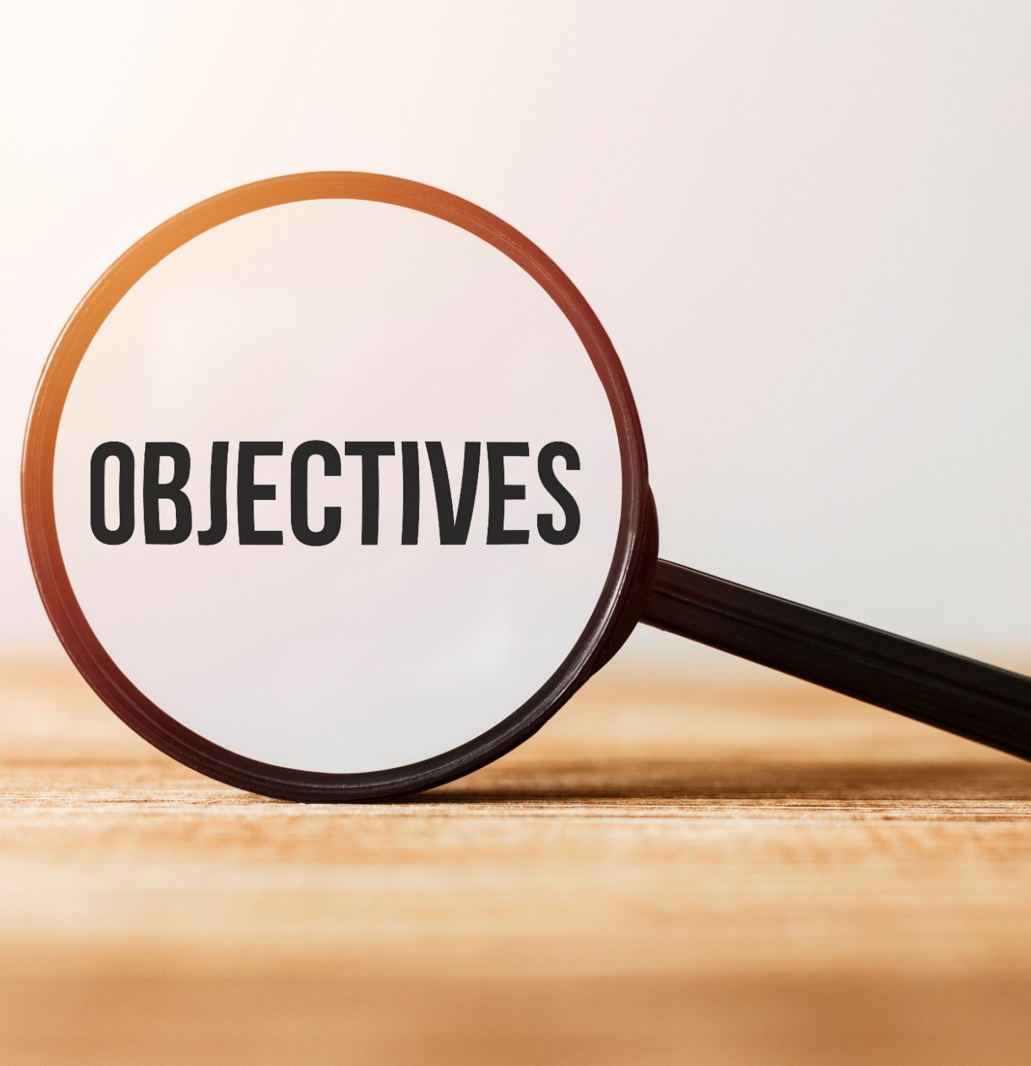
By the end of this lesson, students will be able to…
practice stress the first syllable for most two-syllable adjectives.
talk about the culture of ethnic groups in Vietnam, using articles.

Slide 4
WARM UP

Slide 5
Choose the word whose underlined part is pronounced differently from that of the others.
A. market B. pattern C. basket D. mansion
/ˈmɑːrkɪt/ /ˈpætən/ /ˈbæskət/ /ˈmænʃən/
2. A. highlands B. flowers C. shoulders D. products
/ˈhaɪləndz/ /ˈflaʊərz/ /ˈʃoʊldərz/ /ˈprɑːdʌkts/
3. A. chore B. school C. chat D. chip
/tʃɔːr/ /skuːl/ /tʃæt/ /tʃɪp/

Slide 6
Choose the words whose main stress is placed differently from the others.
A. culture B. wedding C. guitar D. custom
/ˈkʌltʃər/ /ˈwedɪŋ/ /ɡɪˈtɑːr/ /ˈkʌstəm/
2. A. beautiful B. important C. talented D. regular
/ˈbjuːtɪfəl/ /ɪmˈpɔːrtənt/ /ˈtæləntɪd/ /ˈreɡjələr/
3. A. population B. embroidery C. celebrity D. experience
/pɑːpjəˈleɪʃən/ /ɪmˈbrɔɪdəri/ /səˈlebrəti/ /ɪkˈspɪriəns/

Slide 7
Ask and Answer
Can you give me the names of some ethnic groups in Vietnam?
Can you tell me something about ethnic groups in Vietnam?

Slide 8
Pronunciation

Slide 10
b. Listen to the words and focus on the underlined letters.
How many syllables does each word have?
ethnic (adj)
/ˈeθ.nɪk/
silver (adj)
/ˈsɪl.vər/
shiny (adj)
/ˈʃaɪ.ni/

Slide 11
c. Listen and cross out the one with wrong stress.
Take a look at the adjectives below
/ˈprɪt.i/
/ˈpɜː.fekt/
/ˈkɑː.mən/
/ˈspeʃ.əl/
d. Read the words with correct stress to a partner.

Slide 12
Practice

Slide 13
a. Practice the conversation. Fill in the blanks with the correct articles. Swap roles and repeat.
1. What are the rules of using articles?
2. Pay attention on the blue words and phrases.

Slide 14
Match the numbers with the letters to complete the rules.
1. We can use the indefinite article a / an when we talk about …
A. things in general or when we use names of people and places.
2. We can use the definite article the when we talk about …
B. one thing or one member of a group of things
C. know a person or thing(s) we’re talking about, or when there is only one of that thing.
3. We use zero article when we talk about …

Slide 15
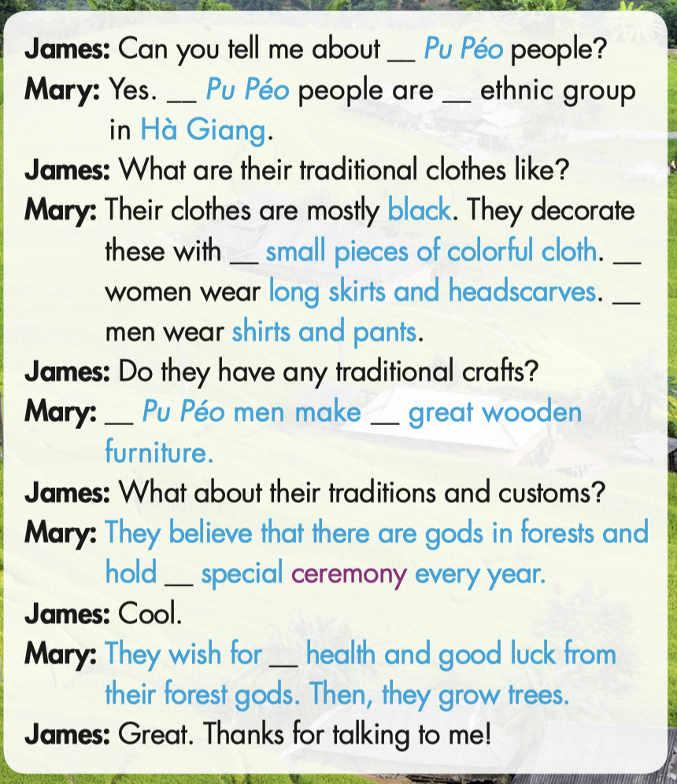
the
the
an
a. Fill in the blanks with the correct articles.
Ø
The
The
Ø
Ø

Slide 16
a. Fill in the blanks with the correct articles.
a
the

Slide 17
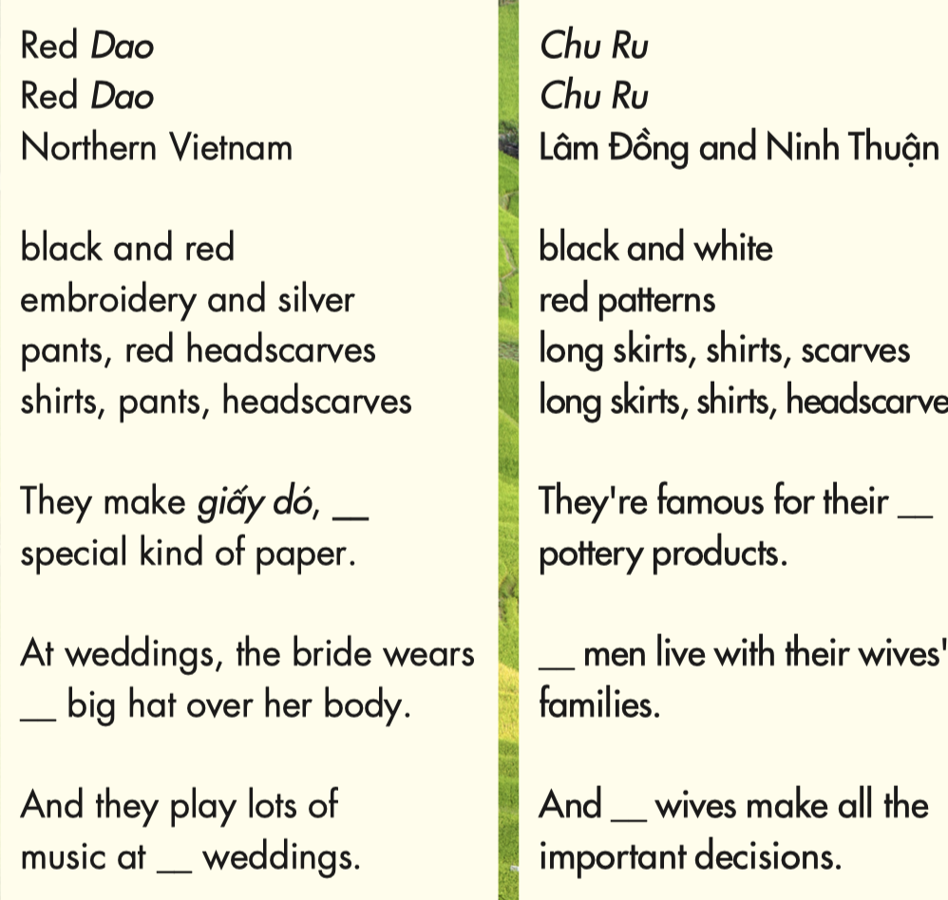
b. Make two more conversations using the ideas on the right.
a
Ø
The
a
the
Ø

Slide 18
Speaking

Slide 19
Task a
The People of Vietnam
Student A, ask questions and complete the Hmong people

Slide 20
Task a
The People of Vietnam
Student B, ask questions and complete the Tày people

Slide 21
Let’s check the answer.

Slide 22
Task b
Do you know any ethnic groups in Vietnam. What do you know about their cultures?
I know that the Hoa people
in Ho Chi Minh City live in Chợ Lớn
in District 5. They also celebrate Lunar New Year and Mid-Autumn Festival like the Kinh people.

Slide 23
CONSOLIDATION

Slide 24
Write four sentences about an ethnic group you learned in the lesson. Remember to include:
+ Where they live
+ What they wear
+ What arts and crafts they make
+ Traditions and customs

Slide 25
WRAP-UP

Slide 26
Today’s lesson
Pronunciation
Stress the first syllable for most two-syllable adjectives.
Speaking
Ask and answer about different ethnic groups’ culture, using articles.

Slide 27
Homework
Review articles
Do the exercises on page 45 WB
Prepare the next lesson (pages 78 & 79 SB)
Do the consolidation games on www.eduhome.com.vn

Slide 28
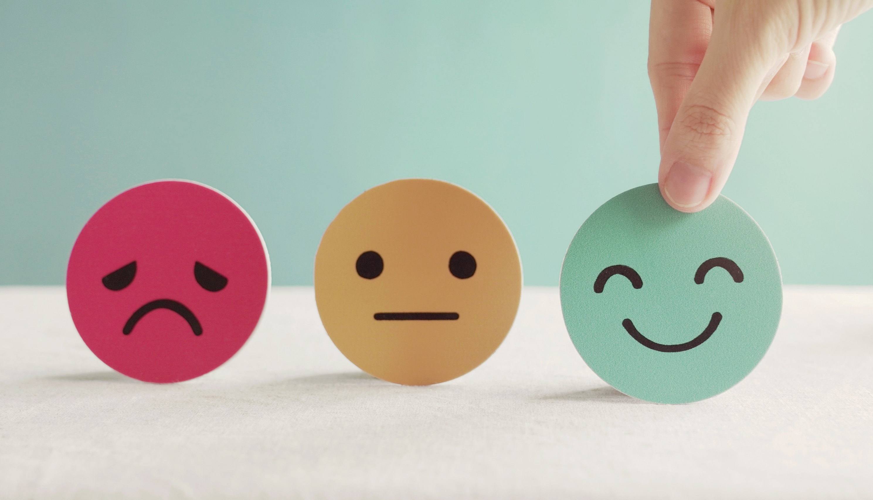
Lesson 3
Stay positive and have a nice day!

