Slide 2
Unit 3
GREEN LIVING
LESSON I
GETTING STARTED
Green Classroom Competition

Slide 3
LESSON I
GETTING STARTED
WARM-UP
Guessing game
PRESENTATION
Vocabulary
Task 1: Listen and read.
Task 2: Read and tick
Task 3: Match each word with its definition.
Task 4: Complete the sentences.
PRACTICE
PRODUCTION
Making mind map
CONSOLIDATION
Wrap-up
Homework

Slide 4
WARM-UP
GUESSING GAME

Slide 5
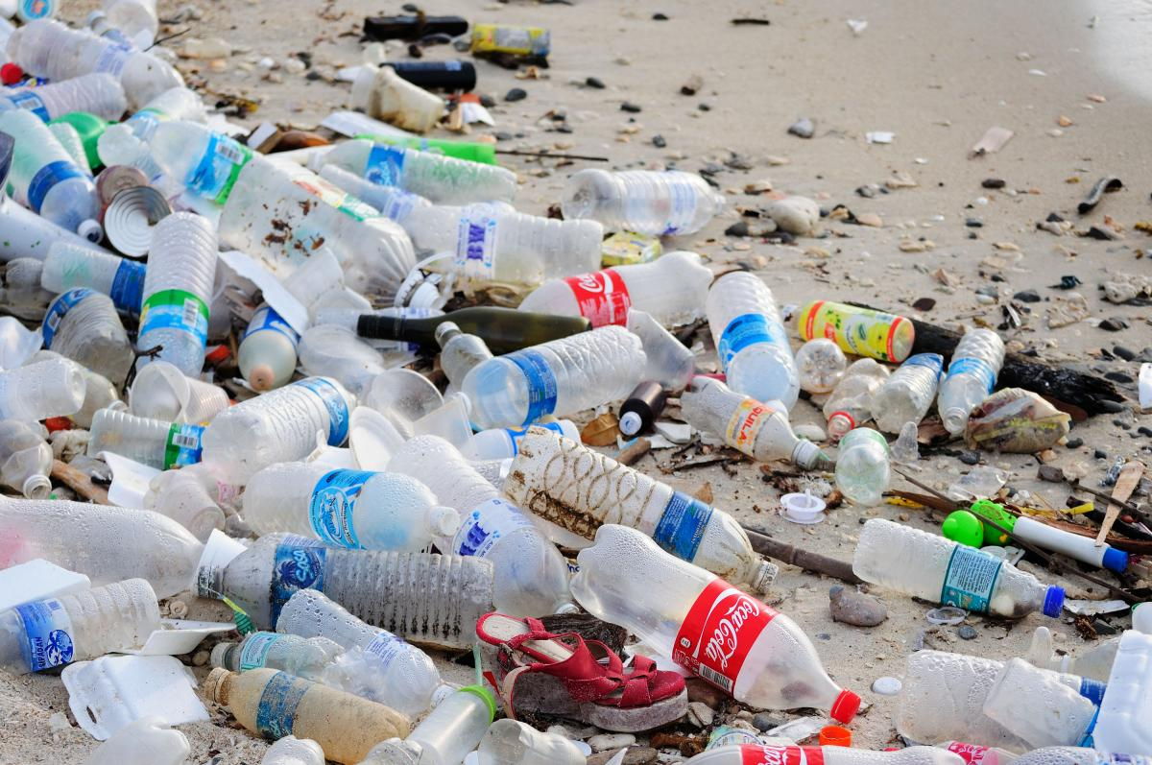
plastic pollution

Slide 6
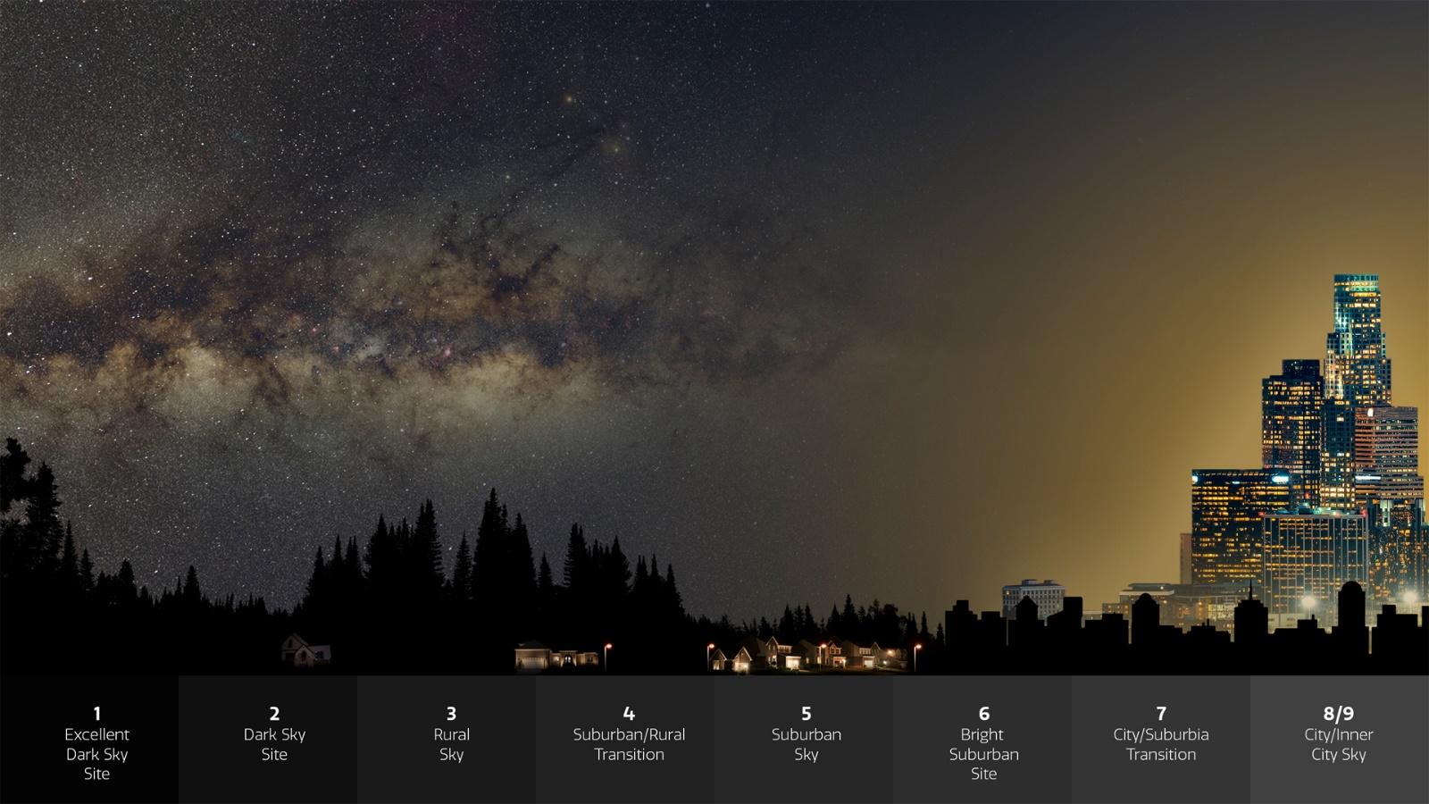
light pollution

Slide 7
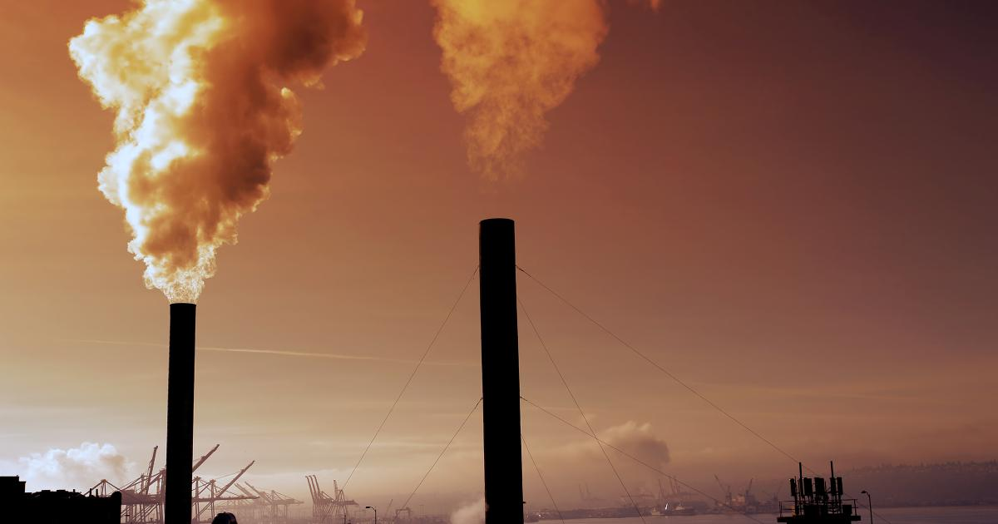
air pollution

Slide 8
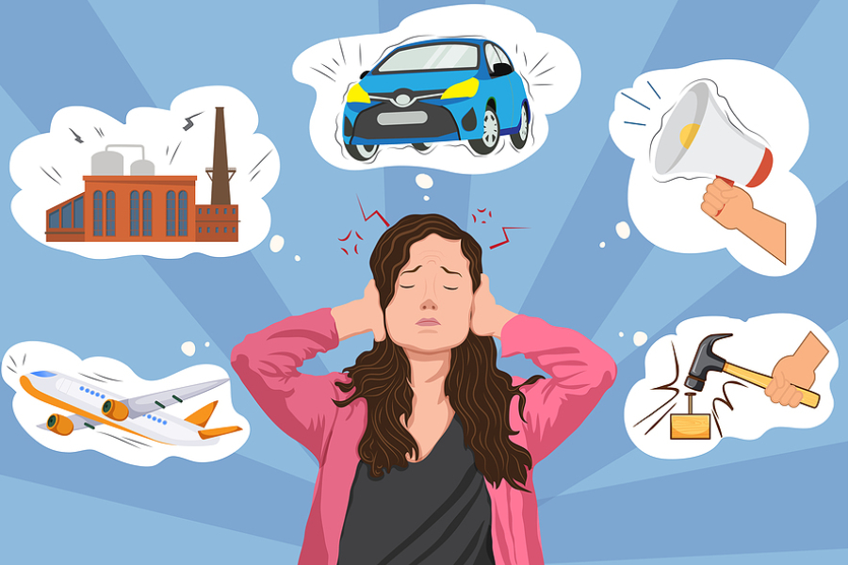
noise
pollution

Slide 9
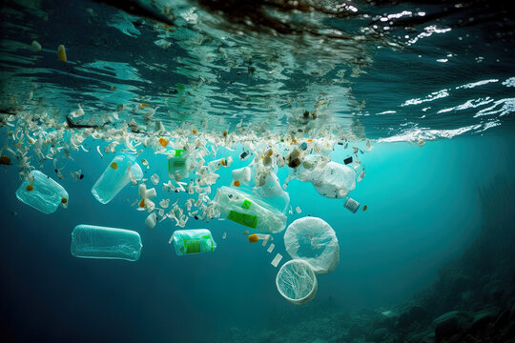
water pollution

Slide 10
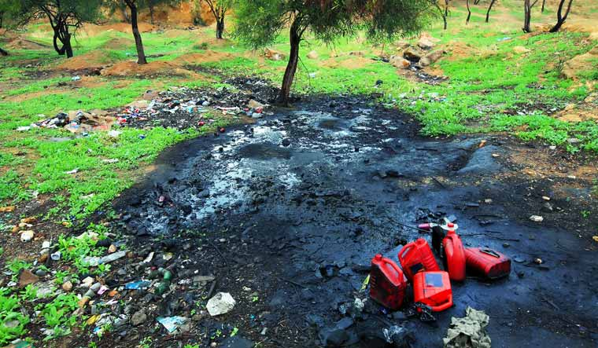
soil pollution

Slide 11

PRESENTATION
awareness (adj)
/əˈweənəs/
knowledge or understanding of a particular subject or situation

Slide 12
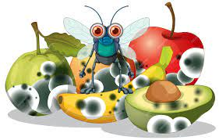
PRESENTATION
decompose (v)
/diːkəmˈpəʊz/
decay or make something decay

Slide 13

PRESENTATION
reusable (n)
/riːˈjuːzəbəl/
able to be used more than once

Slide 14

PRESENTATION
carbon footprint
/kɑːbən ˈfʊtprɪnt/
a measurement of the amount of carbon dioxide that human activities produce

Slide 15
Form | Pronunciation | Meaning | Vietnamese equivalent
1. awareness | /əˈweənəs/ | knowledge or understanding of a particular subject or situation | nhận thức
2. decompose | /ˌdiːkəmˈpəʊz/ | decay or make something decay | phân hủy
3. reusable | /ˌriːˈjuːzəbəl / | able to be used more than once | có thể tái sử dụng
4. carbon footprint | /kɑːbən ˈfʊtprɪnt/ | a measurement of the amount of carbon dioxide that human activities produce | dấu ấn các-bon

Slide 16

PRACTICE
1
Listen and read.

Slide 17
PRACTICE
2
Read the conversation again and tick (✔) the green ideas mentioned in 1.
1. putting more plants in the classroom
2. asking students to bring single-use water bottles
3. placing a big water jug in the classroom
4. leaving lights and air conditioners on when leaving the classroom
5. placing reminders on saving electricity near doors
✔
✔
✔

Slide 18
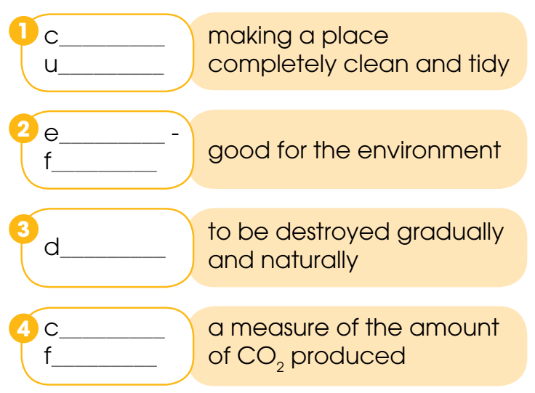
PRACTICE
3
Find words and phrases in 1 with the following meanings.
leaning
p
co
riendly
ecompose
arbon
ootprint

Slide 19
PRACTICE
4
Complete the sentences with words from 1.
away
1. Many students throw (1) _______ plastic water bottles after a single use, (2) _______ is not good for the environment.
2. We need to turn (3) ______ the lights and air conditioners before leaving the classroom.
3. Some students leave them (4) ______ when they rush out, (5) _________ is a waste of electricity.
which
off
on
which

Slide 20

PRODUCTION
Make a mind map about ways to protect the environment.

Slide 21
CONSOLIDATION
1
Wrap-up
What have you learnt today?
Some lexical items about green living
Reading for specific information
Verbs with prepositions

Slide 22
CONSOLIDATION
2
Homework
Do exercises in the workbook.
Make a mind map about ways to protect environment.
Prepare materials for the project in Lesson 8.

Slide 23
Website: hoclieu.vn
Fanpage: facebook.com/www.tienganhglobalsuccess.vn

