Slide 1

Unit 8: Traditions of
Ethnic Group in Vietnam
Lesson 1.1: Vocab & Reading
Pages 74 & 75

Slide 2
Lesson Outline
Warm-up
Vocabulary
Reading
Consolidation
Wrap-up

Slide 3

By the end of this lesson, students will be able to…
- learn and use vocabulary related to traditions of ethnic groups in Vietnam.
- practice reading for gist and detailed information.

Slide 4

New words
embroidery
pottery
headscarf
cloth
basket
ethnic
silver
pattern
product

Slide 5

Lesson 1
WARM UP

Slide 6

Pre-reading

Slide 7



Slide 8

Work in pairs
Let’s talk: Look at the pictures. Do you know the ethnic groups of these people? What’s your ethnic group? What are some traditions of your group?

Slide 9
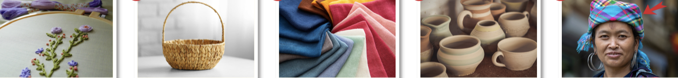
What can you see in each picture?

Slide 10
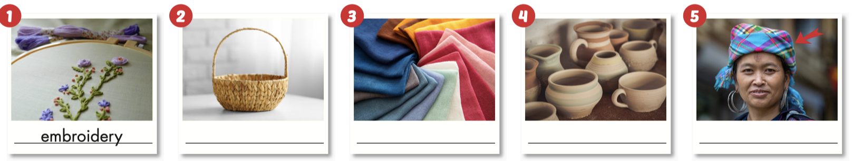
a. Match the words with the pictures.
headscarf pottery embroidery cloth basket
basket
cloth
pottery
headscarf

Slide 11
Check out the words and definitions
ethnic: connect to a group of people sharing same cultures, traditions, and languages
silver: a shiny, white material often used to make jewelry or coins, etc.
pattern: a design regularly made from repeated lines, shapes, or colors
product: a thing that people grow or make, usually for sale

Slide 12
b. Fill in the blanks with the correct words.
ethnic pattern silver product
silver
I have a ____________ necklace. It’s very beautiful and shiny.
There are 54 ____________ groups in Vietnam. The Kinh people have the largest population.
I love the ____________ on this skirt. The stars and clouds look very pretty together.
The local people make lots of different ____________s and sell them at the market.
ethnic
pattern
product

Slide 13

Listen and repeat. Click on each word to hear the sound.
embroidery (n) /ɪmˈbrɔɪdəri/ đồ thêu, sự thêu thùa
headscarf (n) /ˈhedskɑːrf/ khăn trùm đầu
pottery (n) /ˈpɑːtəri/ đồ gốm
cloth (n) /klɑːθ/ vải
basket (n) /ˈbæskɪt/ giỏ, sọt, rổ
ethnic (adj) /ˈeθnɪk/ dân tộc
silver (n) /ˈsɪlvər/ bạc
pattern (n) /ˈpætərn/ hoa văn
product (n) /ˈprɑːdʌkt/ sản phẩm
Notes:
GV click vào từng cụm nghe âm thanh

Slide 14

c. In pairs. Use the new words to talk about traditional arts and crafts you know.

Slide 15

While-Reading

Slide 16
Task a
Pre-reading
Read the instruction and the answers quickly:
Underline the key words.
What are we going to do?
Read and choose the main topic about the Chăm people.
Read the article about the Chăm people. What’s the main topic of the article?
Chăm family traditions
Chăm traditional clothes and crafts

Slide 17
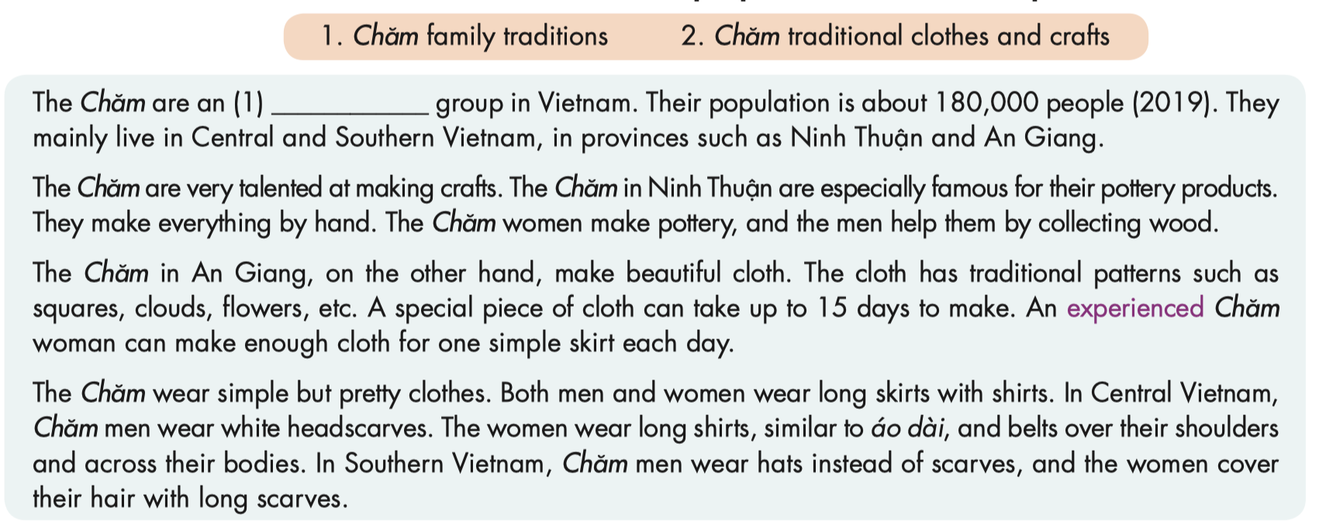
a. Read the article about the Chăm people. What’s the main topic of the article?

Slide 18
Task b
Pre-reading
Read the instruction and the answers quickly:
- Underline the key words.
- What are we going to do?
Read and circle the answer that best fits the numbered blank.
Read and circle the answer that best fits the numbered blank.
1. A. embroidery B. ethnic C. silver

Slide 19
b. Read and circle the answer that best fits numbered blank.
1. A. embroidery
B. ethnic
C. ethnic

Slide 20
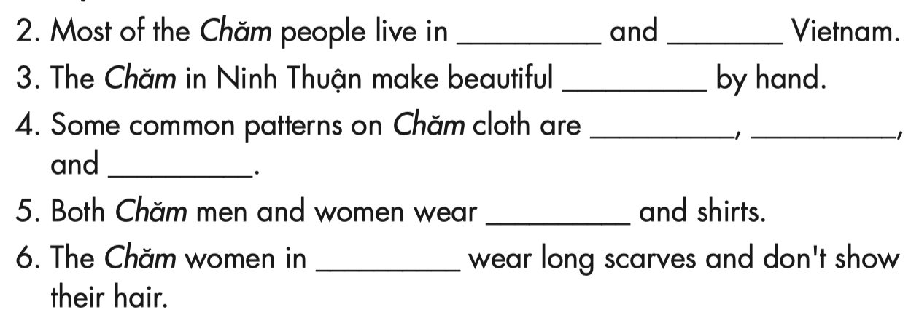
Task b
Pre-reading
Read the instruction and the answers quickly:
Identify the parts of speech in each blank. Underline the key words in each sentences, and relate to the article.
What are we going to do? Read and fill in the blanks.

Slide 21
b. Now, read and fill in the blanks.
2. Most of the Chăm people live in ____________ and ____________ Vietnam.
3. The Chăm in Ninh Thuận make beautiful _______________________ by hand.
4. Some common patterns on Chăm cloth are ____________, ____________,
and ____________.
5. Both Chăm men and women wear ____________ and shirts.
6. The Chăm women in ____________ wear long scarves and don’t show their hair.
Central
Southern
pottery products
squares
clouds
flowers
long skirts
the south

Slide 22
c. Listen and read.
The Chăm are an ethnic group in Vietnam. Their population is about 180,000 people (2019). They mainly live in Central and Southern Vietnam, in provinces such as Ninh Thuận and An Giang.
The Chăm are very talented at making crafts. The Chăm in Ninh Thuận are especially famous for their pottery products. They make everything by hand. The Chăm women make pottery, and the men help them by collecting wood.
The Chăm in An Giang, on the other hand, make beautiful cloth. The cloth has traditional patterns such as squares, clouds, flowers, etc. A special piece of cloth can take up to 15 days to make. An experienced Chăm woman can make enough cloth for one simple skirt each day.
The Chăm wear simple but pretty clothes. Both men and women wear long skirts with shirts. In Central Vietnam, Chăm men wear white headscarves. The women wear long shirts, similar to áo dài, and belts over their shoulders and across their bodies. In Southern Vietnam, Chăm men wear hats instead of scarves, and the women cover their hair with long scarves.

Slide 23
Post-reading

Slide 24

Work in pairs
What are some similarities and differences between your ethnic group and
the Chăm?
We also make pottery, but our traditional clothes are different.

Slide 25

CONSOLIDATION

Slide 26
Talk about your ethnic group. Remember to include:
+ Name of your ethnic group
+ Population
+ Traditional costume
+ Traditional food, arts and crafts

Slide 27

WRAP-UP

Slide 28
Vocabularies
embroidery
pottery
headscarf
cloth
basket
ethnic
silver
pattern
product
Today’s lesson

Slide 29
Today’s lesson
Reading:
- Understanding instructions
Skimming and scanning for general and detailed information
Speaking:
- Talking about your ethnic group and the Chăm

Slide 30
Homework
Learn by hearts vocabularies
Do the exercises on pages 44 & 45 WB
Do the exercises in Tiếng Anh 8 i-Learn Smart World Notebook on pages 62 & 63
Prepare the next lesson (pages 75 & 76 SB)
Do the consolidation games on www.eduhome.com.vn

Slide 31

Lesson 3
Stay positive and have a nice day!

