Slide 1

Unit 10: Cities around the World
Lesson 3.1: Vocabulary & Listening
Page 84

Slide 2
Lesson Outline
Warm-up
Vocabulary
Listening
Useful language
Consolidation
Wrap-up

Slide 3
Objectives
By the end of this lesson, students will be able to…
- use the superlative adjectives in listening/speaking skill
- enlarge their vocabulary relating to the topic – Cities around the World
- get someone’s attention into a conversation and practice listening skills by deciding whether the statement is True or False

Slide 4

WARM-UP

Slide 5
Play a game
2 teams
Look at the picture (on the next slide).
List adjectives to describe the city in the picture.
The team that gets more adjectives will be the winner.
ID: 238876258

Slide 6
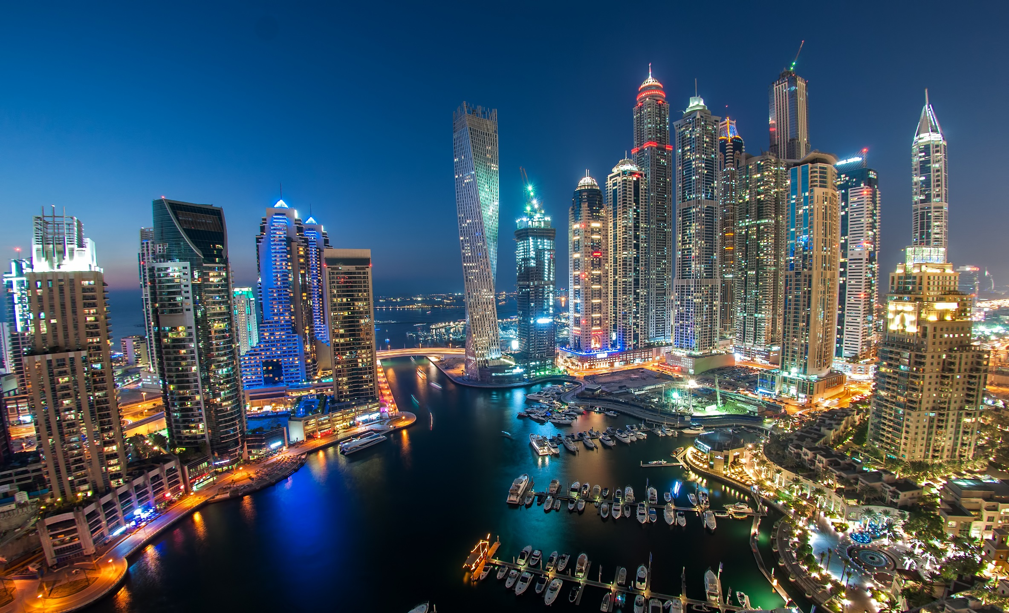
ID: 238876258

Slide 7

New words
clean
populated
cheap
temperature
expensive
polluted

Slide 8


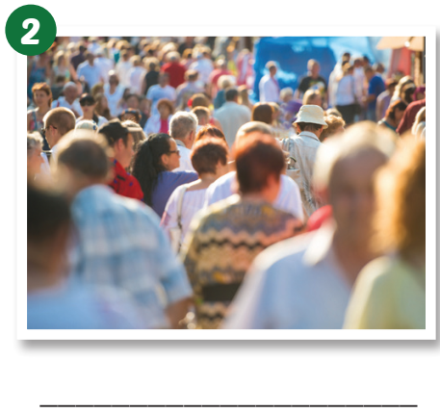
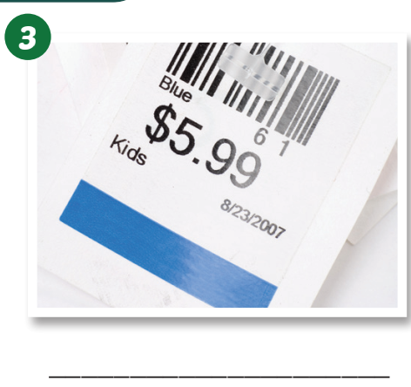
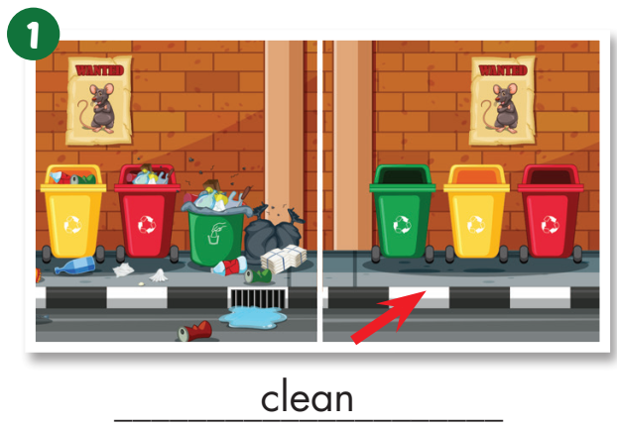
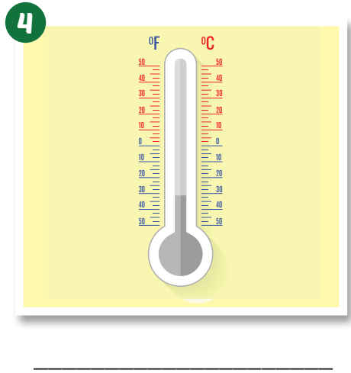
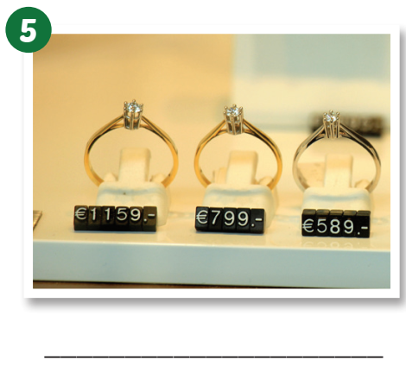
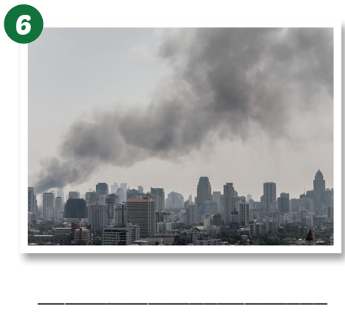
Fill in the blanks. Listen and repeat.
polluted
expensive
cheap
clean
populated
temperature
populated
cheap
temperature
expensive
polluted

Slide 9
New words
clean (adj) /kliːn/ sạch sẽ
populated (adj) /ˈpɑːpjəleɪtɪd/ đông dân
cheap (adj) /tʃiːp/ rẻ
temperature (n) /ˈtempərətʃər/ nhiệt độ
expensive (adj) /ɪkˈspensɪv/ đắt (mắc)
polluted (adj) /pəˈluːtɪd/ ô nhiễm

Slide 10
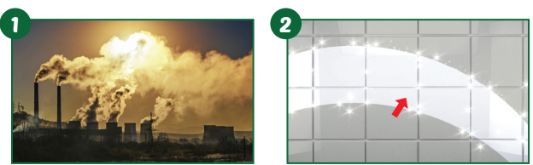
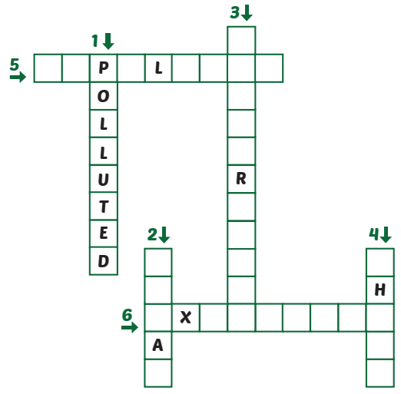
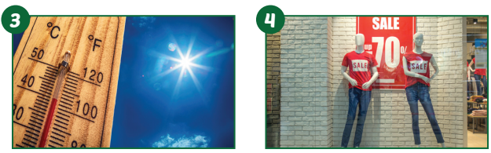
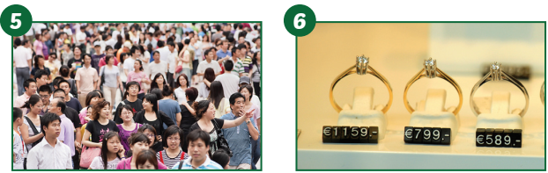
Look at the pictures and do the crossword puzzle
Extra Practice
WB page 60
T
P
O
U
A
T
E
D
M
P
E
A
T
C
U
C
L
R
E
P
E
N
S
I
V
E
A
N
P

Slide 11
Extra Practice
WB page 60
b. Fill in the blanks with the words in Task a.
1. Too many factories make the air ________________.
2. These T-shirts are really __________. They’re only five dollars.
3. The ________________ in summer is usually hot.
4. I did the dishes. Now, they’re all __________.
5. Cities are more ________________ than the country.
6. This sports car is very ________________.
polluted
cheap
temperature
clean
populated
expensive

Slide 12
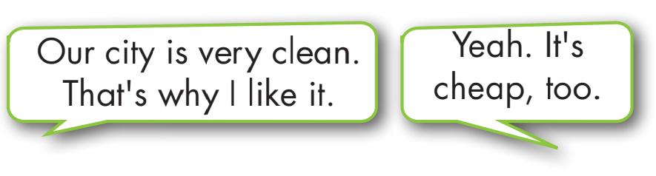
Use the new words to talk about a place you know
Example:

Slide 13

Listening

Slide 14
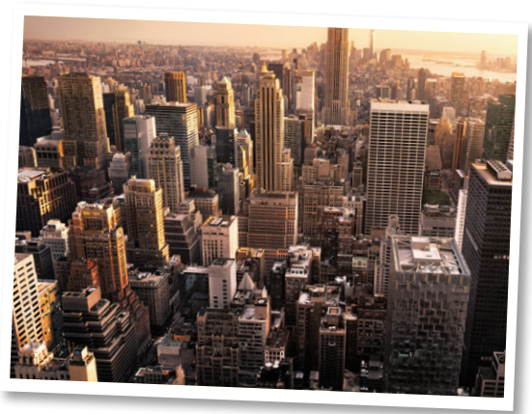
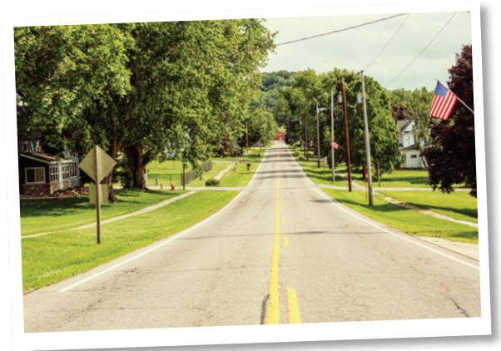
Listen to two students talking about some cities and circle the correct answer.
Pre-Listening
Kayla's project is about comparing…
a. cities in the USA. b. cities around the world. c. countries.

Slide 15
While-Listening
Listen to two students talking about some cities and circle the correct answer.
Kayla's project is about comparing…
a. cities in the USA. b. cities around the world. c. countries.

Slide 16
While-Listening
b. Listen and circle "True" or "False."
1. The most populated city in the USA is Los Angeles. True/False
2. In 2019, nearly 9 million people lived in New York. True/False
3. Buford City is the smallest city in the USA. True/False
4. The most expensive city is San Francisco. True/False

Slide 17
Audio scripts
Kayla: Hey, John. Do you know what the most populated city in the USA is? Can you guess?
John: Hmm, Los Angeles?
Kayla: No. It's New York. In twenty nineteen, nearly nine million people lived there.
John: That's a lot! Is that in your magazine?
Kayla: Yes, it is. It's an article comparing cities in the USA.
John: I guess our city is the smallest? We only have around five thousand people living here.
Kayla: No, that's Buford City in Wyoming. That only has one person!
John: That's funny. What's the most expensive city? Is it San Francisco?
Kayla: No, it isn't. It's New York.
John: Why?
Kayla: Houses are expensive, travel, restaurants, and other things, too.
John: Wow! I'm glad we live here.
Kayla: Me too. I think our city is the best place to live.
1
2
3
4

Slide 18
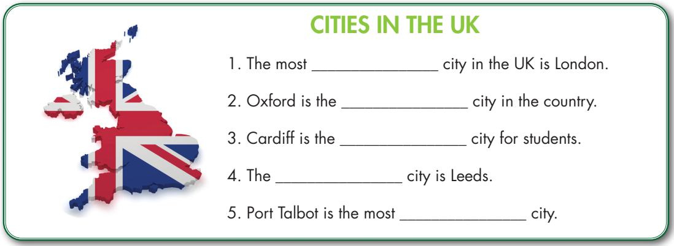
Extra Practice
WB page 60
Listen and fill in the blanks
populated
most expensive
cheapest
coldest
polluted

Slide 19
Audio scripts
Abigail: Hey, Matthew. What are you reading about?
Matthew: It's an article about cities in the UK. Which is the most populated city, do you think?
Abigail: Oh, London. That's easy. It's the capital, so it's the biggest.
Matthew: Correct, Abigail!
Abigail: Is London the most expensive city in the UK?
Matthew: Actually, no. Oxford is the most expensive city in the country.
Abigail: So where's the least expensive place to be?
Matthew: Cardiff is the cheapest city for students.
Abigail: How about the temperatures in different cities there?
Matthew: Well, London has the highest temperatures but the coldest city is Leeds.
Abigail: The UK is pretty clean, isn't it?
Matthew: Hmm. Some places are. Exeter is the cleanest city there.
Abigail: And the most polluted?
Matthew: That's Port Talbot. The air pollution there is pretty bad.
Abigail: I think Exeter sounds nicer.
Matthew: Yeah, me too.
Narrator: Now, listen again
1
2
3
4
5

Slide 20

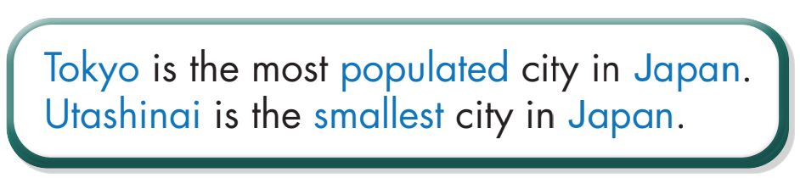
Post-Listening
Listen then practice

Slide 21
Work in pairs - use the Useful Language form to ask and answer about the cities in Vietnam.
Post-Listening
Suggestions:
1. Which is the biggest city in Vietnam?
2. Which is the most beautiful city in Vietnam?
3. Which is the smallest city in Vietnam?
3. Which is the hottest city in Vietnam?
4. Which is the most peaceful city in Vietnam?
5. Which is the most expensive city in Vietnam?

Slide 22

CONSOLIDATION

Slide 23
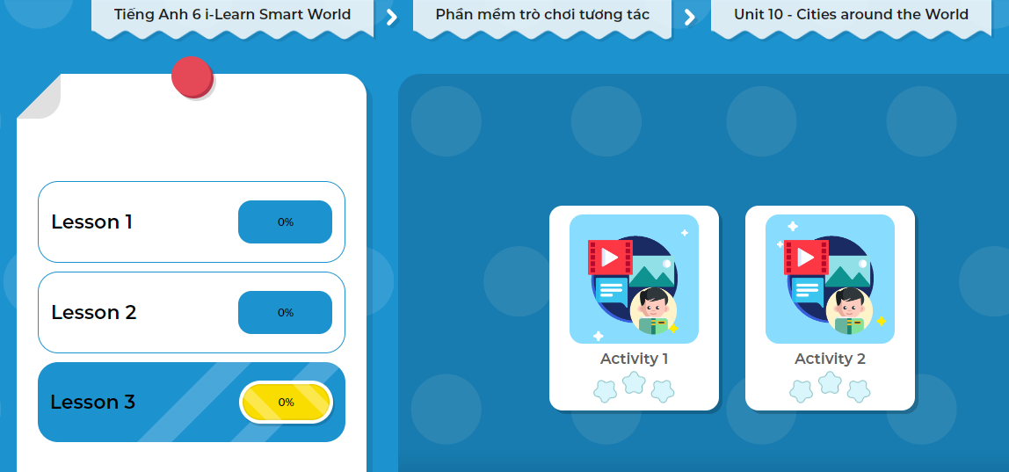
LET’S PLAY!
Click here to play the game!
Notes:
Mở Ứng dụng DHA trên Eduhome. Sách lớp 6, Unit 10, Lesson 3, Activity 1

Slide 24

WRAP-UP

Slide 25
Today’s lesson
Vocabularies
clean
populated
cheap
temperature
expensive
polluted
Sentence patterns
Using the superlative to talk about the cities

Slide 26
Homework
- Learn new words about Cities around the World
- Do the exercises in Tiếng Anh 6 i-Learn Smart World Notebook on page 62
- Prepare for the new lesson – Writing on page 85 (SB).

Slide 27

Have a nice day!

