Slide 1


Slide 2
REVIEW
2
(UNITS 4-5)
Unit
FAMILY LIFE
LESSON 2
SKILLS (1)
Listening and Speaking

Slide 3
LESSON 2
SKILLS (1)
WARM-UP
Watch a video
Task 1: Listen to a conversation. What are they talking about?
Task 2: True or false.
Task 3: Extra activity
LISTENING
SPEAKING
Discussion.
CONSOLIDATION
Wrap-up
Homework

Slide 4
WARM-UP
WATCH A VIDEO
Which environmental problems are mentioned in the video?
What is one of the main causes of global warming?
What can be done to reduce CO2 emissions?

Slide 5
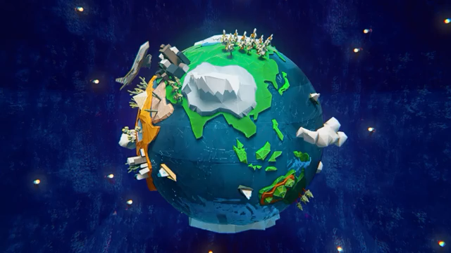
WARM-UP
WATCH A VIDEO
Notes:
Link: https://www.youtube.com/watch?v=7qQ0fDOOYxk

Slide 6
WARM-UP
Which environmental problems are mentioned in the video?
What is one of the main causes of global warming?
What can be done to reduce CO2 emissions?
➔ Global warning and abnormal weather such as torrential rain and drought.
➔ (One of the main causes of global warming is) CO2.
➔ Three main ways:
+ Fully mastering combustion technology to completely burn fuel
+ Convert unused energy into electricity
+ Optimize thermal control

Slide 7

LISTENING
1
Listen to a conversation between Nick and Ann. What are they talking about?
A. The effect of greenhouse gas emissions on climate
B. Ways to reduce greenhouse gas emissions
C. Ways to build green plants

Slide 8
LISTENING
2
True (T) or false (F).
 | T | F
1. Our planet is not as warm as usual.
2. Methane emissions from cows can be changed into usable energy.
3. Methane emissions will increase as a result of population growth.
4. Scientists think that green oceans can’t reduce the amount of CO2.
5. The NZT project involves the transport and storage of CO2.
✓
✓
✓
✓
✓

Slide 9

SPEAKING
Work in groups. Discuss if the following technologies mentioned in the Listening can be used in Viet Nam. Think about how they can help slow global warming.

Slide 10
SPEAKING
Work in groups. Discuss if the following technologies mentioned in the Listening can be used in Viet Nam. Think about how they can help slow global warming.
– Turning methane emissions from cows into energy
– Growing plants in the ocean
– Keeping CO2 in storage sites

Slide 11
CONSOLIDATION
1
Wrap-up
What have you learnt today?
Practise listening for main ideas and specific information about ways to reduce gas emissions;
Develop ideas about technologies to be used in Viet Nam to reduce global warming and discuss in groups.

Slide 12
CONSOLIDATION
2
Homework
Do exercises in the workbook.
Prepare for Review 2 – Lesson 3.

Slide 13

Website: hoclieu.vn
Fanpage: facebook.com/www.tienganhglobalsuccess.vn
Website: hoclieu.vn
Fanpage: facebook.com/sachmem.vn/

