Slide 1


Slide 2



REVIEW
2
LESSON 1: LANGUAGE
Grammar
UNITS
4-5-6
Vocabulary
Pronunciation
Unit
HOBBIES

Slide 3

OBJECTIVES
By the end of the lesson, students will have revised the language they have learnt in Units 4 – 6.

Slide 4
LESSON 1: LANGUAGE
WARM-UP
Game: Finding keywords
PRONUNCIATION
Task 1: Circle the word in which the underlined part is pronounced differently. Then listen, check and repeat.
Task 2: Match. Then complete the sentences.
Task 3: Underline the correct word to complete the sentences.
VOCABULARY
Task 4: Complete the passages about camping.
Task 5: Complete the second sentence.
GRAMMAR
CONSOLIDATION
Wrap-up
Homework

Slide 5

LESSON 1: LANGUAGE
WARM-UP
Game: Finding keywords
Aims of the stage:
to lead in the lesson

Slide 6
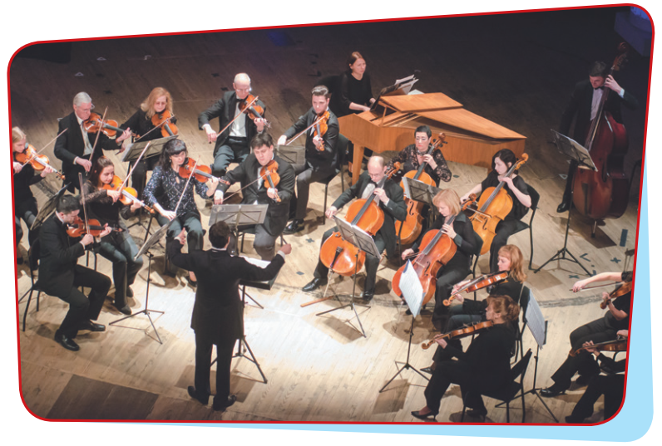
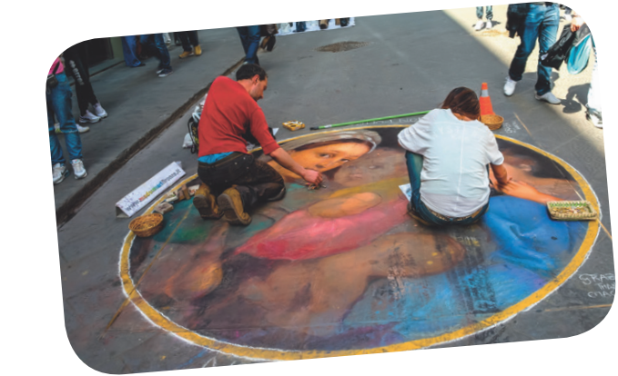
WARM-UP
MUSIC & ARTS

Slide 7
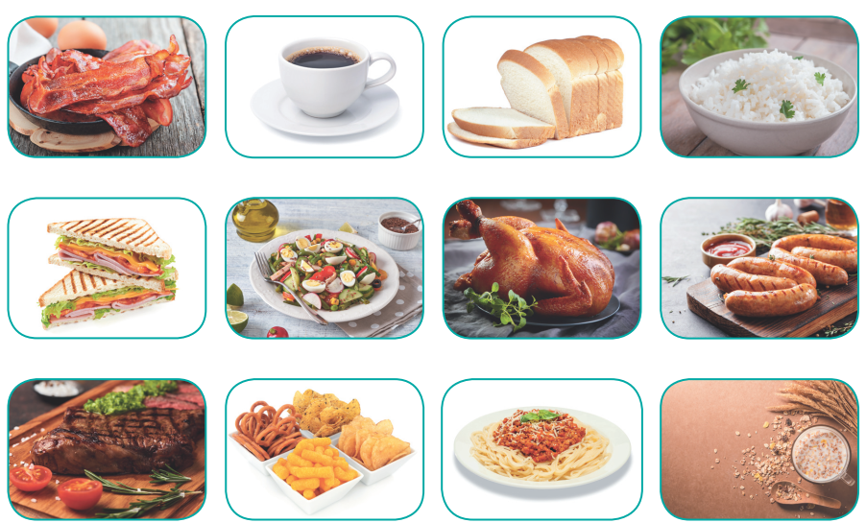
WARM-UP
FOOD & DRINKS

Slide 8

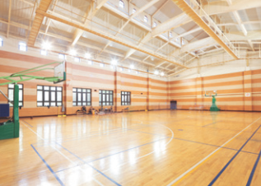

WARM-UP
SCHOOL FACILITIES

Slide 9
LESSON 1: LANGUAGE
WARM-UP
Game: Finding keywords
PRONUNCIATION
Task 1: Circle the word in which the underlined part is pronounced differently. Then listen, check and repeat.

Slide 10

PRONUNCIATION
1
Circle the word in which the underlined part is pronounced differently. Then listen, check and repeat the words.
1. A. decision B. vision C. measure D. sure
2. A. ocean B. cinema C. musician D. delicious
3. A. hot B. cottage C. compose D. lot
4. A. chicken B. architect C. cheap D. chair
5. A. condition B. attention C. question D. addition

Slide 11
LESSON 1: LANGUAGE
WARM-UP
Game: Finding keywords
PRONUNCIATION
Task 1: Circle the word in which the underlined part is pronounced differently. Then listen, check and repeat.
Task 2: Match. Then complete the sentences.
Task 3: Underline the correct word to complete the sentences.
VOCABULARY

Slide 12
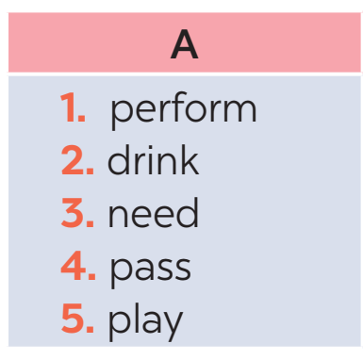
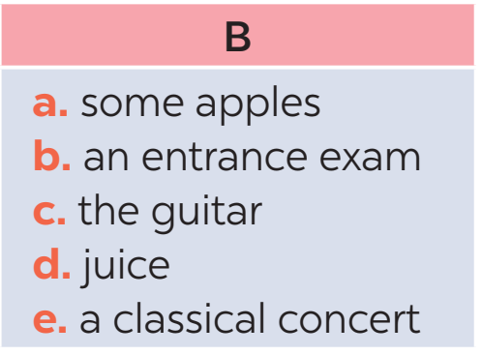
VOCABULARY
2
Match a word in A with a word / phrase in B. Then complete the sentences with the appropriate phrases.

Slide 13
VOCABULARY
2
Match a word in A with a word / phrase in B. Then complete the sentences with the appropriate phrases.
play the guitar
1. The students learn how to ____________ in their music lessons twice a week.
2. We _______________ for this recipe.
3. The orchestra will ______________________ tomorrow.
4. She doesn’t allow her children to ____________ during dinner.
5. They have to ___________________ to enter this school.
need some apples
perform a classical concert
drink juice
pass an entrance exam

Slide 14
VOCABULARY
3
Underline the correct word to complete the sentences.
1. Trinh Cong Son is one of Viet Nam’s greatest scientists / composers.
2. How many butter / apples do we need for an apple pie?
3. The musicians will perform their final portrait / concert next week.
4. Ha Noi Amsterdam School is for normal / gifted students.
5. Students have to take a(n) entrance / final exam to study at my school.

Slide 15
LESSON 1: LANGUAGE
WARM-UP
Game: Finding keywords
PRONUNCIATION
Task 1: Circle the word in which the underlined part is pronounced differently. Then listen, check and repeat.
Task 2: Match. Then complete the sentences.
Task 3: Underline the correct word to complete the sentences.
VOCABULARY
Task 4: Complete the passages about camping.
Task 5: Complete the second sentence.
GRAMMAR

Slide 16
GRAMMAR
4
Complete the passages about camping. Use the words and phrases from the boxes.
How much How many a lot of
Plan your meals in advance. How many sandwiches are you going to make? How many loaves of bread will you need? Do you plan to make popcorn? (1) _________ butter do you need? (2) _________ eggs will you buy? Do you need to buy (3) _________ drinks in advance?
How much
How many
a lot of

Slide 17
GRAMMAR
4
Complete the passages about camping. Use the words and phrases from the boxes.
some much many
Making a fire is a skill. And it is easy to learn. You won’t need (4) ______ practice before you can make a campfire. Start with (5) ______ paper and leaves. Place the wood on top of these. Don’t use (6) ______ big pieces of wood. Just put two or three big pieces over the sticks and keep the rest for later.
much
some
many

Slide 18
GRAMMAR
5
Complete the second sentence, using the words in brackets.
1. I think classical music is not as exciting as rock and roll. (more … than)
→ I think rock and roll _____________________________________________.
2. The poster in the gallery is the same as the one in my house. (different from)
→ The poster in the gallery __________________________________________.
3. A ticket to the theatre is cheaper than I expected. (not as … as)
→ A ticket to the theatre ____________________________________________.
4. The painting in the museum is not different from the painting in the gallery. (like)
→ The painting in the museum _______________________________________.
is more exciting than classical music
is not different from the one in my house
is not as expensive as I expected
is like the one in the gallery

Slide 19
LESSON 1: LANGUAGE
WARM-UP
Game: Finding keywords
PRONUNCIATION
Task 1: Circle the word in which the underlined part is pronounced differently. Then listen, check and repeat.
Task 2: Match. Then complete the sentences.
Task 3: Underline the correct word to complete the sentences.
VOCABULARY
Task 4: Complete the passages about camping.
Task 5: Complete the second sentence.
GRAMMAR
CONSOLIDATION
Wrap-up
Homework

Slide 20
CONSOLIDATION
1
WRAP-UP
Vocabulary
Pronunciation
Grammar
Language

Slide 21

CONSOLIDATION
2
HOMEWORK
Prepare for Review 2 – Skills.

Slide 22

Website: sachmem.vn
Fanpage: facebook.com/sachmem.vn/

