Slide 1


Slide 2

Unit
8
1
FAMILY LIFE
Unit
NEW WAYS TO LEARN
LESSON 7
COMMUNICATION AND CULTURE / CLIL
EVERYDAY ENGLISH & CULTURE

Slide 3

Unit
1
1
OBJECTIVES
FAMILY LIFE
Unit
Family Life
1. Knowledge
- Expand vocabulary with the topic “Modern schools”
- Share opinions about the learning activities at school
2. Core competence
- Give instructions to download a learning app on their smartphone
- Be collaborative and supportive in class discussion
3. Personal qualities
- Be ready to give instructions and share opinions
- Understand the main features of modern schools

Slide 4
LESSON 7
COMMUNICATION AND CULTURE/CLIL
WARM-UP
Kahoot!
Q&A

Slide 5

WARM-UP
COMMUNICTION
Unit
GETTING STARTED
Kahoot! Game
https://create.kahoot.it/share/which-app/d237562c-85d3-4f10-9ca7-30facb238f4a
Get to know 6 popular English learning apps
Choose the right answer as quickly as possible by touching the option shown on the smartphone.
The highest score: the winner

Slide 6








Slide 7


WARM-UP
Q&A:
How many steps are there to download an app on your phone?

Slide 8
LESSON 7
COMMUNICATION AND CULTURE/CLIL
WARM-UP
Kahoot!
Q&A
EVERYDAY ENGLISH
Task 1: Listen and complete the conversation.
Task 2: Make similar conversations.

Slide 9
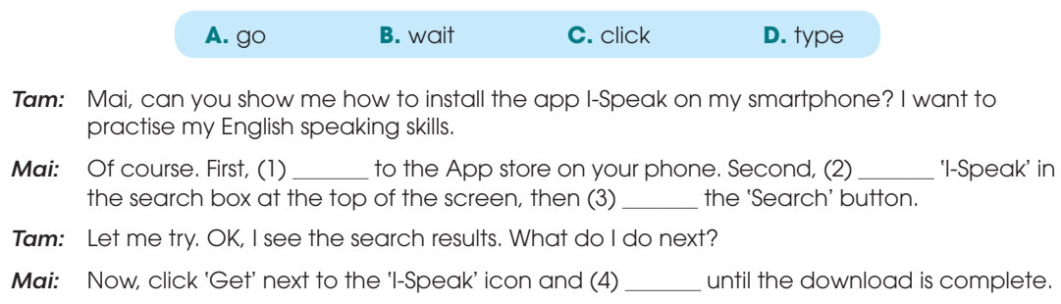
EVERYDAY ENGLISH
1
Listen and complete the conversation.
go
type
click
wait

Slide 10

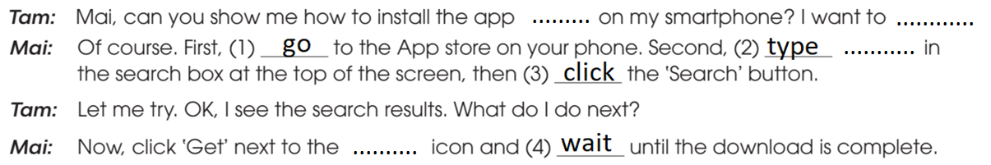
EVERYDAY ENGLISH
2
Make a similar conversation: how to install Zoom on your phone.
EXAMPLE:

Slide 11
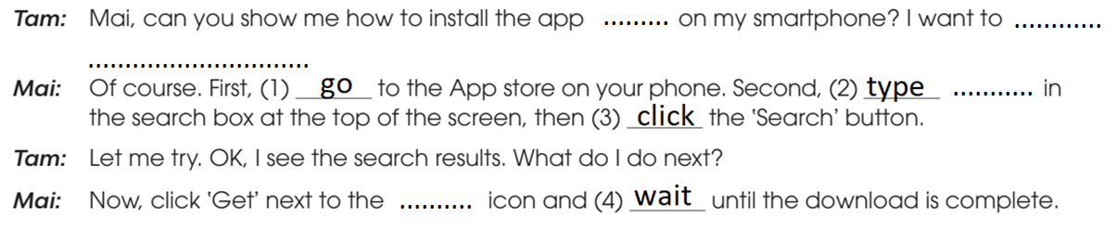
EVERYDAY ENGLISH
2
Make a similar conversation: how to install Zoom on your phone.
SAMPLE ANSWER:
Zoom
study online
'Zoom'
'Zoom'

Slide 12
LESSON 7
COMMUNICATION AND CULTURE/CLIL
WARM-UP
Kahoot!
Q&A
EVERYDAY ENGLISH
Task 1: Listen and complete the conversation.
Task 2: Make similar conversations.
CULTURE
Task 1: Read the text and answer the questions.
Task 2: Vote and discuss.

Slide 13
CULTURE
1
Read the text about modern schools and answer the questions.
What is the role of teachers in modern schools?
What are two common features of modern schools?
How do students use computers in the learning process?
How do students learn about the real world?

Slide 14
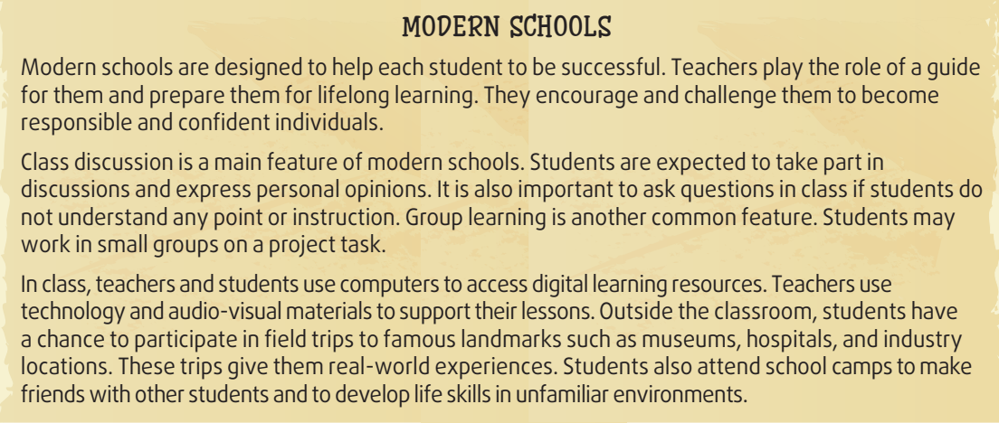
CULTURE
2
Read the text about modern schools and answer the questions.
What is the role of teachers in modern schools?

Slide 15
CULTURE
2
Read the text about modern schools and answer the questions.
2. What are two common features of modern schools?

Slide 16
CULTURE
2
Read the text about modern schools and answer the questions.
3. How do students use computers in the learning process?

Slide 17
CULTURE
2
Read the text about modern schools and answer the questions.
4. How do students learn about the real world?

Slide 18

CULTURE
4
Vote and discuss
Part 1. Go to vote on: https://www.mentimeter.com/s/fe6c01ee75718dbc5388aa0665509af6/22db24998c7f/edit

Slide 19

CULTURE
4
Vote and discuss
Part 2. Discussion
For the highest-voting activities:
Why do you like them?
In which subjects are they used?
For the lowest-voting activities:
Why didn’t you participate in these activities?
Do you want to change anything about these activities?

Slide 20
LESSON 7
COMMUNICATION AND CULTURE/CLIL
WARM-UP
Kahoot!
Q&A
EVERYDAY ENGLISH
Task 1: Listen and complete the conversation.
Task 2: Make similar conversations
CULTURE
Task 1: Read the text and answer the questions.
Task 2: Vote and discuss
CONSOLIDATION
Wrap-up
Homework

Slide 21
CONSOLIDATION
1
Wrap-up
Language items: How to give instructions
Knowledge: Get to know some learning apps and their functions

Slide 22

CONSOLIDATION
2
Homework
Write a paragraph (250 words) about your dream school with selective learning activities.
Prepare for the next lesson: Project

Slide 23

Website: sachmem.vn
Fanpage: facebook.com/sachmem.vn/

