Slide 1
Unit 5: Science and Technology
Lesson 2.1 – Vocabulary & Listening
Pages 48 & 49

Slide 2
Lesson Outline
Warm-up
Vocabulary
Listening
Consolidation
Wrap-up

Slide 3
By the end of this lesson, students will be able to…
learn and use vocabulary related to science and technology
practice listening for the purpose of the talk and for specific information
practice functional English – Showing agreement

Slide 4
New words
rescue
lift
complete
navigate
recognize
carefully
quietly
safely

Slide 5
WARM UP

Slide 6
Option 1
Watch a video and answer the question.
What can the robots do in this competition?
They can carry things.

Slide 7
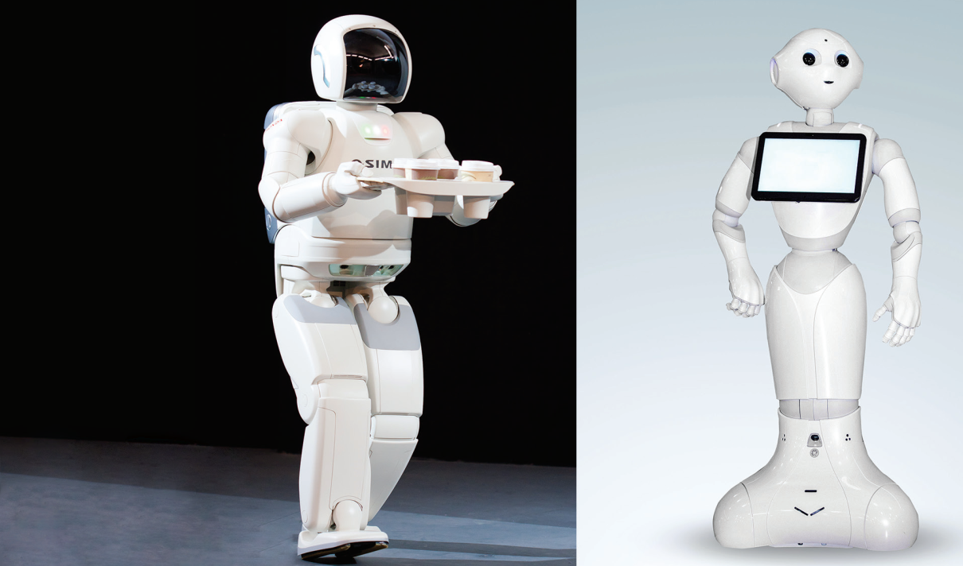
In pairs. Look at the picture. Discuss the questions.
Option 2
What do you think the robots can do? 2. Which robot do you think will be better as a cleaner? 3. Which will be better as a doctor?

Slide 8
Pre – Listening:
Vocabulary

Slide 9
Listen and repeat. Click on each phrase to hear the sound.
rescue (n) /ˈrɛs.kjuː/ sự giải cứu
lift (v) /lɪft/ nâng lên
complete (v) /kəmˈpliːt/ hoàn thành
navigate (v) /ˈnævɪɡeɪt/ điều hướng, vận hành
recognize (v) /ˈrɛkəɡnaɪz/ nhận ra
carefully (adv) /ˈkɛrfəli/ một cách cẩn thận
quietly (adv) /ˈkwaɪətli/ một cách yên lặng
safely (adv) /ˈseɪfli/ một cách an toàn
Notes:
GV click vào từng cụm nghe âm thanh

Slide 10
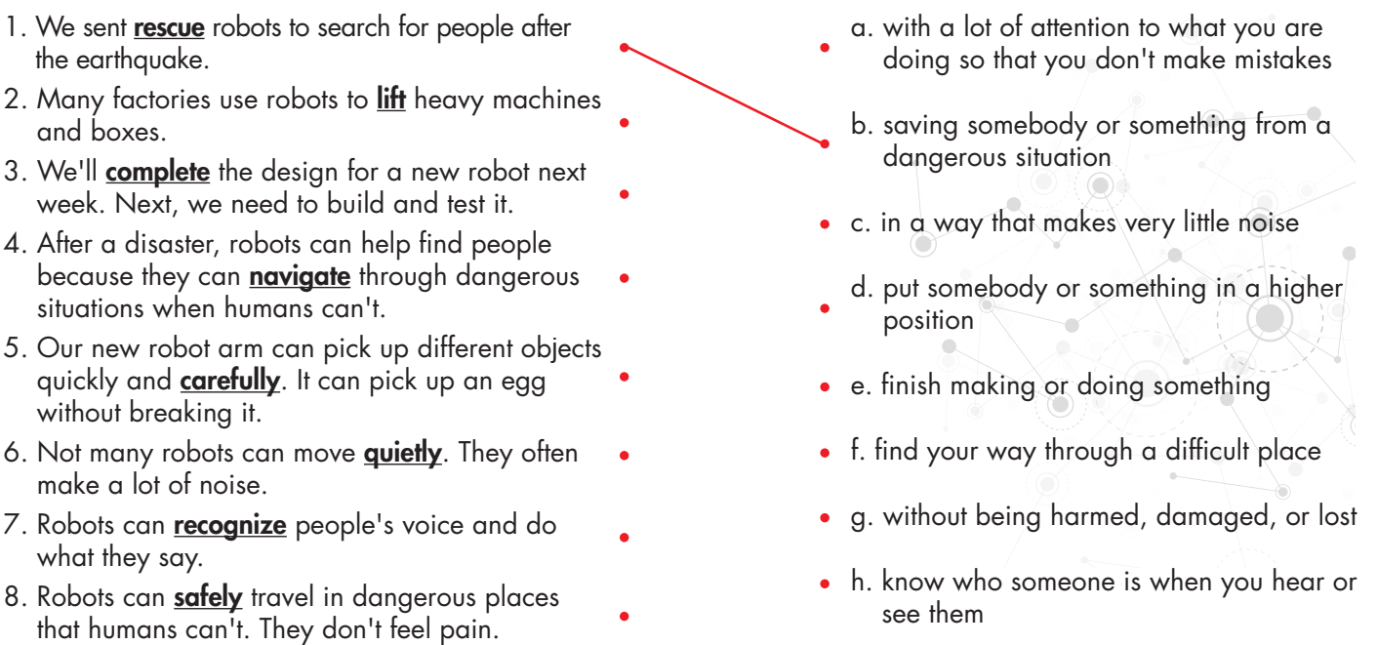

Slide 11
Work in pairs

Slide 12
Listening

Slide 14
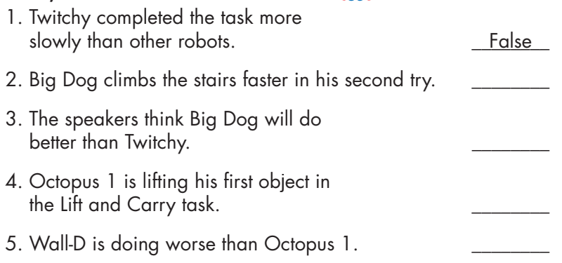
For True/ False
questions:
Listen carefully
Pay attention to
key phrases and words
3. Identify the speaker’s
tone
4. Take notes
5. Confirm your answer
Twitchy is currently in the first place.
False
He’s climbing the stairs more carefully and slowly this time.
False
I don’t think he’ll beat Twitchy.
True
Octopus 1 is the fastest and lifting the first object.
False
Yeah. Wall-D is doing better than Octopus 1.

Slide 15
Post - listening

Slide 16
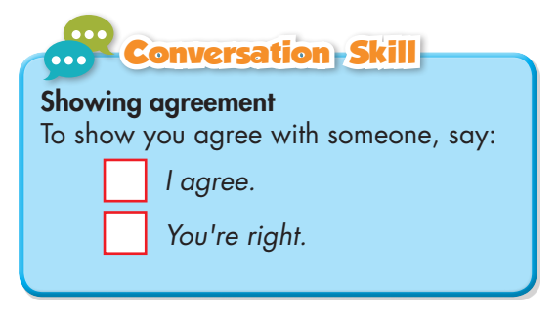

Slide 17
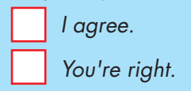
✓

Slide 18
Work in pairs

Slide 19
CONSOLIDATION

Slide 20
Language to show agreement.

Slide 21
Choose the correct word for each sentence. 1. In his first try, he climbed the stairs very quickly and fell. He’s climbing the stairs more carefully and quietly/ slowly this time.
2. Robots need to navigate/ recognize really well to complete this climbing task.
3. Tsunami can’t complete/ lift the ball. I think he needs to move more carefully.

Slide 22
WRAP-UP

Slide 23
Today’s lesson
Vocabulary
rescue
lift
complete
navigate
recognize
carefully
quietly
safely

Slide 24
Today’s lesson
- learn and use vocabulary related to science and technology.
- practice listening for the purpose of the talk and for specific information.
- practice functional English – Showing agreement.

Slide 25
Homework
- Learn the new words.
- Practice talking about robot competitions.
- Do the exercises in WB: New words and Listening (pages 34 & 35).
- Do the exercises in Tiếng Anh 8 i-Learn Smart World Notebook (pages 42 & 43).
- Play the consolidation games in Tiếng Anh 8 i-Learn Smart World DHA App on www.eduhome.com.vn
- Prepare: Lesson 2.2 – Grammar (pages 49 & 50 – SB).

Slide 26
Lesson 3
Stay positive and have a nice day!

