Slide 1
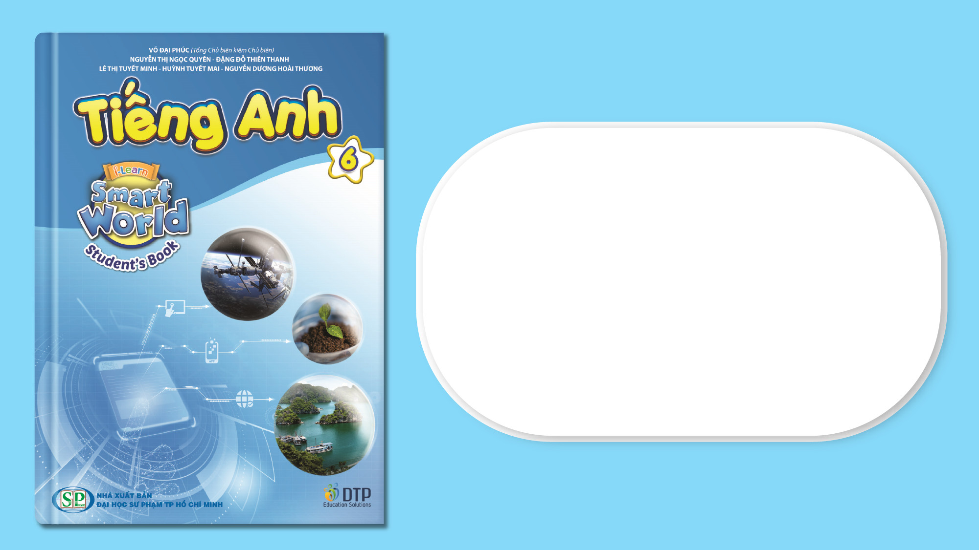
Unit 6: Community Services
Lesson 2.1: Vocabulary & Reading
Page 49

Slide 2
Lesson Outline
Warm-up
Vocabulary
Reading
Consolidation
Wrap-up

Slide 3
Objectives
By the end of this lesson, students will be able to…
- Practice and learn vocabularies: can, plastic bag, trash, plastic, bottle, glass, jar, recycle, throw away, reuse, pick up.
- Practice reading for specific information.
- Practice writing about what to do to protect the environment.

Slide 4

WARM-UP

Slide 5

Work in pairs.
Chatting
Is it necessary to keep the environment clean?
How to keep the environment clean?
What have you done to protect the environment?

Slide 6

New words
can, plastic bag, trash, plastic, bottle, glass, jar, recycle, throw away, reuse, pick up

Slide 7

Listen and repeat. Click each phrase to hear the sound.
trash (n) /træʃ/ rác
plastic bottle (n) /ˈplæstɪk ˈbɑːtl/ chai nhựa
can (n) /kæn/ đồ hộp, lon
glass jar (n) /ɡlæs dʒɑːr/ hũ thủy tinh
plastic bag (n) /ˈplæstɪk bæɡ/ túi ni lông
Notes:
GV click vào từng cụm nghe âm thanh

Slide 8
Listen and repeat. Click each phrase to hear the sound.
recycle (v) /ˌriːˈsaɪkl/ tái chế
throw away (v) /θroʊ əˈweɪ/ vứt, ném
reuse (v) /ˌriːˈjuːz/ tái sử dụng
pick up (v) /pɪk ʌp/ nhặt
Notes:
GV click vào từng cụm nghe âm thanh

Slide 9
Look at the IPA and the meaning of each word to read out the word.
/træʃ/ rác
/ˈplæstɪk ˈbɑːtl/ chai nhựa
/kæn/ đồ hộp
/ɡlæs dʒɑːr/ hũ thủy tinh
/ˈplæstɪk bæɡ/ túi ni lông
/ˌriːˈjuːz/ tái sử dụng
/ˌriːˈsaɪkl/ tái chế
/θroʊ əˈweɪ/ vứt, ném
/pɪk ʌp/ nhặt
Notes:
GV click vào từng cụm nghe âm thanh

Slide 10

Presentation

Slide 11
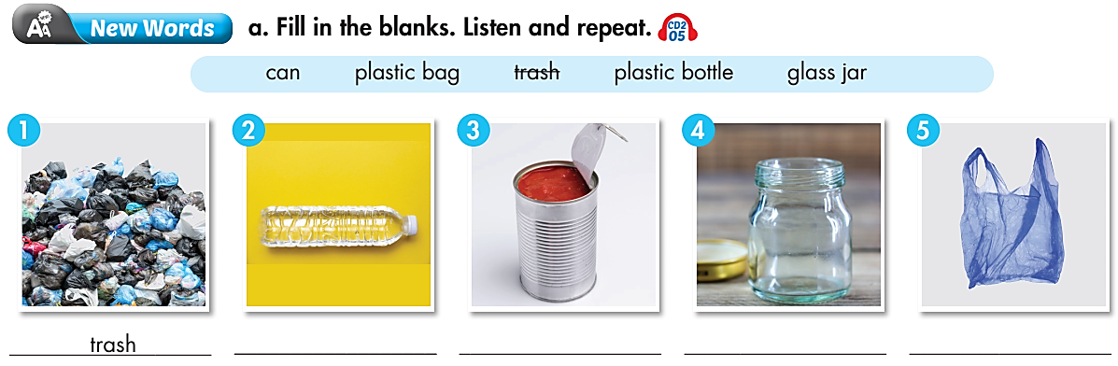
How many pictures are there? –
Five.
Match the world with the pictures.
What are you going to do? –

Slide 12

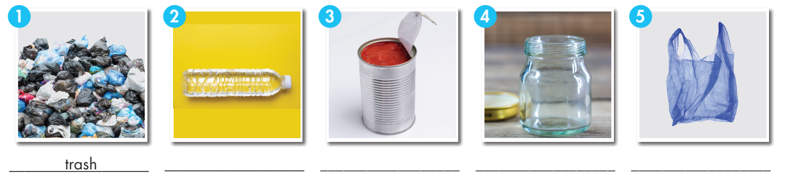
Work in pairs. Fill in the blanks.
can plastic bag trash
plastic bottle glass jar
v
Fill in the table
trash
plastic bottle
can
glass jar
plastic bag

Slide 13
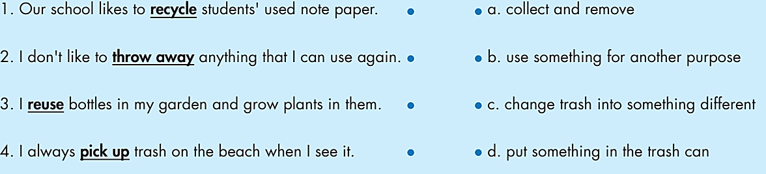
b. Match the underlined words to the definitions.
How many words and definitions are there? –
Four words and
four definitions.
What are you going to do? –
Match the underlined words to the
definitions.

Slide 14
Match the underlined words to the defnitions.
1. Our school likes to recycle students' used note paper. 2. I don't like to throw away anything that I can use again. 3. I reuse bottles in my garden and grow plants in them. 4. I always pick up trash on the beach when I see it. | a. collect and remove. b. use something for another purpose. c. change trash into something different. d. put something in the trash can.
ANSWERS: 1.c 2.d 3. b 4. a

Slide 15

Practice

Slide 16


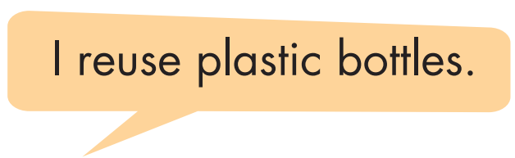
Work in pairs. Say what things you reuse.

Slide 17

Production

Slide 18
Extra Practice
WB page 34
Fill in the blanks using the words you have learnt.
1. Do you pick up __________ to keep your community clean?
2. We reuse ____________ to put water in.
3. We reuse empty __________ to store food, like jam and nuts.
4. We wash bottles and __________ and put them in the
recycling bin.
5. We reuse __________ to carry things.
trash
plastic bottles
glass jars
cans
plastic bags

Slide 19

Reading

Slide 20
Pre - reading
Underline the key words and guess what is if the tips are True or False.
a. Sally blogs about saving the environment. Read her tips and write "True" or "False."

Slide 21
While - reading
Skim the blog and underline the key words.
Hi, everyone!
People ask me all the time what we should do to protect the Earth.
Here are my top tips.
Reuse glass bottles and jars. You can use them in your kitchen, bathroom, or even your garden. Glass bottles are really useful.
Don’t throw away old glass!
Recycle plastic bottles, cans, and paper. Find recycling bins near your
house or school and take your recycling every week. It’s very easy!
Pick up trash. Nobody likes to see it in their town. Picking up trash makes our towns look better. After picking up the trash, make sure you recycle it!
(1)
(3)
(2)
(4)

Slide 22
Are the tips True or False?
1. We should reuse glass bottles. _________
3. It's difficult to recycle paper. _________
2. We shouldn't throw glass jars away. _________
4. We can make where we live look better. _________
True
False
True
True

Slide 23
Post - reading
Write your blog about keeping the environment clean. You can begin with.
Hi, everyone!
I am helping to keep the environment clean and here are my top tips…

Slide 24
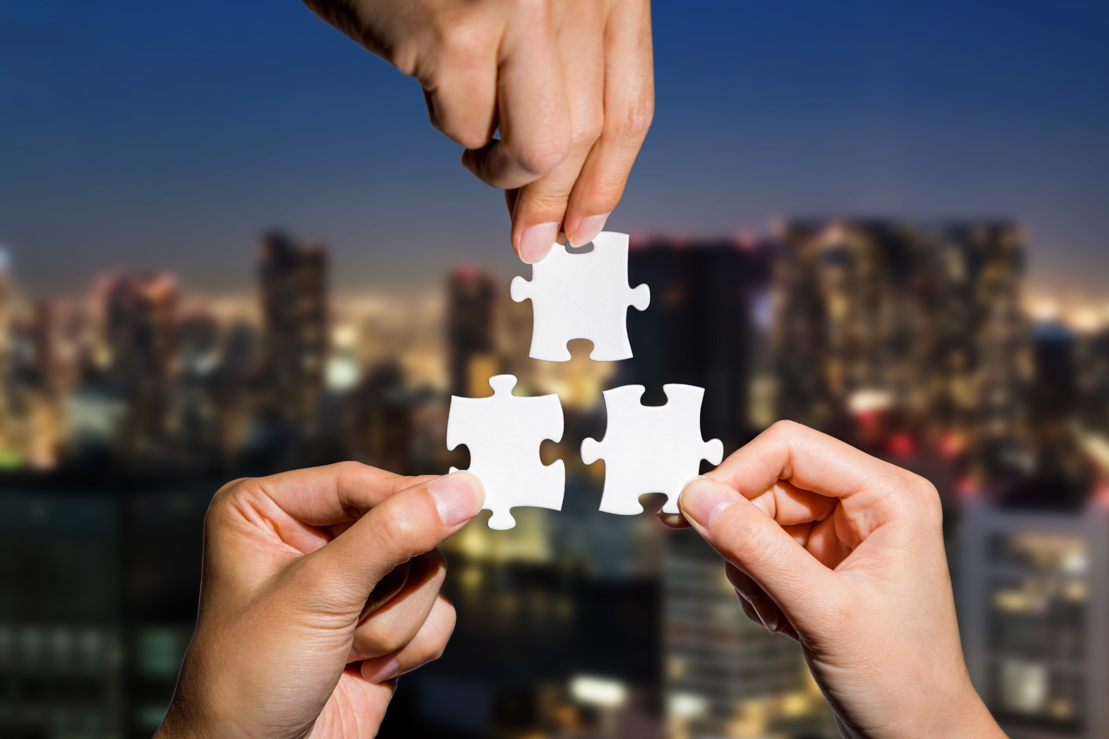
CONSOLIDATION

Slide 25
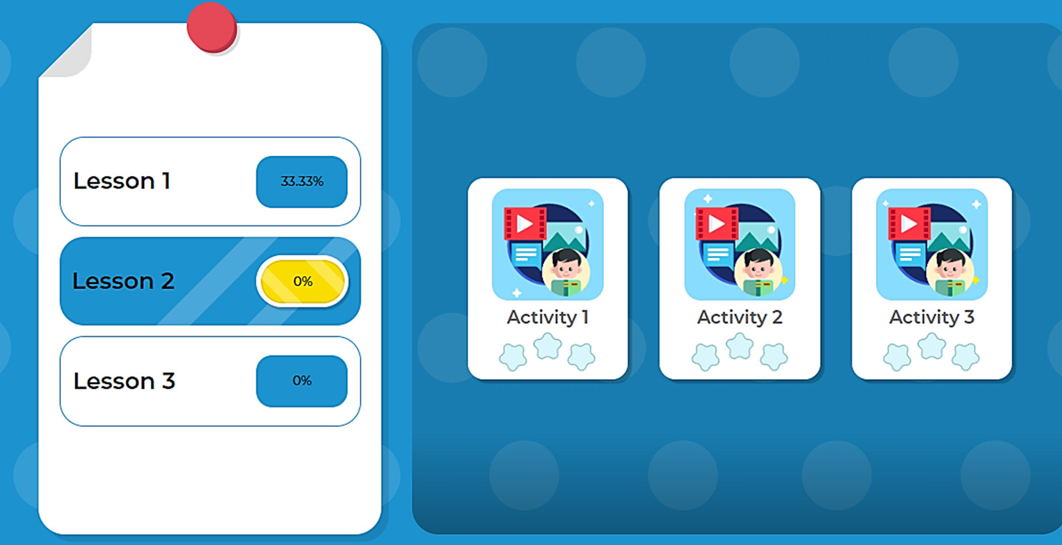
LET’S PLAY!
Click here to play the games.

Slide 26
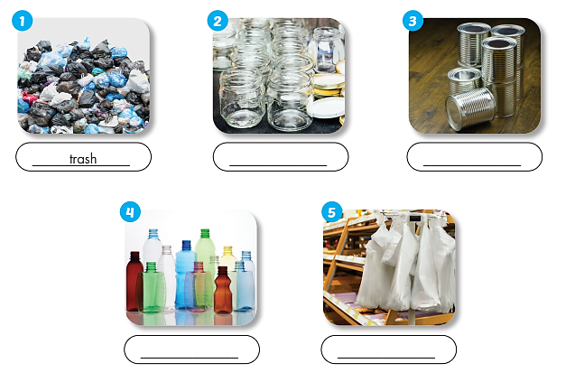
Extra Practice
WB page 34
Work in pairs.
Name the pictures
trash
glass jars
cans
plastic bottles
plastic bags

Slide 27

WRAP-UP

Slide 28
Today’s lesson
Vocabularies
can
plastic bag
trash
plastic
bottle
glass
jar
recycle
throw away
reuse
pick up
Reading: for specific information.
Writing: a blog about keeping the environment clean.

Slide 29
Homework
Learn by heart vocabularies and make sentences using them.
Do the exercises on page 34 WB.
Do the exercises in Tiếng Anh 6 i-Learn Smart World Notebook on page 36.
Prepare the next lesson (page 50 - SB).
Play the consolidation games in Tiếng Anh 6 i-Learn Smart World DHA App on www.eduhome.com.vn.

Slide 30
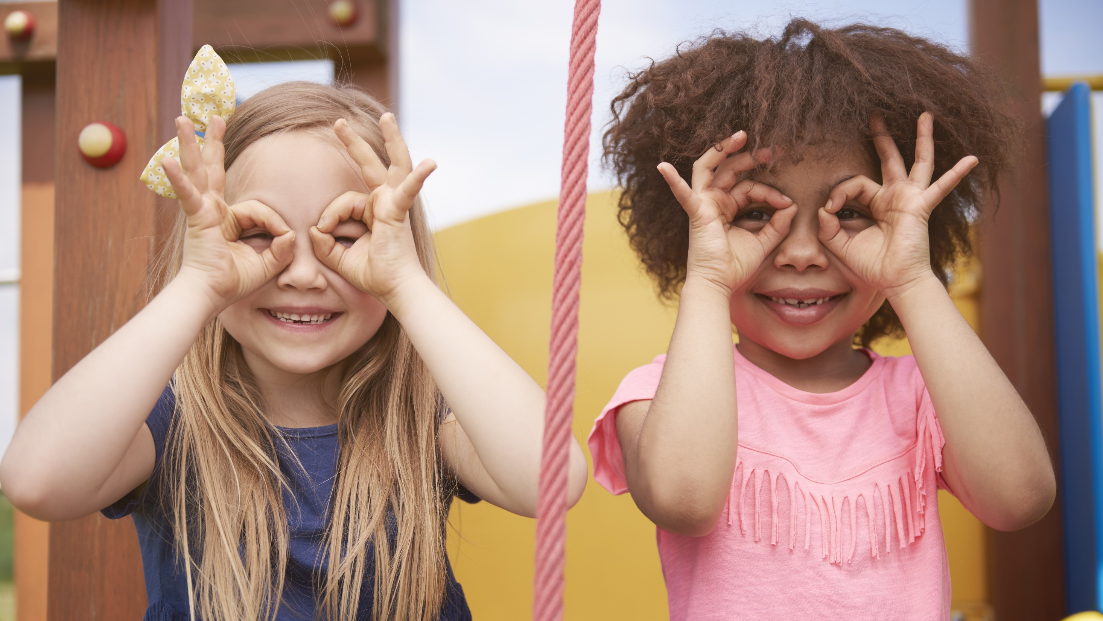
Enjoy your day!

