Slide 1
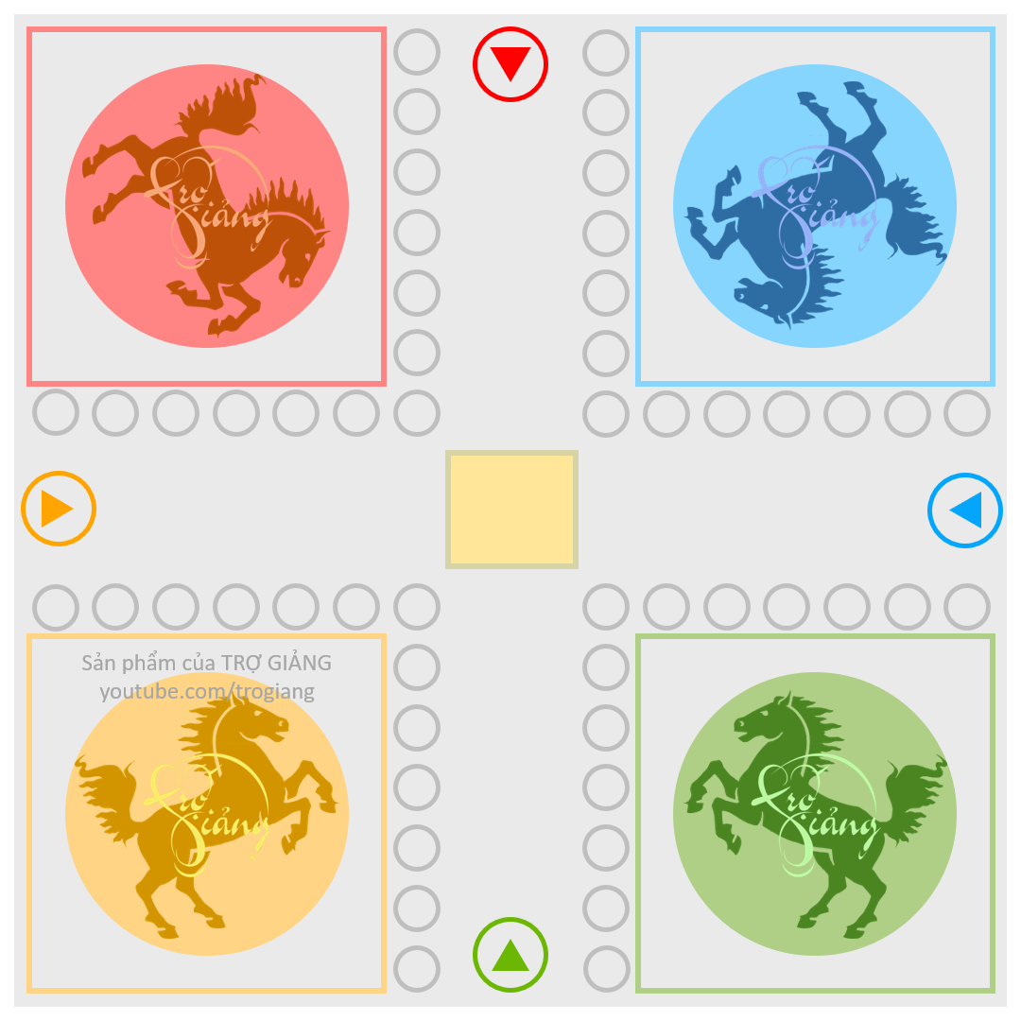
1
2
3
4
5
1
2
3
4
5
1
2
TRÒ CHƠI
CỜ CÁ NGỰA
3
4
5
1
2
3
4
5
5
4
3
2
1
5
4
3
2
1
1
2
3
4
5
1
2
3
4
5

Slide 2
Question 1?
A. wrong
B. right
C. wrong
D. wrong

Slide 3
Question 2?
A. right
B. wrong
C. wrong
D. wrong

Slide 4
Question 3?
A. wrong
B. wrong
C. right
D. wrong

Slide 5
Question 4?
A. wrong
B. wrong
C. wrong
D. right

Slide 6
Question 5?
A. right
B. wrong
C. wrong
D. wrong

Slide 7
Question 1?
A. wrong
B. wrong
C. right
D. wrong

Slide 8
Question 2?
A. right
B. wrong
C. wrong
D. wrong

Slide 9
Question 3?
A. wrong
B. wrong
C. right
D. wrong

Slide 10
Question 4?
A. wrong
B. right
C. wrong
D. wrong

Slide 11
Question 5?
A. wrong
B. wrong
C. right
D. wrong

Slide 12
Question 1?
A. wrong
B. wrong
C. wrong
D. right

Slide 13
Question 2?
A. wrong
B. right
C. wrong
D. wrong

Slide 14
Question 3?
A. right
B. wrong
C. wrong
D. wrong

Slide 15
Question 4?
A. wrong
B. wrong
C. right
D. wrong

Slide 16
Question 5?
A. wrong
B. wrong
C. right
D. wrong

Slide 17
Question 1?
A. right
B. wrong
C. wrong
D. wrong

Slide 18
Question 2?
A. wrong
B. right
C. wrong
D. wrong

Slide 19
Question 3?
A. wrong
B. wrong
C. wrong
D. right

Slide 20
Question 4?
A. wrong
B. wrong
C. right
D. wrong

Slide 21
Question 5?
A. wrong
B. wrong
C. right
D. wrong

Slide 22
SƯU TẦM: ĐOÀN VĂN DOANH, NAM TRỰC, NAM ĐỊNH
LINK NHÓM DÀNH CHO GV BỘ MÔN VẬT LÝ TRAO ĐỔI TÀI LIỆU VÀ CHUYÊN MÔN CT 2018
https://www.facebook.com/groups/299257004355186

