Slide 1
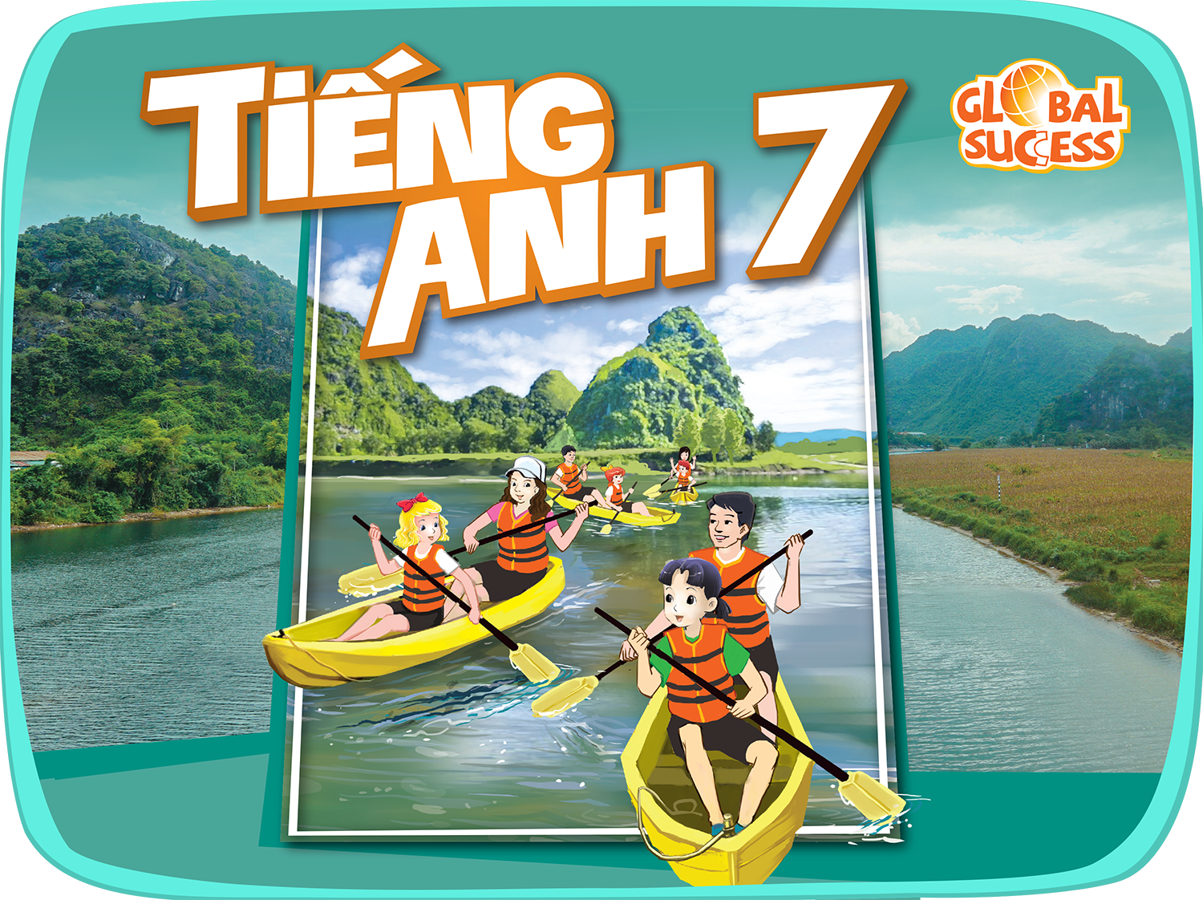

Slide 2



Unit
12
ENGLISH-SPEAKING COUNTRIES
Vocabulary
Use words related to people and places in the English-speaking countries
Pronunciation
Ask questions with the correct rising and falling intonation
LESSON 2: A CLOSER LOOK 1
Unit
HOBBIES

Slide 3
LESSON 2: A CLOSER LOOK 1
WARM-UP
Homework checking
Vocabulary
Task 1: Write the words or phrases under the correct pictures.
Task 2: Use the words in the box to complete the sentences.
Task 3: Work in pairs. Discuss and write the word or phrase in the box next to its explanation.
VOCABULARY
Task 4: Listen and repeat, paying attention to the intonation of the following questions.
Task 5: Circle the correct intonation. Then listen and repeat.
PRONUNCIATION
PRODUCTION
Game: Up or Down?
CONSOLIDATION
Wrap-up
Homework

Slide 4
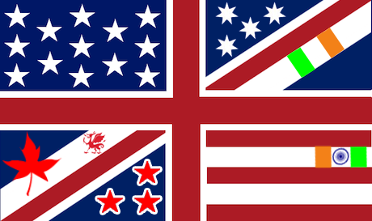
WARM-UP
How many English-speaking countries can you find?
United States
United Kingdom
Canada
Australia
Liberia
Ireland
New Zealand
Jamaica

Slide 5

VOCABULARY
native (adj)
connected with the place where you were born and lived for the first years of your life
/ˈneɪtɪv/
bản ngữ, nguyên quán

Slide 6
VOCABULARY
amazing (adj)
= wonderful, beautiful
/əˈmeɪzɪŋ/
tuyệt vời

Slide 7
VOCABULARY
unique (adj)
= rare,
not many
/juˈniːk/
độc nhất

Slide 8
VOCABULARY
local (adj)
= belonging to a place
/ˈləʊkl/
thuộc về địa phương

Slide 9
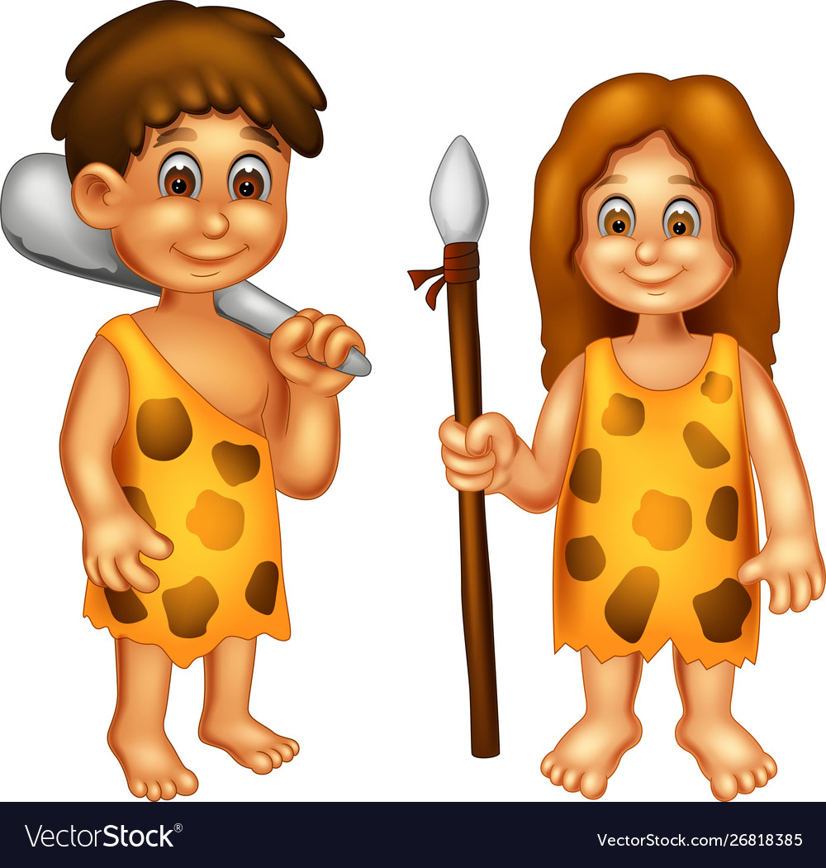
VOCABULARY
ancient (adj)
/ˈeɪnʃənt/
cổ, xưa

Slide 10
VOCABULARY
New words | Pronunciation | Meaning
native (adj) | /ˈneɪtɪv/ | bản ngữ, nguyên quán
amazing (adj) | /əˈmeɪzɪŋ/ | tuyệt vời
unique (adj) | /juˈniːk/ | độc nhất
local (adj) | /ˈləʊkl/ | thuộc về địa phương
ancient (adj) | /ˈeɪnʃənt/ | cổ, xưa

Slide 11
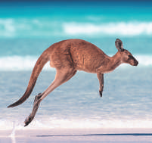
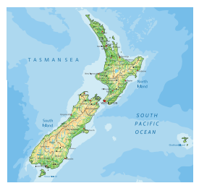
VOCABULARY
1
Write the words or phrases under the correct pictures.
island country Scottish kilt tattoo
castle kangaroo coastline
kangaroo
island country
1. ____________________
2. ____________________
Notes:
Wordwall game: https://wordwall.net/resource/27241481

Slide 12
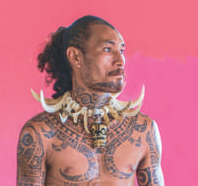
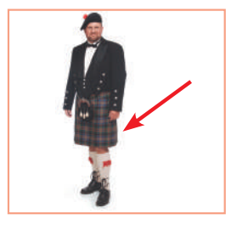
VOCABULARY
1
Write the words or phrases under the correct pictures.
island country Scottish kilt tattoo
castle kangaroo coastline
tattoo
Scottish kilt
3. ____________________
4. ____________________
Notes:
Wordwall game: https://wordwall.net/resource/27241481

Slide 13
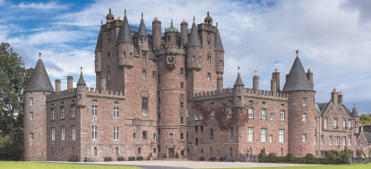
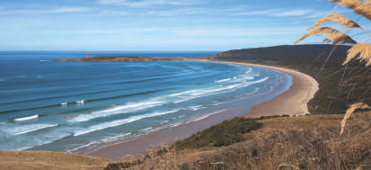
VOCABULARY
1
Write the words or phrases under the correct pictures.
island country Scottish kilt tattoo
castle kangaroo coastline
castle
coastline
5. ____________________
6. ____________________
Notes:
Wordwall game: https://wordwall.net/resource/27241481

Slide 14
VOCABULARY
2
Use the words in the box to complete the sentences.
native amazing unique local ancient
1. From the top of the mountain, we had a(n) _______________ view of the valley below.
2. Scotland is famous for its long history and _______________ castles.
3. The long fences around the sheep farms in Australia are _______________. You can’t find them anywhere else in the world.
4. When you visit a new place, talk to the _______________ people.
5. Kangaroos are _______________ to Australia. It is their home.
amazing
ancient
unique
local
native

Slide 15
VOCABULARY
3
Work in pairs. Discuss and write the word or phrase in the box next to its explanation.
symbol boat ride capital tower
1. a tall narrow building with a small top
2. an object representing a place
3. the most important city of a country
4. a tour on a river
tower
……………………………………
symbol
……………………………………
capital
……………………………………
boat ride
……………………………………

Slide 16

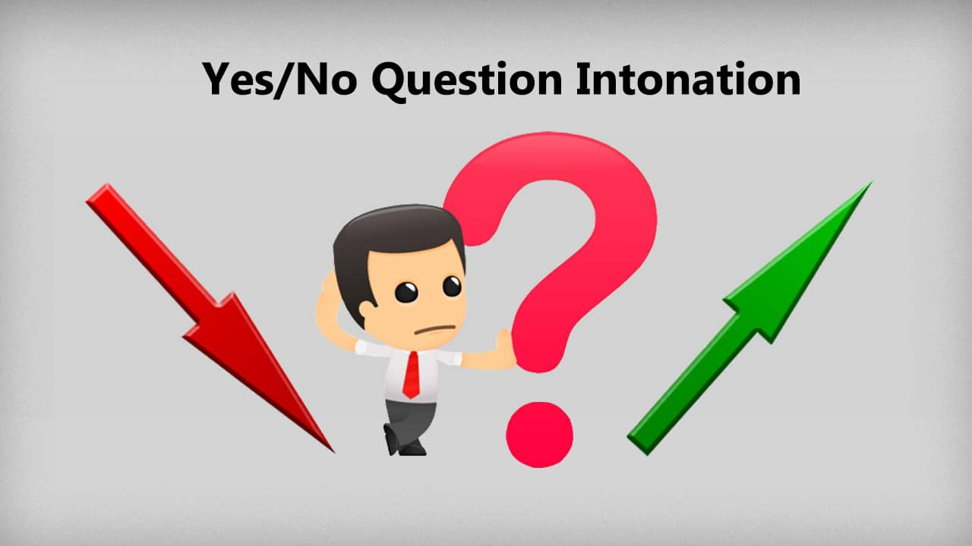
PRONUNCIATION
Rising and falling intonation for questions
- Can you speak English?
- What is the capital of Scotland?

Slide 17
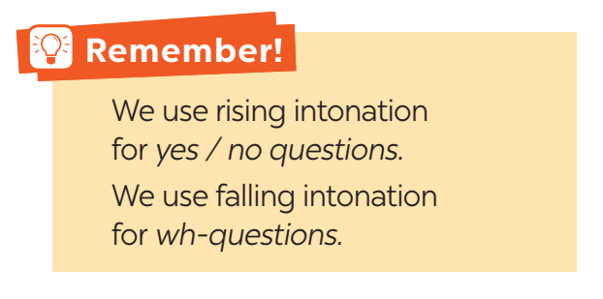
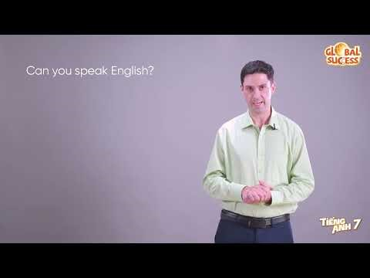
PRONUNCIATION
Rising and falling intonation for questions
Notes:
Video link: https://youtu.be/vshYnOtSEnY

Slide 18


PRONUNCIATION
4
Listen and repeat, paying attention to the intonation of the following questions.
1. Can you speak English?
2. Is Australia an island?
3. Will you visit Washington next year?
4. What is the capital of Scotland?
5. How big is Canada?

Slide 19
PRONUNCIATION
5
Listen to the sentences and pay attention to the underlined parts. Tick the appropriate sounds. Practise the sentences.
1. Where is Canada?
2. Could you show me Singapore on this map?
3. How many states are there in the USA?
4. Is English an official language in Malaysia?
5. Do you know much about New Zealand?

Slide 20

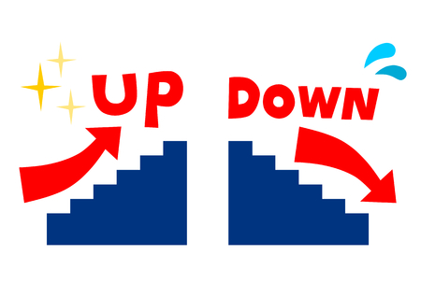

PRONUNCIATION
Game:
How was your holiday in Australia?
Did you travel a lot?
What do you call the people from Canada?
What is a symbol of London?
Can you see the Big Ben from your hotel?
Notes:
- Teacher divides the class into 2 teams.
- Students will listen to questions which are made up from the words in the lesson.
- Students will have to stand up if it is a yes / no question and sit down if it is a wh-question.
- The team will receive minus points equivalent to the number of students who pose incorrect actions (stand up or sit down).
- The team with less minus points will be the winner.

Slide 21
CONSOLIDATION
1
WRAP-UP
Vocabulary
Use words related to people and places in the English-speaking countries.
Pronunciation
Ask questions with the correct rising and falling intonation

Slide 22

CONSOLIDATION
2
HOMEWORK
Choose a favourite English-speaking country. Find information about its location and attractions.

Slide 23

Website: hoclieu.vn
Fanpage: facebook.com/www.tienganhglobalsuccess.vn/

