Slide 1
Unit 5: Science and technology
Lesson 3.1 – Reading & Writing
Pages 52 & 53

Slide 2
Lesson Outline
Warm-up
Reading
Writing
Consolidation
Wrap-up

Slide 3
By the end of this lesson, students will be able to…
- practice reading for specific information.
- practice writing longer and more interesting sentences using conjunctions.

Slide 4
WARM UP

Slide 5
Let’s talk!
Look at the pictures. What are the people using their smartphones for? What do you use your smartphone for?

Slide 6
Reading

Slide 7
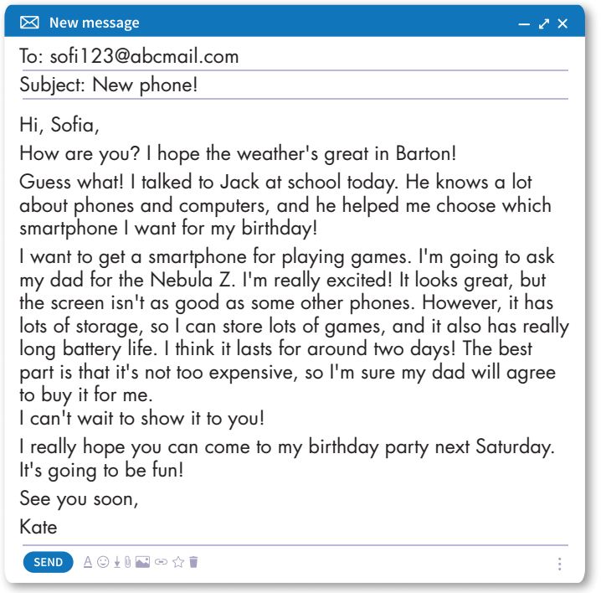
Pre-reading

Slide 8
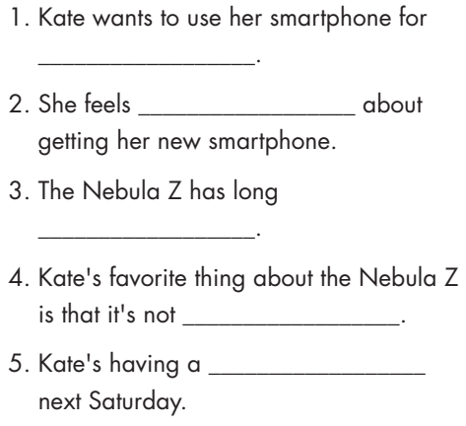

Slide 9
While-reading
• Skim the email
• Look for context clues (key words and the words before or after the blank)
• Guess based tone of the email (positive or negative)
• Read the email again slowly and carefully to check.
What are we going to do?
Read the email and fill in the blanks.

Slide 10
While-reading
playing games
excited
battery life
too expensive
birthday party

Slide 11
While-reading

Slide 12
Post-reading
Work in pairs
Would you like the phone Kate chose? Why (not)?

Slide 13
Writing

Slide 14
AND
ALSO
BUT
HOWEVER
SO

Slide 15
AND
ALSO
to link ideas in one sentence
to link two sentences

Slide 16
BUT
HOWEVER
link contrasting ideas in one sentence
to link two sentences

Slide 17
SO
to talk about results

Slide 18
AND
ALSO
BUT
HOWEVER
SO

Slide 19
However
so
but
and
also

Slide 20
CONSOLIDATION

Slide 21
Combine the sentences using conjunctions.
1. It has long battery life. It's very expensive.
2. It has a great screen. It has a really good speaker.
3. It has a lot of storage. It can store lots of music and photos.
Check answers
It has long battery life, but it's very expensive./
It has a great screen. It also has a really good speaker.
2. It has a great screen, and the speaker is really good./
It has long battery life. However, it's very expensive.
3. It has a lot of storage, so it can store lots of music and photos.

Slide 22
WRAP-UP

Slide 23
Today’s lesson
- Reading about an email about a new smartphone.
- Learning about using conjunctions to make longer, more interesting sentences.

Slide 24
Homework
- Do the exercises in WB: Listening and Reading (page 36).
- Do the vocabulary exercise in Tiếng Anh 8 i-Learn Smart World Notebook (page 44).
- Play consolidation games in Tiếng Anh 8 i-Learn Smart World DHA App on www.eduhome.com.vn
- Prepare: Unit 6 - Lesson 3 – Speaking and Writing (page 63 – SB).

Slide 25
Lesson 3
Stay positive and have a nice day!

