Slide 1


Slide 2



Unit
7
TRAFFIC
LESSON 2: A CLOSER LOOK 1
VOCABULARY
PRONUNCIATION
Unit
HOBBIES

Slide 3

OBJECTIVES
By the end of the lesson, students will be able to:
Vocabulary:
+ use the verbs going with means of transport
+ read the road signs
Pronunciation: pronounce and recognize the sounds /aɪ/ and /eɪ/

Slide 4
LESSON 2: A CLOSER LOOK 1
WARM-UP
Game: Jumbled words
Task 1: Match the words in A with the phrases in B.
Task 2: Write the correct phrases under the signs.
Task 3: Work in pairs. Take turns to say which of the signs in 2 you see on the way to school.
VOCABULARY
Task 4: Listen and repeat. Pay attention to the sounds /aɪ/ and /eɪ/.
Task 5: Underline the words with the sound /aɪ/ and circle the words with the sound /eɪ/.
PRONUNCIATION
CONSOLIDATION
Wrap-up
Homework

Slide 5
LESSON 2: A CLOSER LOOK 1
WARM-UP
Game: Jumbled words
Aims of the stage:
To activate students’ prior knowledge and vocabulary related to the topic, the targeted vocabulary, and its pronunciation.

Slide 6
WARM-UP: JUMBLED WORDS
MEANS OF TRANSPORT
1- OTBA
2- ITANR
3- NPEILARA
4- RSOTRPCA
5- OTMIROEKB
-> BOAT
-> TRAIN
-> AIRPLANE
-> SPORT CAR
-> MOTORBIKE

Slide 7

LESSON 2: A CLOSER LOOK 1
WARM-UP
Game: Jumbled words
Task 1: Match the words in A with the phrases in B.
Task 2: Write the correct phrases under the signs.
Task 3: Work in pairs. Take turns to say which of the signs in 2 you see on the way to school.
VOCABULARY
Aims of the stage:
To introduce visually some nouns related to the topic

Slide 8

VOCABULARY
road sign (n)
/ˈrəʊd saɪn/
biển báo giao thông

Slide 9
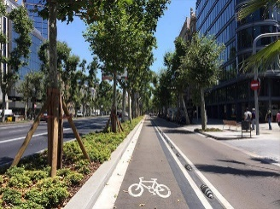
VOCABULARY
cycle lane (n)
/ˈsaɪkl leɪn/
làn đường
dành riêng cho xe đạp

Slide 10

VOCABULARY
traffic light (n.phr.)
/ˈtræfɪk laɪt/
đèn giao thông

Slide 11
VOCABULARY
New words | Pronunciation | Meaning
1. road sign (n.phr.) | /ˈrəʊd saɪn/ | biển báo giao thông
2. cycle lane (n.phr.) | /ˈsaɪkl leɪn/ | làn đường dành riêng cho xe đạp
3. traffic light (n.phr.) | /ˈtræfɪk laɪt/ | đèn giao thông

Slide 12
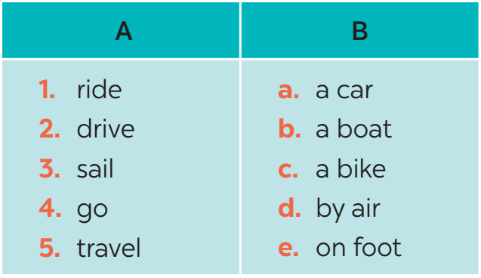
VOCABULARY
1
Match the words in A with the phrases in B.
1. c
2. a
3. b
4. e
5. d

Slide 13

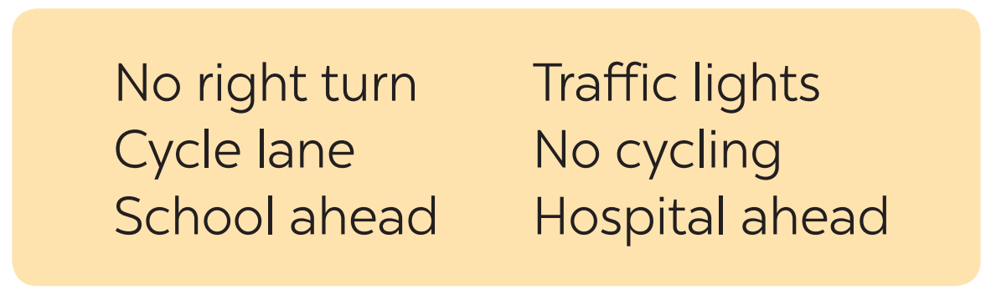




VOCABULARY
2
Look at these road signs. Then write the correct phrases under the signs.
1.
Traffic lights
2.
Hospital ahead
3.
No right turn
4.
Cycle lane
5.
School ahead
6.
No cycling

Slide 14

VOCABULARY
3
Work in pairs. Take turns to say which of the signs in 2 you see on the way to school.

Slide 15
LESSON 2: A CLOSER LOOK 1
WARM-UP
Game: Jumbled words
Task 1: Match the words in A with the phrases in B.
Task 2: Write the correct phrases under the signs.
Task 3: Work in pairs. Take turns to say which of the signs in 2 you see on the way to school.
VOCABULARY
Task 4: Listen and repeat. Pay attention to the sounds /aɪ/ and /eɪ/.
Task 5: Underline the words with the sound /aɪ/ and circle the words with the sound /eɪ/.
PRONUNCIATION

Slide 16

PRONUNCIATION
/aɪ/ and /eɪ/
Aims of the stage:
To help Ss identify the and classify the sounds
To give students authentic practice in pronouncing sounds in common words

Slide 17

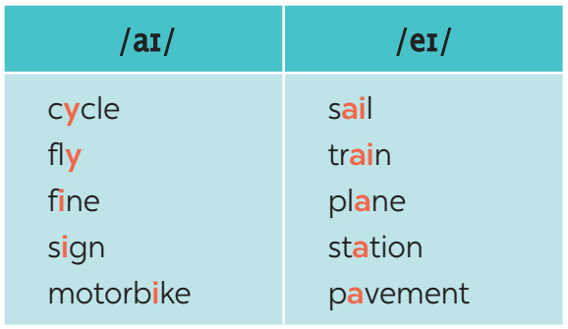
PRONUNCIATION
4
Listen and repeat. Pay attention to the sounds /aɪ/ and /eɪ/.

Slide 18
PRONUNCIATION
5
Underline the words with the sound /aɪ/ and circle the words with the sound /eɪ/. Then listen, check and repeat
1. The bus station is far from my house.
2. Remember to ride your bike carefully.
3. We must obey traffіc rules for our safety.
4. You have to get there in time for the train.
5. Don’t ride on the pavement.

Slide 19
LESSON 2: A CLOSER LOOK 1
WARM-UP
Game: Jumbled words
Task 1: Match the words in A with the phrases in B.
Task 2: Write the correct phrases under the signs.
Task 3: Work in pairs. Take turns to say which of the signs in 2 you see on the way to school.
VOCABULARY
Task 4: Listen and repeat. Pay attention to the sounds /aɪ/ and /eɪ/.
Task 5: Underline the words with the sound /aɪ/ and circle the words with the sound /eɪ/.
PRONUNCIATION
CONSOLIDATION
Wrap-up
Homework

Slide 20
CONSOLIDATION
1
WRAP-UP
VOCABULARY
PRONUNCIATION

Slide 21

CONSOLIDATION
2
HOMEWORK
Exercises in the workbook

Slide 22

Website: hoclieu.vn
Fanpage: facebook.com/www.tienganhglobalsuccess.vn/

