Slide 1


Slide 2

Unit
10
1
Unit
FAMILY LIFE
ECOTOURISM
LESSON 2
LANGUAGE

Slide 3

Unit
1
1
FAMILY LIFE
Family Life
Unit
OBJECTIVES
Use the lexical items related to the topic ecotourism;
Identify intonation patterns and use appropriate intonation
(i.e. rising or falling tone);
Use conditional sentences Type 1 and Type 2 correctly.

Slide 4
LESSON 2
LANGUAGE
WARM-UP
Matching: Caves in Phong Nha – Ke Bang National Park
PRONUNCIATION
Task 1: Listen and repeat.
Task 2: Role-play the conversation.
VOCABULARY
Task 1: Match the sentences with the explanations.
Task 2: Complete these sentences.
GRAMMAR
Task 1: Decide whether these statements can be real (R) or not (N).
Task 2: Put the verbs in brackets in the correct forms.
EXTRA ACTIVITY
Game: Surprising matching!
CONSOLIDATION
Wrap-up
Homework

Slide 5

WARM-UP
Match the pictures with names of the caves in Phong Nha – Ke Bang National Park.

Slide 6
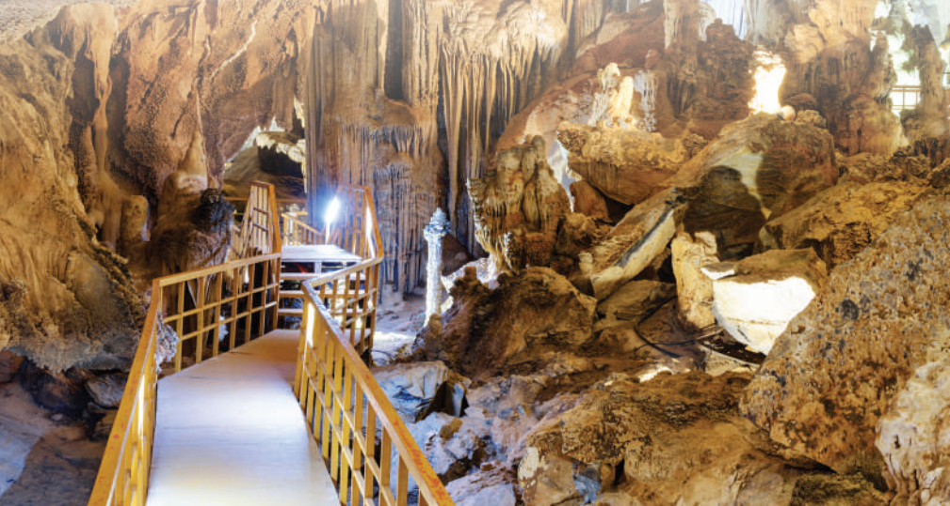
WARM-UP
Phong Nha Cave
Son Doong Cave
Hang En Cave
Hang Toi Cave (Dark Cave)
Hang Voi Cave (Elephant Cave)
Thien Duong Cave (Paradise Cave)
Tra Ang Cave
Tu Lan Cave
Hang Va Cave
Hang Vom & Hang Gieng Vooc Cave
Phong Nha Cave

Slide 7
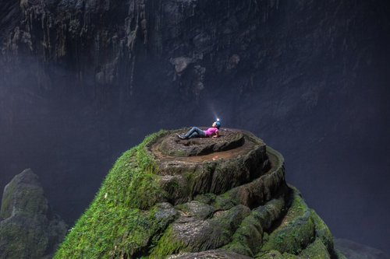
WARM-UP
Phong Nha Cave
Son Doong Cave
Hang En Cave
Hang Toi Cave (Dark Cave)
Hang Voi Cave (Elephant Cave)
Thien Duong Cave (Paradise Cave)
Tra Ang Cave
Tu Lan Cave
Hang Va Cave
Hang Vom & Hang Gieng Vooc Cave
Son Doong Cave

Slide 8
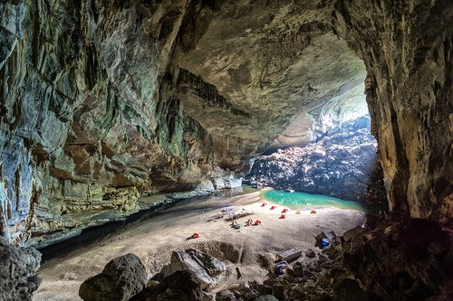
WARM-UP
Phong Nha Cave
Son Doong Cave
Hang En Cave
Hang Toi Cave (Dark Cave)
Hang Voi Cave (Elephant Cave)
Thien Duong Cave (Paradise Cave)
Tra Ang Cave
Tu Lan Cave
Hang Va Cave
Hang Vom & Hang Gieng Vooc Cave
Hang En Cave

Slide 9
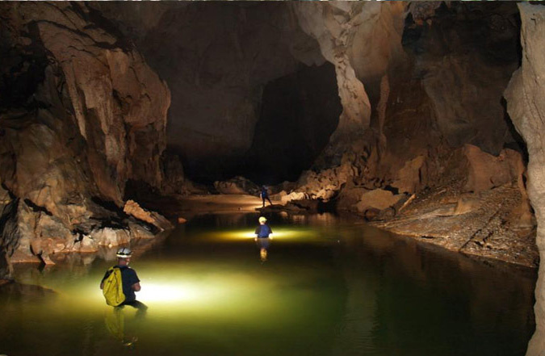
WARM-UP
Phong Nha Cave
Son Doong Cave
Hang En Cave
Hang Toi Cave (Dark Cave)
Hang Voi Cave (Elephant Cave)
Thien Duong Cave (Paradise Cave)
Tra Ang Cave
Tu Lan Cave
Hang Va Cave
Hang Vom & Hang Gieng Vooc Cave
Hang Toi Cave

Slide 10
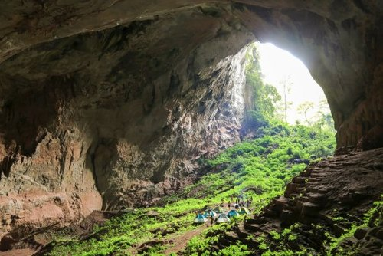
WARM-UP
Phong Nha Cave
Son Doong Cave
Hang En Cave
Hang Toi Cave (Dark Cave)
Hang Voi Cave (Elephant Cave)
Thien Duong Cave (Paradise Cave)
Tra Ang Cave
Tu Lan Cave
Hang Va Cave
Hang Vom & Hang Gieng Vooc Cave
Hang Voi Cave

Slide 11
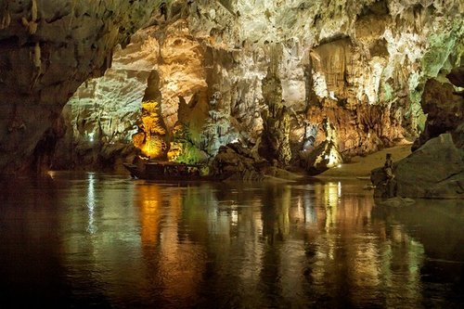
WARM-UP
Phong Nha Cave
Son Doong Cave
Hang En Cave
Hang Toi Cave (Dark Cave)
Hang Voi Cave (Elephant Cave)
Thien Duong Cave (Paradise Cave)
Tra Ang Cave
Tu Lan Cave
Hang Va Cave
Hang Vom & Hang Gieng Vooc Cave
Thien Duong Cave

Slide 12
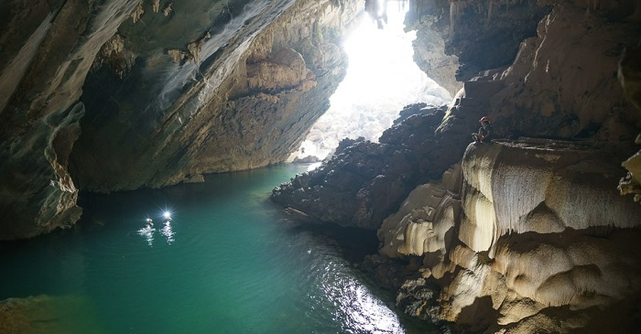
WARM-UP
Phong Nha Cave
Son Doong Cave
Hang En Cave
Hang Toi Cave (Dark Cave)
Hang Voi Cave (Elephant Cave)
Thien Duong Cave (Paradise Cave)
Tra Ang Cave
Tu Lan Cave
Hang Va Cave
Hang Vom & Hang Gieng Vooc Cave
Tra Ang Cave

Slide 13
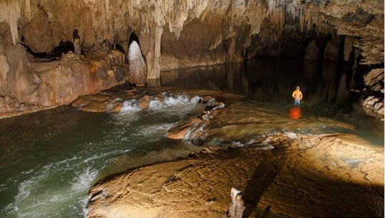
WARM-UP
Phong Nha Cave
Son Doong Cave
Hang En Cave
Hang Toi Cave (Dark Cave)
Hang Voi Cave (Elephant Cave)
Thien Duong Cave (Paradise Cave)
Tra Ang Cave
Tu Lan Cave
Hang Va Cave
Hang Vom & Hang Gieng Vooc Cave
Tu Lan Cave

Slide 14
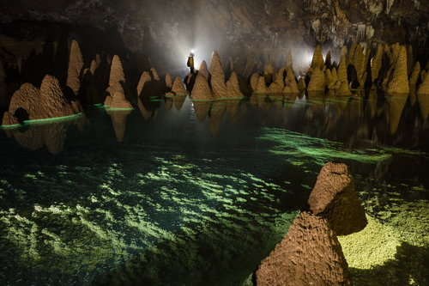
WARM-UP
Phong Nha Cave
Son Doong Cave
Hang En Cave
Hang Toi Cave (Dark Cave)
Hang Voi Cave (Elephant Cave)
Thien Duong Cave (Paradise Cave)
Tra Ang Cave
Tu Lan Cave
Hang Va Cave
Hang Vom & Hang Gieng Vooc Cave
Hang Va Cave

Slide 15
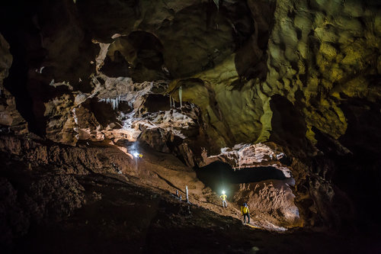
WARM-UP
Phong Nha Cave
Son Doong Cave
Hang En Cave
Hang Toi Cave (Dark Cave)
Hang Voi Cave (Elephant Cave)
Thien Duong Cave (Paradise Cave)
Tra Ang Cave
Tu Lan Cave
Hang Va Cave
Hang Vom & Hang Gieng Vooc Cave
Hang Vom & Hang Gieng Vooc Cave

Slide 16
LESSON 2
LANGUAGE
WARM-UP
Matching: Caves in Phong Nha – Ke Bang National Park
PRONUNCIATION
Task 1: Listen and repeat.
Task 2: Role-play the conversation.

Slide 17



PRONUNCIATION
1
Listen to these sentences. Pay attention to the intonation and repeat.
1. I’ll also try to bring snacks with less packaging.
2. What’s an eco-friendly fieldtrip?
3. Can we bring snacks?

Slide 18
PRONUNCIATION
2
Work in pairs and role-play this conversation. Pay attention to the intonation. Then listen and check.
Mum: Have you packed for the trip tomorrow?
Mai: Yes, I have.
Mum: Why are you taking so little food?
Mai: Because I don’t want to leave litter behind. It’s not good for the environment.
Mum: That’s a good idea.

Slide 19
LESSON 2
LANGUAGE
WARM-UP
Matching: Caves in Phong Nha – Ke Bang National Park
PRONUNCIATION
Task 1: Listen and repeat.
Task 2: Role-play the conversation.
VOCABULARY
Task 1: Match the sentences with the explanations.
Task 2: Complete these sentences.

Slide 20
VOCABULARY
1
Below is what ecotourists do. Match each sentence on the left with its explanation on the right.
1. I am responsible for protecting the environment.
2. I am aware of the damage I may cause to the environment.
3. I help people learn about the environmental impact of tourism.
4. I help local businesses make a profit.
5. I buy traditional arts and crafts to help local culture and businesses.
a. I know that when I travel, I may damage the environment.
b. I understand it is my duty to protect the environment.
c. I buy handmade things to help local artists and craftsmen or craftswomen earn some money and introduce their culture to more people.
d. I help local people earn some money by using local services and buying local products.
e. I tell people about the positive and negative effects of tourism on the environment.

Slide 21
VOCABULARY
2
Complete these sentences with the highlighted words in Task 1.
1. We can help local artists make a _____________ by buying handmade arts and _____________.
2. Many tourists are not _____________ of the _____________ of their actions on the local community.
3. Both local people and tourists should be _____________ for protecting the environment.
profit
crafts
aware
impact
responsible

Slide 22
LESSON 2
LANGUAGE
WARM-UP
Matching: Caves in Phong Nha – Ke Bang National Park
PRONUNCIATION
Task 1: Listen and repeat.
Task 2: Role-play the conversation.
VOCABULARY
Task 1: Match the sentences with the explanations.
Task 2: Complete these sentences.
GRAMMAR
Task 1: Decide whether these statements can be real (R) or not (N).
Task 2: Put the verbs in brackets in the correct forms.

Slide 23

GRAMMAR
1
Decide whether these statements can be real (R) or not (N).
 | R | N
1. If I were a bird, I would fly.
2. If we work hard, we will get good marks.
3. If my parents were 10 years younger, they would travel around the world.
4. If it rains tomorrow, we will stay at home.

Slide 24
PRACTICE
GRAMMAR
2
Put the verbs in brackets in the correct forms.
1. If tourists buy local products, more of their money (stay) ___________ in the community.
2. If we lived in the countryside, we (grow) ___________ our own vegetables.
3. If my grandmother (be) ___________ still alive, she (be) ___________ a hundred today.
4. If people (give) ___________ up flying, they (reduce) ___________ their carbon footprint.
will stay
would grow
were / was
would be
give
will reduce

Slide 25
LESSON 2
LANGUAGE
WARM-UP
Matching: Caves in Phong Nha – Ke Bang National Park
PRONUNCIATION
Task 1: Listen and repeat.
Task 2: Role-play the conversation.
VOCABULARY
Task 1: Match the sentences with the explanations.
Task 2: Complete these sentences.
GRAMMAR
Task 1: Decide whether these statements can be real (R) or not (N).
Task 2: Put the verbs in brackets in the correct forms.
EXTRA ACTIVITY
Game: Surprising matching!

Slide 26

Game: Surprising matching!
4 groups:
Group A will write If clause type 1.
Group B will write Main clause type 1.
Group C will write If clause type 2.
Group D will write Main clause type 2.

Slide 27
Game:
Surprising matching!
Now match:
Group A + Group B
Group C + Group D

Slide 28
LESSON 2
LANGUAGE
WARM-UP
Matching: Caves in Phong Nha – Ke Bang National Park
PRONUNCIATION
Task 1: Listen and repeat.
Task 2: Role-play the conversation.
VOCABULARY
Task 1: Match the sentences with the explanations.
Task 2: Complete these sentences.
GRAMMAR
Task 1: Decide whether these statements can be real (R) or not (N).
Task 2: Put the verbs in brackets in the correct forms.
EXTRA ACTIVITY
Game: Surprising matching!
CONSOLIDATION
Wrap-up
Homework

Slide 29
CONSOLIDATION
1
Wrap-up
Use the lexical items related to the topic ecotourism;
Identify intonation patterns and use appropriate intonation
(i.e. rising or falling tone);
Use conditional sentences Type 1 and Type 2 correctly.

Slide 30
CONSOLIDATION
2
Homework
1. Prepare for the next lesson: Unit 10 – Reading
2. Do exercises in the workbook

Slide 31

Website: hoclieu.vn
Fanpage: facebook.com/tienganhglobalsuccess.vn/

