Slide 1

UNIT 10: NEW WAYS TO LEARN
Lesson 2.2 – Grammar
Page 86

Slide 2


LESSSON OUTLINE
Consolidation

Slide 3

By the end of this lesson,
students will be able to:
Practice and use be going to and will correctly.
Improve writing skill.

Slide 4



Slide 5
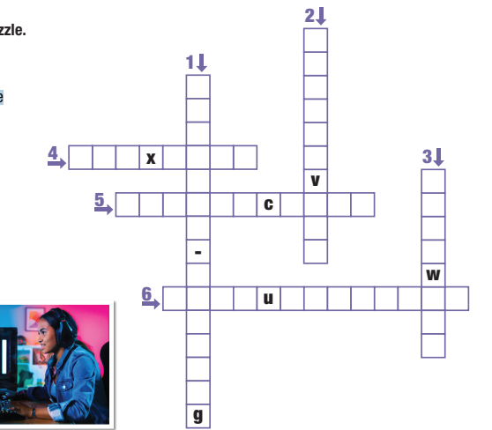

Work in pairs.
Crossword puzzle
C
1. Looking for solutions to complicated or
diffcult issues.
R
P
E
R
A
O
T
2. Getting new ideas from
being imaginative.
E
I
B
L
I
F
L
B
E
L
T
N
T
E
A
I
I
E
R
T
I
V
E
E
3. Working with other people.
M
T
A
Y
M
4. Able to change easily.
S
N
I
O
N
O
T
O
C
O
M
C
M
I
A
L
R
5. Exchanging information between
a computer user and a program.
V
K
I
N
6. Speaking and listening, for example.
Notes:
GV click vào các câu để hiện ra đáp án

Slide 6



Slide 7
1. It looks great! I'll download it, too.
2. Are they going to study online tomorrow?
- Yes, they are./No, they're not

Slide 8
Lead in
1. What tense do we use in those sentences?
Simple future for 1 and “be going to” for 2.
2. What do we use Simple future for?
We use will for future actions based on decisions
at the moment of speaking.
3. What do we use “be going to” for?
We use be going to to talk about plans we have
already made

Slide 9
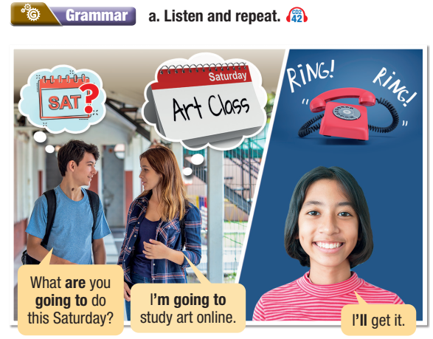
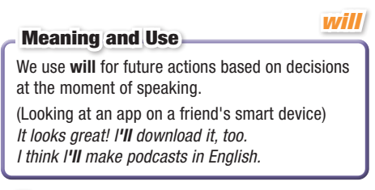
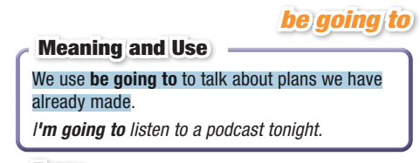


Slide 10
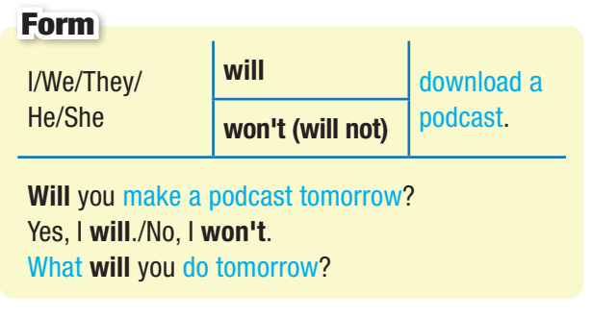
Will

Slide 11
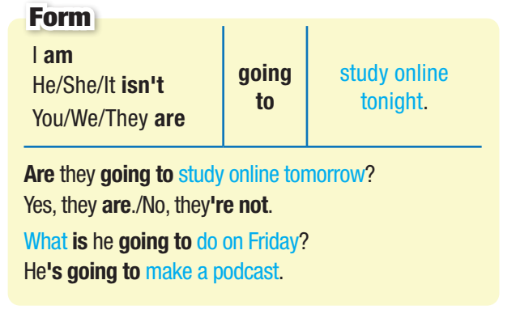
Be going to

Slide 12

PRACTICE

Slide 13
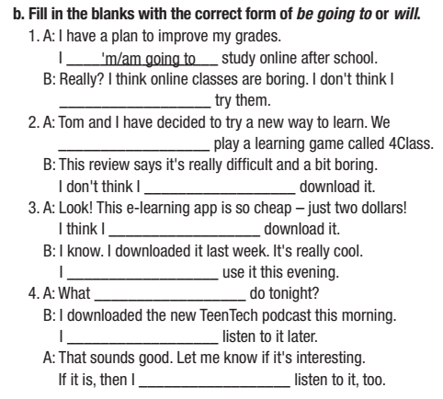
Practice
How many sentences are there?
→ There are 4.
What are you going to do?
Fill in the blanks with the
correct form of be going to or will

Slide 14
Fill in the blanks with a verb from the box and the correct form of
be going to or will.
1. A: I have a plan to improve my grades.
I __________________ study online after school.
B: Really? I think online classes are boring. I don't think I
__________________ try them.
2. A: Tom and I have decided to try a new way to learn. We
__________________ play a learning game called 4Class.
B: This review says it's really diffcult and a bit boring.
I don't think I __________________ download it.
'm/am going to
‘ll/ will
‘re/are going to
‘ll/ will
will have

Slide 15
Fill in the blanks with a verb from the box and the correct form of
be going to or will.
3. A: Look! This e-learning app is so cheap – just two dollars!
I think I __________________ download it.
B: I know. I downloaded it last week. It's really cool.
I __________________ use it this evening.
4. A: What __________________ do tonight?
B: I downloaded the new TeenTech podcast this morning.
I __________________ listen to it later.
A: That sounds good. Let me know if it's interesting.
If it is, then I __________________ listen to it, too.
‘ll/ will
'm/am going to
are you going to
'm/am going to
‘ll/ will

Slide 16
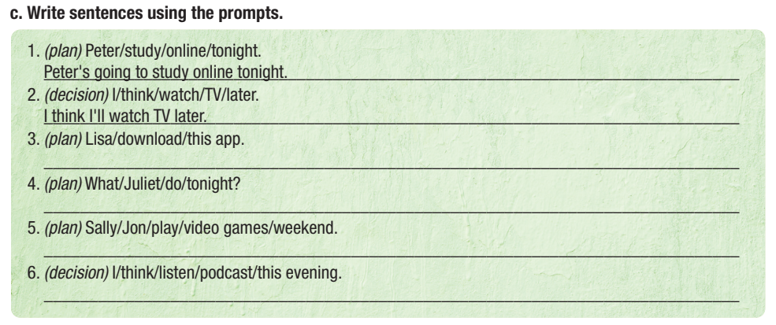
Practice
How many sentences are there?
→ There are 6.
What are you going to do?
Write sentences with the prompts.

Slide 17

Write sentences using the prompts.
(plan) Peter/study/online/tonight.
______________________________________
2. (decision) I/think/watch/TV/later.
________________________________________
3. (plan) Lisa/download/this app.
________________________________________
Peter's going to study online tonight.
I think I'll watch TV later.
Lisa’s going to download this app.
Notes:
Please, click on each phrase to hear the sound

Slide 18
Write sentences using the prompts.
4. (plan) What/Juliet/do/tonight?
_______________________________________________
5. (plan) Sally/Jon/play/video games/weekend.
________________________________________________
6. (decision) I/think/listen/podcast/this evening.
________________________________________________
What’s Juliet going to do tonight?
Sally and Jon are going to play video games on the weekend.
I think I’ll listen to a podcast this evening.
Notes:
Please, click on each phrase to hear the sound

Slide 19

Extra Practice
WB, page 59
1. Eve: I've downloaded this educational app. I will/am going to try it this evening.
Dan: I think I will/am going to download it, too.
2. Eve: I am not going to/won't go bowling on Saturday.
Dan: Really? I am not going to/won't go either, then.
3. Eve: I am going to/will go to the mall after school. Do you want to come?
Dan: Yes, I am going to/will.

Slide 20
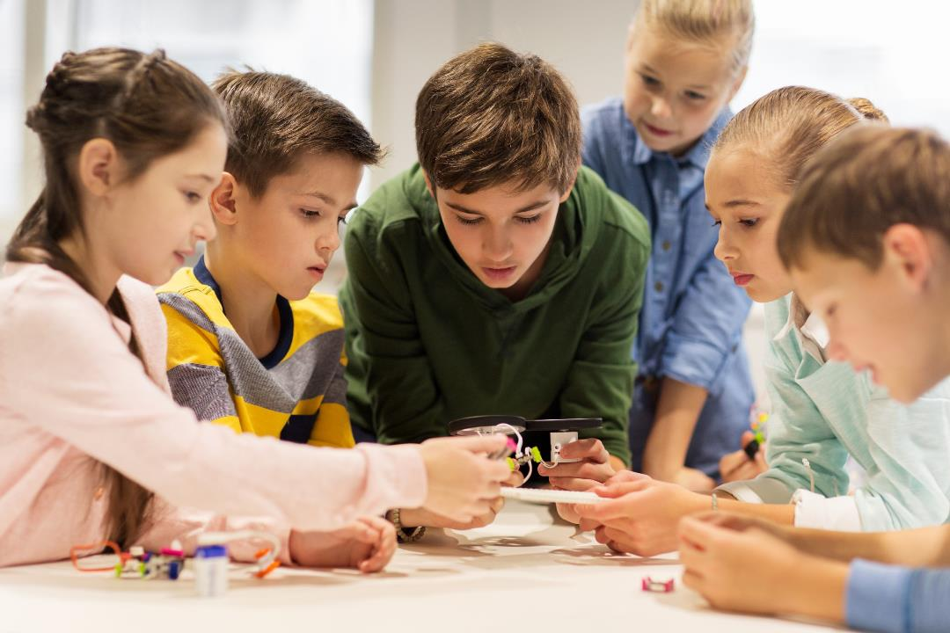
PRODUCTION

Slide 21

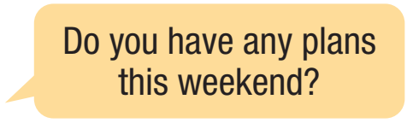
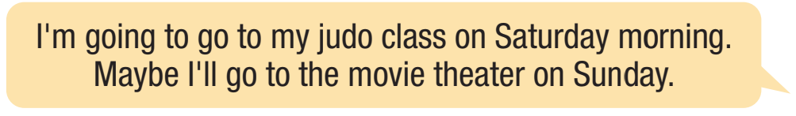
Work in pairs.
Ask your partner about their plans for the weekend.
Notes:
Please, click on each phrase to hear the sound

Slide 22

Consolidation

Slide 23
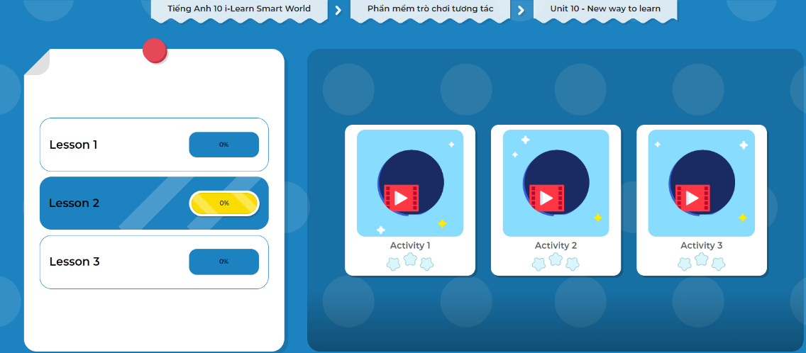
LET’S PLAY!
Click here to play the games.

Slide 24
Extra Practice
WB, page 59
Louise: Hey, Peter/what/do/learn/new way? (1)________________________________________________ Peter: Download/app./Use/every day. (2) _______________________________________________ Louise: Maybe/I/download/too. (3) ______________________________________________
Hey, Peter. What are you going to do to learn in a new way?
I've just downloaded this app. I'm going to use it every day.
Maybe I'll download it, too.

Slide 25
Extra Practice
WB, page 59
2. Peter: Hi, Louise./What/you/do/tonight? (4)__________________________________________ Louise: Not sure./Maybe/watch/movie/TV. (5)__________________________________________ Peter: I/not/think/that/help/you/learn. (6)__________________________________________
Hi, Louise. What are you going to do tonight?
I'm not sure. Maybe I'll watch a movie on TV.
I don't think that will help you learn.

Slide 26

WRAP-UP

Slide 27
Consolidation
Today’s lesson
Grammar: Practice and use be going to and will correctly.
Speaking & Writing:
- Talk about what your plans for the weekends.
- Write the conversation with will and be going to.

Slide 28

- Write five sentences about your plans for the weekend with your family.
- Do the exercises in workbook on page 59.
- Prepare the next lesson: Lesson 2.3 – Pronuciation & Speaking (page 78).
- Complete the grammar notes in Tiếng Anh 10 i-Learn Smart World Notebook (page 59).
- Play the consolidation games in Tiếng Anh 10 i-Learn Smart World DHA App on www.eduhome.com.vn

Slide 29
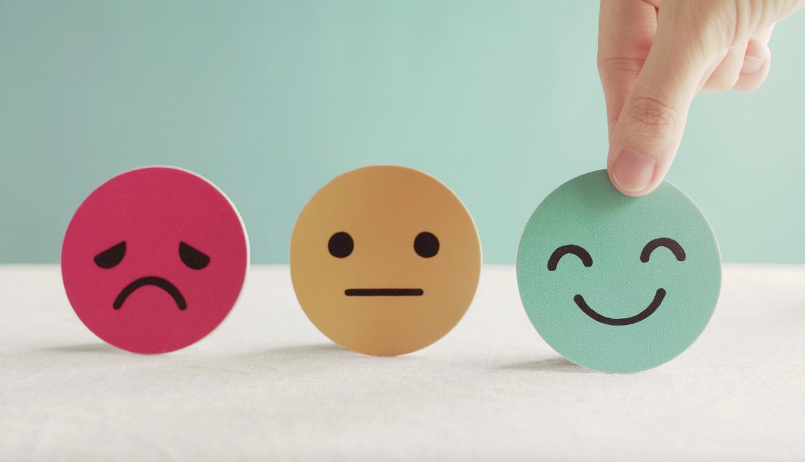
Lesson 3
Stay positive and have a nice day!

