Slide 1
Gender Equality
Unit 6
Lesson 5: Listening

Slide 2
OBJECTIVES
Listen for specific information in a talk about the first woman in space
Identify and use lexical items related to gender equality

Slide 3
Table of contents
01
02
03
Warm-up
Pre-listening
While-listening
04
05
Post-listening
Consolidation

Slide 4
01
Warm-up
Video: A history of women in space

Slide 5
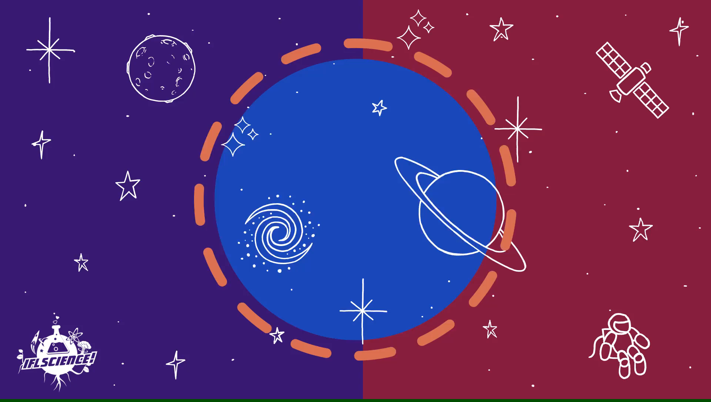
VIDEO WATCHING
Write down as many names that you can hear as possible.
After watching: Which names have you already known and which names have you never heard of?
Notes:
https://www.youtube.com/watch?v=HIEach7rmDg

Slide 6
02
Pre-listening

Slide 7
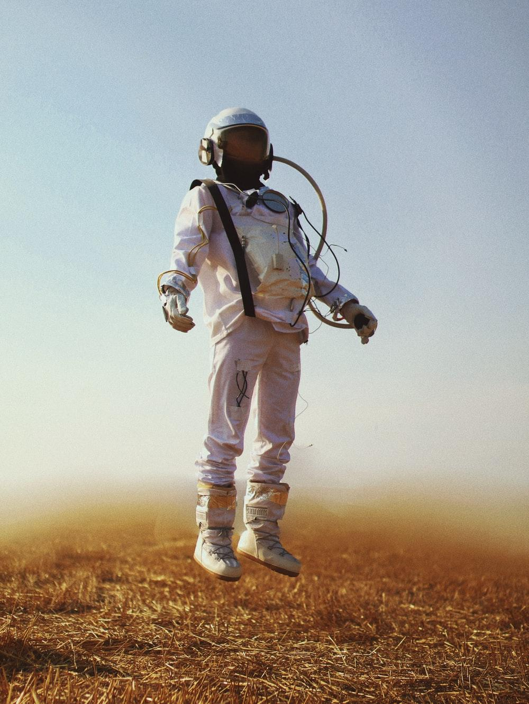
VOCABULARY
cosmonaut (n)
/ˈkɒzmənɔːt/
an astronaut from the former Soviet Union or Russia

Slide 8
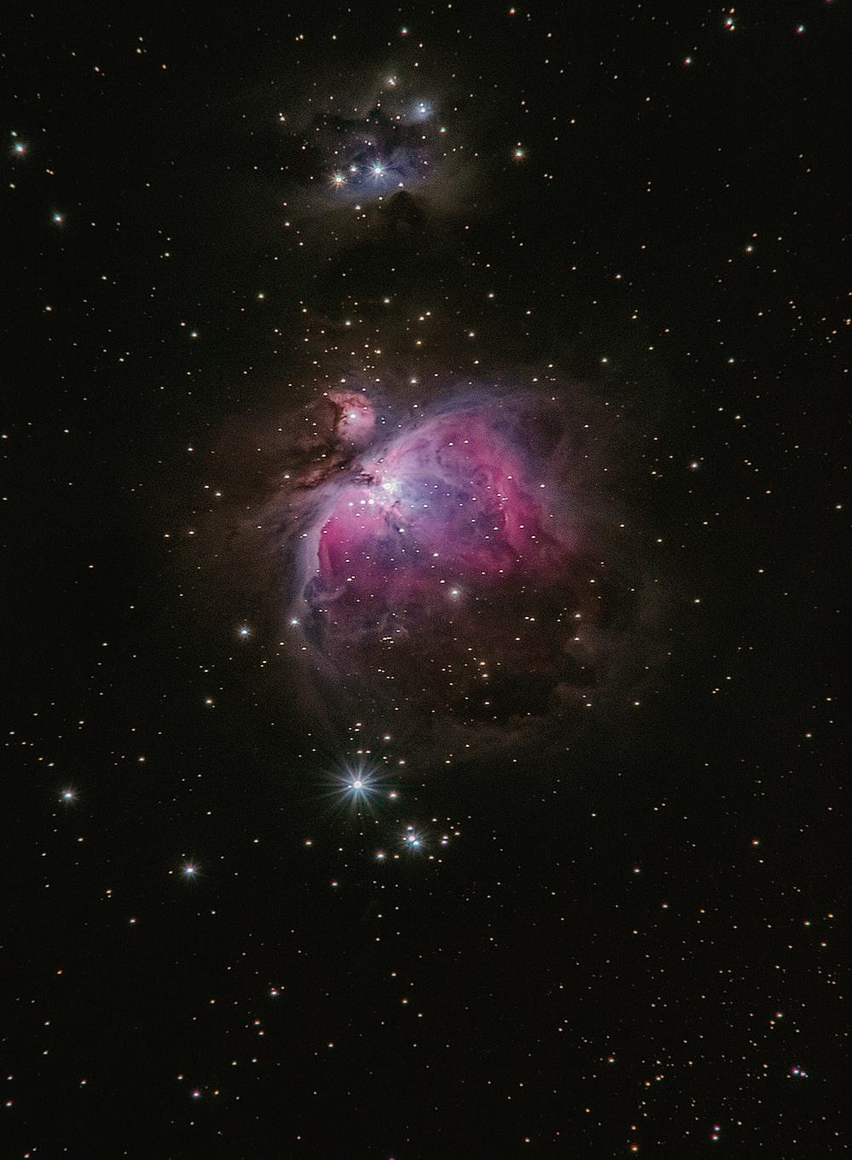
VOCABULARY
space (n)
/speɪs/
the area outside the earth’s atmosphere where all the other planets and stars are

Slide 9
VOCABULARY
parachutist (n)
/ˈpærəʃuːtɪst/
a person who jumps from a plane using a parachute

Slide 10
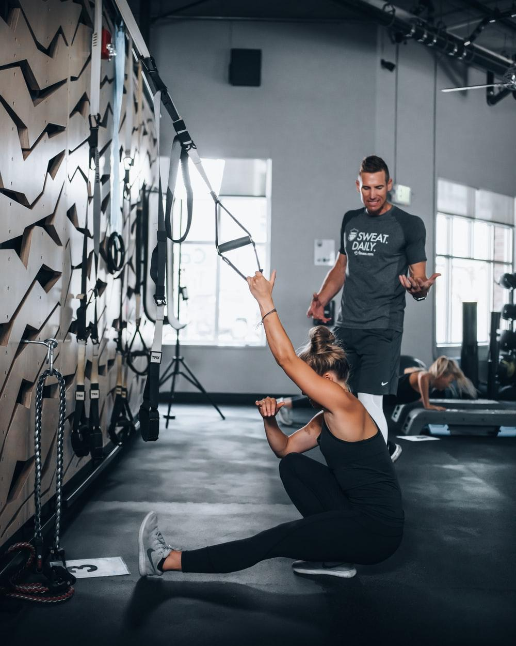
VOCABULARY
instructor (n)
/ɪnˈstrʌktə(r)/
a person whose job is to teach somebody a practical skill or sport

Slide 11
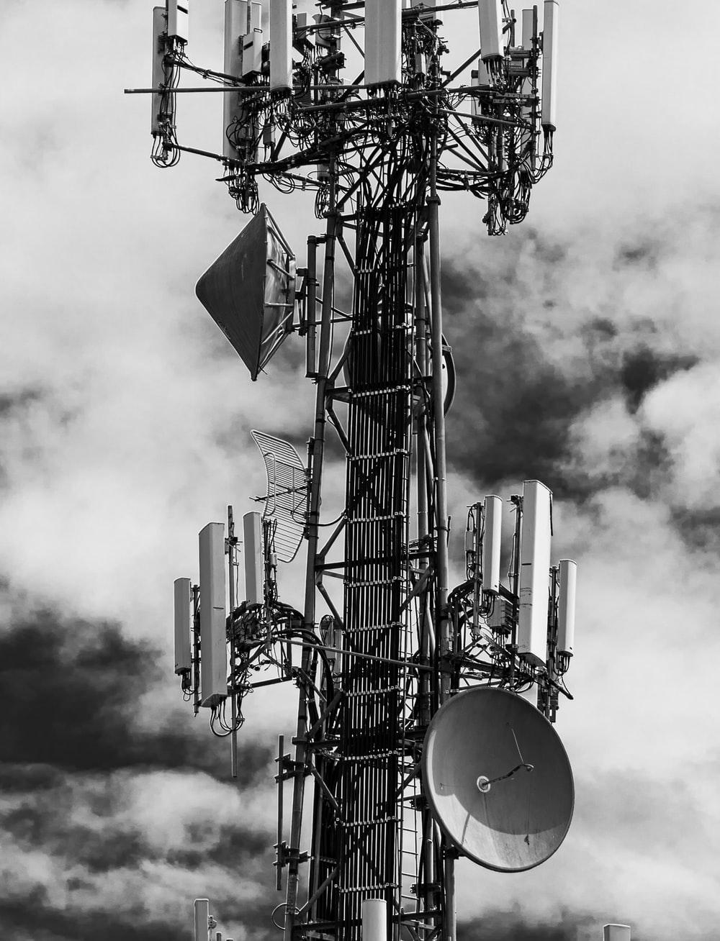
VOCABULARY
technical (adj)
/ˈteknɪkl/
connected with the practical use of machines, methods, etc. in science and industry

Slide 13
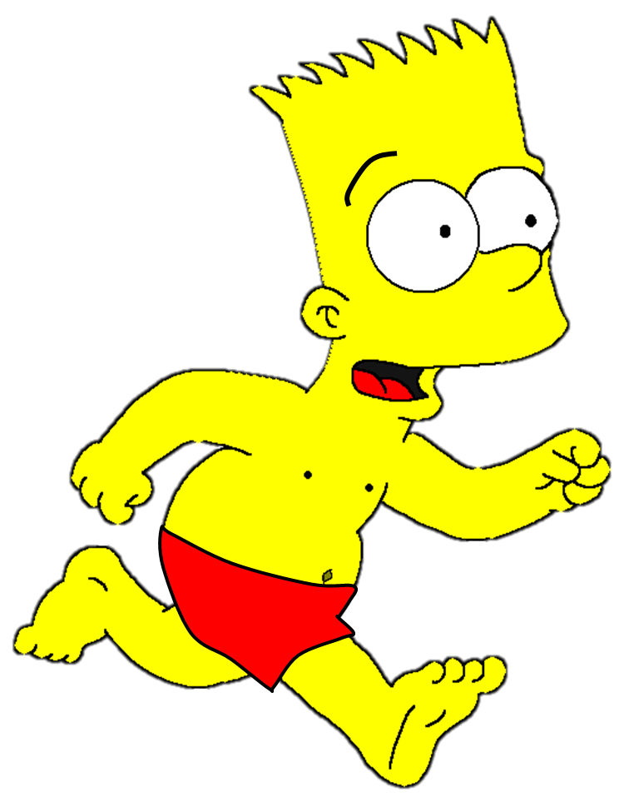
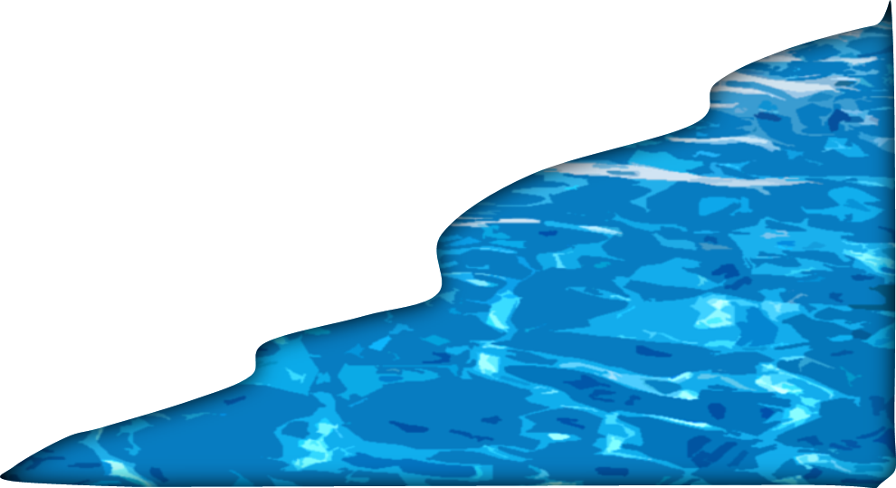
Vocabulary Game

Slide 14
In 1966, he was selected for ________ training.
cosmonaut
planet
space

Slide 15
He currently holds the position of ________
manager.
space
technical
parachutist

Slide 16
I am trained to be a _________ .
astronaut
instructor
parachutist

Slide 17
Who was the first human to go into ________ ?
space
technical
cosmonaut

Slide 18
An ________ is also a teacher at a college or university, ranking lower than a professor.
instructor
cosmonaut
space

Slide 19
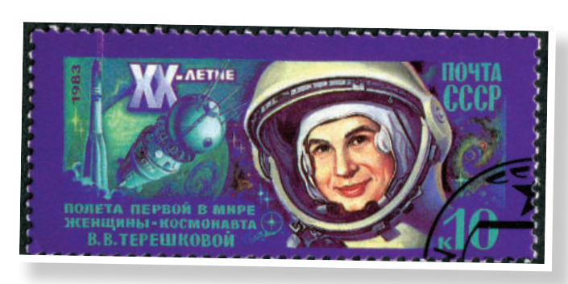
PRE-LISTENING
1
Work in pairs. Look at the picture and tell your partner what this woman’s job is.
She’s a cosmonaut.

Slide 20
03
While-listening

Slide 21
WHILE-LISTENING
2
Listen to a talk about Valentina Tereshkova. Choose the best answer to complete each sentence.
1. Valentina Tereshkova joined a local flying club and became a talented parachutist while she was ________________________.
2. Tereshkova and _______ other women were chosen for the Soviet space programme.
3. Tereshkova joined the Soviet Air Force and became _________________ after completing her training and passing an examination.
4. She travelled into space in Vostok 6 and successfully returned to earth on ______________.
5. After the flight, Tereshkova received many awards, and __________________________.
A. working as a factory worker
B. four
A. an Air Force officer
B. 19 June, 1963
B. completed her university degree

Slide 22
WHILE-LISTENING
3
Listen again and give short answers to the following questions.
1. When was Tereshkova born?
1937
2. How old was she when she started working?
16
3. When did she join the Soviet space programme?
1962
4. At what age did she travel into space?
26
5. How many days did she spend in space?
Three days/ 3 days

Slide 23
04
Post-listening

Slide 24
POST-LISTENING
4
Work in groups. Discuss the following questions.
Do you want to be a cosmonaut? Why or why not?

Slide 25
05
Consolidation

Slide 26
CONSOLIDATION
1
Wrap-up
Lexical items about women in space
Listening for specific information

Slide 27
CONSOLIDATION
2
Homework
Do exercises in the workbook.
Prepare for the Project.

Slide 28
SEE YOU NEXT TIME !!

