Slide 1

Unit 3: All about food
Lesson 3d: Everyday English
Page 59

Slide 2
Lesson Outline
Warm-up
Presentation
Practise
Production
Consolidation
Wrap-up

Slide 3
Objectives
By the end of this lesson, students will be able to…
give instructions in cooking.
learn word stress.

Slide 4

WARM-UP

Slide 5
Pair work
Fill in the gaps with the correct cooking tools.
............................ beat eggs
…………………………. mix vegetables
…………………………. bake a cake
…………………………. grate carrots
…………………………. peel potatoes
whisk
spoon
cake tin
grater
knife

Slide 6

It’s time to learn …

Slide 7

Presentation

Slide 8
Pair work
Discuss the ingredients and the steps to make a cake.
Ingredients
Flour
Eggs
Baking powder
Milk
Strawberry
Butter
Sugar
Recipe
Beat the butter and sugar.
Break the eggs.
Mix in the flour, milk and baking powder.
Pour the mixture into the cake tin.
Add the strawberries to the cake tin.
Bake it for 45 minutes.

Slide 9
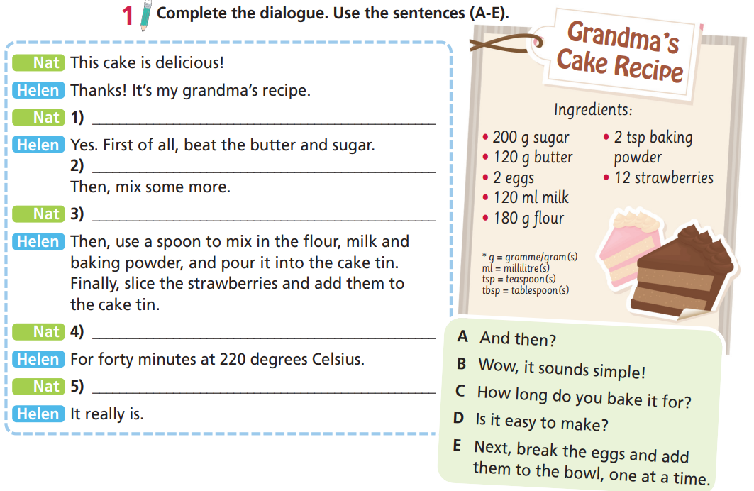
Nat This cake is delicious!
Helen Thanks! It’s my grandma’s recipe.
Nat 1) __________________________________
Helen Yes. First of all, beat the butter and sugar.
2) ______________________________________
________________________________________
Then, mix some more.
Nat 3) _________________________________
Helen Then, use a spoon to mix in the flour, milk and baking powder, and pour it into the cake tin.
Finally, slice the strawberries and add them to
the cake tin.
Nat 4) __________________________________
Helen For forty minutes at 220 degrees Celsius.
Nat 5) ___________________________
Helen It really is.
D Is it easy to make?
E Next, break the eggs and add them to the bowl, one at a time.
A And then?
C How long do you bake it for?
B Wow, it sounds simple!

Slide 10
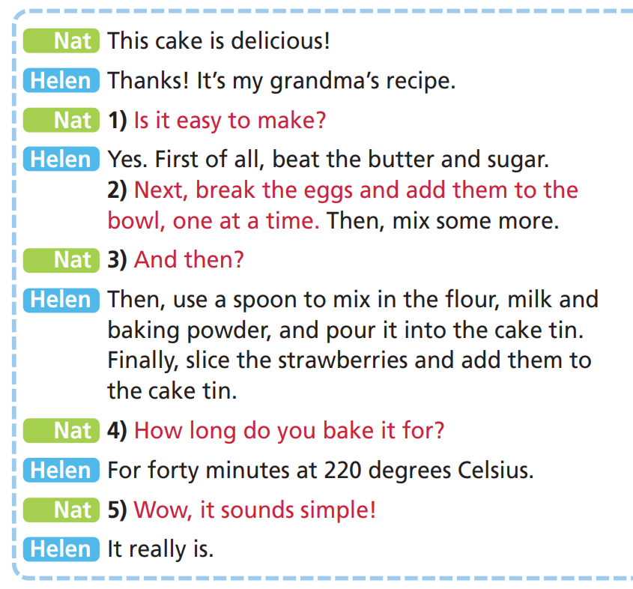

2. Listen and check. Act out the dialogue in pairs.

Slide 11
Asking about quantity
How many + _____________________+ …?
How much + _____________________+ …?
countable noun (plural)
uncountable noun
Example:
A: How much sugar do we need?
B: We need 200 grammes of sugar.
A: How many eggs do we need?
B: We need two eggs.

Slide 12
Put the following words into two groups: countable and uncountable nouns.
butter, milk, flour, baking powder, strawberries
Countable nouns | Uncountable nouns
butter, milk, flour, baking powder
strawberries

Slide 13
Underline the correct word.
1 How many/much milk do you need?
2 How many/much eggs do you need?
3 How many/much strawberries do you need?
4 How many/much baking powder do you need?

Slide 14
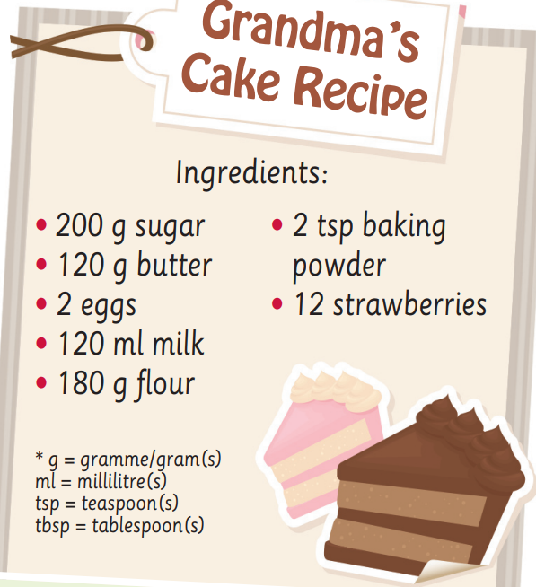
3 Look at the ingredients in the recipe. Ask and answer questions as in the example.
A: How much butter do we need?
B: We need 120 grammes of butter.
A: How much flour do we need?
B: We need 180 grammes of flour.
A: How much baking powder do we need?
B: We need 2 teaspoons of baking powder.
A: How much milk do we need?
B: We need 120 millilitres of milk.
A: How many strawberries do we need? B: We need 12 strawberries.

Slide 15
★ Match the sentences (1-5) to the sentences (a-e).
Is it easy to make? 1
Wow, it sounds simple! 2
How long do you bake it for? 3
And then? 4
How much cheese do you need? 5
a It really is!
b For 25 minutes.
c Yes, it is.
d About 100 grammes.
e Then, heat the mix in a saucepan.

Slide 16
Complete the dialogue. Use the sentences in the previous exercise.
Thomas The baked potato is delicious.
Suzie Thanks! It’s my grandmother’s recipe.
Thomas 1) _____________________________________
Suzie Yes, it is. First of all, wash the potato and grate some cheese.
Thomas 2) _________________________________________
Suzie About 80 grammes.
Thomas OK. 3) _____________________________________
Suzie Then, you bake the potato in the oven.
Thomas 4) ___________________________________________
Suzie For 30 minutes. Then, cut open your potato and add the cheese.
Thomas 5) _________________________________________
Suzie It really is!
Is it easy to make?
How much cheese do you need?
And then?
How long do you bake it for?
Wow, it sounds simple!

Slide 17
Production

Slide 18
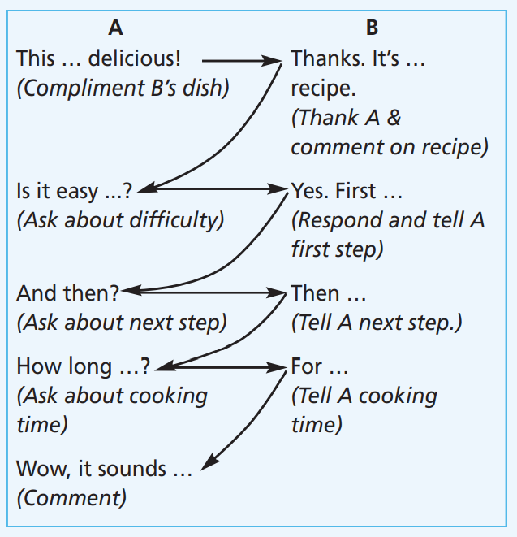
4 Think of an unusual dish. Tell your partner how to make it. Act out
a dialogue similar to the one in Exercise 1. Mind the sentence stress.
A: This potato dish is delicious!
B: Thanks! It’s my own recipe.
A: Is it easy to make?
B: Yes. First, wash the potatoes carefully.
A: And then?
B: Then, put them in a saucepan and add some carrots, butter, sugar and salt.
A: How long do you cook them for?
B: Cook them for about ten minutes. Mix them together and add a little yoghurt.
A: Wow, it sounds simple!

Slide 19
Pronunciation
Word stress
Listen and underline the stressed syllables. Then listen again and repeat.
Each word below has got one stress. We only stress vowels, e.g. orange.
• apple
• chicken
• cereal
• tomato
• pepper
• onion
• coffee
• lemon

Slide 20
Practice
Underline the stressed syllables.
oranges
sugar
pasta
yoghurt
pepper
cucumbers
potatoes
strawberries
vegetable
recipe

Slide 21

CONSOLIDATION

Slide 22
Make a dialogue with your friend, talking about a recipe to make a dish. Use the phrases to give instructions you have learnt today.

Slide 23

WRAP-UP

Slide 24
Today’s lesson
Speaking
Giving instructions
Pronunciation
Word stress

Slide 25
Homework
Practise giving instructions to show how to make a dish
Do the exercises in TA 6 Right on Workbook (p. 31)
Prepare the next lesson (p. 60 SB)

Slide 26
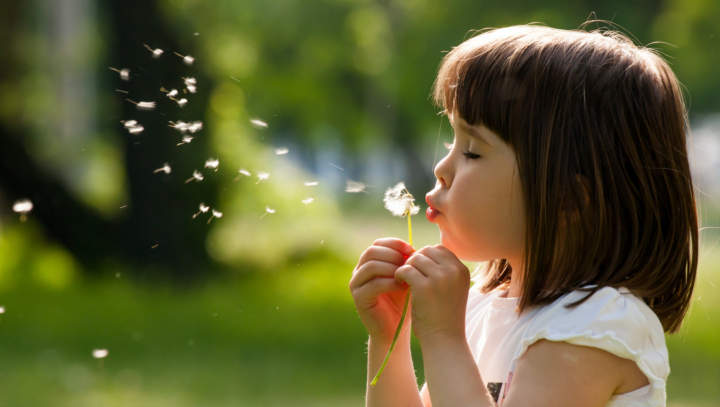
Enjoy your day!

