Slide 2


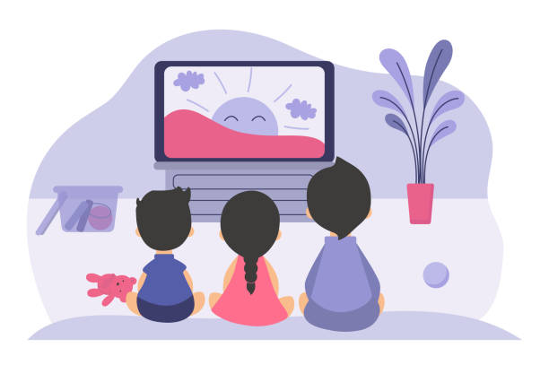
Unit
7
TELEVISION
LESSON 1: GETTING STARTED
What’s on today?

Slide 3
LESSON 1: GETTING STARTED
LESSON 1: GETTING STARTED
WARM-UP
Spider web completion
PRESENTATION
Vocabulary
Task 1: Listen and read.
Task 2: Choose the correct answer A, B, or C.
Task 3: Read the conversation again and match the names with suitable descriptions.
Task 4: Find and write the adjectives in the conversation which describe the programmes and characters.
PRACTICE
PRODUCTION
Task 5: Work in groups. Interview your partners about their favourite TV programmes and report to the class.
CONSOLIDATION
Wrap-up
Homework

Slide 4


WARM-UP: SPIDER WEB COMPLETION
TELEVISION
cartoon
news
channel
TV show

Slide 5
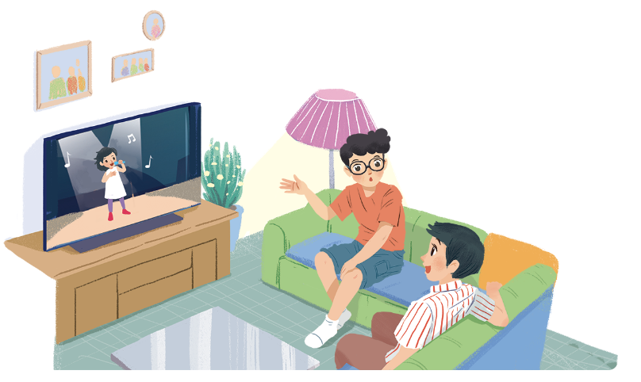
WARM-UP
1. What do you think they are talking about?
2. Do you like watching TV?
Why/ Why not?
3. How many hours a day do you watch TV?
4. What channel do you like best?

Slide 6


PRESENTATION
talent (for) (n)
/ˈtælənt/
tài năng

Slide 7

PRESENTATION
programme (n)
/ˈprəʊɡræm/
chương trình

Slide 8

PRESENTATION
animated (adj)
/ˈænɪmeɪtɪd/
(mang tính) hoạt hình

Slide 9
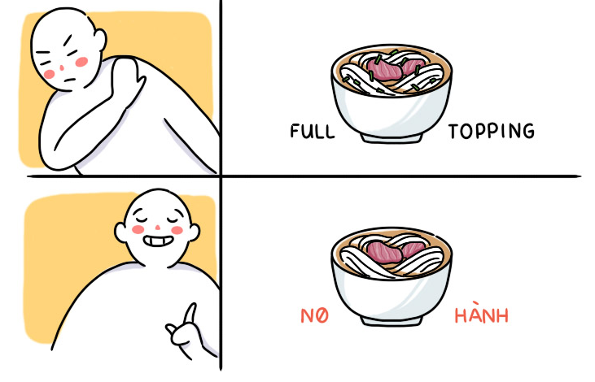
PRESENTATION
prefer (v)
/prɪˈfɜː(r)/
yêu thích

Slide 10
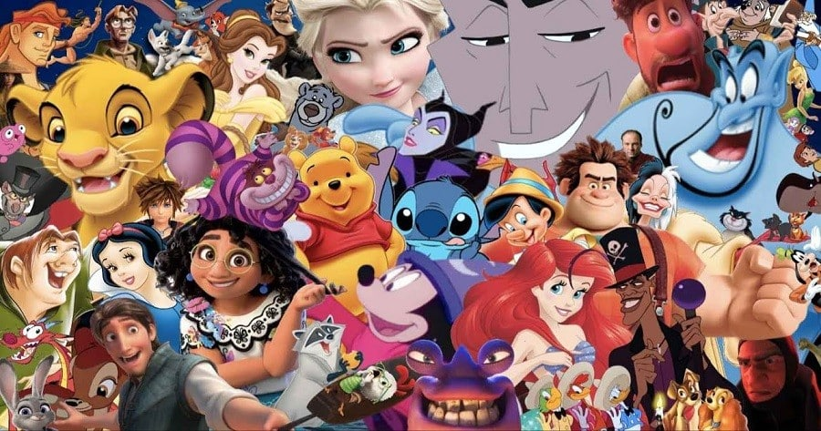
PRESENTATION
character (n)
/ˈkærəktə(r)/
nhân vật

Slide 11

PRESENTATION
educational (adj)
/ˌedʒʊˈkeɪʃənəl/
(mang tính) giáo dục

Slide 12
PRESENTATION
New words | Pronunciation | Meaning
1. talent (n) | /ˈtælənt/ | tài năng
2. programme (n) | /ˈprəʊɡræm/ | chương trình
3. animated (n) | /ˈænɪmeɪtɪd/ | (mang tính) hoạt hình
4. prefer (v) | /prɪˈfɜː(r)/ | yêu thích
5. character (n) | /ˈkærəktə(r)/ | nhân vật
6. educational (adj) | /ˌedʒʊˈkeɪʃənəl/ | (mang tính) giáo dục

Slide 13
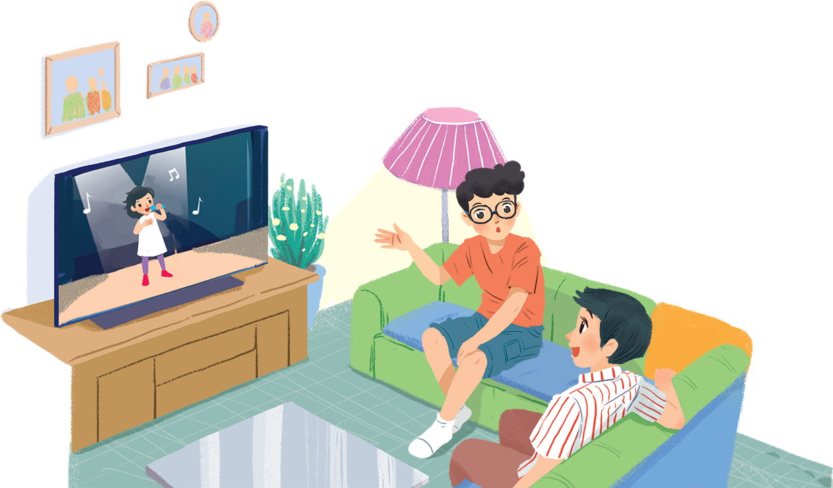
PRACTICE
1
Listen and read.
What's on today?
Phong: What are you watching, Hung?
Hung: The Voice Kids.
Phong: That music talent show is very interesting.
Hung: It is. What programme do you often watch, Phong?
Phong: Films. I like animated films like The Lion King.
Hung: I love them, too. They’re wonderful.
Phong: I often watch them with my little brother, but he prefers cartoons.
Hung: Tom and Jerry?
Phong: Ha... ha... Yes, he loves Jerry the mouse.
Hung: Jerry's a clever character. Do you know any English programmes for children?
Phong: Yes. I watch English in a Minute on VTV7. This channel has many educational programmes.
Hung: Great. I'll watch it, too.

Slide 14
PRACTICE
2
Choose the correct answer A, B, or C.
1. Phong and Hung are talking about ____________.
A. The Voice Kids programme
B. English in a Minute programme
C. different TV programmes
2. Phong likes ____________.
A. animated films B. cartoons C. talent shows
3. When you're viewing a TV programme, you say: “I'm ____________ TV.”
A. watching B. seeing C. looking
4. When a programme teaches you something, it's ____________.
A. educational B. funny C. clever

Slide 15
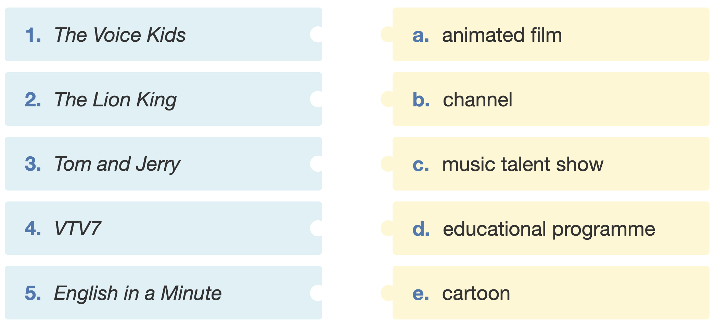
PRACTICE
3
Read the conversation again and match the names with suitable descriptions.

Slide 16
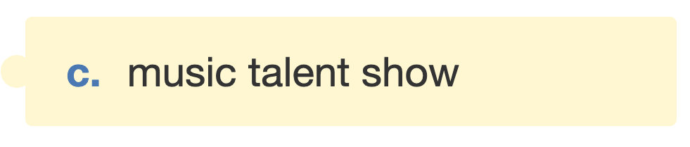
PRACTICE
3
Read the conversation again and match the names with suitable descriptions.

Slide 17
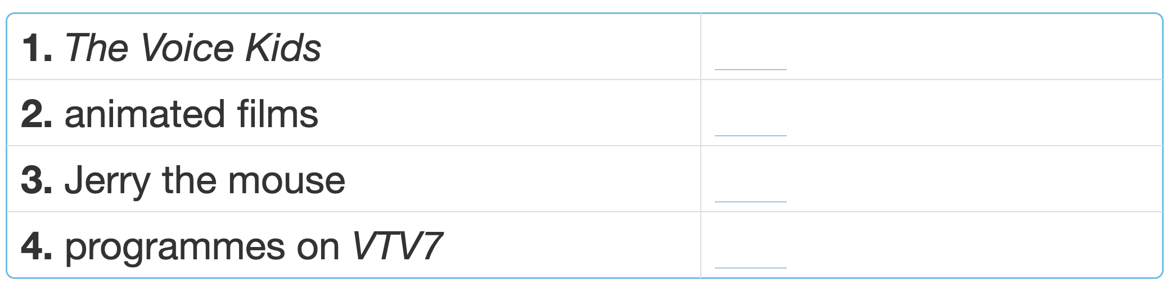
PRACTICE
4
Find and write the adjectives in the conversation which describe the programmes and characters.
interesting
wonderful
clever
educational

Slide 18
PRACTICE
5
Work in groups. Interview your partners about their favourite TV programmes and report to the class.
Do you like …?
Yes, I do.
No, I don’t.
Example:
In our group, Mai likes sports programme on TV. Binh likes …

Slide 19

CONSOLIDATION
1
Wrap-up
What have we learnt in this lesson?
Topic of the unit?
6 new words?

Slide 20

CONSOLIDATION
2
Homework
- Do exercises in the workbook.
- Write 5 sentences to describe a TV programme you like (name, type, channel, character(s) and characteristics…)
- Start preparing for the Project of the unit

Slide 21






Website: hoclieu.vn
Fanpage: facebook.com/www.tienganhglobalsuccess.vn/

