Slide 2
Unit 7
The world of mass media
LESSON 6
WRITING
Description of pie charts

Slide 3
LESSON 6
WRITING
WARM-UP
Pictionary
PRE-WRITING
- Task 1: Choose the correct answer.
- Task 2: Complete the descriptions.
WHILE-WRITING
- Task 3: Write a pie chart description.
POST-WRITING
Peer review
CONSOLIDATION
- Wrap-up
- Homework

Slide 4
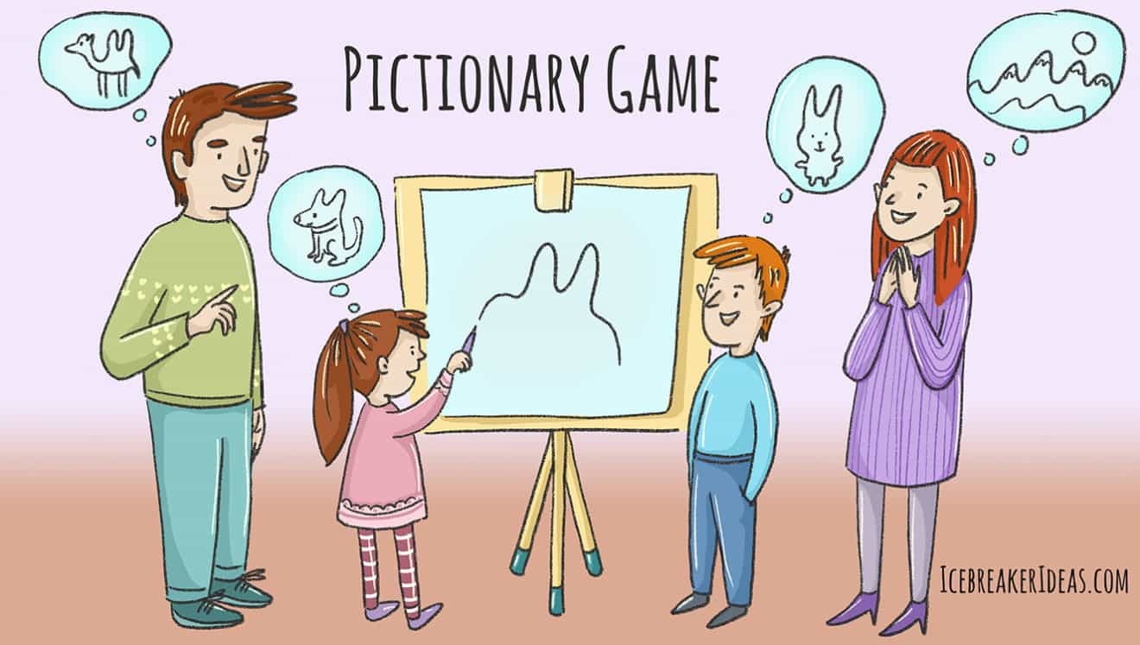
WARM-UP
PICTIONARY

Slide 5
PRE-WRITING
1
Work in pairs. Study the pie charts on the next page and choose the correct answer a or B.
The pie charts below compare the main news sources for young adults and old people according to a survey in 2022.

Slide 6
PRE-WRITING
1
Work in pairs. Study the pie charts on the next page and choose the correct answer a or B.
1. In general, which news source was very popular with both age groups?
A. Television.
B. Printed newspapers.
2. Which news source was least popular among young adults?
A. Printed newspapers.
B. Online news sites.
3. Which news source was least popular among old people?
A. Printed newspapers.
B. Online news sites.

Slide 7
PRE-WRITING
1
Work in pairs. Study the pie charts on the next page and choose the correct answer a or B.
4. Printed newspapers were old people's _________ choice of news source.
A. top
B. second
5. Other sources of news were chosen by around _________ of the people in both age groups.
A. a quarter
B. half

Slide 8
PRE-WRITING
2
Complete the following descriptions of the charts in 1. Use the words and phrases in the box.
as opposed to meanwhile
while most popular
The pie charts compare the main news sources for young adults and old people according to a survey in 2022.
Overall, television was the (1) _______________ source of news for both age groups. It was chosen by 42 per cent of old people, and more than one third of young adults. (2) _________, more young adults turned to the Internet for news. The figure was 33 per cent for young adults (3) _____________ just 6 per cent for old people. By contrast, printed newspapers were the second choice of news source for old people with 29 per cent (4) _________ only 6 per cent of young adults reported getting their news from printed newspapers. In both age groups, around a quarter relied on other sources for news.
most popular
Meanwhile
as opposed to
while

Slide 9
PRE-WRITING
2
Complete the following descriptions of the charts in 1. Use the words and phrases in the box.
Tips
To describe pie charts, you should:
introduce and describe the most outstanding feature of the pie charts, e.g.
The pie charts show information about/
illustrate/compare ... Overall, ...
make comparisons, using comparatives and superlatives, e.g. ... was more ... than .../
compare data, using linking words at the beginning of the sentence, e.g. similarly, by contrast, meanwhile, at the beginning, around a quarter relied on other sources for news. the beginning of a noun phrase, e.g. as compared with, as opposed to, both.

Slide 10
WRITING
3
Write a description (120–150 words) of the charts below. Use the model and tips in 2 to help you.

Slide 11
WRITING
3
Write a description (120–150 words) of the charts below. Use the model and tips in 2 to help you.
Suggested answer:
The pie charts compare the main news sources for teenagers, young adults and old people according to a survey in 2022.
Overall, television was a very popular source of news for all age groups. It was the top news source for old and young adults, chosen by 42 percent of old people and more than one third of young adults and teenagers. Meanwhile, online news sites were most chosen by teenagers, with more than 50 percent. By contrast, the Internet was the least common news source for old people, with just 6 percent. On the other hand, printed newspapers were the top news source for 29 percent of old people while only fewer than 10 percent of young adults and teenagers reported getting their news from them.
As for other sources of news, around a quarter of young adults and old people relied on other sources for news, as opposed to only 4 percent of teenagers.

Slide 12
POST-WRITING
Cross-checking
Suggested writing rubric
1. Organization: …/10
2. Legibility: …/10
3. Ideas: …/10
4. Word choice: …/10
5. Grammar use: …/10
TOTAL: …/50

Slide 13
CONSOLIDATION
1
Wrap-up
What have you learnt today?
Synthesise and summarise information in order to write a pie chart description.

Slide 14
CONSOLIDATION
2
Homework
Do exercises in the workbook.
Prepare for Lesson 7 – Communication & Culture.

Slide 15
Website: hoclieu.vn
Fanpage: facebook.com/www.tienganhglobalsuccess.vn

