Slide 1

Unit 3: Music and Arts
Lesson 2.1: Vocabulary & Reading
Page 23

Slide 2



Lesson 2.1
LESSON OUTLINE
Consolidation

Slide 3

By the end of this lesson, students will be able to…
talk about favorite types of music.
invite someone to speak.
practice listening for main ideas and specific information.

Slide 4

New words
electronic
heavy metal
reggae
blues
folk (music)
RnB

Slide 5

WARM-UP

Slide 6

Work in pairs.
1. What type of music do you often listen to?
2. Who is your favorite singer?
3. When do you often listen to music?

Slide 7



Slide 8

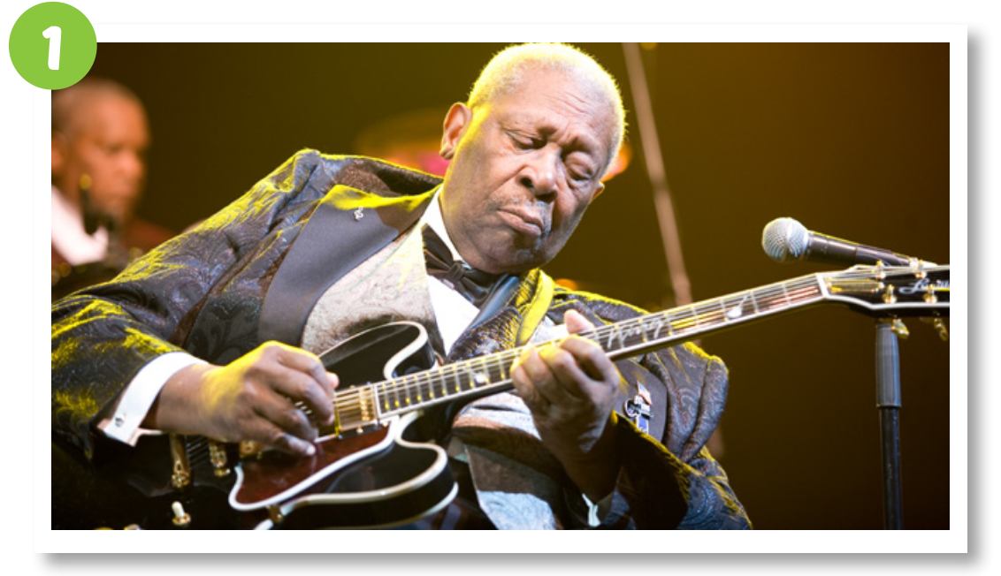
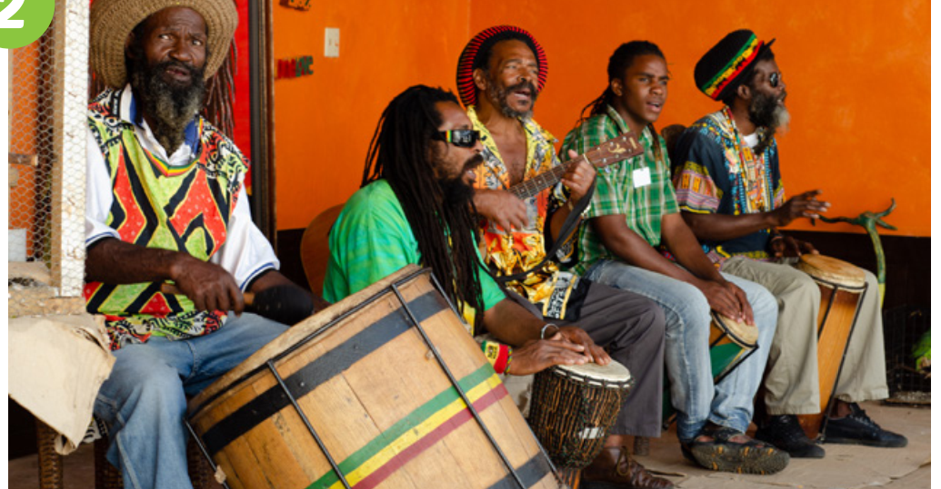
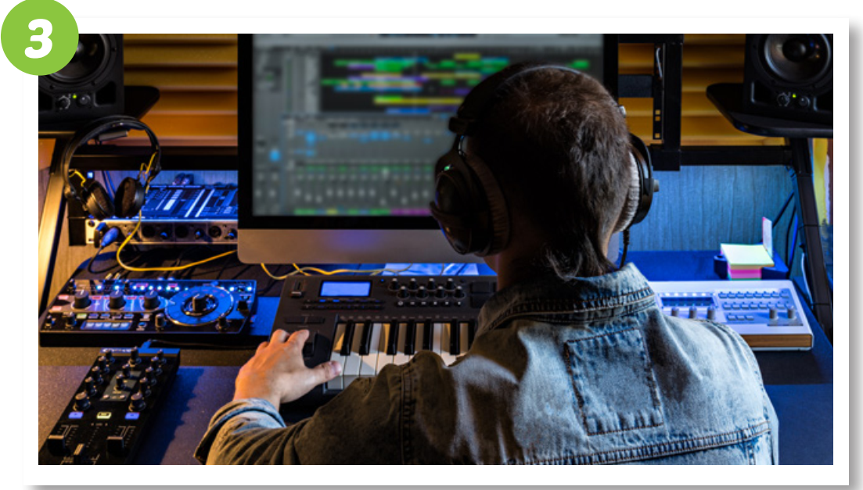
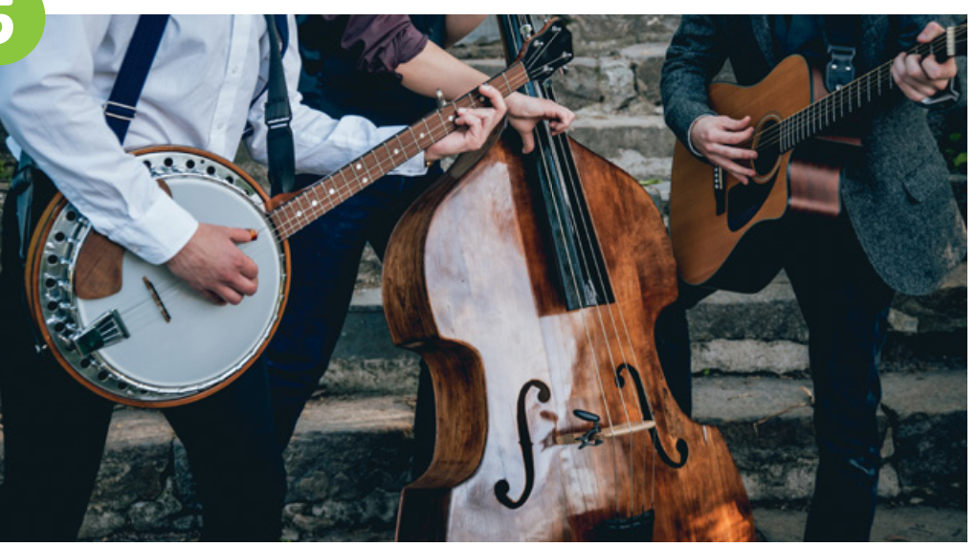
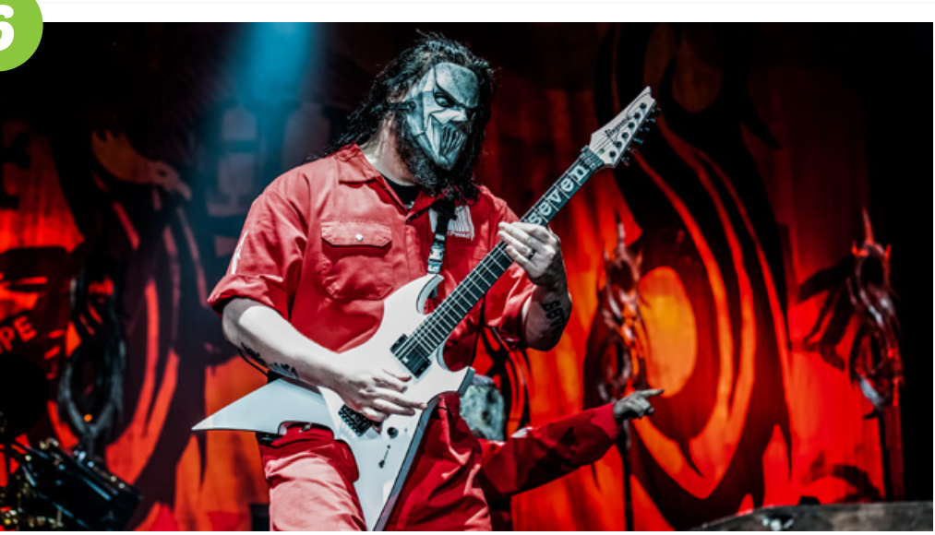
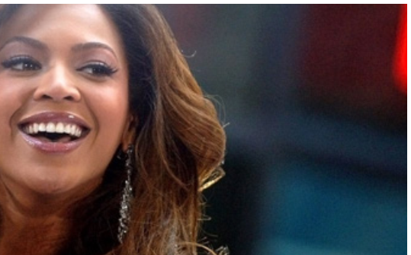
Work in pairs.
What can you see in each picture?

Slide 9

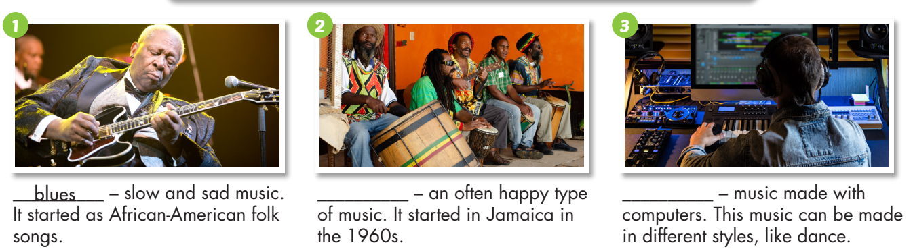
Work in pairs.
a. Match the words with the pictures.
electronic heavy metal reggae
blues folk (music) RnB
electronic
blues
reggae
– music made with computers. This music can be made in different styles, like dance.
– slow and sad music. It started as African
- American folk songs.
– an often happy type of music. It started in Jamaica in the 1960s.
______________
__________
__________

Slide 10
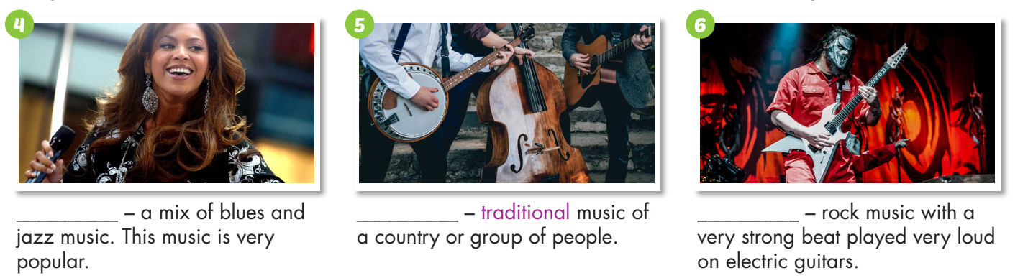
Work in pairs.
a. Match the words with the pictures.
electronic heavy metal reggae
blues folk (music) RnB
heavy metal
folk (music)
__________ – rock music with a very strong beat played very loud on electric guitars.
RnB
_______ – a mix of blues and jazz music. This music is very popular.
_________ – traditional music of a country or group of people.

Slide 11

Listen and repeat. (Click each word/phrase to hear the sound)
blues (n) /bluːz/ nhạc blues
folk (music) (n. phr) /foʊkˈmjuːzɪk/ dân ca
electronic (n) /iˌlekˈtrɑːnɪk/ nhạc điện tử
RnB (n) /ˌɑːr ən ˈbiː/ nhạc R&B
reggae (n) /ˈreɡeɪ/ nhạc nhịp mạnh
heavy metal (n) /ˌhevi ˈmetl/ nhạc rốc với giai điệu mạnh và ồn ào

Slide 12
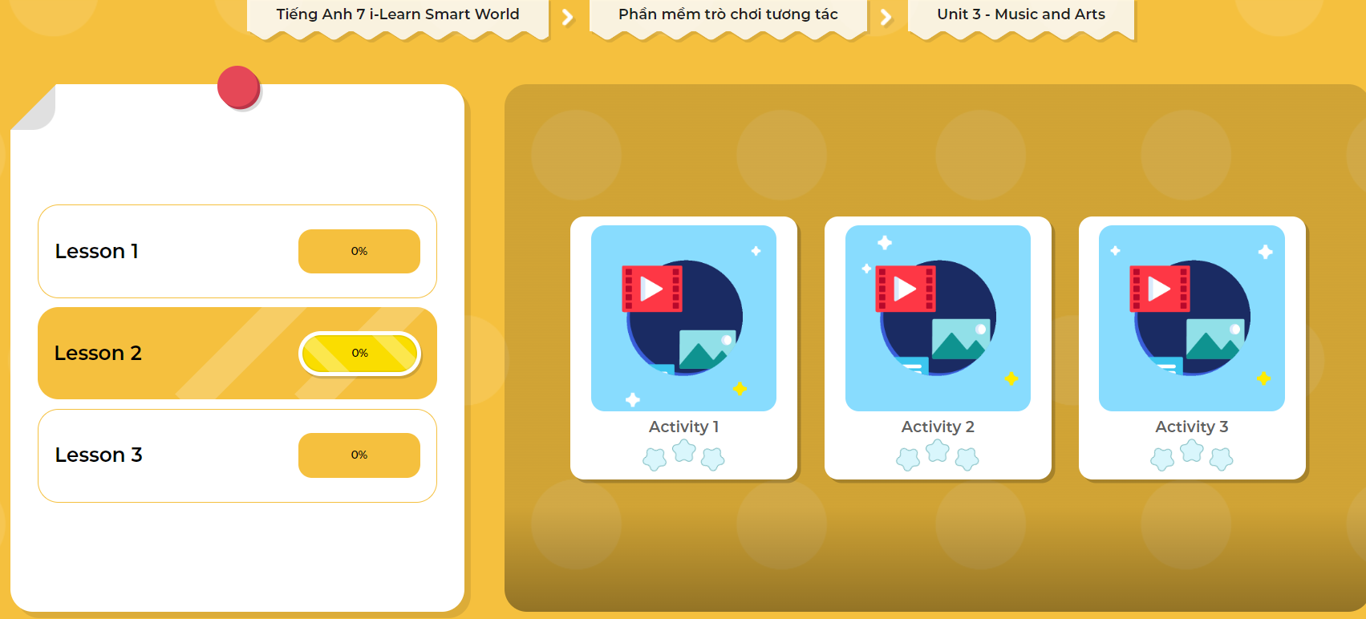
Extra Practice
DHA
Play the games in DHA App. Click the picture below.

Slide 13


Work in pairs.
b. Ask and answer about each type of music. Do you like any of them?

Slide 14


It’s listening time….

Slide 15
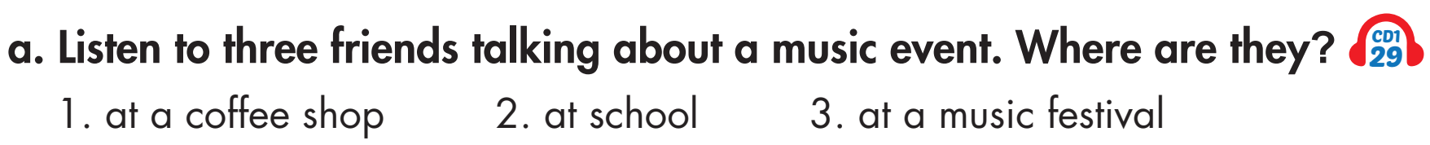
Pre - listening
Read the instruction quickly. Underline the key words. What are we going to do?
Listen and choose the correct answer.

Slide 16
While - listening
Now listen and choose the correct answer.
☞ YOUR ANSWER?
at school
☞ WHY?
Tom: Hey, lunch break is over. It's time to get back to class.

Slide 17
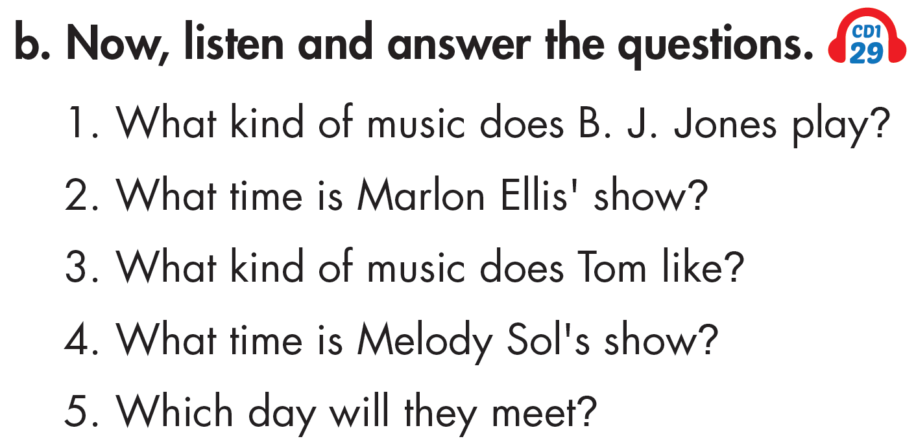
Pre - listening
Read the instruction and questions quickly. Underline the key words. What are we going to do?
Listen and answer the questions.

Slide 18
Now listen and answer the questions.  FIRST TIME
1. What kind of music does B. J. Jones play?
______________________________________________________
2. What time is Marlon Ellis' show? ______________________________________________________
3. What kind of music does Tom like? ______________________________________________________
4. What time is Melody Sol's show? ______________________________________________________
5. Which day will they meet? ______________________________________________________

Slide 19
Now listen again and check.  SECOND TIME
1. What kind of music does B. J. Jones play?
______________________________________________________
2. What time is Marlon Ellis' show? ______________________________________________________
3. What kind of music does Tom like? ______________________________________________________
4. What time is Melody Sol's show? ______________________________________________________
5. Which day will they meet? ______________________________________________________
blues
5 p.m.
rock
3 p.m.
Sunday
☞ WHY ARE THESE ANSWERS?

Slide 20
Now listen again and check.  THIRD TIME
Jack: What about B. J. Jones?
Mary: Hmm, blues is OK, but I prefer reggae.
Jack: What about Marlon Ellis? He's a reggae singer.
Mary: Oh yeah, he's great. When's his show?
Jack: It's at 5 p.m. on Saturday.
1. What kind of music does B. J. Jones play? blues
2. What time is Marlon Ellis' show? 5 p.m.

Slide 21
Tom: Hmm...I prefer rock to folk music.
Jack: OK. What about Melody Sol? She's an RnB singer.
Tom: When's her show?
Jack: It's at 3 p.m. on Sunday.
3. What kind of music does Tom like? rock
Jack: See you guys on Sunday.
4. What time is Melody Sol's show? 3 p.m.
5. Which day will they meet? Sunday

Slide 22
Work in pairs.
Post - listening
What kind of music concert would you like to go to?
Which band or singer would you like to see?

Slide 23
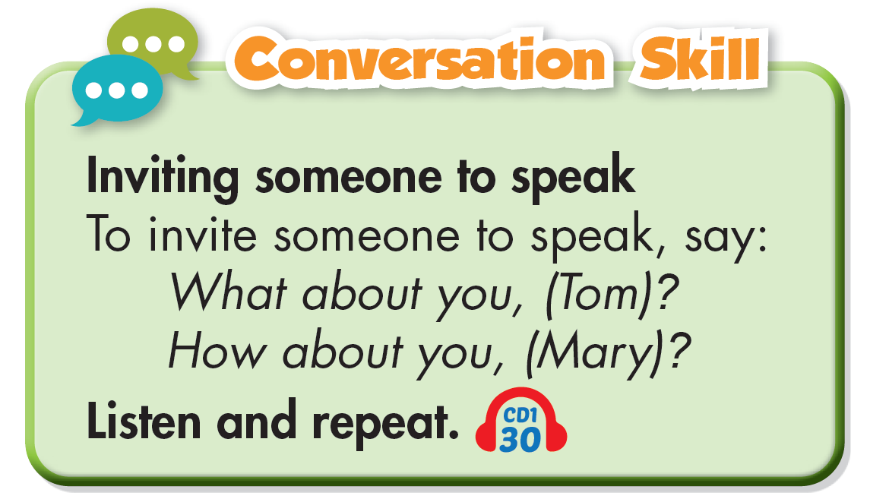

Slide 24

CONSOLIDATION

Slide 25
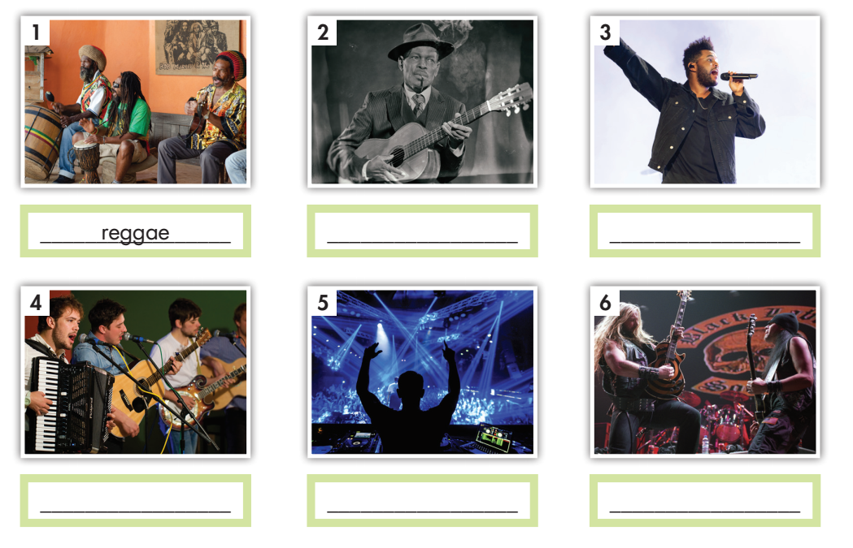
Fill in the blanks.
blues folk (music) electronic RnB reggae heavy metal
Extra Practice
WB, page 16
blues
RnB
folk (music)
electronic
heavy metal

Slide 26

WRAP-UP

Slide 27
Today’s lesson
Vocabularies
electronic
heavy metal
reggae
blues
folk (music)
RnB

Slide 28
Today’s lesson
Make plans to go to a music event.
Use prepositions of time and possessive adjectives.
Invite someone to speak.
Practice listening for main ideas and specific information.

Slide 29
Homework
Learn by heart vocabularies and make sentences using them.
Do the Listening exercise on page 16 WB.
Do the exercises in Tiếng Anh 7 i-Learn Smart World Notebook on page 16.
Prepare the next lesson (page 24 SB).
Play the consolidation games in Tiếng Anh 7 i-Learn Smart World DHA App on www.eduhome.com.vn.

Slide 30

Lesson 3
Stay positive and have a nice day!

