Slide 1

Welcome to
our class

Slide 2
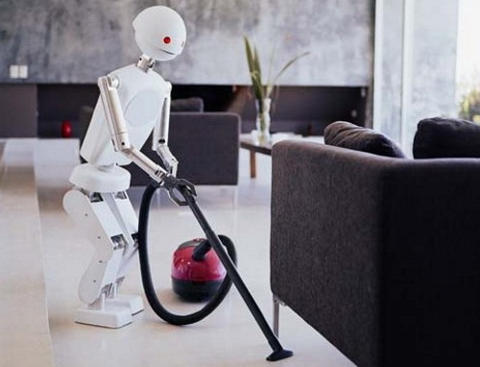
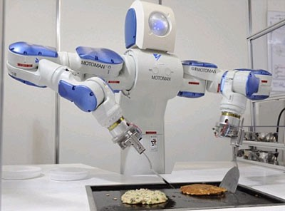
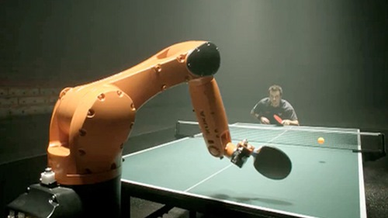
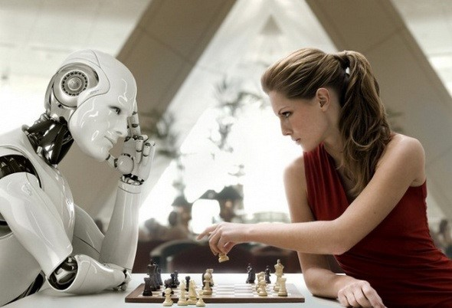
What is robot doing?
1
2
3
4

Slide 3

Unit 11: CHANGING ROLES IN SOCIETY
Lesson 1 : Getting started

Slide 4
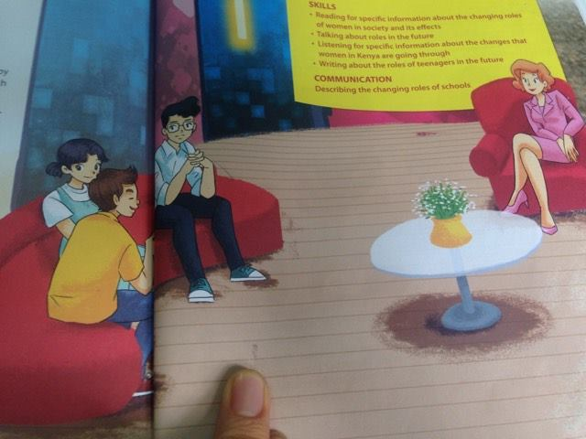
Interviewer
Phong
Mai
Nguyen

Slide 5
* Tick the person who has this idea.
 | Idea | Phong | Nguyen | Mai
1 | Students will learn from a real workplace.
2 | Students love seeing themselves as part of the process.
3 | The teacher will act more like a facilitator.
4 | The father will not necessarily be the breadwinner of the family.
5 | With the in the home, they will develop a closer bond with their chidren.
√
√
√
√
√

Slide 6

* Answer the questions:
1. What is the purpose of the Beyond 2030 forum?
2. Who has been invited to the discussion?
3. What does Phong think about classes in the future?
4. Why might students like having classes outside school?
5. Will the father of the future always stay at home?
6. Does Nguyen feel nagative a man doing housework?
1. It's is for people to share their vision of the future.

Slide 7

1. It's is for people to share their vision of the future.
2. Some students from Oak Tree school in Happy Valley.
3. He says that learning will also take place outside school.
4. It will give them a sense of participation and of being part of the lesson.
5. No, he won't. He may still go to work.
6. No, he doesn't.

Slide 8
* Find the meaning of the phrases and sentences.
A | B
1. Beyond 2030. | a. Ideas about what life will be in the future.
2. Vision of the future . | b.Both housework and paid work are worthy of respect.
3. It's work, paid or not, isn't it? | c. I love being with my father.
4. I love every moment, I spend with him. | d. after the year 2030.

Slide 9
Words | Explanations
1. facilitator | A. a person who provides facilitieslike the projector, the interactive whiteboard. B. a person who helps somebody to do something more easily by discussing and giving guidance.
2. information provider | A. a person who gathers information and uses it to teach others. B. a machine which sells newspapers.
3. breadwinner | A. a person who makes bread to feed the family. B. a person who supports the family with the money he/she earns.
B. a person who helps somebody to do something more easily by discussing and giving guidance.
A. a person who gathers information and uses it to teach others.
B. a person who supports the family with the money he/she earns.
.

Slide 10
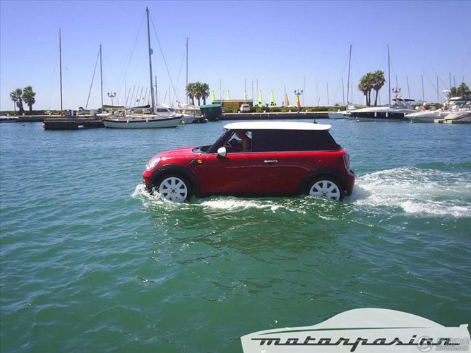
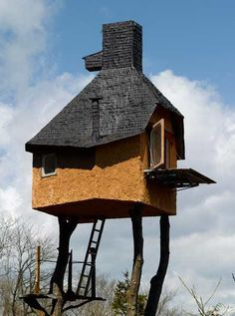
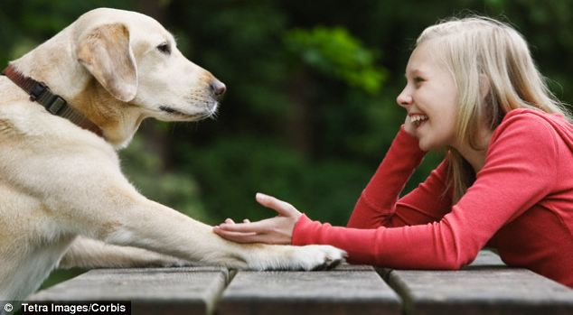
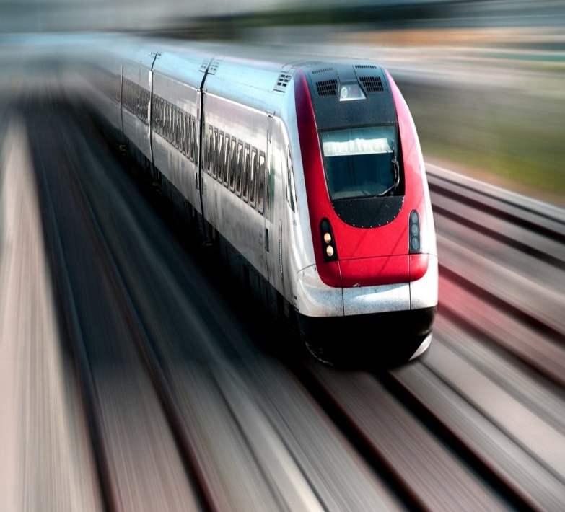
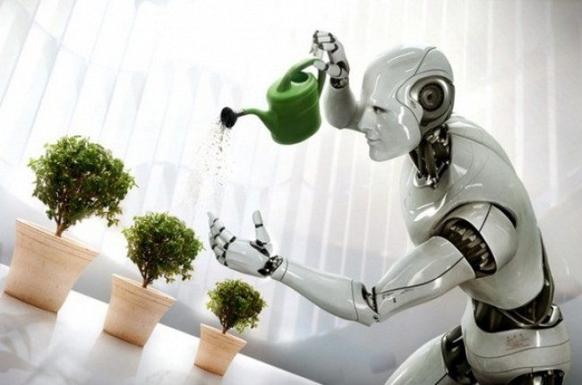
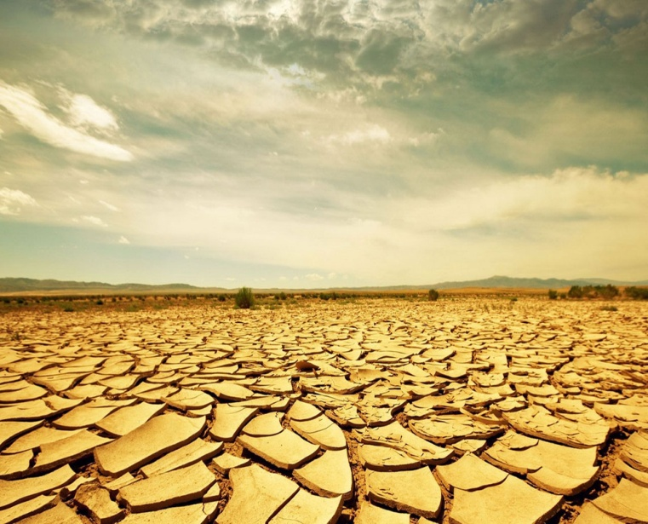
2
1
3
4
5
6

Slide 11

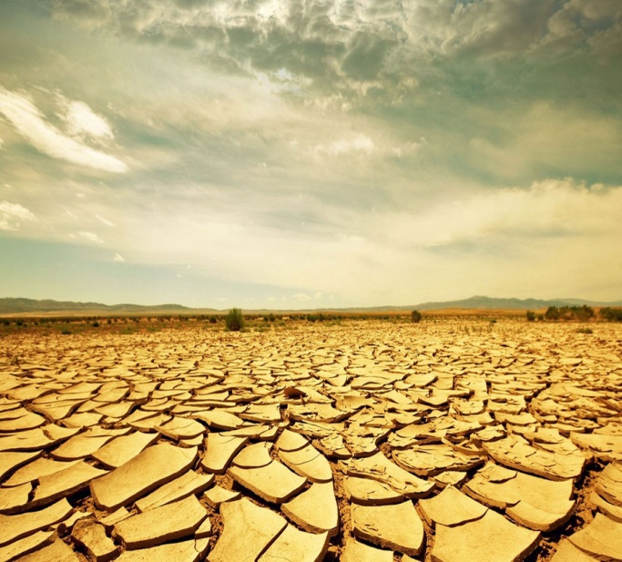
1.Car will be running
on water.
3. People will be able to
talk their pets.
2. People will live in house in the sky.
4. Robots will be doing
the housework.
5. Trains will be running
as fast as 300 km/h.
6. Land will become
barren.

Slide 12
GAME
One group names a service. The other group gives their vision of that service in the future.

Slide 13

HOMEWORK:
- Do activity 2 in notebook.
- Learn newwords by heart.
- Prepare new lesson : A closer look 1.

Slide 14

Thank you very much for attending

