Slide 1

UNIT 5: GENDER EQUALITY
Lesson 2 – Grammar
Page 42

Slide 2




LESSSON OUTLINE
Consolidation

Slide 3

By the end of this lesson,
students will be able to:
- know the grammatical structures of reported speech in four tenses
- know when reported speech is used
- report what someone said at an earlier time

Slide 4



Slide 5
Add giúp anh warm up activity

Slide 6

Presentation

Slide 7
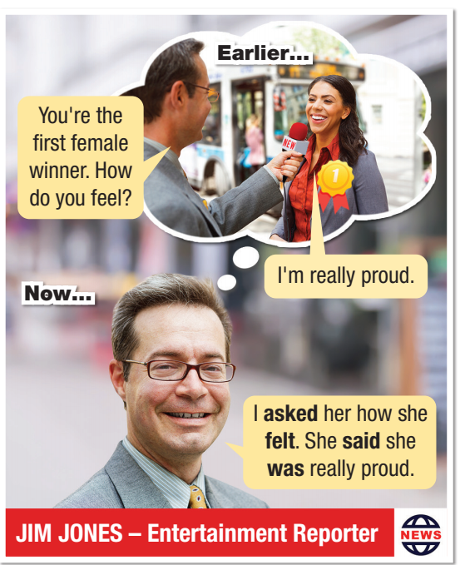

a. Listen and repeat

Slide 8

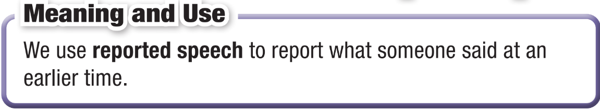

Slide 9
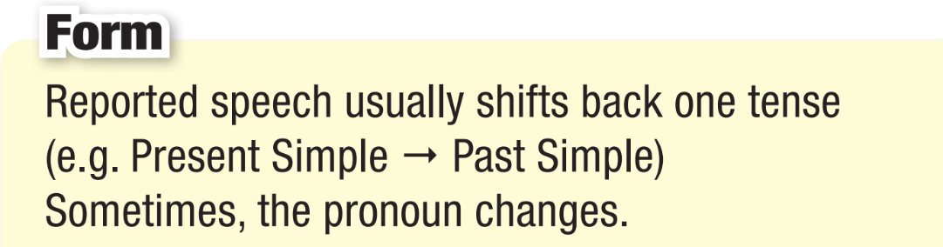

Slide 10
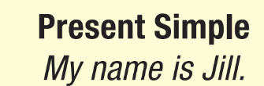
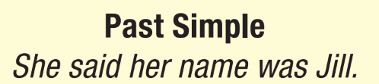
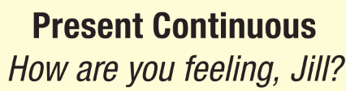
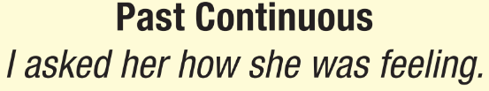
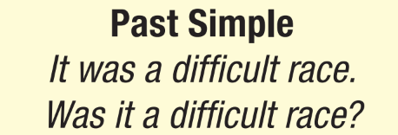
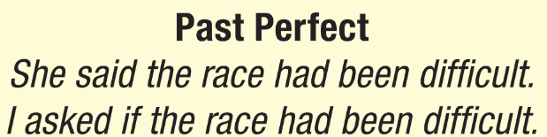
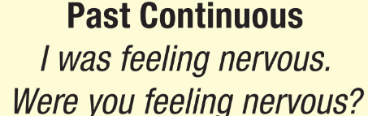
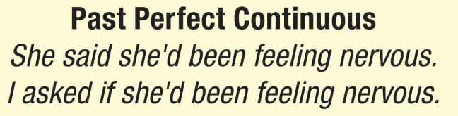

Slide 11
Practice

Slide 12
b. Fill in the blanks with the correct verb form
1. Girl: I really like action movies.
She said
she really
liked
action movies.
Present simple => Past simple
I => She

Slide 13
wasn’t having
was
weren’t
was
had
had done

Slide 14
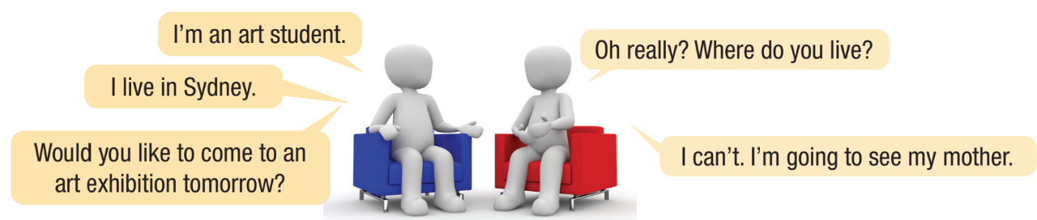

c. Write sentences to report Bill and Ben’s conversation

Slide 15


c. Write sentences to report Bill and Ben’s conversation

Slide 16
Extra practice, p.29 - WB
a. Fill in the blanks with correct word form.
love
Was
am

Slide 17
Extra practice, p.29 - WB
a. Fill in the blanks with correct word form.
worked
Did
turn
do
go

Slide 18
Production

Slide 19
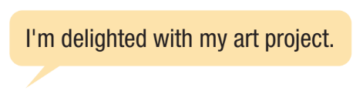
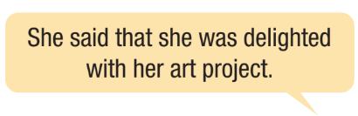



Work in groups of three.
d. Student A says something about yourself or ask a question. Student B reports it to student C. Swap roles and repeat.

Slide 20

Consolidation

Slide 21
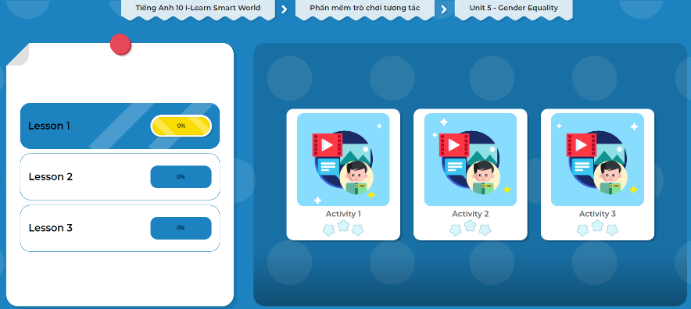
Let’s play!
Click here to play the games!

Slide 22
Consolidation
Today’s lesson
Grammar: Reported speeches
+ Meaning and use
+ Form

Slide 23
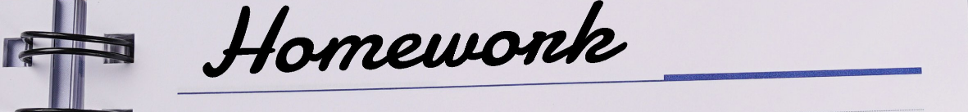
Practice rewriting the sentences using reported speech - Exercise b page 29 in WB
Prepare the next lesson - Pronunciation and Speaking on page 43 in SB.
Complete the grammar notes in Tiếng Anh 10 i-Learn Smart World Notebook (page 29)
Play the consolidation games in Tiếng Anh 10 i-Learn Smart World App on www.eduhome.com.vn

Slide 24

Have a nice day!

