Slide 1


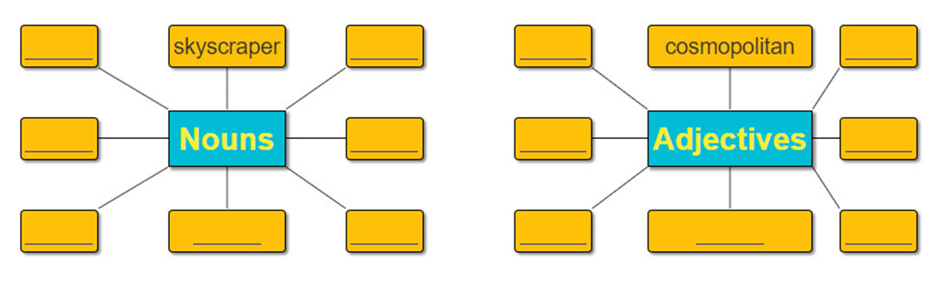
*Complete the word webs with nouns and adjectives connected with the city.

Slide 2
Welcome all of teachers and students
UNIT 2: CITY LIFE
Lesson 7: Looking back & project
Lesson plan for English 9
Teacher: Bui Thi Chin
Tien Lu secondary school

Slide 3
2. Put one word from the box in each gap
full
bored
fabulous
urban
noisy
crowded
fascinating
A big city is full of life. City life is more modern and (1)………………. than elsewhere. It is usually very busy and (2)……………… , even at night.
Life in a big city starts early in the morning. Soon the roads are (3)…………………. of vehicles. School children in their uniforms can be seen on the pavement, walking or waiting for buses. People rush to work. With every passing hour, the traffic goes on increasing. The shops and the market places remain (4)………………… till the evening hours.
Certainly (5)………………… life has certain charms. It offers great opportunities and challenges, especially for the young. There are lots of things to do, and facilities are well developed. There are (6)…………………….. places for amusement and recreation. One never feels (7) ………………. in a city.

Slide 4
3. Complete the sentences
as (so) interesting as
1.The last exhibition was not …………………………..… this one. (INTERESTING)
2. This city is developing ………………………….….. in the region. (FAST)
3. Let’s take this road. It is …………………….…….way to the city. (SHORT)
4. I was disappointed as the film was ……………….…........ than I had expected. (ENTERTAINING)
5. You’re not a safe driver! You should drive ………………… . (CAREFULLY)
the fastest
the shortest / a shorter
less entertaining than
more carefully.

Slide 5
4. Complete the sentences with a phrasal verb from the box
cheer up get over turn back find out turn down go on
turned down
1.She ………...…… his invitation to the party and now he’s really upset.
2. What’s …………..…….in the street over there? Open the door!
3. Lots of fruit and vegetables will help you ………….. your cold.
4. My brother was ………………..with a trip to the zoo.
5.The road was jammed, so we had to ……………… and find an alternative route.
6. I have …………….. about a fabulous place where we can go for a picnic this weekend.
going on
get over
cheered up
turn back
found out

Slide 6
5. Rewrite sentences
1.Don’t leave the lights on when you leave the classroom. (OFF)
2.Mai spent her childhood in a small town in the south. (UP)
3.Kathy checked the restaurant on her mobile phone. (LOOKED)
4.My grandmother has recovered from her operation. (GOT)
5.We are really expecting to see you again with pleasure.(LOOK)
Turn off the lights
grew up
looked up
got over
looking forward to seeing you again.

Slide 7
Complete the table ( individual- groups)
City/ Town | Man-made/ natural attraction
Bac Ninh
Ha Noi
Hoa Binh
Lam Dong
Hai Phong | Cat Ba island, Do Son beach
Quang Ninh | Halong bay, Dau Go cave
Dam pagoda, Phat Tich pagoda, Eight Kings of Ly empire Temple,…
Ngoc Son temple, Ha Noi museum, Hoan Kiem lake,…
Kim Boi hot spring, Mai Chau valley
Xuan Huong lake, Gougah waterfall
Team work: Team A give the city/ town. Team B says its attraction. The team with the most items is winner.
Ex: Team A: Hue city
Team B: Hue conical hats

Slide 8
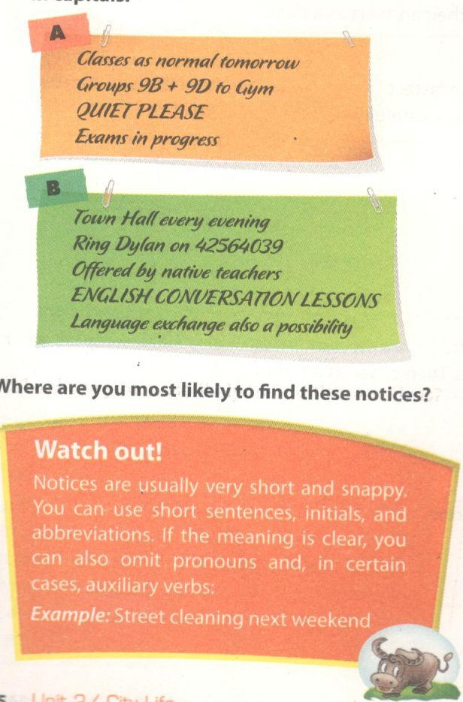
1. Put the items in these scrambled notices in the correct order
A.
QUIET PLEASE
Exam in progress
Group 9B + 9D to Gym
Classes as normal tomorrow
B.
ENGLISH CONVERSATION
LESSONS
Offered by native teachers
Language exchange also a possibility
Town Hall every evening
Ring Dylan on 42564039
Where are you most likely to find these notices?

Slide 9
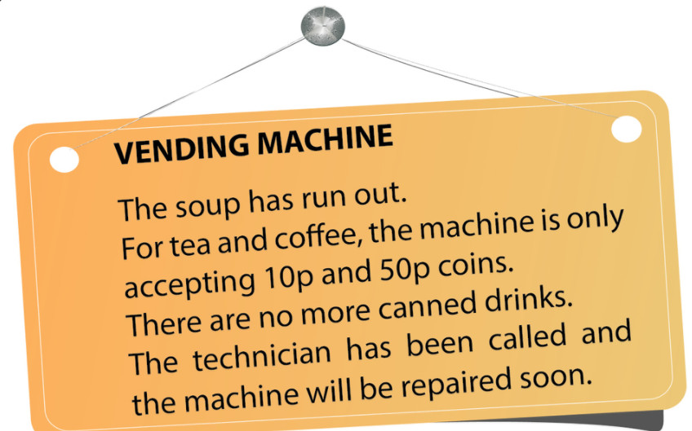
2. Delete the words which are unnecessary in these notices
VENDING MACHINE
No soup
Tea and coffee, 10p and 50p coins only
No more canned drinks
Machine will be repair soon
3. In 20-30 words, write a notice for one of the following situations
2.
ONE-DAY TRIP AROUND THE CITY
Sun 29th Oct in Hanoi
Ngoc Son Temple - Hoan Kiem Lake – Ancient town – Dong Xuan market – One-pillar Pagoda – Temple of Literature
For more information, call hotline: 1900-232323 (Mr. X)
1.
SEMINAR ABOUT FEATURES OF CITY LIFE
Monday Nov 10th in town hall
All teenage girls are welcome
For further detail, ring Trang - 098456789

Slide 10


HOMEWORK
Learn by heart phrasal verbs
-Prepare : Unit 3 – Getting started

