Slide 2
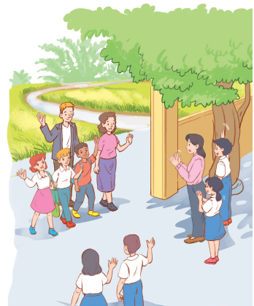
Unit
6
A VISIT TO A SCHOOL
LESSON 4: COMMUNICATION
Unit
HOBBIES

Slide 3
OBJECTIVES
By the end of the lesson, students will be able to
ask for details and talk about their school.

Slide 4
LESSON 4: COMMUNICATION
WARM-UP
Game: Conversation rearranging
Task 1: Listen and read the conversations. Pay attention to the highlighted sentences.
Task 2: Work in pairs. Ask and answer questions about your visit to a famous school.
EVERYDAY ENGLISH
Task 3: Make a list of what you want to show your overseas friends about your school.
Task 4: Ask and answer questions about your plan.
Task 5: Read the passage and complete the table about a high school in the UK. Then discuss and fill in the information.
WELCOME TO OUR SCHOOL!
CONSOLIDATION
Wrap-up
Homework

Slide 5
LESSON 4: COMMUNICATION
WARM-UP
Game: Conversation rearranging
Aims of the stage:
to activate students’ prior knowledge and vocabulary related to the targeted structures of asking for details

Slide 6
WARM-UP
Listen and check.
Mi: Are you doing anything this Sunday?
Phong: Not really.
Mi: Would you like to go with us to Binh Minh Lower Secondary School?
Phong: Sounds great! Can you tell me more?
Mi: We’ll leave at 7 a.m. My friends David and Nick are coming too.

Slide 7
LESSON 4: COMMUNICATION
WARM-UP
Game: Conversation rearranging
Task 1: Listen and read the conversations. Pay attention to the highlighted sentences.
Task 2: Work in pairs. Ask and answer questions about your visit to a famous school.
EVERYDAY ENGLISH

Slide 8
EVERYDAY ENGLISH
Can you tell me more?
Can you tell me how?
Can you tell me why?

Slide 9
EVERYDAY ENGLISH
1
Listen and read the conversations. Pay attention to the highlighted sentences.
Mi: Are you doing anything this Sunday?
Phong: Not really.
Mi: Would you like to go with us to Binh Minh Lower Secondary School?
Phong: Sounds great! Can you tell me more?
Mi: We’ll leave at 7 a.m. My friends David and Nick are coming too.

Slide 10
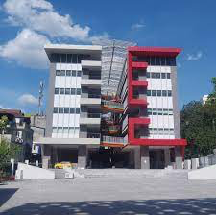
EVERYDAY ENGLISH
2
Work in pairs. Ask and answer questions about your visit to a famous school. Use “Can you tell me more?” or “Can you tell me why?”, “Can you tell me how?”.
Chu Van An Lower Secondary School

Slide 11
LESSON 4: COMMUNICATION
WARM-UP
Game: Conversation rearranging
Task 1: Listen and read the conversations. Pay attention to the highlighted sentences.
Task 2: Work in pairs. Ask and answer questions about your visit to a famous school.
EVERYDAY ENGLISH
Task 3: Make a list of what you want to show your overseas friends about your school.
Task 4: Ask and answer questions about your plan.
Task 5: Read the passage and complete the table about a high school in the UK. Then discuss and fill in the information.
WELCOME TO OUR SCHOOL!

Slide 12
PRACTICE
Welcome to our school!
Aims of the stage:
to let students brainstorm ideas about things they want to show their friends at school
to give students chances to practice asking and answering questions about their plans

Slide 13
WELCOME TO OUR SCHOOL!
3
Imagine that some overseas friends are planning to visit your school.
Make a list of what you want to show them, then fill in the note.

Slide 14
WELCOME TO OUR SCHOOL!
4
Work in pairs. Ask and answer questions about your plan.
Example:
A: I’m going to show them the school library.
B: Sounds good. Can you tell me why?
A: I want them to see our learning resources. I think they’re very modern.

Slide 15
WELCOME TO OUR SCHOOL!
4
Work in groups. Read the passage and complete the table about a high school in the UK.
 | Wilson High School | Your school
Number of students and teachers
Subjects
School facilities
About 1,000 students and 100 teachers
English, literature, maths, science, etc.
modern science laboratories, computer
rooms, a large library, a sports hall, and
an activity studio

Slide 16
WELCOME TO OUR SCHOOL!
4
Then discuss and fill in the information about your school.
 | Wilson High School | Your school
Number of students and teachers
Subjects
School facilities
About 1,000 students and 100 teachers
English, literature, maths, science, etc.
modern science laboratories, computer
rooms, a large library, a sports hall, and
an activity studio
Example:
There are about 1,000 students in Wilson High School. They are between 11 and 16 years old.
Our school has about 900 students. We are between 11 and 14 years old.

Slide 17
LESSON 4: COMMUNICATION
WARM-UP
Game: Conversation rearranging
Task 1: Listen and read the conversations. Pay attention to the highlighted sentences.
Task 2: Work in pairs. Ask and answer questions about your visit to a famous school.
EVERYDAY ENGLISH
Task 3: Make a list of what you want to show your overseas friends about your school.
Task 4: Ask and answer questions about your plan.
Task 5: Read the passage and complete the table about a high school in the UK. Then discuss and fill in the information.
WELCOME TO OUR SCHOOL!
CONSOLIDATION
Wrap-up
Homework

Slide 18
CONSOLIDATION
1
WRAP-UP
In this lesson, we have learn to:
ask for details
talk about our school

Slide 19
CONSOLIDATION
2
HOMEWORK
Do exercises in the Workbook.

Slide 20
Website: sachmem.vn
Fanpage: facebook.com/sachmem.vn/

