Slide 2


Unit
2
MY HOUSE
LESSON 6: SKILLS 2
Listening
Writing
1

Slide 3
LESSON 6: SKILLS 2
LESSON 1: GETTING STARTED
WARM-UP
Lucky number
Task 1: Name the furniture. Guess if they are mentioned in the listening text. Listen and check.
Task 2: True or False statements
LISTENING
WRITING
Task 3: Answer the questions
Task 6: Write an email to Mira, your pen friend and tell her about your house
CONSOLIDATION
Wrap-up
Homework

Slide 4
WARM-UP
Lucky numbers
Work in 2 teams.
Each team chooses the number they like, then tries to answer the question correctly.
The team which chooses a lucky number will get two points
without answering any questions.
The team which has more points will be the winner.
3. Do you like collecting glass bottles?
4. Do you enjoy mountain climbing?

Slide 5
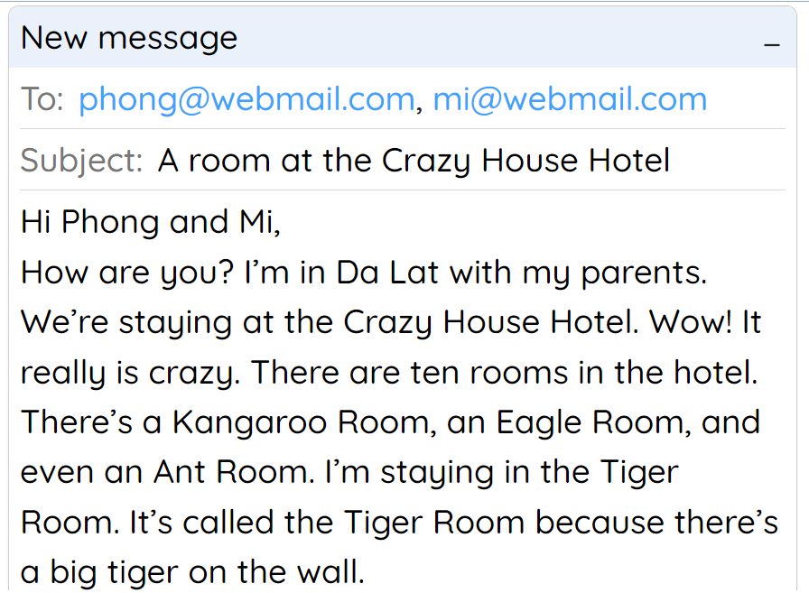
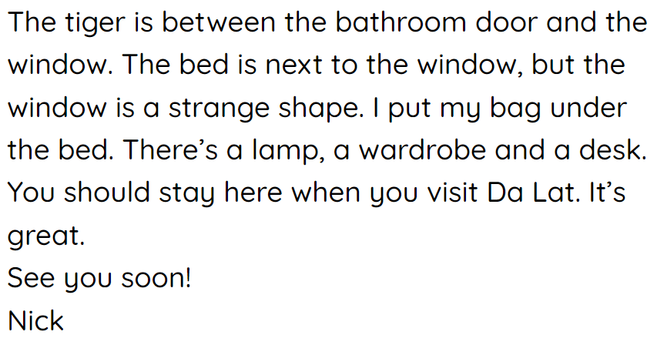
WARM-UP

Slide 6

WARM-UP
Lucky numbers
1
2
3
4
5
6
7
8
9
10
END GAME

Slide 7
WARM-UP
Lucky numbers
Question 1:
What is the name of the room where Nick is staying?
→ It’s the Tiger Room.
GO BACK

Slide 8
WARM-UP
Lucky numbers
Question 2:
How many rooms are there in the hotel?
→ There are ten rooms in the hotel.
GO BACK

Slide 9
WARM-UP
Lucky numbers
Question 3:
Is there a wardrobe in Nick’s room?
→ Yes, there is.
GO BACK

Slide 10
WARM-UP
Lucky numbers
Question 4:
Where is that Crazy House Hotel?
→ It is in Da Lat.
GO BACK

Slide 11
WARM-UP
Lucky numbers
Question 5:
Are the rooms named after different flowers?
→ No, they aren’t.
GO BACK

Slide 12

WARM-UP
Lucky numbers
You have 2 points.
GO BACK

Slide 13
WARM-UP
Lucky numbers
Question 7:
Where is the bed in Nick’s room?
→ It’s under the window.
GO BACK

Slide 14
WARM-UP
Lucky numbers
Question 8:
Why is the room called the Tiger room?
→ Because there’s a big tiger on the wall.
GO BACK

Slide 15
WARM-UP
Lucky numbers
Question 9:
Who is Nick staying with?
→ He is staying with his parents.
GO BACK

Slide 16
WARM-UP
Lucky numbers
You have 2 points.
GO BACK

Slide 17

I. Listening

Slide 18


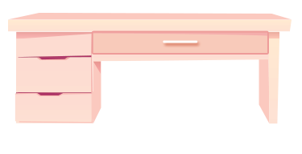

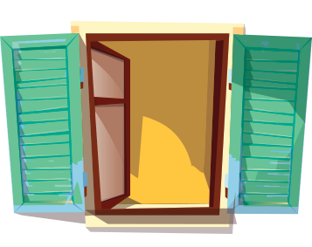

LISTENING
1
Look at the pictures. Name each of them. Guess if they are mentioned in the listening text.
1
2
3
sofa
desk
bookself
4
5
clock
window
Now listen and check your guess

Slide 19
LISTENING
2
Listen to Mai talking about her house. Tick () T (True) or F (False)
 |  | T | F
1. | There are four people in Mai’s family.
2. | Mai’s house has seven rooms.
3. | The living room is next to the kitchen.
4. | In her bedroom, there’s a clock on the wall.
5. | She often listens to music in her bedroom.

There are three people in Mai’s family.

Mai’s house has six rooms.



She often reads books in her bedroom.

Slide 20
II. Writing

Slide 21
Necessary parts of an email
address
1
subject (topic)
To: phong@webmail.com; mi@webmail.com
Subject: A room at the Crazy House Hotel
1. greeting
Hi Phong and Mi,
How are you? I’m in Da Lat with my parents. We’re staying at the Crazy House Hotel. Wow! It really is crazy.
There are ten rooms in the hotel. There’s a Kangaroo Room, an Eagle Room, and even an Ant Room. I’m staying in the Tiger Room. It’s called the Tiger Room because there’s a big tiger on the wall.
The tiger is between the bathroom door and the window. The bed is next to the window, but the window is a strange shape. I put my bag under the bed. There’s a lamp, a wardrobe and a desk.
You should stay here when you visit Da Lat. It’s great.
See you soon!
Nick
2. introduction
3. body
4. conclusion

Slide 22


How to write email to friend?
2.
Begin the email with a greeting (Dear/ Hi/ Hello).
3
1.
In the subject line, write briefly, what the email is about.
3.
The introduction is the first
paragraph. Ask about his/ her health, thank him/ her for the
previous email or write the reasons for the email, etc.
EMAIL TO A FRIEND
4.
In the body, write the subject(s) of the email. Write each subject in a new paragraph.
5.
The conclusion is the last paragraph. Say goodbye, ask your friend to write back, etc.

Slide 23
WRITING
3
Answer the questions.
1. Where do you live?
2. How many rooms are there in your house? What are they?
3. Which room do you like the best in your house? Why?

Slide 24

WRITING
4
Write an email to Mira, your pen friend. Tell her about your house. Use the answers to the questions in 3.
To: mira@webmail.com
Subject: My house
Hi Mira,
Thanks for your email. Now I’ll tell you about my house.
What about you? Where do you live? Tell me in your next email.
All the best,

Slide 25

CONSOLIDATION
1
Wrap-up
What have we learnt in this lesson?
Use the lexical items related to the topic My house
Listen to get information about rooms and houses.
Write an e-mail to a friend

Slide 26

CONSOLIDATION
2
Homework
- Rewrite the email on the notebook.
- Do exercises in the workbook.

Slide 27






Website: hoclieu.vn
Fanpage: facebook.com/www.tienganhglobalsuccess.vn/

