Slide 1

Unit 5: Sports and hobbies
Review & Practice 2
Page 81

Slide 2
Lesson Outline
Warm-up
Listening
Writing
Speaking
Consolidation
Wrap-up

Slide 3
Objectives
By the end of this lesson, students will be able to review the Vocabulary and Structure about sports and hobbies.

Slide 4

WARM UP

Slide 5


Swap positions

Slide 6
How to play
The students stand in a circle (or sit on the circle of chairs), except for one student (or the teacher), who stands in the middle. Each student must have a fixed position.
The person in the middle says a sentence that starts with Change positions if you… and ends with some condition (e.g. …have curly hair).
If that condition is true for a student, they have to stand up and find a new position as quickly as possible.
Students who can't find swap positions will be penalized.

Slide 7
1. Change positions if you can play tennis.
2. Change positions if you use your head in volleyball.
3. Change positions if you wear a watch.
4. Change positions if you have curly hair.
5. Change positions if you like to sing.

Slide 8
6. Change positions if the first letter of your name is N.
7. Change positions if the last letter of your name is G.
8. Change positions if you can’t play basketball.
9. Change positions if you can play soccer.
10. Change positions if you love your teacher.

Slide 9

It’s time to Review & Practice

Slide 10

Listening

Slide 11
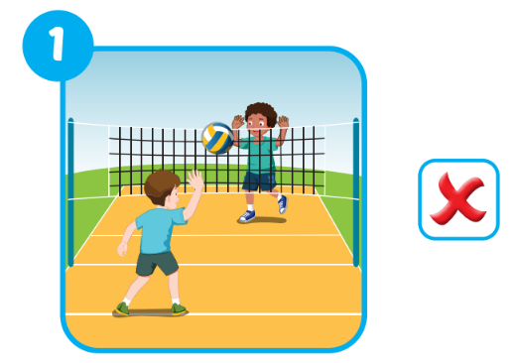
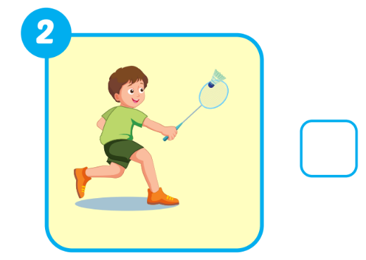

Extra Practice
WB, page 57.
✔️
Click on the picture to hear the sound

Slide 12
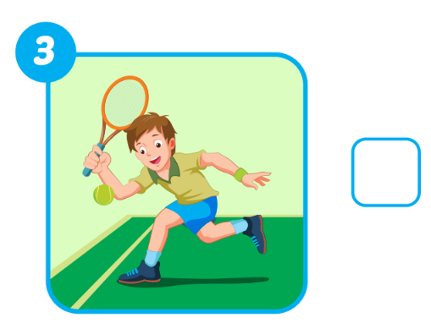
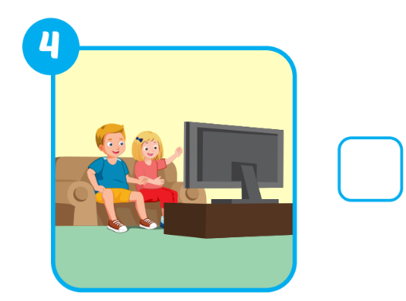
Extra Practice
WB, page 57.
✔️
❌
Click on the picture to hear the sound

Slide 13

Writing

Slide 14

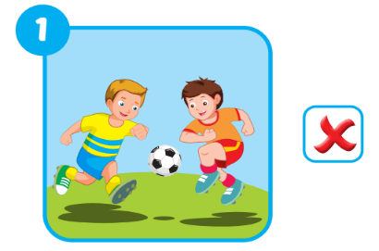
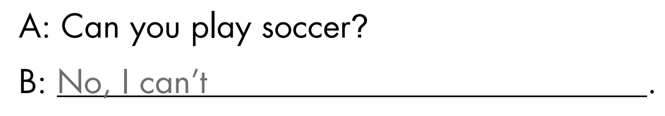
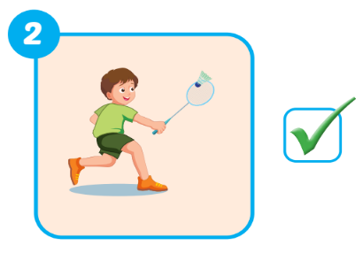
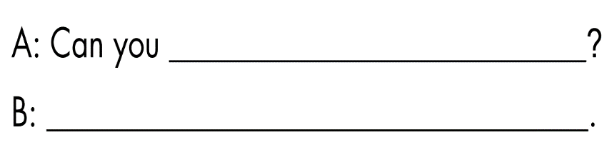
Extra Practice
WB, page 57.
play badminton
Yes, I can

Slide 15
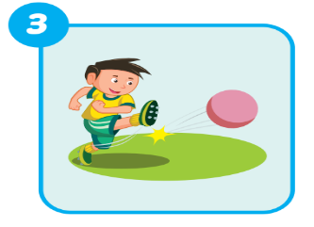
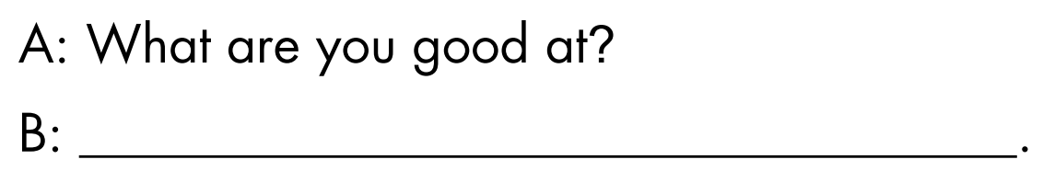
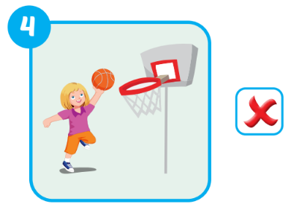
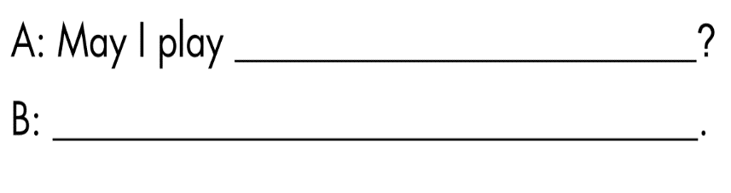
Extra Practice
WB, page 57.
I’m good at kicking
basketball
No, you may not.

Slide 16

Speaking

Slide 17

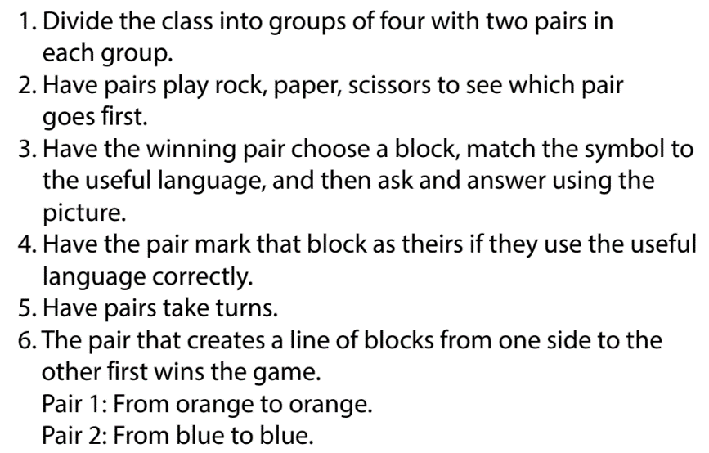

Slide 18
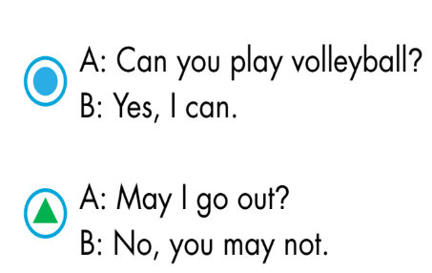
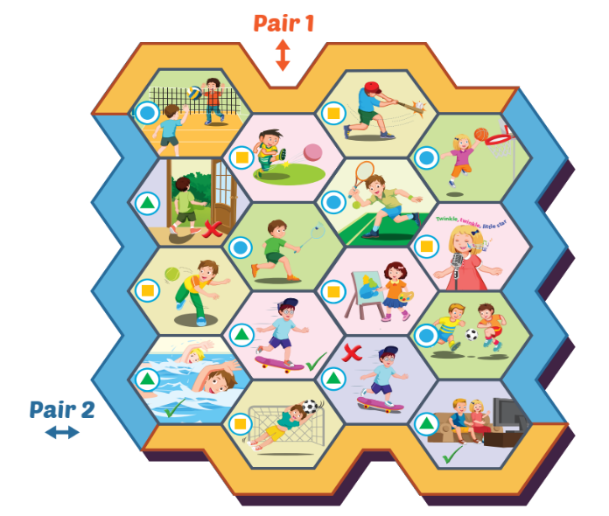
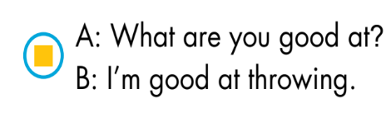

Slide 19

CONSOLIDATION

Slide 20



Farm
construction

Slide 21








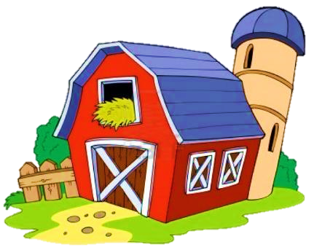








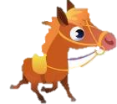





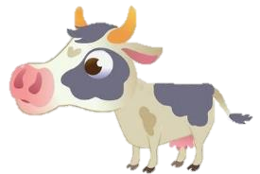

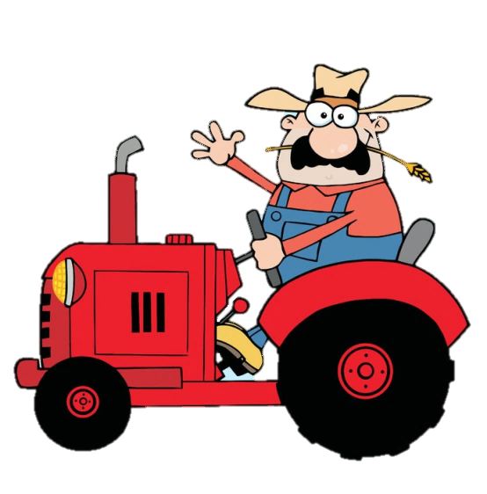

Click on items
Click on the number to open the task
END

Slide 22



are/ What/ at?/ you/ good
What are you good at?

Slide 23
play/ I/ May/ volleyball?
May I play volleyball?

Slide 24
tennis?/ Can/ play/ you
Can you play tennis?

Slide 25
May I ___ skateboarding?
go

Slide 26
am/ I/ at/ throwing/ good
I am good at throwing.

Slide 27
_____ go swimming?
- No, you may not.
May I

Slide 28

WRAP-UP

Slide 29
Today’s lesson
Structures/ Sentence patterns
Can you play soccer?
- Yes, I can./No, I can't.
May I go out?
- Yes, you may/ No, you may not.
What are you good at?
- I am good at kicking.
Vocabularies
badminton
tennis
volleyball
basketball
soccer

Slide 30
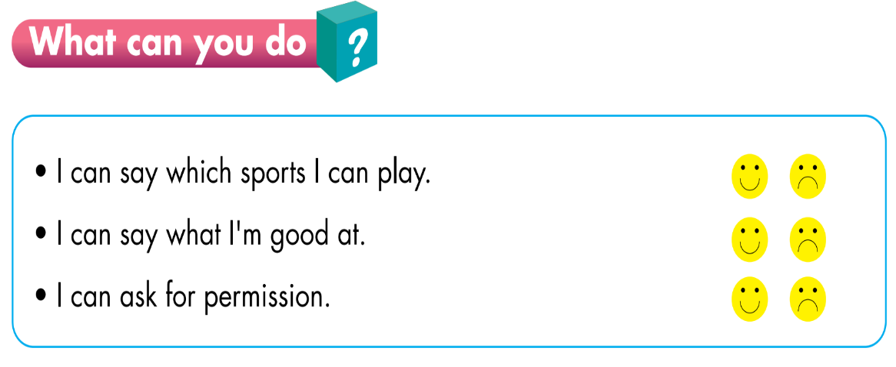

Slide 31
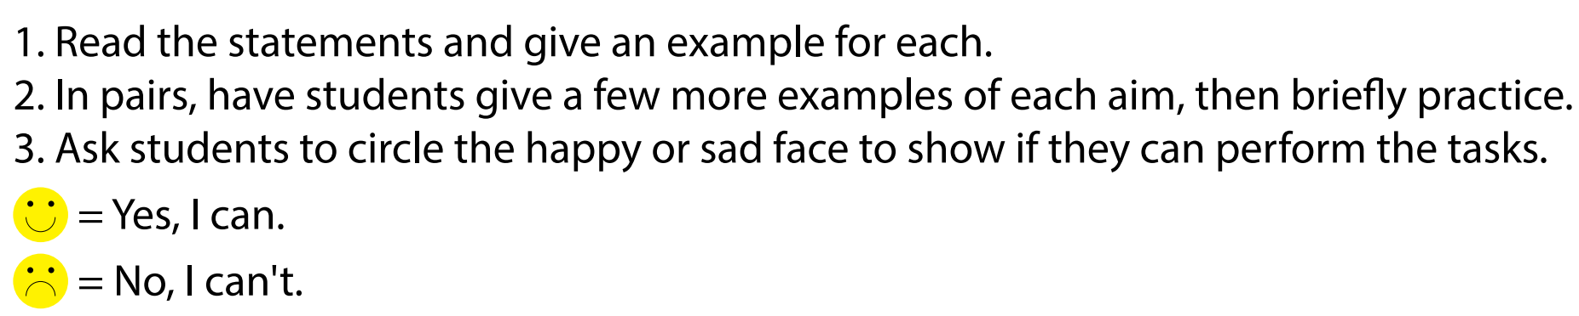

Slide 32
Homework
Practice vocabularies and structure. Make sentences using them.
Do the exercises in Tiếng Anh 3 i-Learn Smart Start Workbook (page 57)
Do the exercises in Tiếng Anh 3 i-Learn Smart Start Notebook (page 39)
Play the consolidation games in Tiếng Anh 3 i-Learn Smart Start DHA App on www.eduhome.com.vn
Prepare the next lesson (page 82)

Slide 33

Have a nice day!

